Slide 1

Python Flow
Lecture 6. Design patterns

Slide 2

OVERVIEW
Design Patterns
Singleton
Factory
Decorator
Facade
Adapter

Slide 3
What is Design Pattern?
Design pattern is a general reusable solution to a commonly occurring problem within a given context in software design.
It is not a finished design that can be transformed directly into source code.
It is a description or template for how to solve a problem that can be used in many different situations.
Design patterns are formalized best practices that the programmer can use to solve common problems when designing an application or system.

Slide 4
Design Pattern. Classification
Creational
Creational patterns are ones that create objects for you, rather than having you instantiate objects directly. This gives your program more flexibility in deciding which objects need to be created for a given case.
Structural
These use inheritance to compose interfaces and define ways to compose objects to obtain new functionality.
Behavioral
Most of these design patterns are specifically concerned with communication between objects.

Slide 5
Singleton
Singleton pattern is a software design pattern that restricts the instantiation of a class to one object.
The Singleton design pattern solves problems like
How can it be ensured that a class has only one instance?
How can the sole instance of a class be accessed easily?
How can a class control its instantiation?
How can the number of instances of a class be restricted?

Slide 6
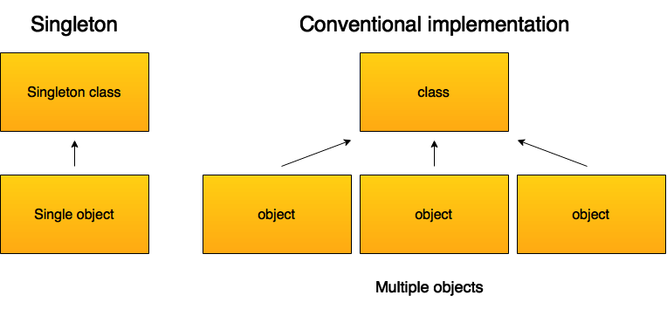
Singleton

Slide 7
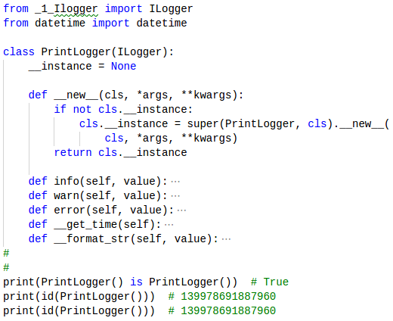
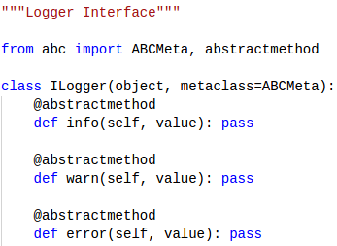
Singleton. Logger

Slide 8
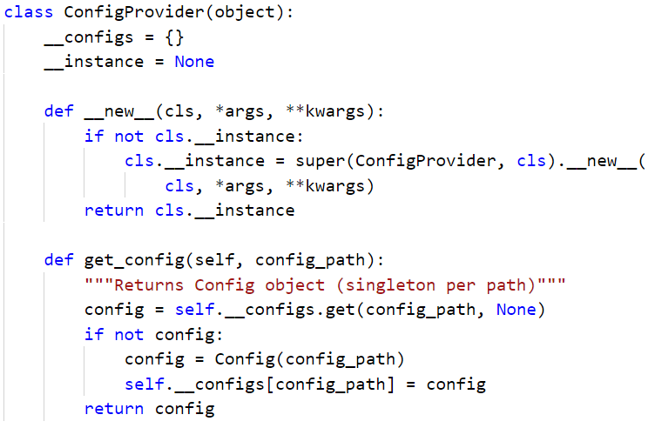
Singleton. Config Provider

Slide 9
Factory
What is factory pattern all about?
It introduces abstraction.
In other words: helps software developers with the problem of creating objects without knowing exact class of the object that will be created.
It gives you a lot more flexibility when it comes time to change the application (i.e. you can create new implementations without changing the dependent code)

Slide 10
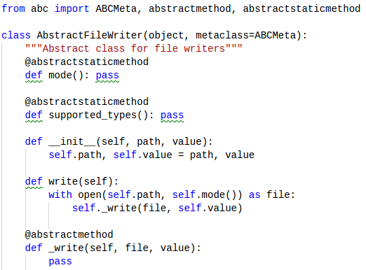
Factory Example. File Writer
At first, let’s create a simple base class to have a common interface for all file writers classes.

Slide 11
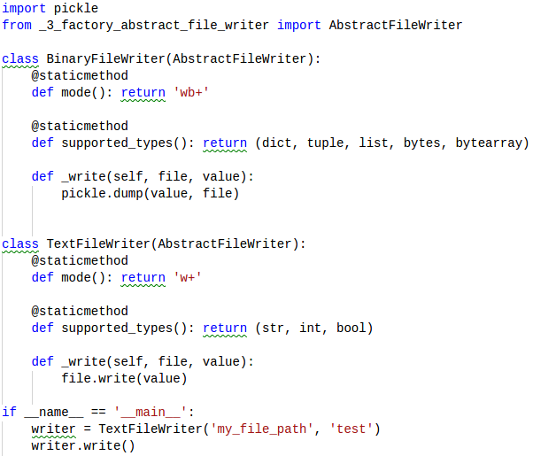
Factory Example. File Writer
Let's look how these children look like:

Slide 12
Factory
Let’s say we just want to write values in file knowing only path of the file
Let’s say we want use binary format for collections and bytes (or bytearray) and text format for simple types (int, str...)
Here is the place where factory pattern starts to work

Slide 13
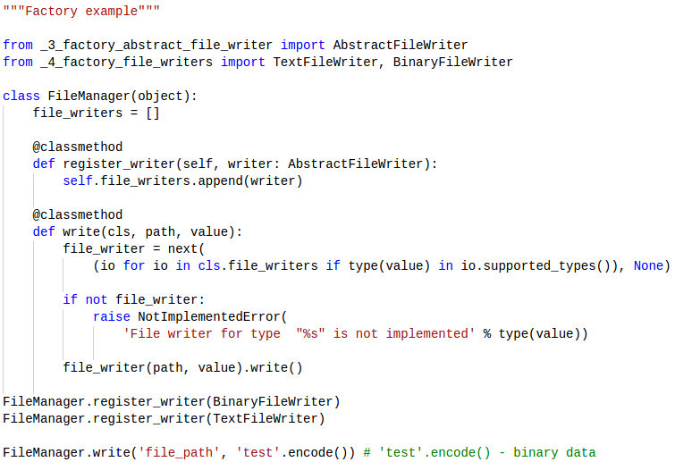
Factory Example. File Manager

Slide 14
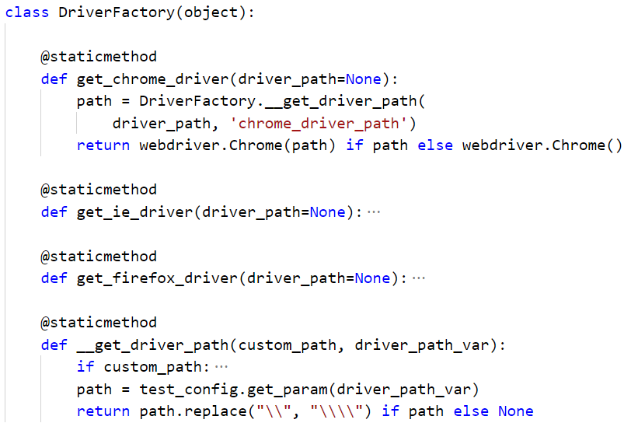
Driver Factory

Slide 15
Decorator Pattern
In OOP, the decorator pattern is a design pattern that allows behaviour to be added to an existing object dynamically.
The decorator pattern can be used to extend (decorate) the functionality of a certain object at run-time, independently of other instances of the same class.

Slide 16
Decorators in Python
Despite the name, Python decorators are not an implementation of the decorator pattern.
Python decorators add functionality to functions and methods at definition time.
So in Python a decorator is any callable Python object that is used to modify a function, method or class definition.

Slide 17
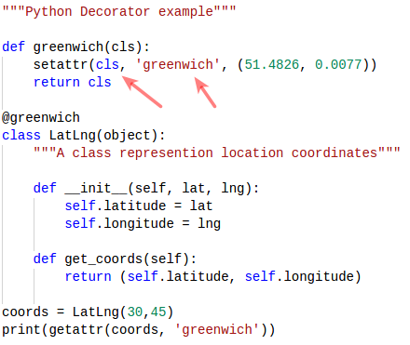
Decorators in Python

Slide 18
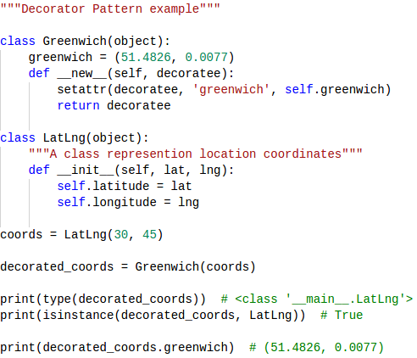
Decorator Pattern

Slide 19
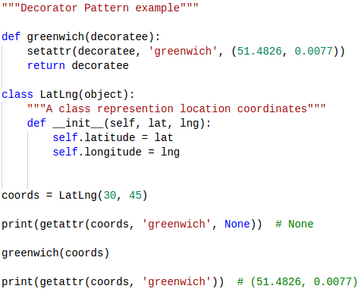
Decorator Pattern

Slide 20
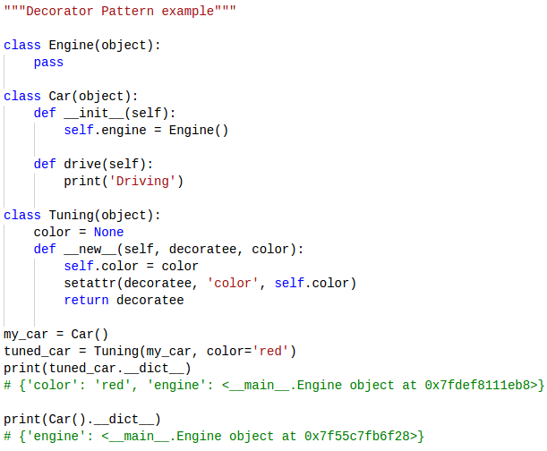
Decorator Pattern

Slide 21
Facade
The Facade pattern is a way to provide a simpler unified interface to a more complex system.
It provides an easier way to access functions of the underlying system by providing a single entry point.
This kind of abstraction is seen in many real life situations.
For example, we can turn on a computer by just pressing a button, but in fact there are many procedures and operations done when that happens (e.g., loading programs from disk to memory).
In this case, the button serves as an unified interface to all the underlying procedures to turn on a computer.

Slide 22
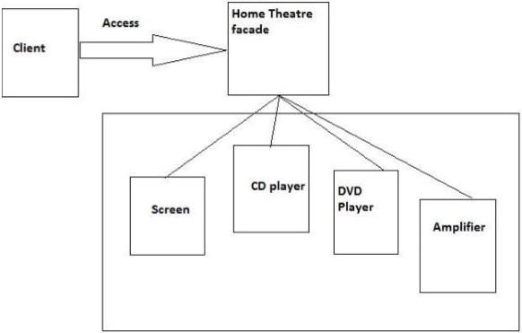
Facade

Slide 23
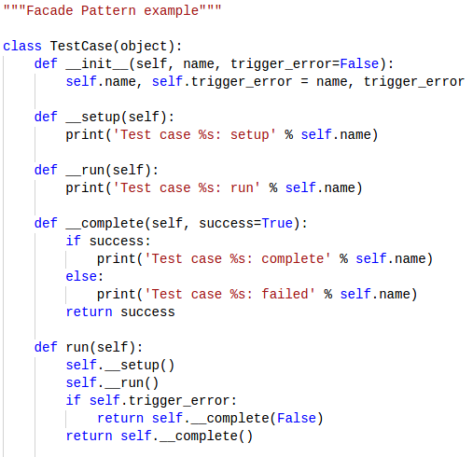
Facade
Let’s say we have a class TestCase and we may have many instances of it.

Slide 24
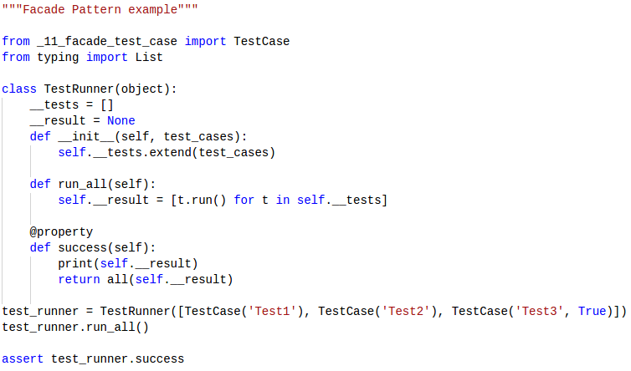
Facade
Let’s say we have a class TestRunner which is a Facade for test cases

Slide 25
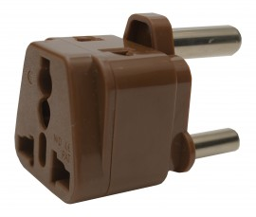
Adapter
The Adapter pattern provides a different interface for a class.
We can think about it as a cable adapter that allows you to charge a phone somewhere that has outlets in a different shape.
Following this idea, the Adapter pattern is useful to integrate classes that couldn't be integrated due to their incompatible interfaces.

Slide 26
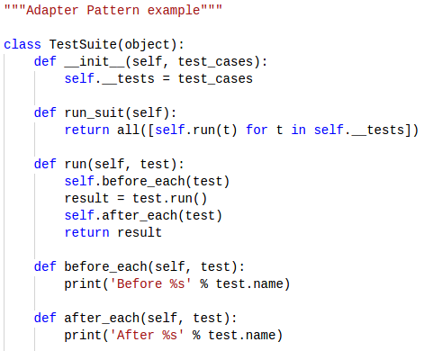
Adapter
Let’s say we have a class TestSuite which can run containing tests and call ‘before each’ and ‘after each’ test hooks(methods).

Slide 27
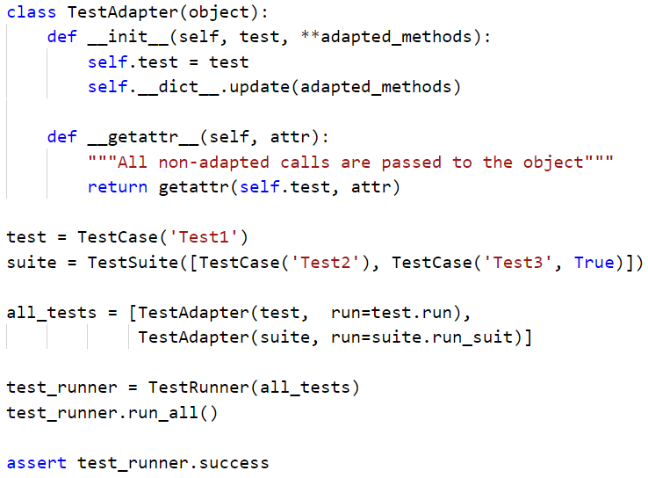
Adapter
Let’s say we have a class TestAdapter which provide ability to adapt instances with different interface(TestCase, TestSuite) for TestRunner.

Slide 28
Thanks for watching

