Slide 1

Python Flow
Lecture 7. Functional testing. Integration testing. Unit testing

Slide 2

OVERVIEW
Functional testing
Testing levels
Unit Tests
Integration Tests
Testing frameworks
Unittest
Doctest
Pytest

Slide 3
What is Functional Testing?
Functional testing is a type of testing which verifies that each function of the software application operates in conformance with the requirement specification.
This testing mainly involves black box testing and it is not concerned about the source code of the application.
Each and every functionality of the system is tested by providing appropriate input, verifying the output and comparing the actual results with the expected results.

Slide 4
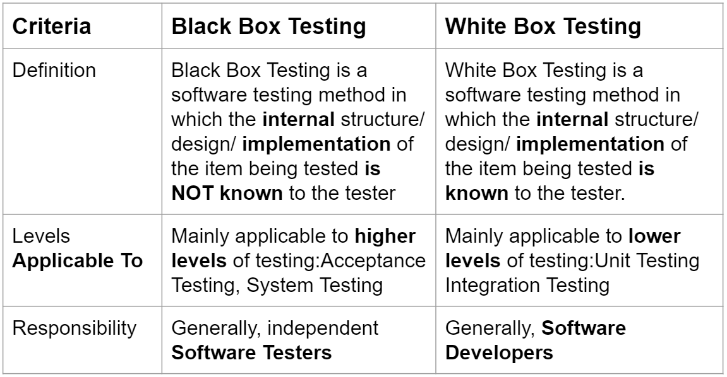
Black Box vs White Box

Slide 5
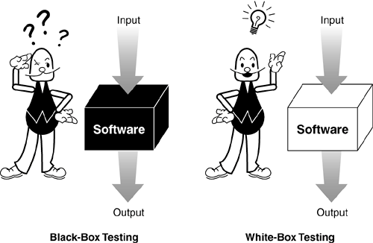
Black Box vs White Box

Slide 6
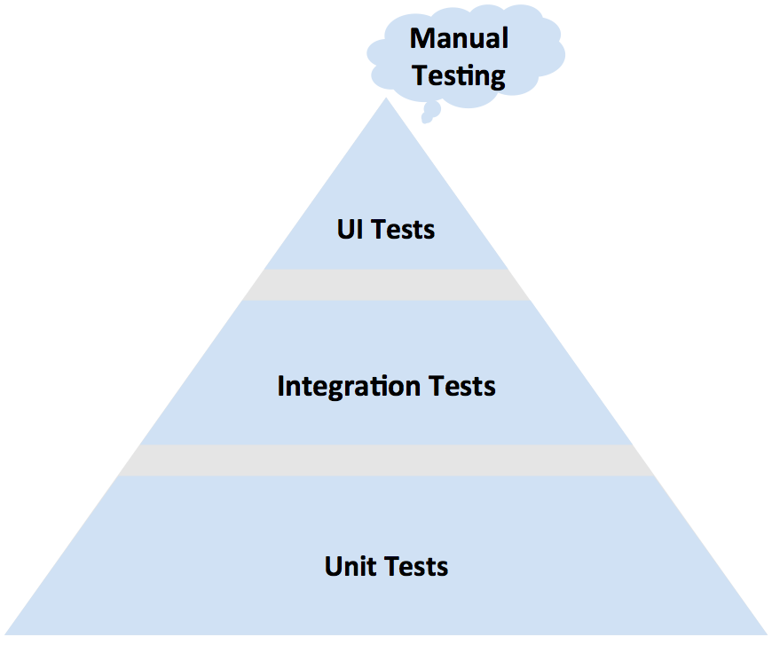
Testing levels

Slide 7
Unit Tests
Essentially, a unit test is a method that instantiates a small portion of our application and verifies its behavior independently from other parts.
Usually a unit test is code written by a developer that tests as small a piece of functionality (the unit) as possible.
One function may have multiple unit tests according to the usage and outputs of the function.

Slide 8
Unit Tests
The purpose of a unit test is to verify the behavior of a relatively small piece of software, independently from other parts.
Unit tests are narrow in scope, and allow us to cover all cases, ensuring that every single part works correctly.
Tests ensure
The code meets expectations and specifications
Does what it says it should do.
The code continues to meet expectations over time
Avoiding regression.

Slide 9

Unit Tests

Slide 10

Integration Tests

Slide 11
Integration Tests
Integration tests demonstrate that different parts of a system work together in the real-life environment.
They validate complex scenarios (we can think of integration tests as a user performing some high-level operation within our system), and usually require external resources, like databases or web servers, to be present.
Difference between unit and integration tests:
A unit test verifies the behavior of small part of the application, isolated from the environment and other parts.
An integration test covers interactions between different components, in the close-to-real-life environment, and requires additional setup and teardown phases.

Slide 12
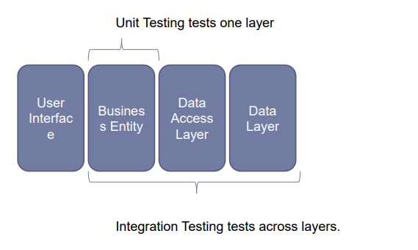
Unit vs. Integration Tests

Slide 13
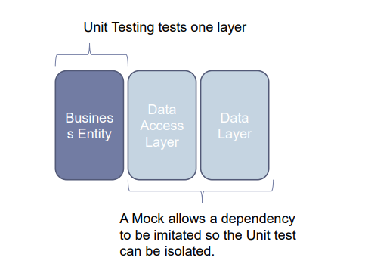
Unit vs. Integration Tests

Slide 14
Unit vs. Integration Tests
A reasonable combination of unit and integration tests ensures that every single unit works correctly, independently from others, and that all these units play nicely when integrated, giving us a high level of confidence that the whole system works as expected.
But if writing a test for some class requires external resources like web services or databases to be present, something is not right — that means bad design.
There is no ability to inject fake dependency to your class
If this class is yours - remember SOLID. Use DIP

Slide 15
Tests Best Practices
Single Responsibility
Self-descriptive
No conditional logic or loops
No exception handling
Informative Assertion messages
No test logic in production code
Separation per business module

Slide 16
Unittest
Unittest is a built-in Python’s testing framework
Unittest supports some important concepts in an object-oriented way
test fixture - represents the preparation needed to perform one or more tests, and any associate cleanup actions.
test case - individual unit of testing. It checks for a specific response to a particular set of inputs.
test suite - collection of test cases, test suites, or both. It is used to aggregate tests that should be executed together.
test runner - component which orchestrates the execution of tests and provides the outcome to the user.

Slide 17
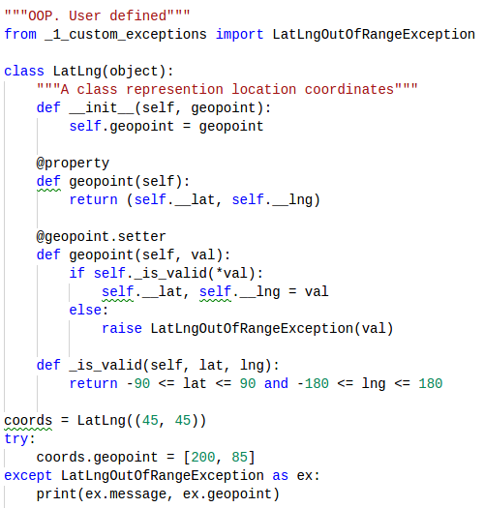
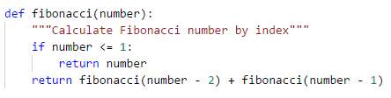
Unittest. Let’s cover following

Slide 18
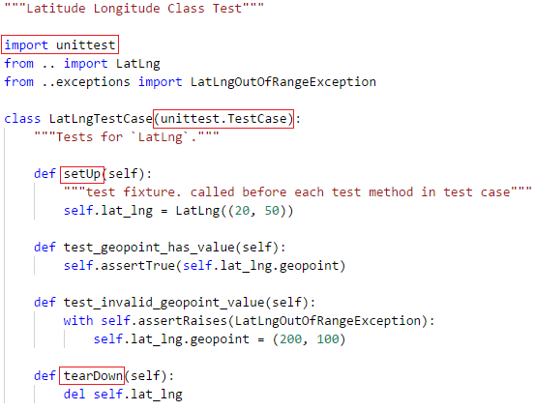
Unittest. Test Case

Slide 19
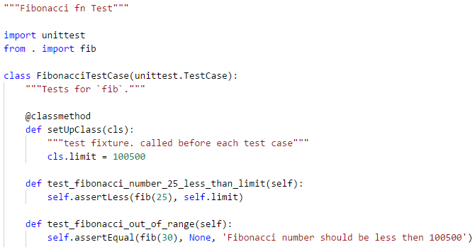
Unittest. Test Case

Slide 20
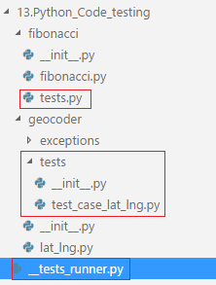
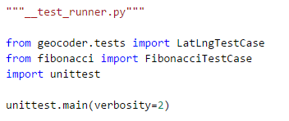
How to organize tests?

Slide 21

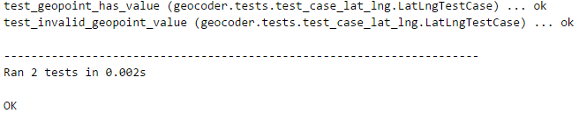
How to run tests?

Slide 22
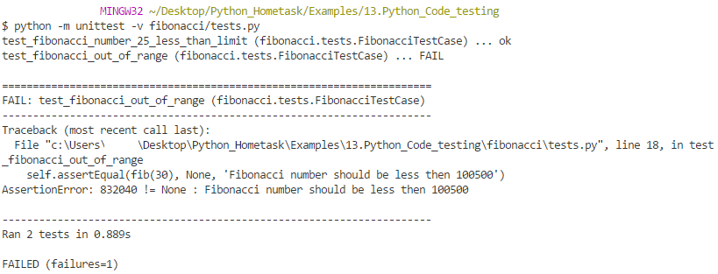
How to run tests?

Slide 23
Unittest. Result
Running a test results in one of three outcomes
Success (expected result)
Failure (unexpected result)
Error (error running the test)

Slide 24
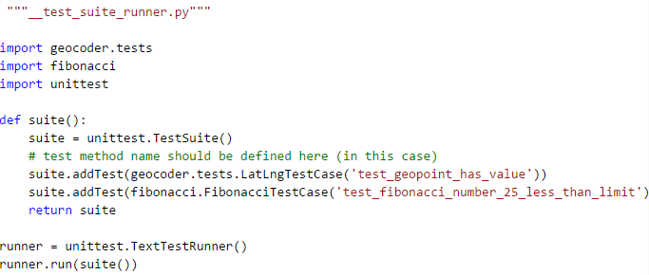
Unittest. Test Suite

Slide 25
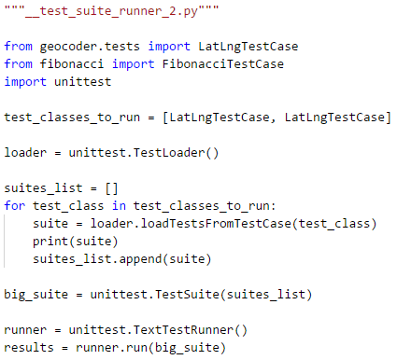
Unittest. Test Suite

Slide 26
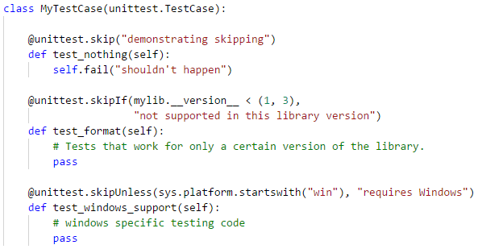
Unittest. Decorators

Slide 27
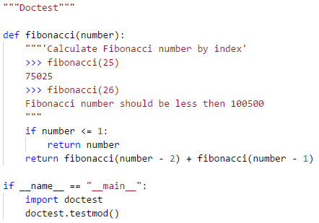
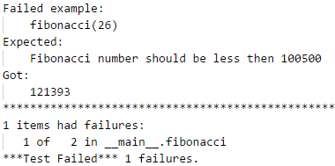
Doctest

Slide 28

Pytest
Do less work when testing app, but be just as expressive, just as elegant, and just as readable.
The pytest testing framework helps you write tests quickly and keep them readable and maintainable - with no boilerplate code.
Pytest can run unittest TestCase and combined test suits (see example with TestLoader).
pytest test_unittest_testcase_fibonacci.py

Slide 29
Pytest. Unittest TestCase

Slide 30
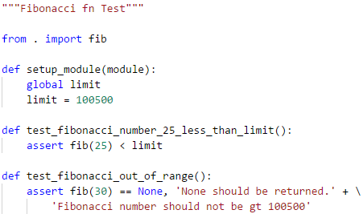
The same for Pytest

Slide 31
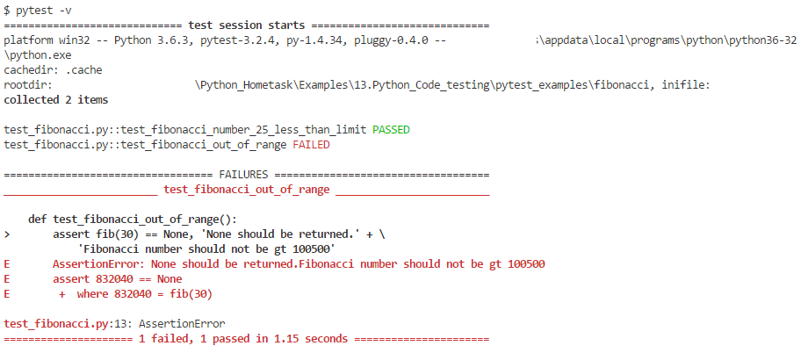
Pytest. How to run?

Slide 32
Pytest Fixtures
Although unittest does allow us to have setup and teardown, pytest extends this quite a bit. We can add specific code to run:
at the beginning and end of a module of test code (setup_module/teardown_module)
at the beginning and end of a class of test methods (setup_class/teardown_class)
alternate style of the class level fixtures (setup/teardown)
before and after a test method call (setup_method/teardown_method)

Slide 33
Pytest Extended Fixtures
What should we do if fixture is needed only for some tests?
Here is the place where extended fixture come
What is an extended fixture?
Fixture functions are created by marking them with the @pytest.fixture decorator.
Test functions that require fixtures should accept them as arguments.
Fixtures may be used by other fixtures
Fixtures can return result and may be used by other fixtures

Slide 34
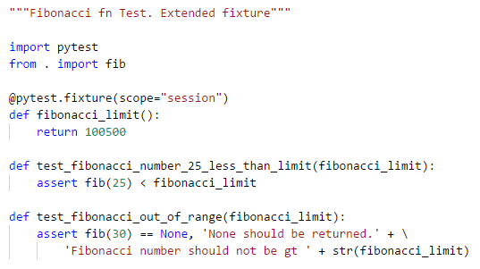
Pytest Extended Fixtures

Slide 35
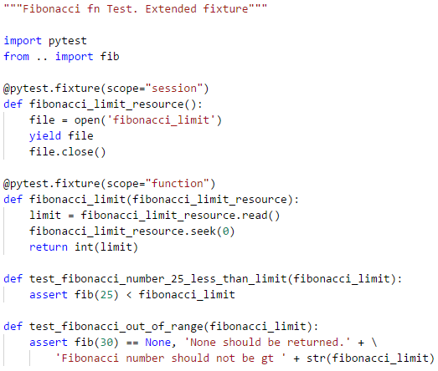
Pytest Extended Fixtures

Slide 36
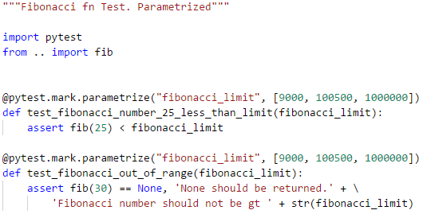
Pytest. Parameterized Test Fn

Slide 37
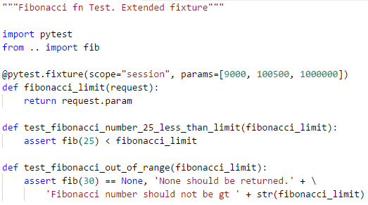
Pytest. Parameterized Fixtures

Slide 38
Pytest Fixtures. conftest.py
It is best practice to define commonly used fixtures in conftest.py file.
Pytest automatically imports this file.
All fixtures defined in this file are available automatically, without import statement.

Slide 39
Pytest. Marks
Pytest support “marks”.
They are available as mark’s class decorators
@pytest.mark.parametrize - need to parametrize tests
@pytest.mark.xfail - provide ability to mark test to be failed as expected
@pytest.mark.skipif - provide ability to skip test by some condition
@pytest.mark.usefixtures - provide ability to enumerate all fixtures which will be used in test
Custom marks also available. It can be useful when we need to mark some tests and run them separately. For example @pytest.mark.critical. We can run marked test: pytest -s -v -m 'critical' test_fibonacci.py

Slide 40


Slide 41
Thanks for watching

