Slide 1

Python Flow
Lecture 8. API architecture approaches. Load testing.

Slide 2

OVERVIEW
Working with API.
REST.
Requests.
CORS.
Load testing.
Locust.

Slide 3
What is an API?
In computer programming, an application programming interface (API) is a set of subroutine definitions, protocols, and tools for building application software.
API defines functionality which are provided by module/package.
API simplifies programming by abstracting the underlying implementation and only exposing objects or actions the developer needs.
A single API can have multiple implementations (remember interfaces and DI)
An API may be for a web-based system, operating system, database system, computer hardware or software library.
An API is like a coding contract.

Slide 4
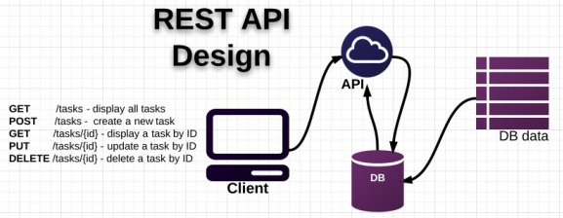
Web API
Web API is an API over the web which can be accessed using HTTP protocol.
It is a concept and not a technology.
Web API could be built using different technologies (Python, Java, .NET etc.)

Slide 5
A RESTful API
For an API or webservice to be RESTful, it must do the following:
Separate the client from the server
Not hold state between requests (meaning that all the information necessary to respond to a request is available in each individual request; no data, or state, is held by the server from request to request)
Use HTTP and HTTP methods

Slide 6
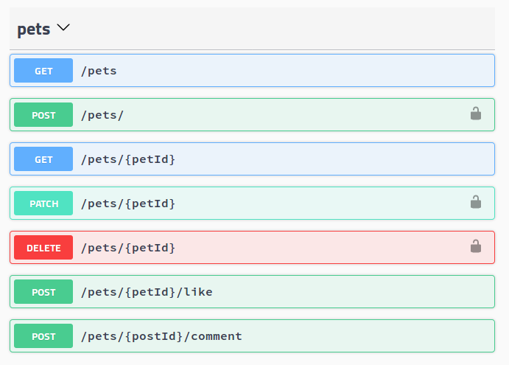
Web API. Example

Slide 7
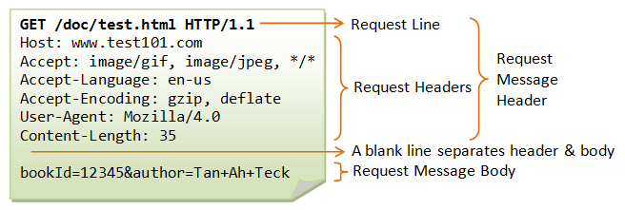
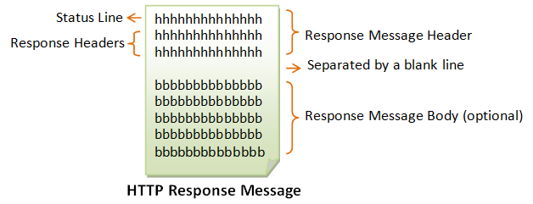
HTTP Request

Slide 8
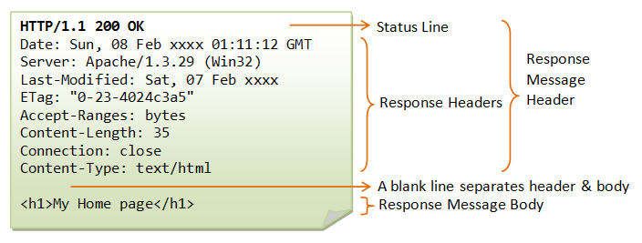
HTTP Response

Slide 9
How to send a request via Python?
There are several Python libraries which allow us to send a HTTP request:
httplib2
urllib3
Requests
Requests is the only Non-GMO HTTP library for Python, safe for human consumption. :)
pip install requests

Slide 10
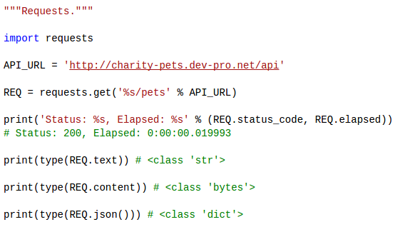
How to send a request via Python?

Slide 11
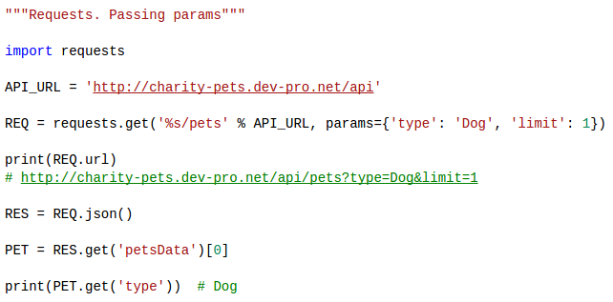
Passing Parameters In URLs

Slide 12
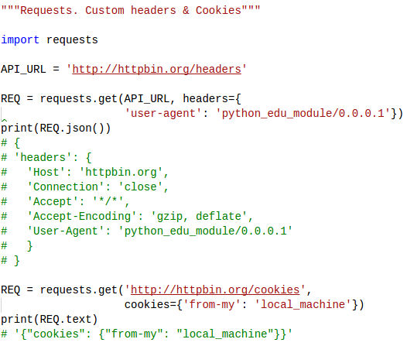
Custom Headers & Cookies

Slide 13
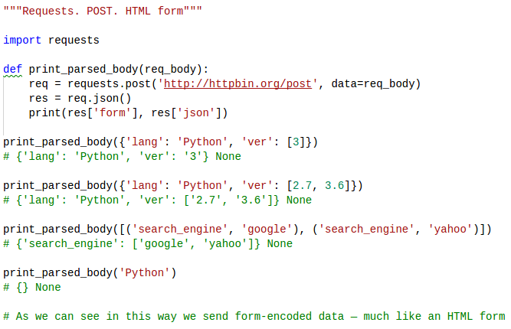
POST requests. HTML form

Slide 14
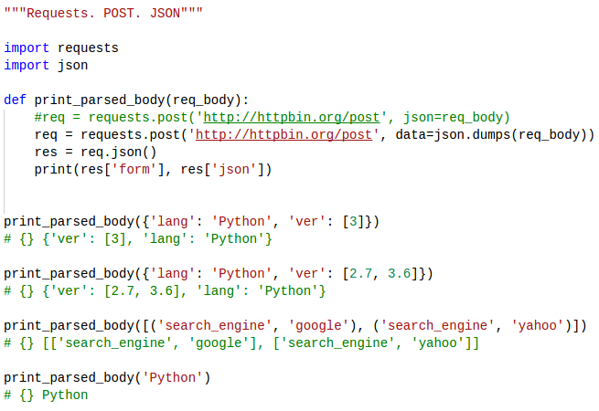
POST requests. JSON

Slide 15
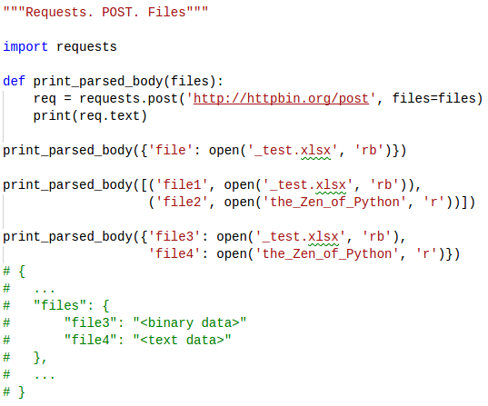
POST. Files

Slide 16
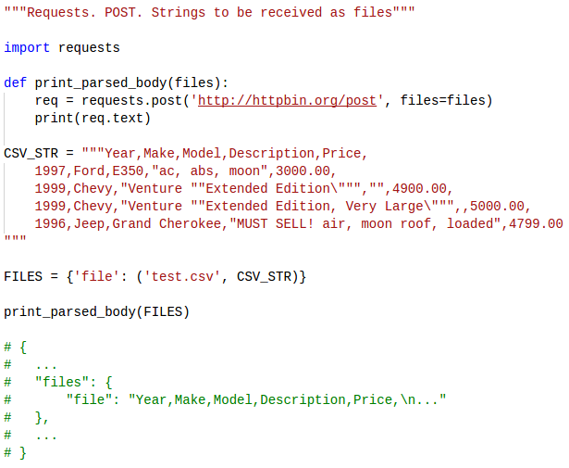
POST. Files

Slide 17
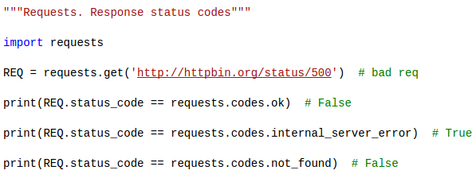
Response Status Codes

Slide 18
Errors and Exceptions
In the event of a network problem (e.g. DNS failure, refused connection, etc), Requests will raise a ConnectionError exception.
Response.raise_for_status() will raise an HTTPError if the HTTP request returned an unsuccessful status code.
If a request times out, a Timeout exception is raised.
If a request exceeds the configured number of maximum redirections, a TooManyRedirects exception is raised.
All exceptions that Requests explicitly raises inherit from requests.exceptions.RequestException.

Slide 19
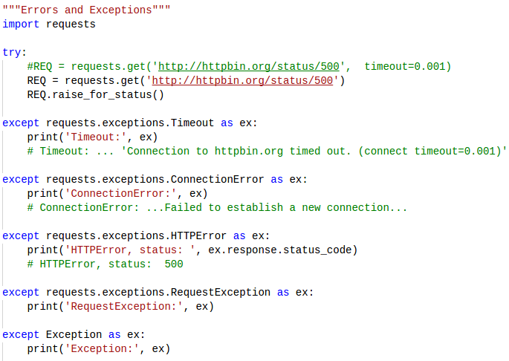
Errors and Exceptions

Slide 20
Session object
The Session object allows you to persist certain parameters across requests.
It also persists cookies across all requests made from the Session instance.
So if you're making several requests to the same host, the underlying TCP connection will be reused, which can result in a significant performance increase (see HTTP persistent connection).
A Session object has all the methods of the main Requests API.

Slide 21
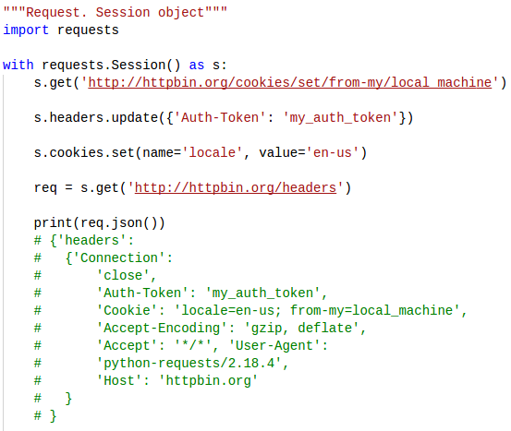
Session object

Slide 22
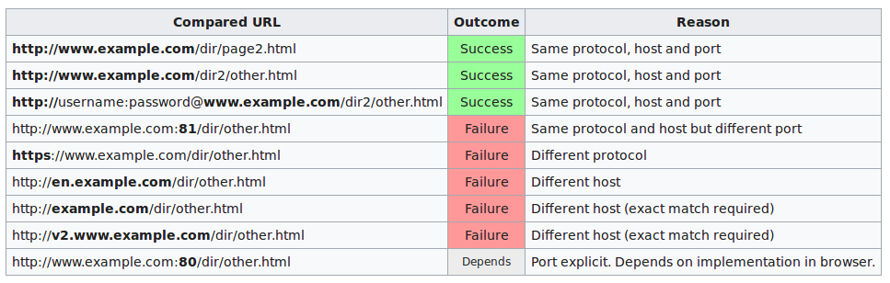
Same-origin policy
The same-origin policy restricts how a document or script loaded from one origin can interact with a resource from another origin. It is a critical security mechanism for isolating potentially malicious documents.

Slide 23
CORS
Cross-origin resource sharing (CORS) is a mechanism that allows restricted resources (e.g. fonts) on a web page to be requested from another domain outside the domain from which the first resource was served.
CORS defines a way in which a browser and server can interact to determine whether or not it is safe to allow the cross-origin request.
The CORS standard describes new HTTP headers which provide browsers and servers a way to request remote URLs only when they have permission.

Slide 24

How do the CORS works?
To initialize Cross-origin request browser adds “Origin” header to HTTP request (site domain, from which request is sent)
For example:
Page http://www.a.com/page.html is trying to get data from http://www.b.com/cors.txt
If client(browser) supports CORS then request will look like this:
If www.b.com server allows accessing data from www.a.com then server response headers should have following line
Access-Control-Allow-Origin: http://www.a.com

Slide 25
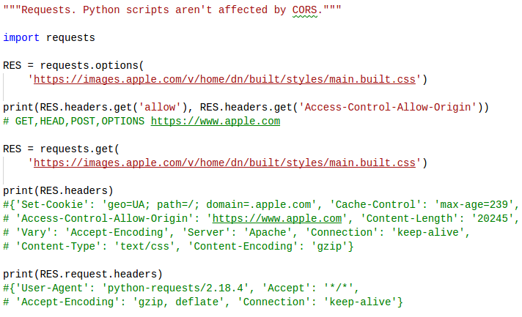
Python scripts vs. CORS

Slide 26
Web API Testing. Tips & Tricks
Separate:
Test Logic
Test Data
Application Driver
There should be different tests for:
API JSON schema
API response

Slide 27

Load testing
Performance Testing - how fast is the system?
Load Testing - how much volume can the system process?

Slide 28

What is Locust?
Locust is an easy-to-use, distributed, user load testing tool. It is intended for load-testing web sites (or other systems) and figuring out how many concurrent users a system can handle.
The idea is that during a test, a swarm of locusts will attack your website. The behavior of each locust (or test user if you will) is defined by you and the swarming process is monitored from a web UI in real-time.
Locust is an Open Source load testing tool that enables you to define user behavior using Python to test your system’s performance under millions of simulated, simultaneous users.

Slide 29
Writing a locust file
A locustfile is a normal python file. The only requirement is that it declares at least one class— let’s call it the locust class—that inherits from the class Locust.
The Locust class represents one user (or a swarming locust if you will). Locust will spawn (hatch) one instance of the locust class for each user that is being simulated.
There are a few attributes that a locust class should typically define.

Slide 30
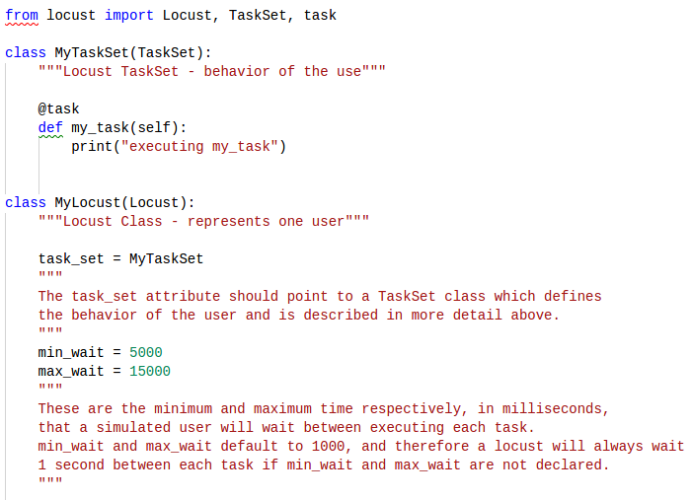
Writing a locust file

Slide 31
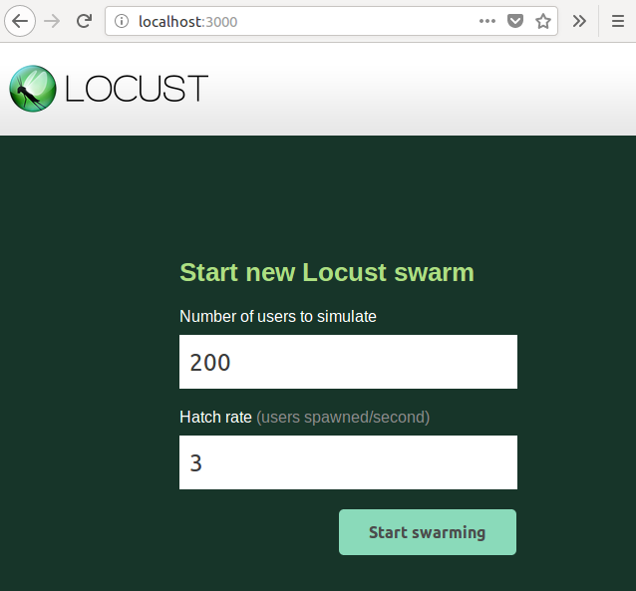
How to start locust?
pip install locustio (if something goes wrong - see next line :) )
sudo pip install git+git://github.com/locustio/locust.git@master#egg=locustio
locust -f _13_locust_pets_test.py --web-host=localhost --web-port=3000

Slide 32
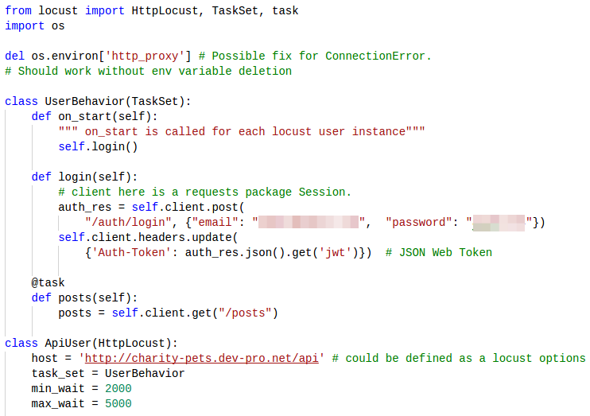
Locust file

Slide 33
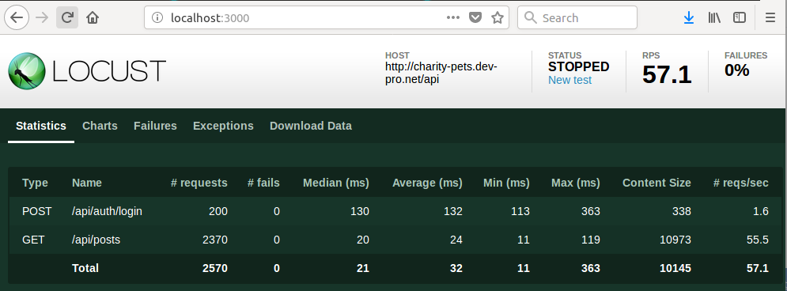
Locust Statistics

Slide 34
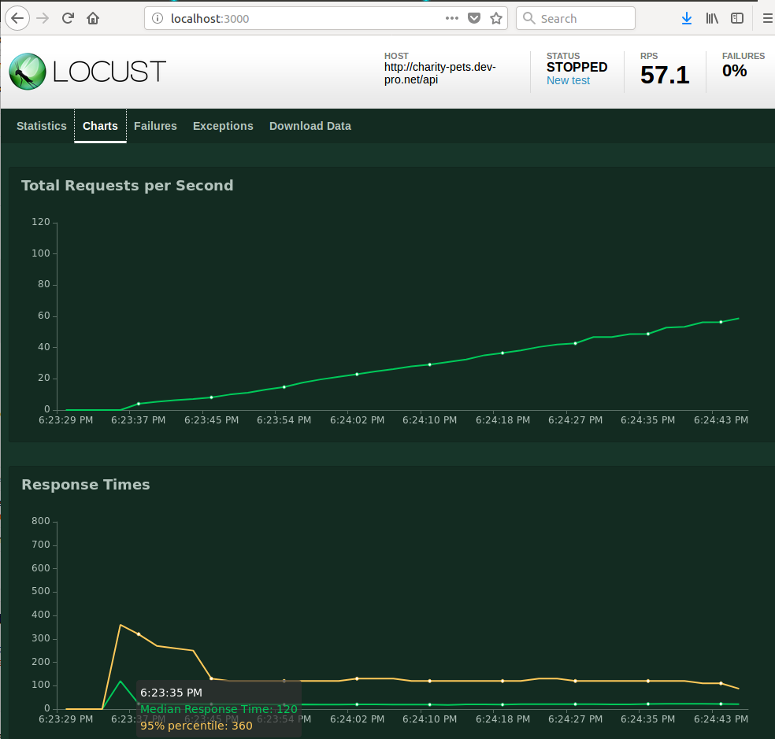
Locust Charts

Slide 35


Slide 36
Thanks for watching

