Slide 1

Python Flow
Lecture 9. Acceptance testing. Selenium. OOP in tests.

Slide 2

OVERVIEW
Acceptance testing.
Selenium
Test issues
DSL introduction
OOP in tests.
Page Object Pattern
Example of test project structure.
Code organization

Slide 3
What is Acceptance Testing?
Acceptance tests are used to verify that a story (requirement) is complete.
This is formal testing with respect to user needs, requirements, and business processes conducted to determine whether or not a system satisfies the acceptance criteria and to enable the user, customers or other authorized entity to determine whether or not to accept the system.
So it is a good thing that
Each new story/feature should be accepted by BA, user, customers or other authorized entity before any automation
Accepted stories/features could be covered by UI automation testing

Slide 4
What is UI Testing?
UI or User Interface, is the front end of your application that your users interact with on their screens.
Anything the user is likely to do, might do, or can do, or often more importantly can do but shouldn't be able to do with your application while it is running, is part of the user interface, and therefore is a candidate for being tested.
UI automation testing, is similar to manual testing, but instead of having a user click through your application, and visually verify the data. You create a script for each test case that you want to test.

Slide 5
Selenium?
Selenium WebDriver - library/ies for managing browsers (Selenium 2.0).
Selenium RC - previous library/ies for managing browsers (current - WebDriver).
Selenium Server - server which allows to control browser from remote machine.
Selenium Grid - cluster which consists of several Selenium Servers. It is intended for the organization of a distributed network, allowing in parallel to the launch of many browsers on a large number of machines.
Selenium IDE - Firefox browser extension. Provides ability to record user actions, reproduce them, and generate code for WebDriver, in which the same actions are performed. In general, this is the Selenium-Recorder

Slide 6
Selenium WebDriver
Selenium WebDriver is the successor to Selenium RC.
Selenium WebDriver accepts commands (sent in Selenese, or via a Client API) and sends them to a browser.
This is implemented through a browser-specific browser driver, which sends commands to a browser, and retrieves results.
Unlike in Selenium 1, where the Selenium server was necessary to run tests, Selenium WebDriver does not need a special server to execute tests.
Instead, the WebDriver directly starts a browser instance and controls it.

Slide 7
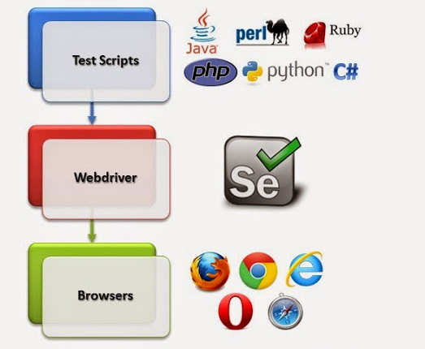
Selenium WebDriver Workflow

Slide 8
WeDriver. Installation
pip install selenium
Browser Driver should be installed for each browser separately. And path to the driver should be placed into “Path” environment variable.
ChromeDriver
pip install chromedriver_installer --install-option="--chromedriver-version=2.33"

Slide 9
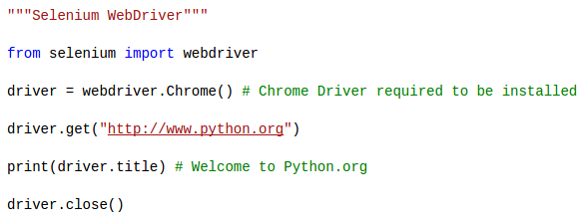
Selenium WebDriver

Slide 10
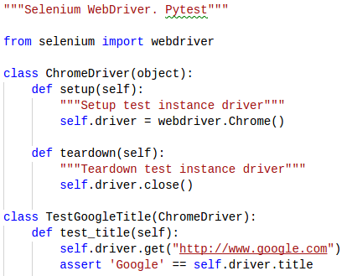
Selenium WebDriver. Pytest

Slide 11
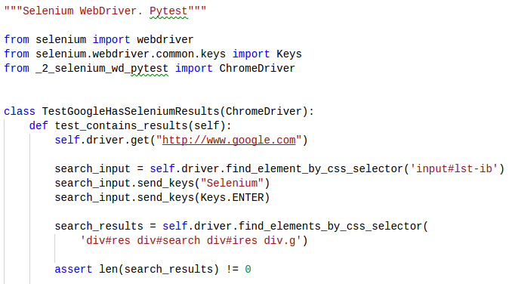
Selenium WebDriver. Pytest

Slide 12
Selenium WebDriver. Waits
Selenium Webdriver provides two types of waits - implicit & explicit.
Explicit wait - makes WebDriver wait for a certain condition to occur before proceeding further with execution.
Implicit - makes WebDriver poll the DOM for a certain amount of time when trying to locate an element.

Slide 13
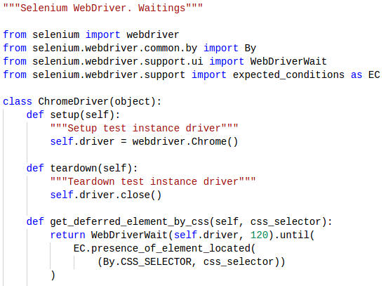
Selenium WebDriver. Waits

Slide 14
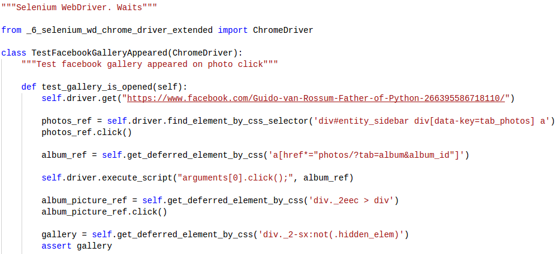
Selenium WebDriver. Waits

Slide 15
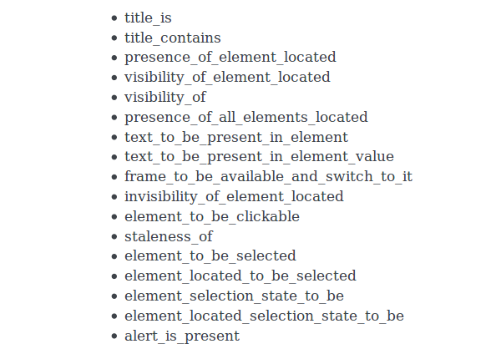
Expected Conditions

Slide 16
Test Components
Test Logic
Test Data
Application Driver

Slide 17
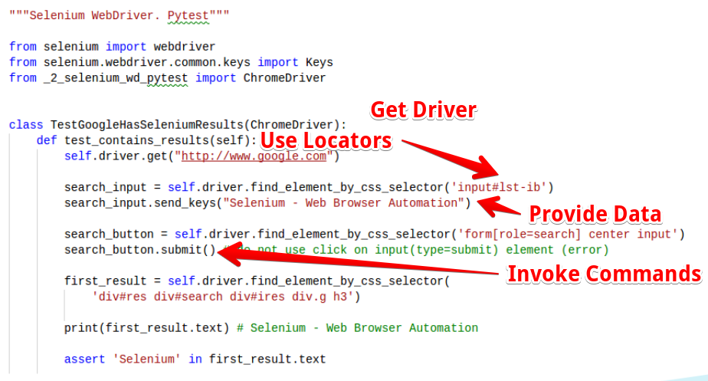
How WebDriver Works?

Slide 18
Selenium Test Issues
Verbose
driver.find_elements_by_css_selector( 'div#res div#search div#ires div.g')
WebDriverWait(driver, 120).until(...)
driver.execute_script("arguments[0].click();", album_ref)
driver.findElement(By.xpath(...)).sendKeys(...)

Slide 19
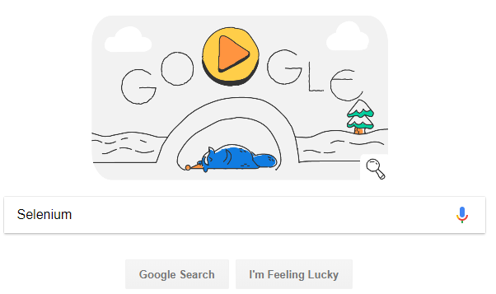
Selenium Test Issues
Not Expressive

Slide 20
Selenium Test Issues
Unreadable, fragile and depends to much on page structure.

Slide 21
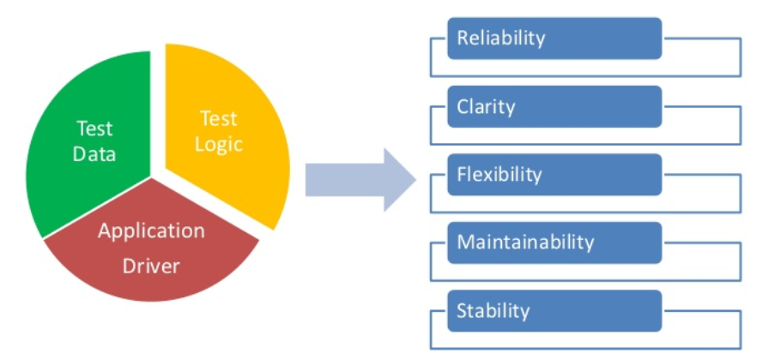
How to improve?
Separate all parts!

Slide 22
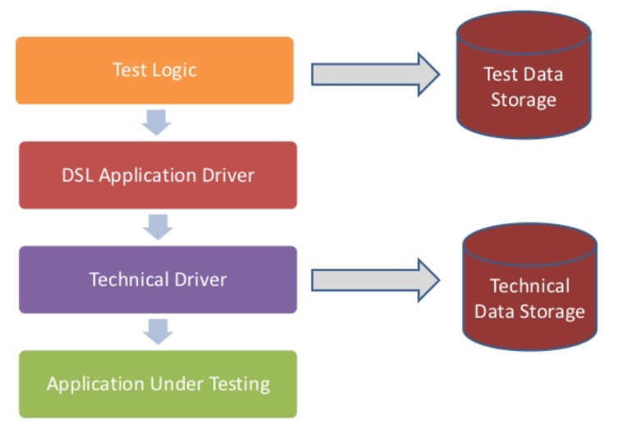
How to improve?
Separate all parts!

Slide 23
DSL?
A domain-specific language (DSL) is a computer language specialized to a particular application domain.
A domain-specific language is created specifically to solve problems in a particular domain and is not intended to be able to solve problems outside it

Slide 24
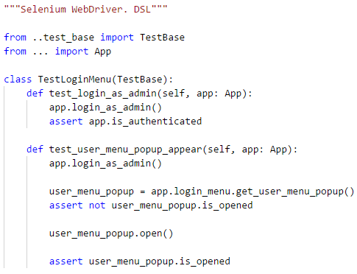
Tests with DSL

Slide 25
Benefits of DSL
High-level - tests are in the language of product management, at the user level
Readable - product management can understand them
Writable - easy for developer or qa to write new test
Extensible - tests base is able to grow with dsl

Slide 26
Tips and Tricks
Use test class hierarchy
Use design patterns
Some common methods move to base test class
Minimize usage of driver instance in tests

Slide 27
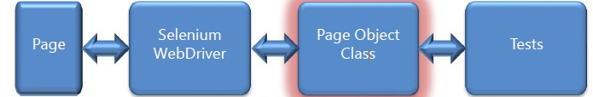
What's Next?

Slide 28
Page Object Pattern
The basic rule of thumb for a page object is that it should allow a software client to do anything and see anything that a human can.
It should also provide an interface that's easy to program to and hides the underlying widgetry in the window.
So to access a text field you should have accessor methods that take and return a string, checkboxes should use booleans, and buttons should be represented by action oriented method names.
The page object should encapsulate the mechanics required to find and manipulate the data in the gui control itself

Slide 29
Page Object Pattern
Page objects are commonly used for testing, but should not make assertions themselves. Their responsibility is to provide access to the state of the underlying page. It's up to test clients to carry out the assertion logic.

Slide 30
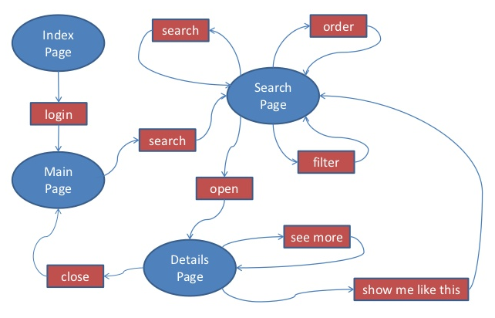
Page Object Pattern

Slide 31
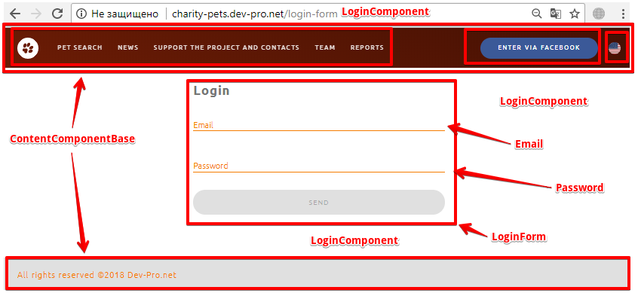
Page Object Pattern

Slide 32
Let's do it!

Slide 33
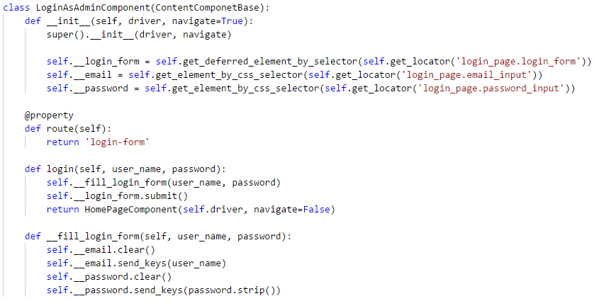
Page Object & Technical Driver

Slide 34
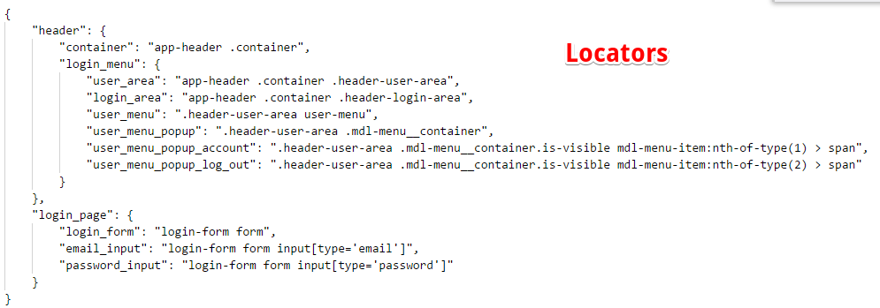
Technical Data Storage

Slide 35
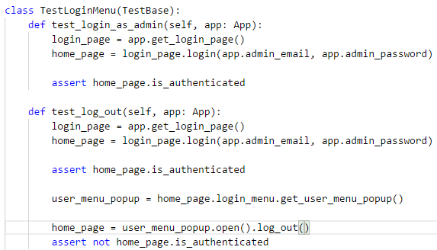
Test Logic & DSL App Driver

Slide 36
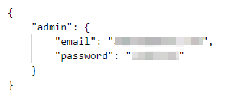
Test Data Storage

Slide 37
Tips and Tricks
Allow chain invocation
Basic page with driver details and common methods
Expose only what is allowed to see or do on the page
Don’t use driver instance in tests at all

Slide 38

Too many questions?

Slide 39

It’s Demo Time!

Slide 40
Need more improvements?
Use Page Element Pattern!

Slide 41
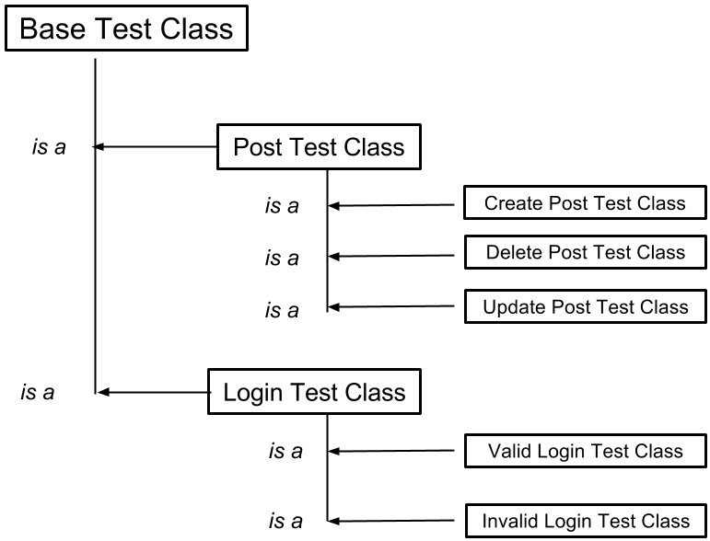
Make smart use of inheritance

Slide 42


Slide 43
Thanks for watching

