Slide 1
Chapter 10
On-policy control with Approximation
2017.5.23
Game AI Team
Joon-Hong Seok

Slide 2
Overview: Reinforcement Learning
2. Bandit Problems
3. Finite Markov Decision Process
9. On-policy Prediction with Approximation
Part I:
Tabular Solution Methods
8. TD + Model Learning/Planning
7. MC + TD
Part II:
Approximate Solution Methods
4~6. Solving Finite MDP
DP, MC, TD
10. On-policy Control with Approximation
11. Off-policy Control with Approximation
6.1. TD Prediction
6.4. Sarsa On-Policy TD Control
6.5. Q-Learning Off- Policy TD Control

Slide 3
Overview: Approximate Solution Methods
Part I:
Tabular Solution
Part II:
Approximate Solution
Arbitrarily Large Space
Good Approximation
Due to Limited Experience,
Generalization is needed
Function Approximation
Nonstationarity
bootstrapping
Difficulties
Delayed Targets

Slide 4
Overview: On-policy Prediction with Approximation
9. On-policy Prediction with Approximation
Given Policy / Value Function Approximation
Stochastic Gradient Descent / Semi Gradient Descent TD(0)
Convergent Proof for Linear / On-policy Case
Feature Construction of Continuous State Space
Nonlinear Function Approximation
On-Policy Methods for
Optimal Policy Approximation
Off-Policy Methods for
Optimal Policy Approximation
10. On-policy Control with Approximation
11. Off-policy Control with Approximation

Slide 5
Overview: On-policy Control with Approximation
9. Semi Gradient Descent TD(0)
Action Value / On-Policy Control
11. On-policy Control
with Approximation
10. 1 Episodic Semi-Gradient Control
One-Step Vs. n-Step
Off-policy Vs. On-policy
10.2 N-step Semi-Gradient Sarsa
10. On-policy Control with Approximation
10. 5 N-step Differential Semi-Gradient Sarsa
Episodic Vs. Continuing
One-Step Vs. n-Step
10.3 Average Reward for Continuing Tasks
10.4 Futility of Discounting for Continuing Tasks
Average Reward Vs. Discounted Reward

Slide 6
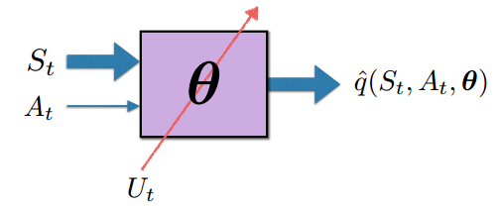
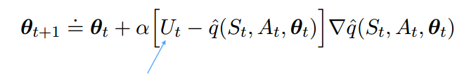


Episodic Semi-gradient Control in the On-policy GPI Way
Replacing the table with a general parameterized form
Learning the action-value function of the current policy
Acting near-greedily w.r.t the current action-value estimates
The Learning Rule is the same as in Chapter 9: General Gradient-Descent Update
: Approximation of

Slide 7
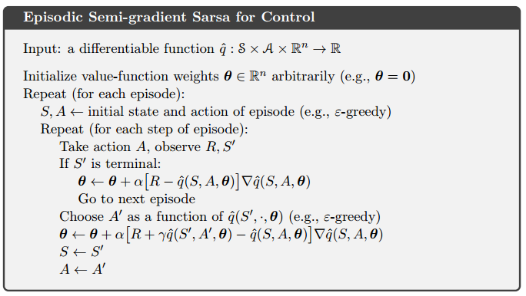
Episodic Semi-gradient One-step Sarsa

Slide 8
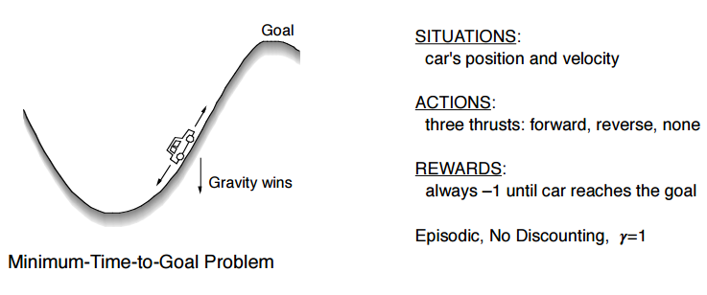
Example: Mountain-Car Problem
Definition

Slide 9
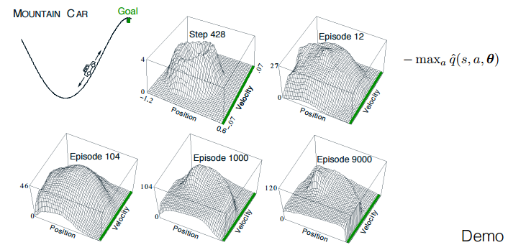
Example: Mountain-Car Problem
Values learned while solving Mountain-Car with tile coding function approximation

Slide 10
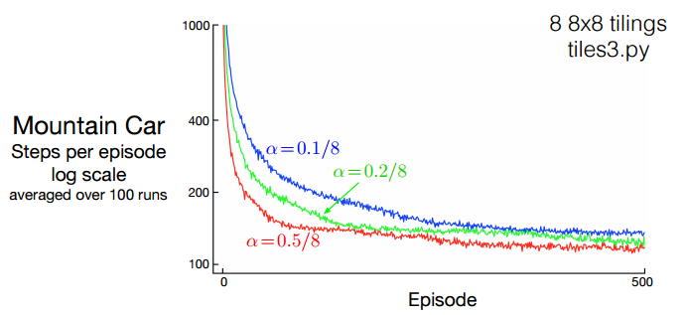
Example: Mountain-Car Problem
Learning Curves for Semi-Gradient Sarsa with Tile Coding

Slide 11
Episodic Semi-gradient n-step Sarsa
N-step Return: from its tabular form to a function approximation form
N-step Update Equation: N-step Return as Update Target

Slide 12
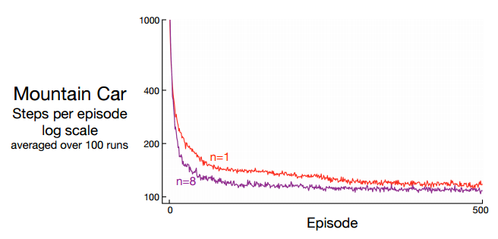
Episodic Semi-gradient n-step Sarsa
One-step Vs. Multi-step Performance

Slide 13
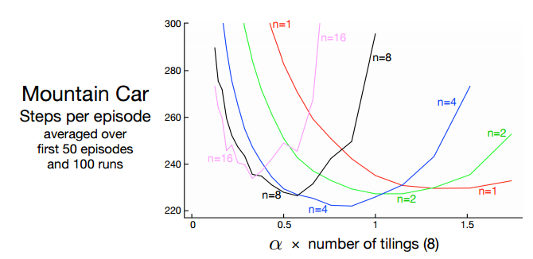
Episodic Semi-gradient n-step Sarsa
Effect of the $α$ and n

Slide 14
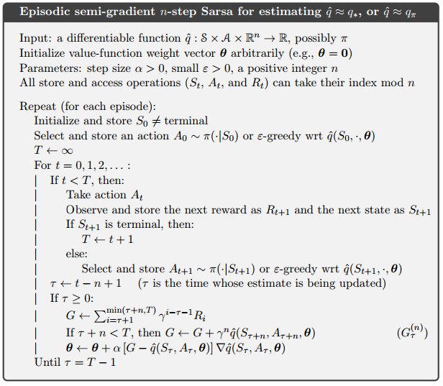
Episodic Semi-gradient n-step Sarsa

Slide 15
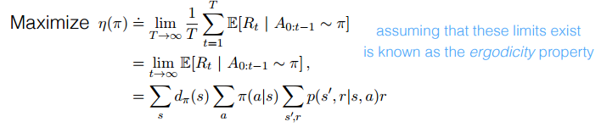

Average Reward: A New Problem Setting for Continuing Tasks
New Quality of Policy π: Average Rate of Reward while Following that Policy
Steady-state Distribution dπ
To exist / To be independent of S0 (by ergodicity)
Depending only on the policy and the MDP transition probabilities
Selecting actions according to π remains in the same distribution.

Slide 16
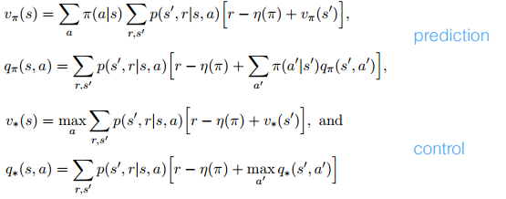
Differential Form: Value Function, Bellman Equations
Average Reward Returns (Differential Return)
Bellman Equations of Differential Value Functions

Slide 17



Differential Form: Update Targets, TD Error, Semi-gradient Sarsa
Update Targets
TD Errors
Semi-gradient Sarsa

Slide 18
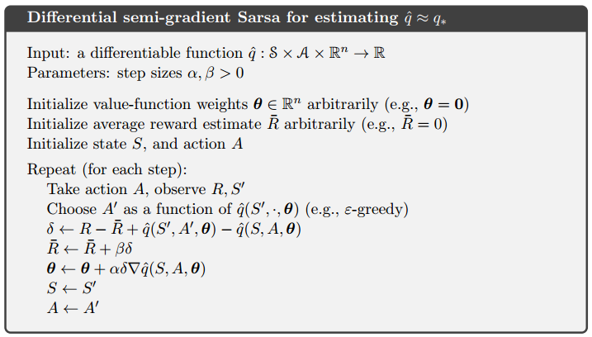
Differential Semi-gradient One-step Sarsa

Slide 19
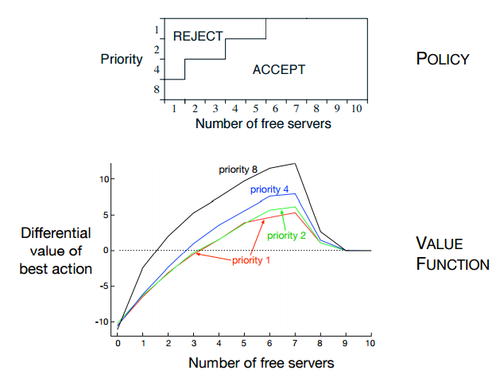
Differential Semi-gradient One-step Sarsa
An Access-control Queuing Task

Slide 20
Deprecating the Discounted Setting
Tabular case
Returns from each state can be separately identified and averaged.
Approximate case
Infinite sequence of returns with no beginning or end, and no clearly identified state.
VS.

Slide 21
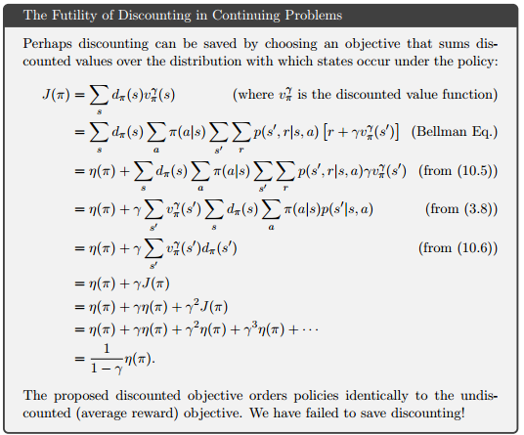
Deprecating the Discounted Setting

Slide 22

Differential Semi-gradient n-step Sarsa
N-step return Differential form with function approximation
N-step TD error

Slide 23
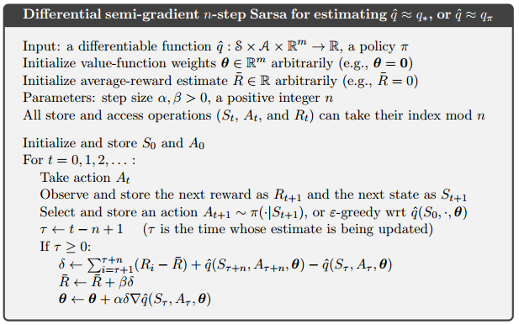
Differential Semi-gradient n-step Sarsa

Slide 24
Summary
Control: Parametrized Function Approximation and Semi-gradient Descent
Episodic Case: Straightforward to Extend
Continuing Case: Average Reward per Time Step
Not Valid Discounted Formulation
Differential Versions of Value Functions, Bellman Equations, TD Errors by Average Reward

Slide 25
End of Document

