Slide 1
PHP&MySQL Hands on

Slide 2
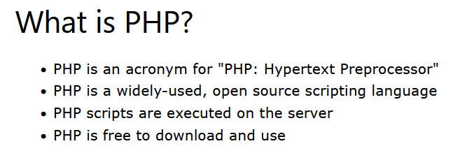
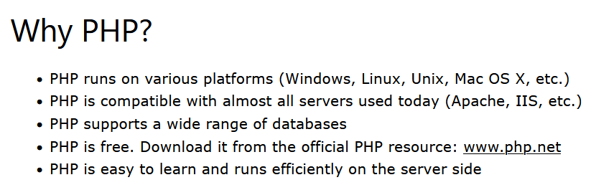

Slide 3
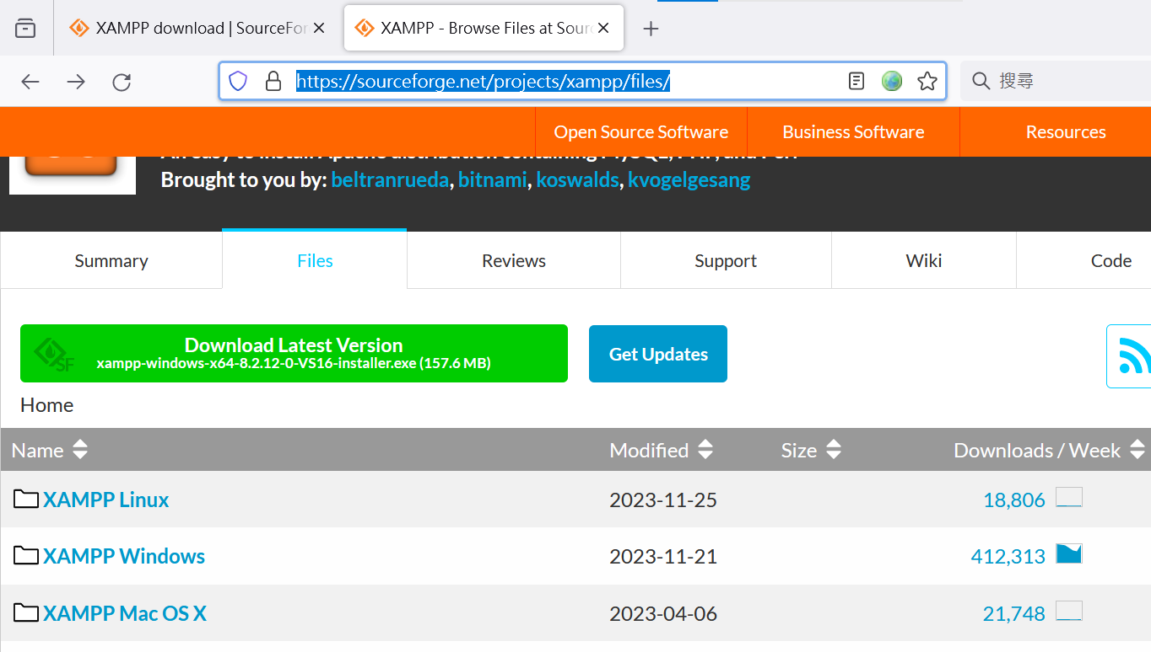
XAMMP

Slide 4
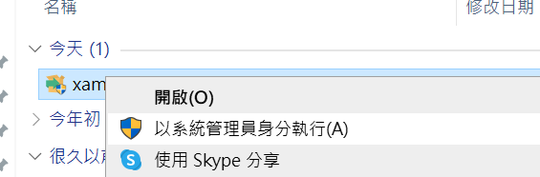
Run as system administrator

Slide 5
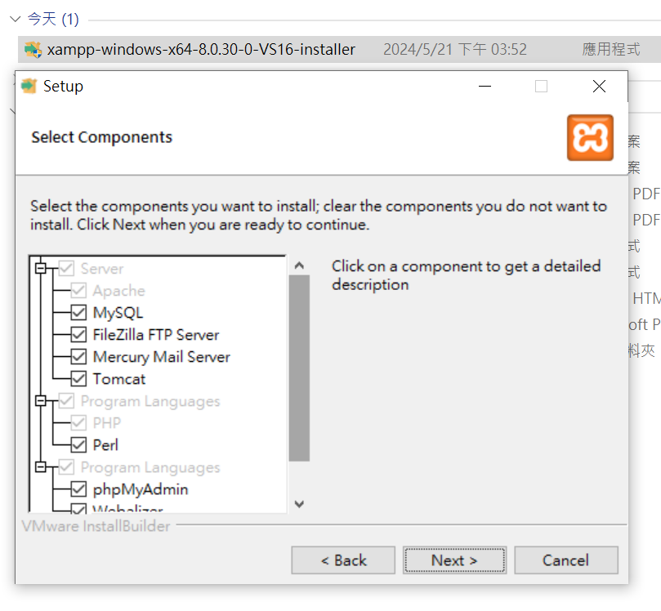
Just click next

Slide 6
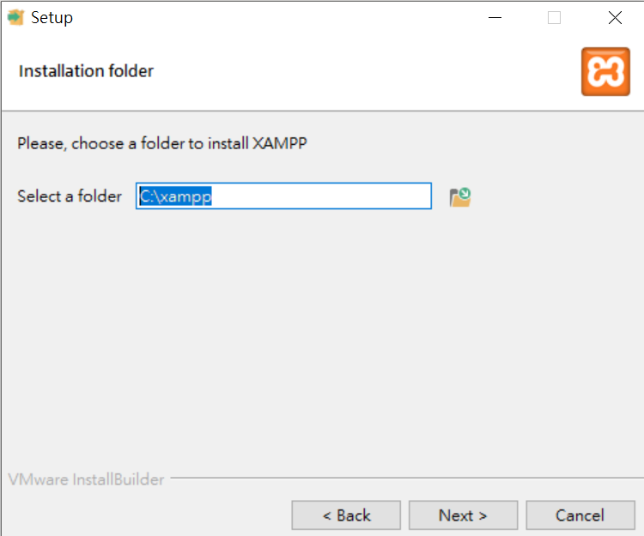
Don’t forget your path!

Slide 7
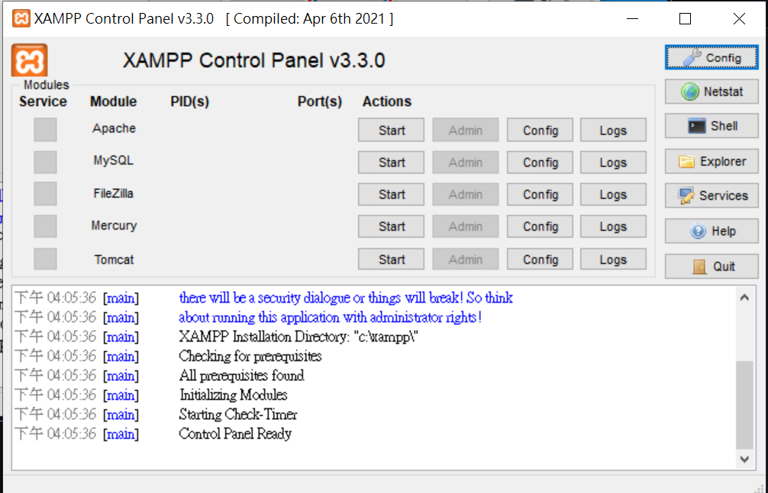

Slide 8
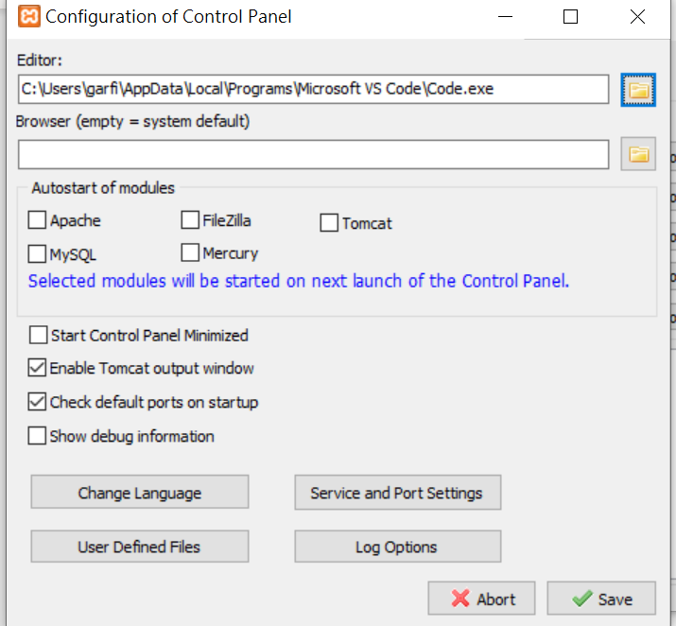
Visual studio code
NotePad ++

Slide 9
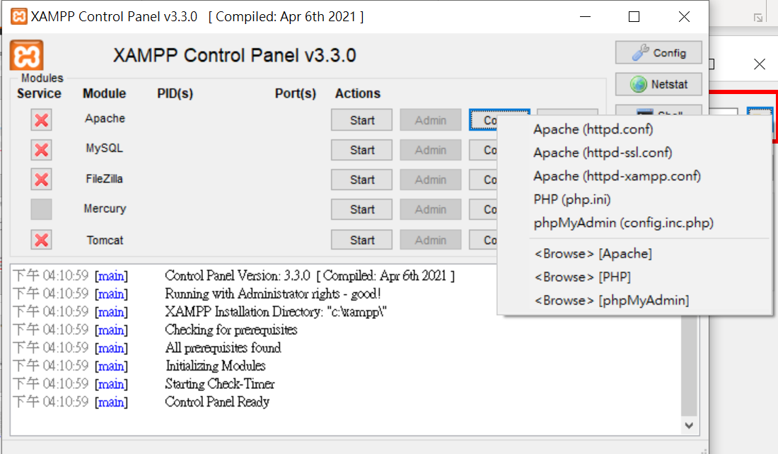

Slide 10
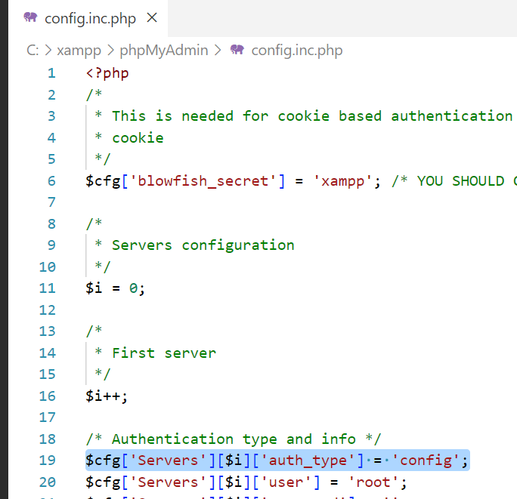
Change “config” to “cookie”
Or “http”

Slide 11
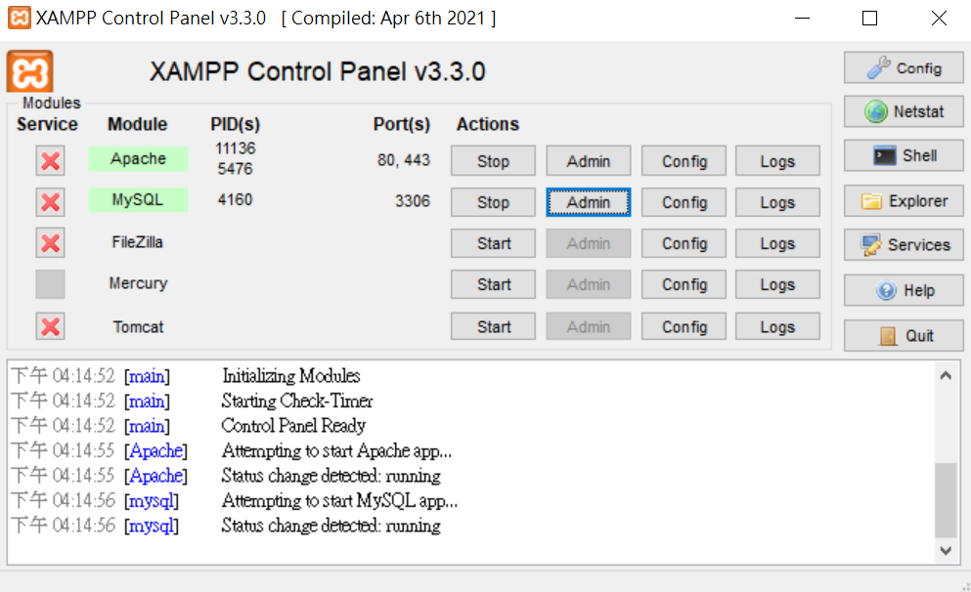
Click admin or enter 127.0.0.1 on your browser

Slide 12
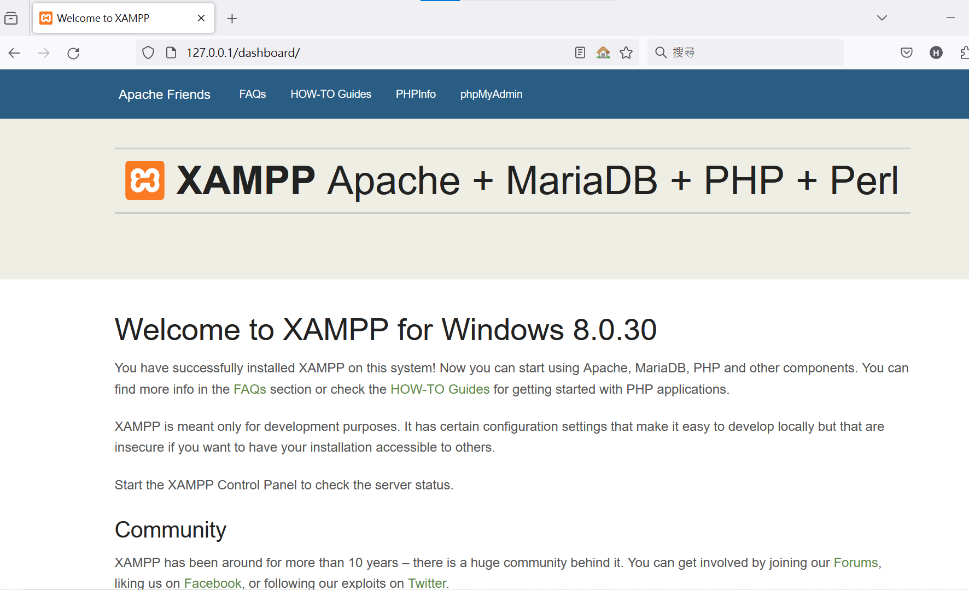

Slide 13
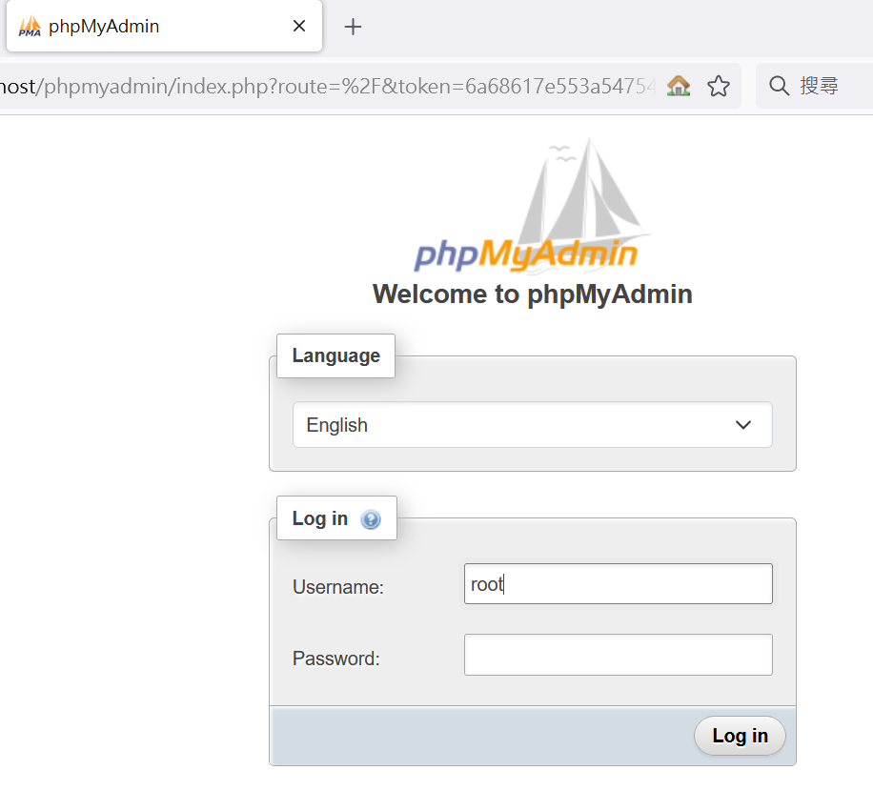

Slide 14
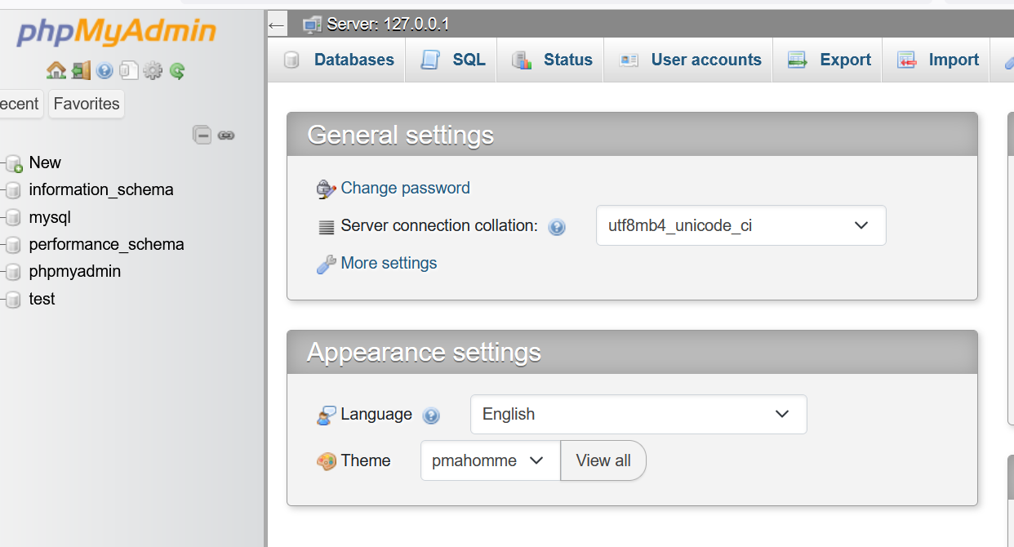

Slide 15
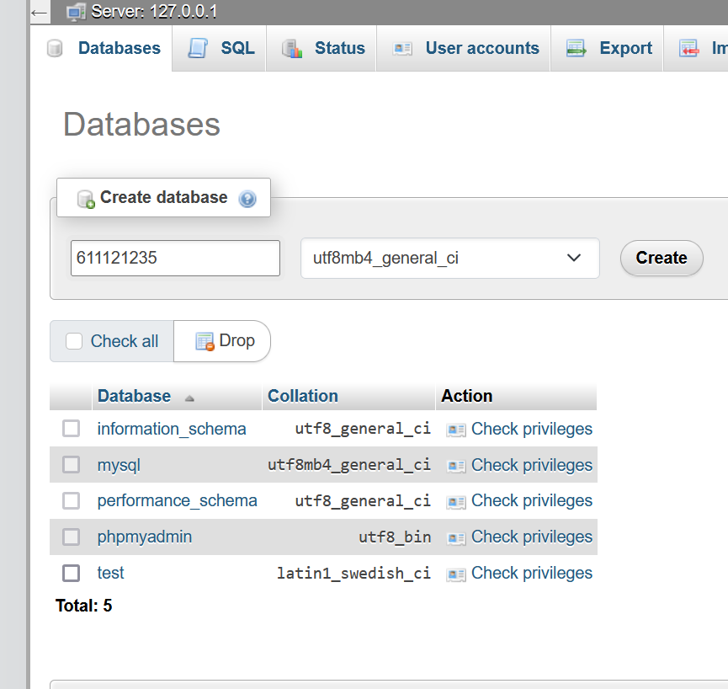
Your Student ID

Slide 16
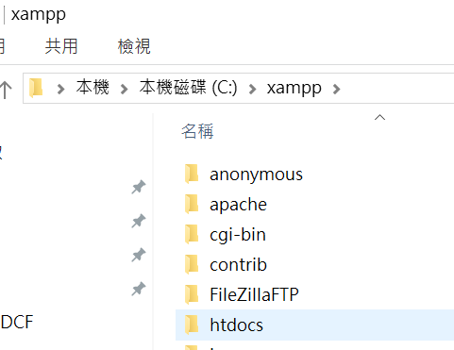
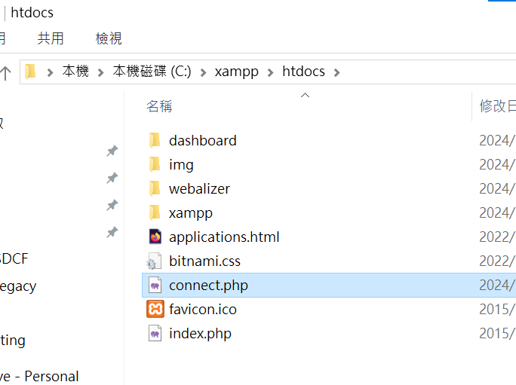
Create a file and name it as connect.php

Slide 17
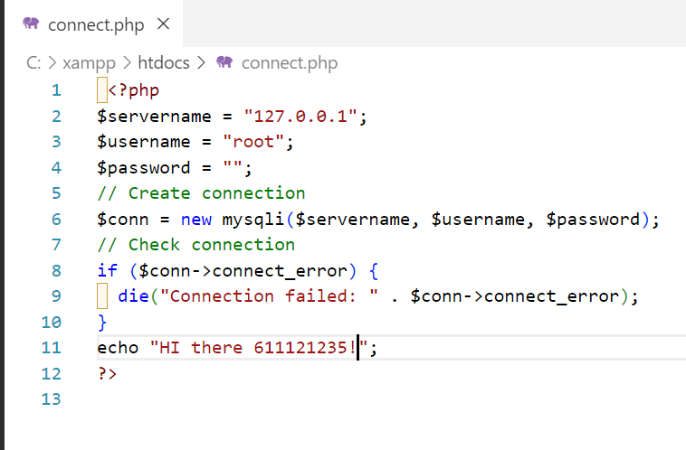
<?php
$servername = "127.0.0.1";
$username = "root";
$password = "";
// Create connection
$conn = new mysqli($servername, $username, $password);
// Check connection
if ($conn->connect_error) {
die("Connection failed: " . $conn->connect_error);
}
echo "Connected successfully";
?>
Change it to yours

Slide 18
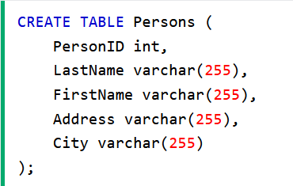
CREATE TABLE Persons (
PersonID int,
LastName varchar(255),
FirstName varchar(255),
Address varchar(255),
City varchar(255)
);

Slide 19
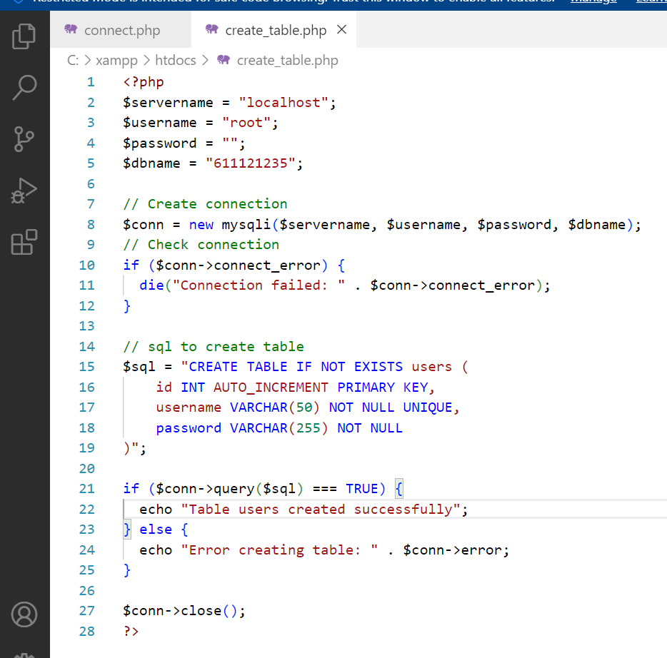
<?php
$servername = "localhost";
$username = "root";
$password = "";
$dbname = "611121235";
// Create connection
$conn = new mysqli($servername, $username, $password, $dbname);
// Check connection
if ($conn->connect_error) {
die("Connection failed: " . $conn->connect_error);
}
// sql to create table
$sql = "CREATE TABLE IF NOT EXISTS users (
id INT AUTO_INCREMENT PRIMARY KEY,
username VARCHAR(50) NOT NULL UNIQUE,
password VARCHAR(255) NOT NULL
)";
if ($conn->query($sql) === TRUE) {
echo "Table users created successfully";
} else {
echo "Error creating table: " . $conn->error;
}
$conn->close();
?>

Slide 20
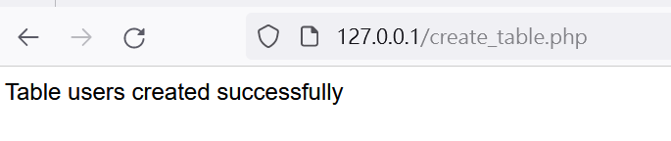
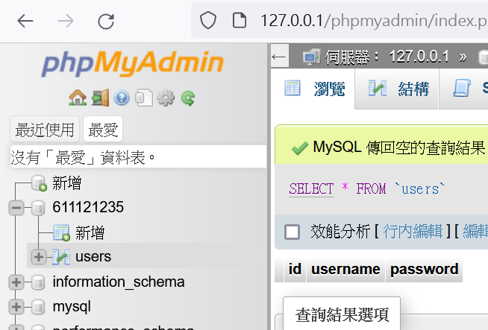

Slide 21
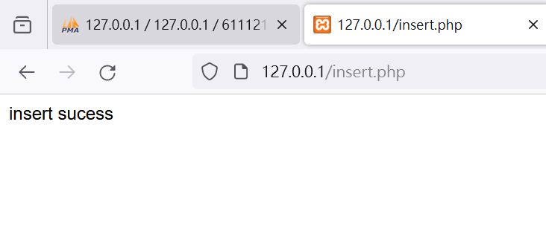
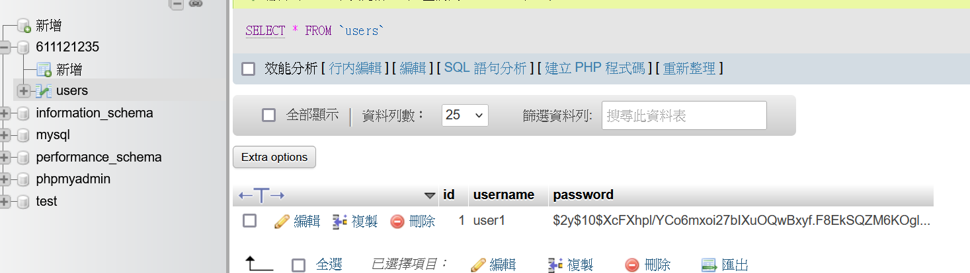

Slide 22
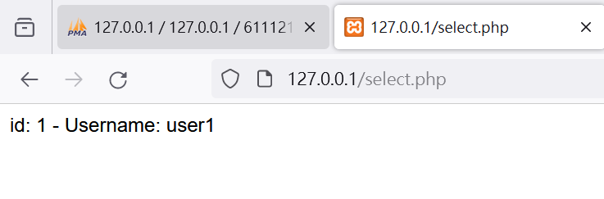

Slide 23
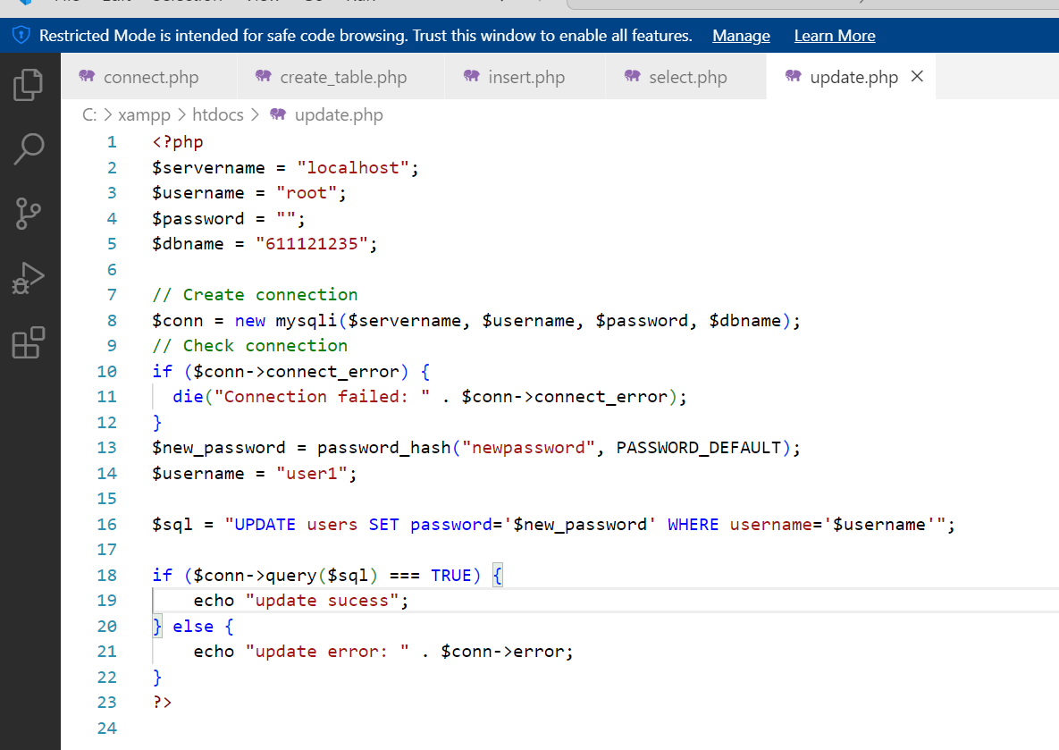
<?php
$servername = "localhost";
$username = "root";
$password = "";
$dbname = "611121235";
// Create connection
$conn = new mysqli($servername, $username, $password, $dbname);
// Check connection
if ($conn->connect_error) {
die("Connection failed: " . $conn->connect_error);
}
$new_password = password_hash("newpassword", PASSWORD_DEFAULT);
$username = "user1";
$sql = "UPDATE users SET password='$new_password' WHERE username='$username'";
if ($conn->query($sql) === TRUE) {
echo "update sucess";
} else {
echo "update error: " . $conn->error;
}
?>

Slide 24
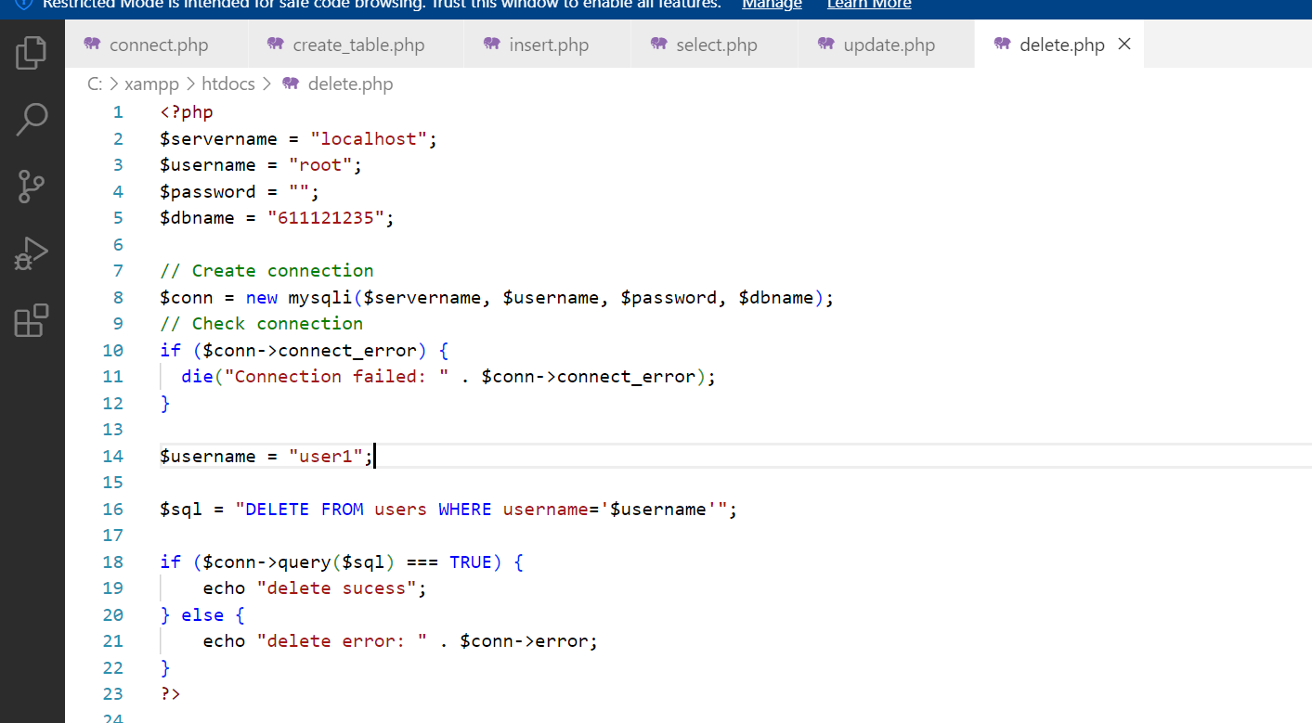
<?php
$servername = "localhost";
$username = "root";
$password = "";
$dbname = "611121235";
// Create connection
$conn = new mysqli($servername, $username, $password, $dbname);
// Check connection
if ($conn->connect_error) {
die("Connection failed: " . $conn->connect_error);
}
$username = "user1";
$sql = "DELETE FROM users WHERE username='$username'";
if ($conn->query($sql) === TRUE) {
echo "delete sucess";
} else {
echo "delete error: " . $conn->error;
}
?>

Slide 25
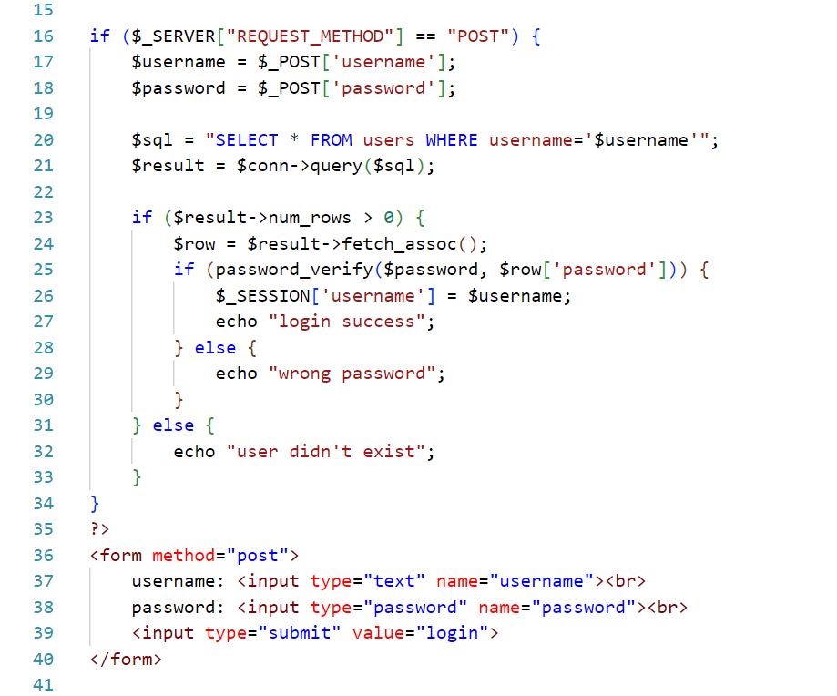
<?php
$servername = "localhost";
$username = "root";
$password = "";
$dbname = "611121235";
// Create connection
$conn = new mysqli($servername, $username, $password, $dbname);
// Check connection
if ($conn->connect_error) {
die("Connection failed: " . $conn->connect_error);
}
// $conn
session_start();
if ($_SERVER["REQUEST_METHOD"] == "POST") {
$username = $_POST['username'];
$password = $_POST['password'];
$sql = "SELECT * FROM users WHERE username='$username'";
$result = $conn->query($sql);
if ($result->num_rows > 0) {
$row = $result->fetch_assoc();
if (password_verify($password, $row['password'])) {
$_SESSION['username'] = $username;
echo "login success";
} else {
echo "wrong password";
}
} else {
echo "user didn't exist";
}
}
?>
<form method="post">
username: <input type="text" name="username"><br>
password: <input type="password" name="password"><br>
<input type="submit" value="login">
</form>

Slide 26
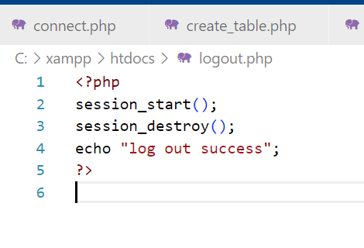
<?php
session_start();
session_destroy();
echo "log out success";
?>

Slide 27
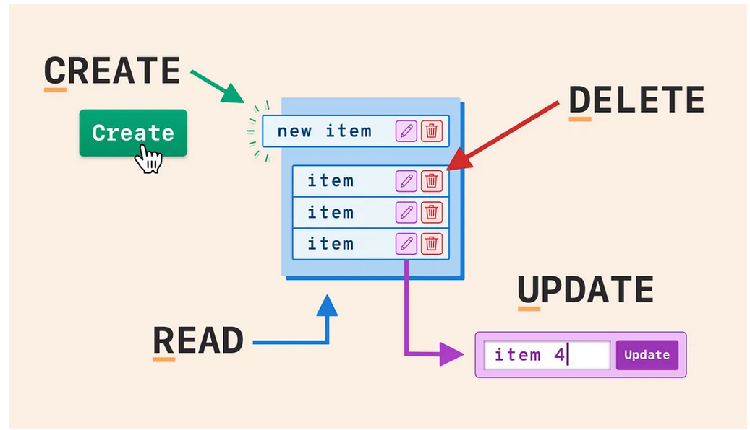
Design a web on your own
Must have CRUD
https://www.w3schools.com/php/default.asp

Slide 28
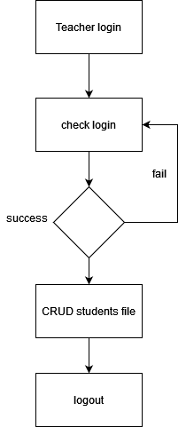
EXAMPLE

