Slide 1
ATTENDLY
Smart Attendance
Management System
Java Swing • JDBC • MariaDB
A desktop application to manage users, classes, attendance, and reports.
Project Presentation | Design, data model, workflow, and benefits

Slide 2
01 | Problem & Solution
Why an attendance management system is useful
THE PROBLEM
Manual registers and scattered records take time, are difficult to search, and make reporting error-prone.
THE SOLUTION
A desktop interface connected to a central MariaDB database keeps users, classes, enrolments, and attendance together.
THE OUTCOME
Staff can record attendance consistently, review history, and generate clear summaries.
02

Slide 3
02 | Objectives & Users
Designed around common classroom workflows
ADMIN
TEACHER
STUDENT
Manage user accounts and roles.
Maintain records and access.
View assigned classes.
Record and review attendance.
Student records connect to classes and attendance history.
CORE OBJECTIVES
PROJECT SCOPE
Reduce repetitive work; keep consistent records; make attendance easier to audit.
Java Swing desktop UI, JDBC database access, class enrolments, attendance CRUD, and reports.
03

Slide 4
03 | Main Features
The application is organized into clear modules
DASHBOARD
USERS
CLASSES
At-a-glance counts and attendance chart.
Create, edit, activate/deactivate, and remove users.
View classes and enrol students.
ATTENDANCE
REPORTS
Load enrolled students, set status, save, edit, or delete records.
Summaries and visual comparisons for attendance.
04

Slide 5
04 | How It Works
From class setup to attendance report
1
2
3
4
5
Set up users
→
Create classes
→
Enrol students
→
Record attendance
→
Review reports
Admin accounts and teacher/student roles
Assign a teacher to each class
Link students to the classes they attend
Choose class/date and mark present, absent, late, or excused
Use history and charts to understand attendance
05

Slide 6
05 | System Architecture
Simple separation between user interface and stored data
JAVA SWING UI
JDBC LAYER
MARIADB
Dashboard, user management, classes, attendance, reports.
→
Executes SQL queries and updates through the MariaDB driver.
→
smart_attendance database with relational tables and constraints.
Database constraints help preserve data integrity: unique emails, unique class codes, foreign keys, and one attendance record per student/class/date.
06

Slide 7
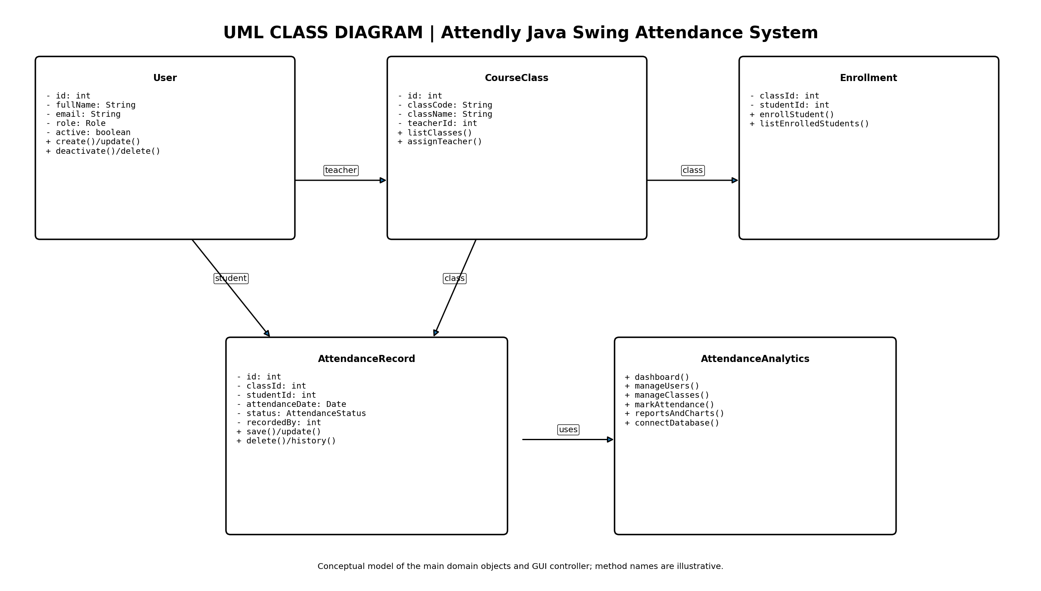
06 | UML Class Diagram
Conceptual classes and their main responsibilities
07

Slide 8
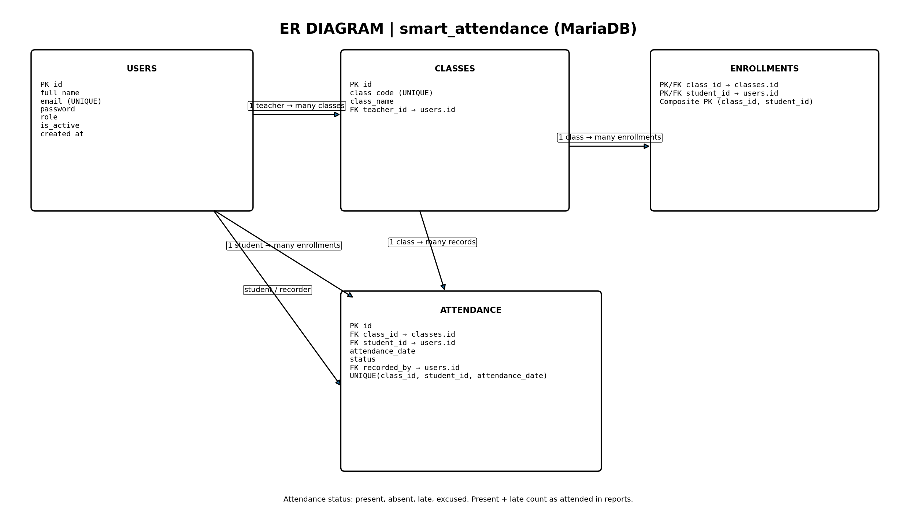
07 | Entity Relationship Diagram
Actual relational data model for smart_attendance
08

Slide 9
08 | Database Tables
Four connected tables store the main system data
users
Stores account details, role (admin/teacher/student), active flag, and creation time.
classes
Stores class code/name and the teacher responsible for the class.
enrollments
Join table linking a student to a class; class_id + student_id form the primary key.
attendance
Stores date and status; unique(class_id, student_id, attendance_date) prevents duplicate daily records.
09

Slide 10
09 | Attendance Rules & Reporting
Consistent statuses make reports meaningful
PRESENT
LATE
ABSENT / EXCUSED
Student attended the class.
Student attended but arrived late.
Absent is not attended. Excused is recorded separately.
REPORTING RULE
The current report logic counts Present + Late as attended. Confirm institutional policy before using the output for official decisions.
10

Slide 11
10 | Validation & Limitations
Checks that protect the records
DATABASE VALIDATION
Unique email and class code; foreign keys between classes, users, enrolments, and attendance.
DUPLICATE PROTECTION
A student cannot have two attendance records for the same class on the same date.
OPERATIONAL NOTE
Database credentials must be configured locally. User deletion may be blocked when related records exist; deactivate is safer.
11

Slide 12
THANK YOU
Questions?
Attendly brings class management, attendance recording, and reporting into one connected workflow.
BUILT WITH
DATABASE
FOCUS
Java Swing + JDBC
MariaDB
Reliable records

