Slide 1


A Basic Introduction to SFold
Kevin MacDonald
December 7, 2004
BI420 Final Presentation

Slide 2
Introduction to Gene Knockout
One method of studying gene expression and function is through gene knockout. In this process the targeted gene is silenced (inactivated) and the results are studied.
One effective way in which genes are knocked out is through the use of small interfering RNAs (siRNAs), antisense oligonucleotides and trans-cleaving ribozymes. This is called RNA interference, RNAi.
RNAi works by introducing siRNA, which are about 21 nucleotides long, at the post-transcriptional phase to mRNA. The double-stranded siRNA induces gene silencing and is homologous to the gene to be silenced.

Slide 3
RNAi continued
Problems with RNAi
siRNA has a short life span due to lack of stability
Lack of potency and effectiveness due to poor design of siRNAs and oligonucleotides
Cost Efficiency
Solutions
Increase lifespan of siRNA through conformational change: linear siRNA short hairpin RNA (shRNA)
Increase potency and cost efficiency through better design
-use of Target Accessibility Prediction and GC content analysis
SFold provides an answer to all of these problems

Slide 4
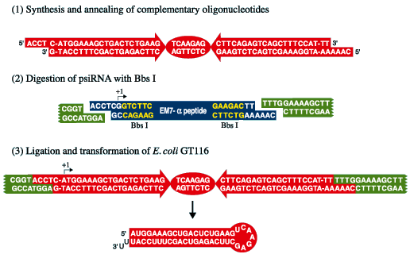
siRNA production (InvivoGen)

Slide 5
Basics of SFold
Developed by Ye Ding and Charles Lawrence of the Wadsworth Center, New York State Department of Public Health
SFold is a software package that allows for Target Accessibility Prediction and rational design of siRNAs, antisense oligonucleotides and trans-cleaving ribozymes. It also provides general features and output for statistical RNA folding.
How does SFold work?
-SFold uses a target accessibility algorithm combined with other algorithms that take into account empirical rules for siRNA design (such as Tuschl’s rules) as well as RNA duplex thermodynamics

Slide 6
SFold Functions: siRNA
siRNA- performs target accessibility prediction and RNA duplex thermodynamics for siRNA design
Input for siRNA: DNA sequence in either Plain Sequence, FASTA or GenBank format
Output includes: Probability Profile of Accessibility Prediction, Loop Profiling, Internal Stability Profiling and siRNA score.
-siRNA score indicates the potency of the designed siRNA (max score = 20)
-SEE EXAMPLE USING Human Insulin Growth Factor II (NM 006546)

Slide 7
SFold Functions: sOligo
The function of sOligo is very similar to that of siRNA. Algorithms that take account of binding strength, GC content and avoidance of GGGG motifs are used to design antisense oligonucleotides.
Input is the same as for sRNA
Output includes graphical accessibility prediction profiles, listings of target sequences and antisense oligonucleotides, GC content and oligo binding energies

Slide 8
SFold Functions: sRibo and sRNA
sRibo is used to design trans-cleaving ribozymes for RNAi
-Output includes graphical representation of ribozyme cleavage site probability
sRNA provides general features for statistical RNA folding
-Output includes graphical representation of the RNA molecule based upon free-energies

Slide 9
How does SFold solve the problems of RNAi?
SFold is the first program to take into account various aspects of RNA targeting nucleic acids into account
-by analyzing target accessibility and GC content, it provides a better probability of designing a more potent siRNA or antisense oligonucleotide
However, SFold is not perfect by any means and its authors suggest using SFold along with a number of other methods when designing siRNAs
-Currently there are studies being carried out to verify the predictions made by SFold, as well as to add to its functions

Slide 10
References
http://sfold.wadsworth.org/index.pl
Ding, Y. and Lawrence, C.E. (2004) Rational design of siRNAs with the Sfold software. In RNA Interference: from Basic Science to Drug Development, ed. Krishnarao Appasani, Cambridge University Press.
Ding, Y. (2002) Rational statistical design of antisense oligonucleotides for high throughput functional genomics and drug target validation. Statistica Sinica 12, 273-296.
http://www.invivogen.com/siRNA/siRNA_overview.htm

