Slide 1
Predict Loan Default with Tree-Based Models
maycd

Slide 2
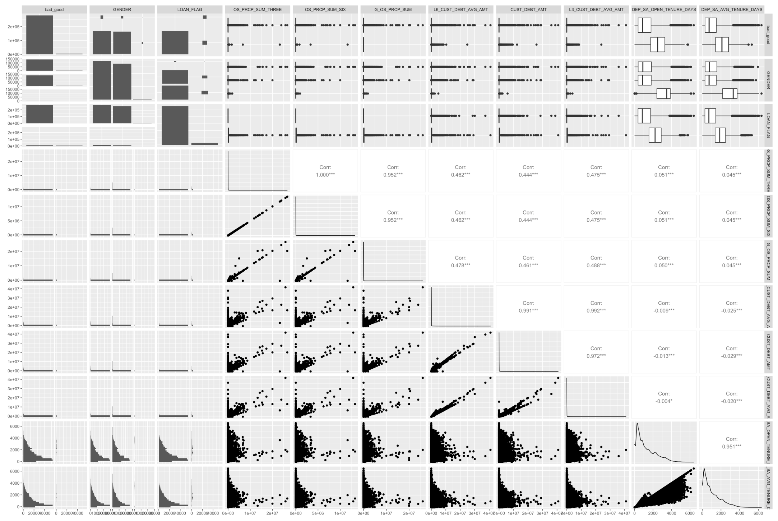
1. Data Preprocessing & Model Training
All 285,285 obs
1 target: bad_good
10 out of 626 selected features
Data preprocessing: convert data type, EDA, stratified sampling, normalize & standardize numeric, one-hot encoding nominal
Model training: fit random forest, basic GBM, XGBoost
Performance metric: 10-fold CV error

Slide 3
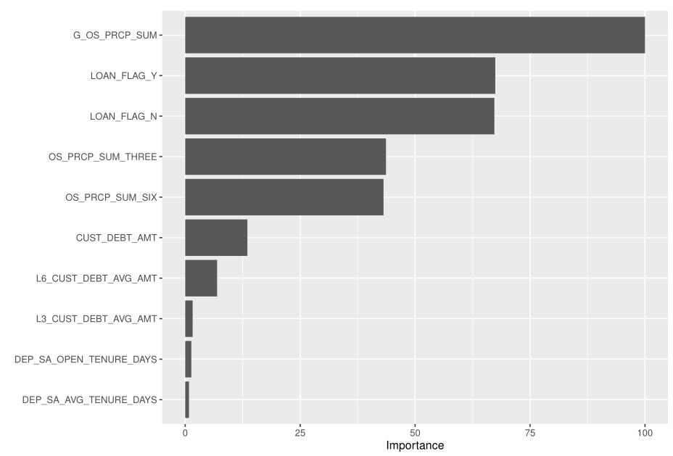
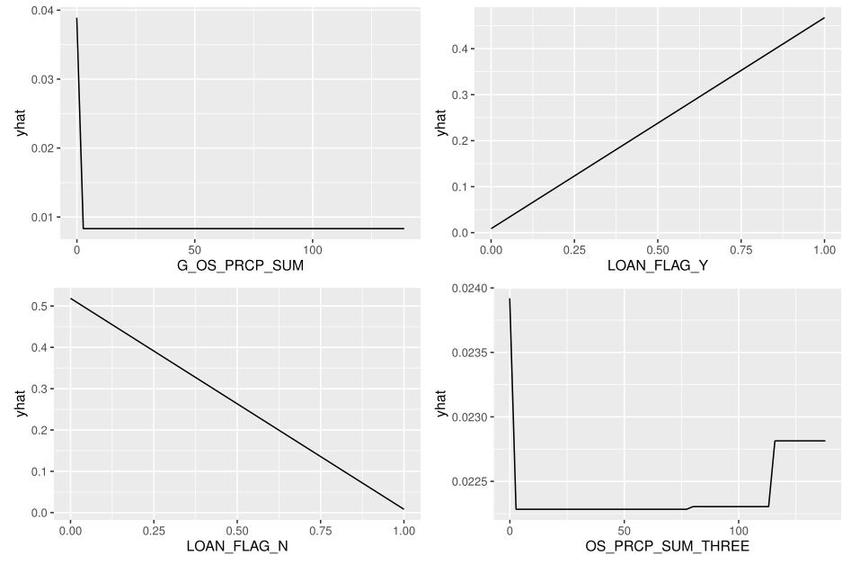

2.1 Random Forest
CV error = $7.80×{10}^{−6}$ -> $4.11×{10}^{−6}$ after tuning by full cartesian grid search, mtry = 6, min.node.size = 3, replace = FALSE, and sample.fraction = 0.80
Gross outstanding sum
Loan flag Y
Loan flag N
OS 3mths
Gross OS
Loan flag Y
OS 6mths
Loan flag N
OS 3 mths

Slide 4
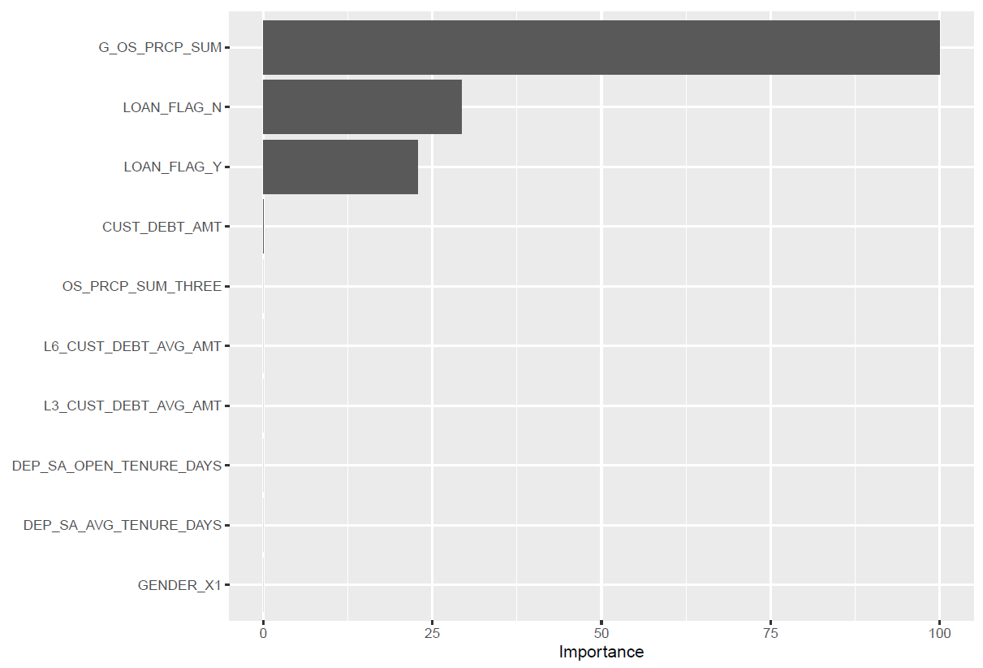
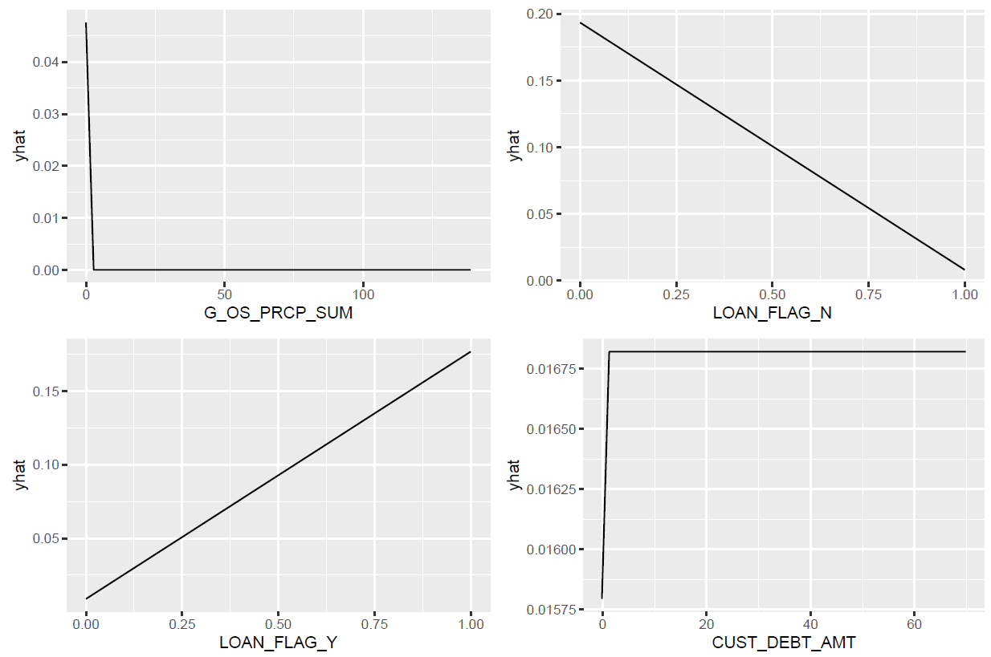

2.2 Basic GBM
CV error = $2.51×{10}^{−4}$, (default) shrinkage = 0.1, interaction.depth = 5, n.minobsinnode = 10, (n.trees = 3000, best n.trees around 600)
Gross outstanding sum
Loan flag N
Loan flag Y
Debt amount
Gross OS
Loan flag N
Loan flag Y
Debt amount

Slide 5
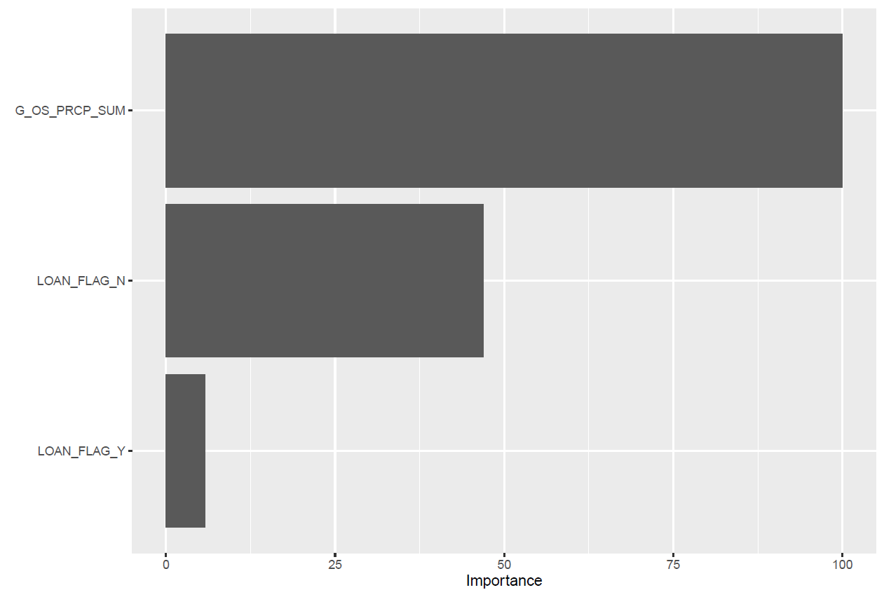
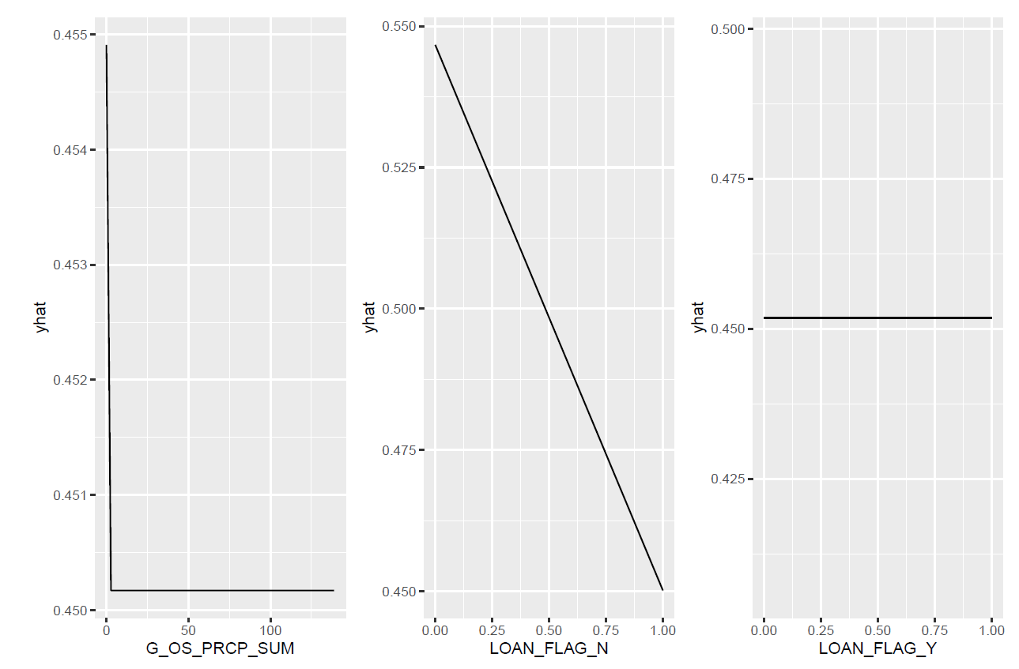
2.3 XGBoost
CV error = 0, default (gamma = 0, lambda = 1, alpha = 0)
Gross outstanding sum
Loan flag N
Loan flag Y
Loan
flag N
Loan
flag Y
Gross OS

Slide 6
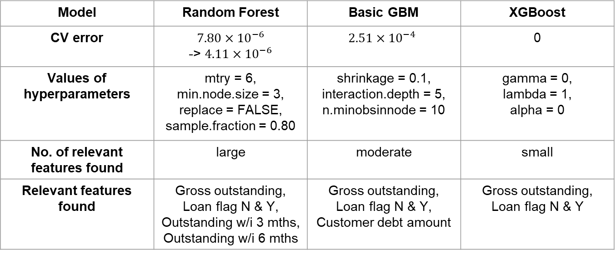
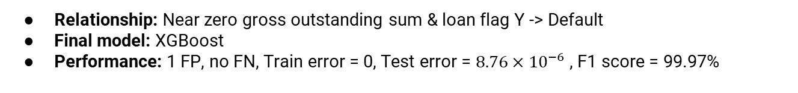
3. Comparison & Final Model
Model | Random Forest | Basic GBM | XGBoost
CV error | $7.80×{10}^{−6}$ -> $4.11×{10}^{−6}$ | $$2.51×{10}^{−4}$$ | 0
Values of hyperparameters | mtry = 6, min.node.size = 3, replace = FALSE, sample.fraction = 0.80 | shrinkage = 0.1, interaction.depth = 5, n.minobsinnode = 10 | gamma = 0, lambda = 1, alpha = 0
No. of relevant features found | large | moderate | small
Relevant features found | Gross outstanding, Loan flag N & Y, Outstanding w/i 3 mths, Outstanding w/i 6 mths | Gross outstanding, Loan flag N & Y, Customer debt amount | Gross outstanding, Loan flag N & Y
Relationship: Near zero gross outstanding sum & loan flag Y -> Default
Final model: XGBoost
Performance: 1 FP, no FN, Train error = 0, Test error = $8.76×{10}^{−6}$ , F1 score = 99.97%

Slide 7
Thanks

