Slide 1
Predicting House Prices for King County House Data by Tree-Based Methods
maycd

Slide 2
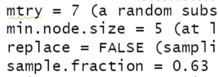


RF
GBM
XGB
0.0792796
Tune
0.07912199
0.0742174
Tune shrinkage = 0.05
0.07382686
Tune interaction.depth = 7, n.minobsinnode = 5
0.07293927
0.072148, 221.6 sec
Tune 8 hrs
0.0719843

Slide 3
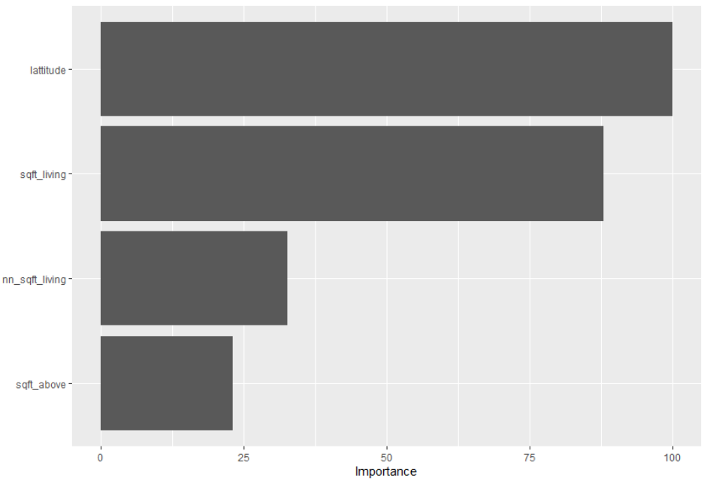
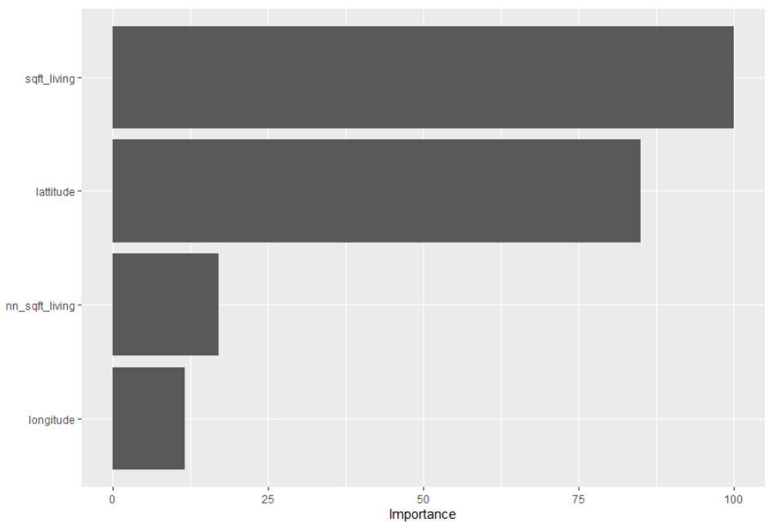
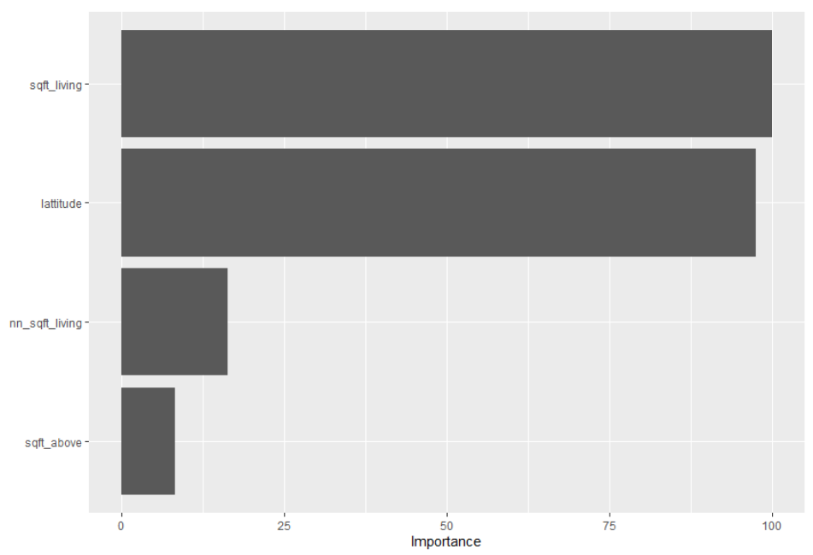
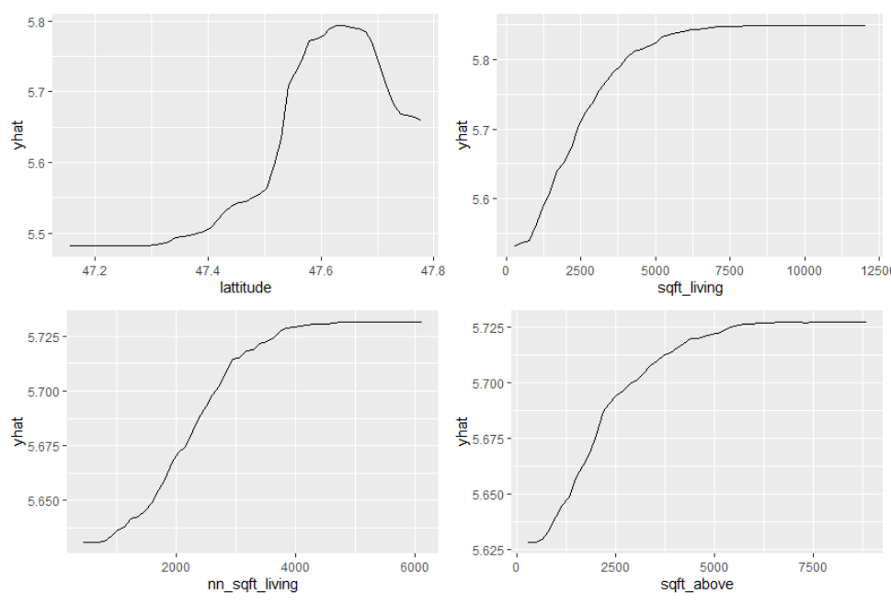
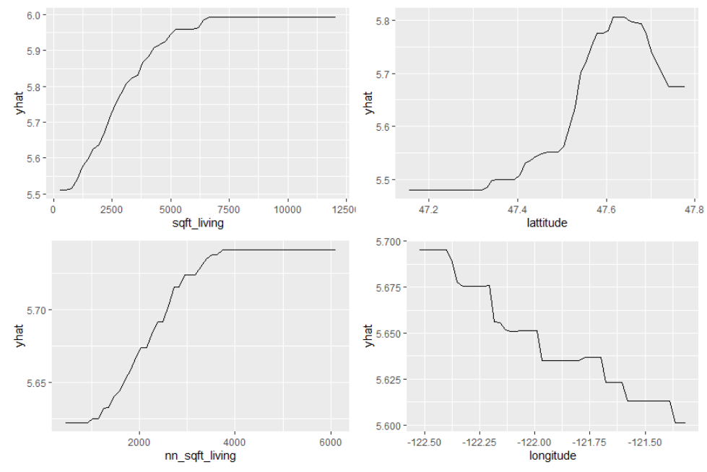
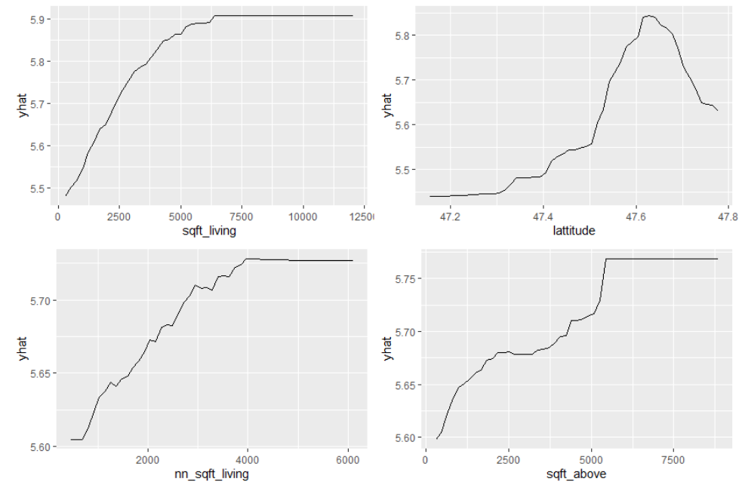
RF
GBM
XGB
lattitude
sqft_living
sqft_living
sqft_living
lattitude
lattitude
nn_sqft_living
nn_sqft_living
nn_sqft_living
sqft_above
longitude
sqft_above
lattitude
sqft_living
sqft_living
lattitude
sqft_living
lattitude
nn_sqft_living
sqft_above
nn_sqft_living
longitude
nn_sqft_living
sqft_above

