Slide 1
Introduction to Python & Apps
Final Project Presentation
October 2023

Slide 2
MoSCoW Method
Must Have:
Total sales across all months
Read the data from the spreadsheet
List of all sales from each month
Should Have:
Highest sales month and lowest sales month
Average sales
Monthly changes as a percentage
A summary of the results in a spreadsheet
Could Have:
Sales margin and profit
Graphs
Plots
Won’t Have:
Use a data source from a different spreadsheet
Statistics
Calculate Outliers

Slide 3
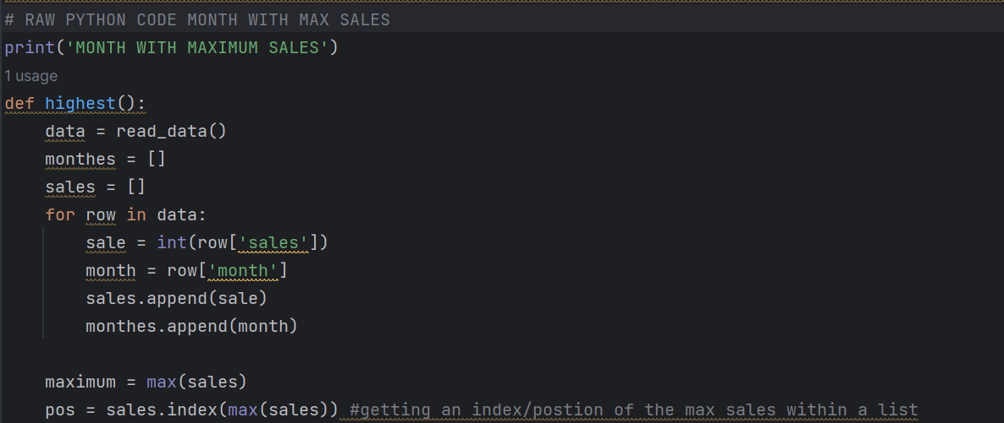
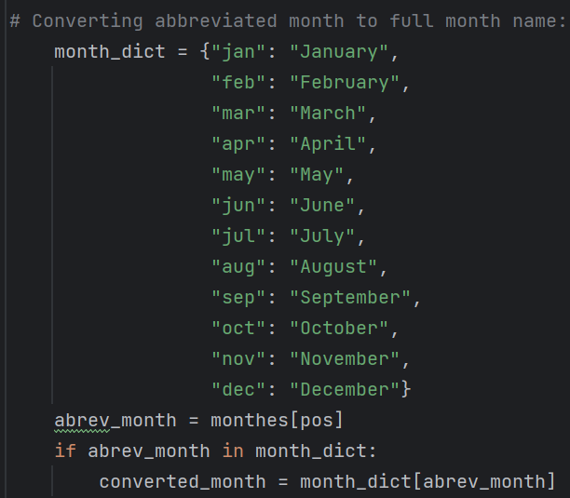
Month With the Highest Sales: Raw Python Code
OUTPUT

Slide 4
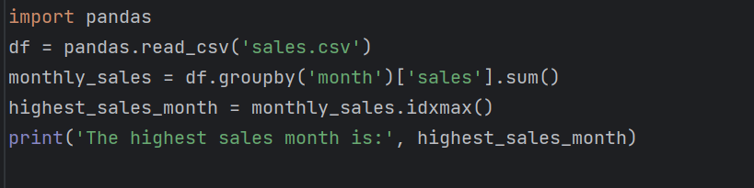
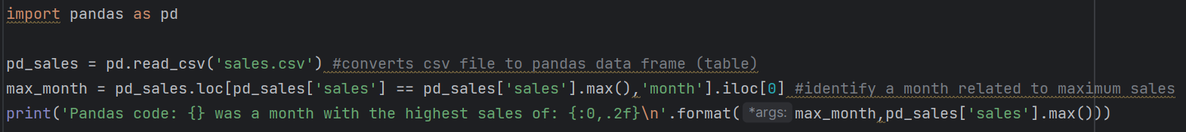
Month With the Highest Sales: Pandas Codes
1st version:
2nd version:

Slide 5
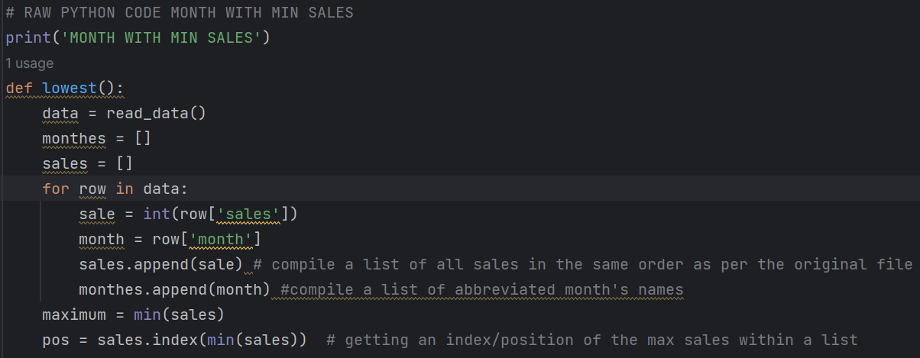
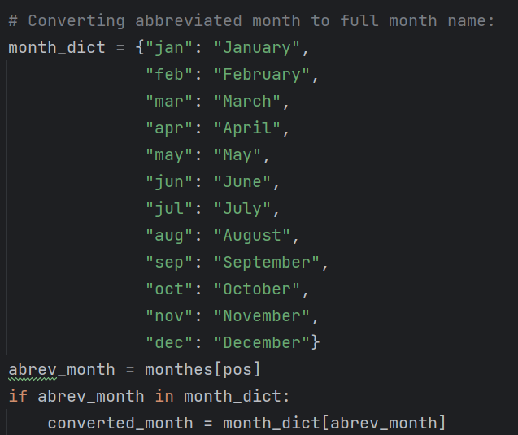
Month with the Lowest Sales

Slide 6
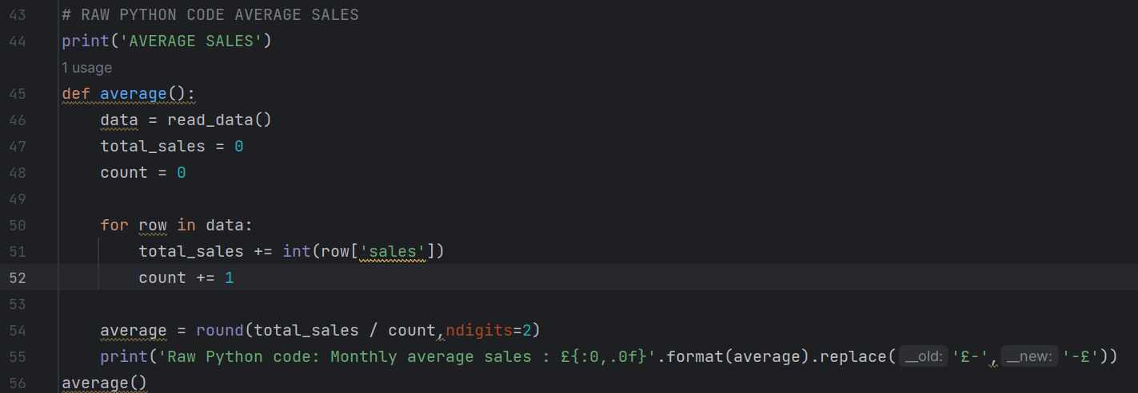
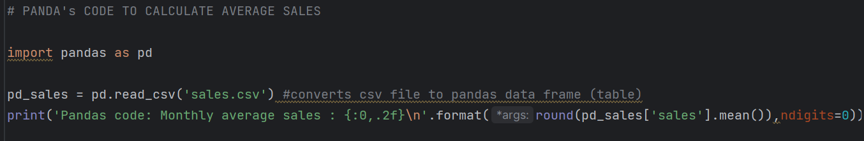
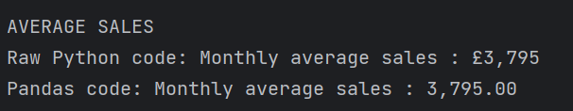
Average Sales
Pandas Version

Slide 7
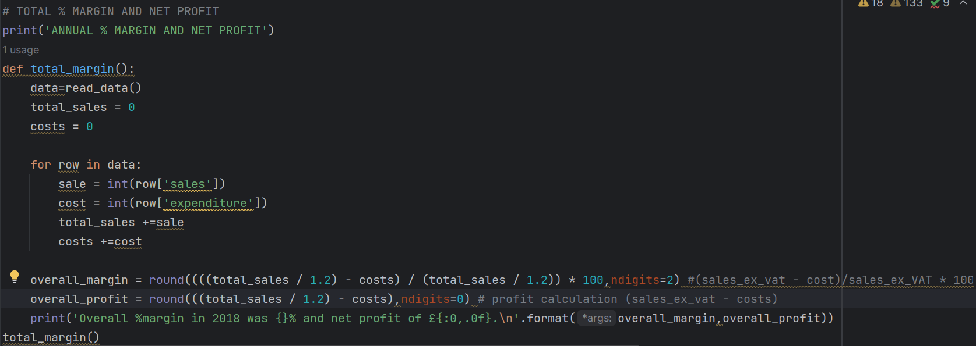

Total Sales % Margin and profit
OUTPUT

Slide 8
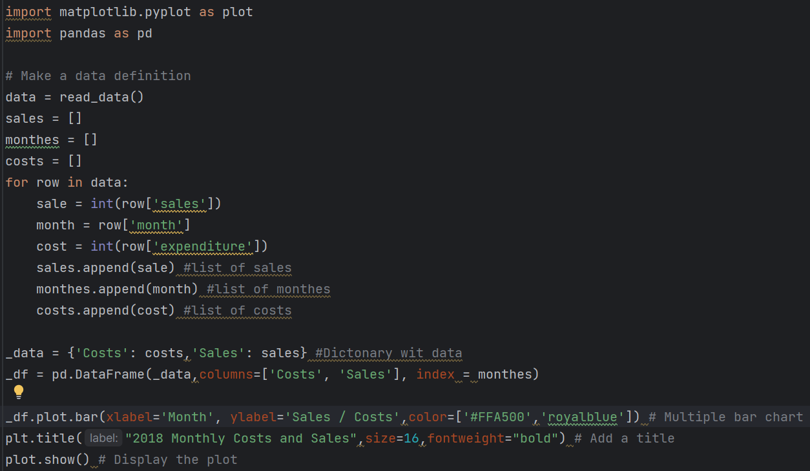
Monthly Costs and Sales Chart

Slide 9
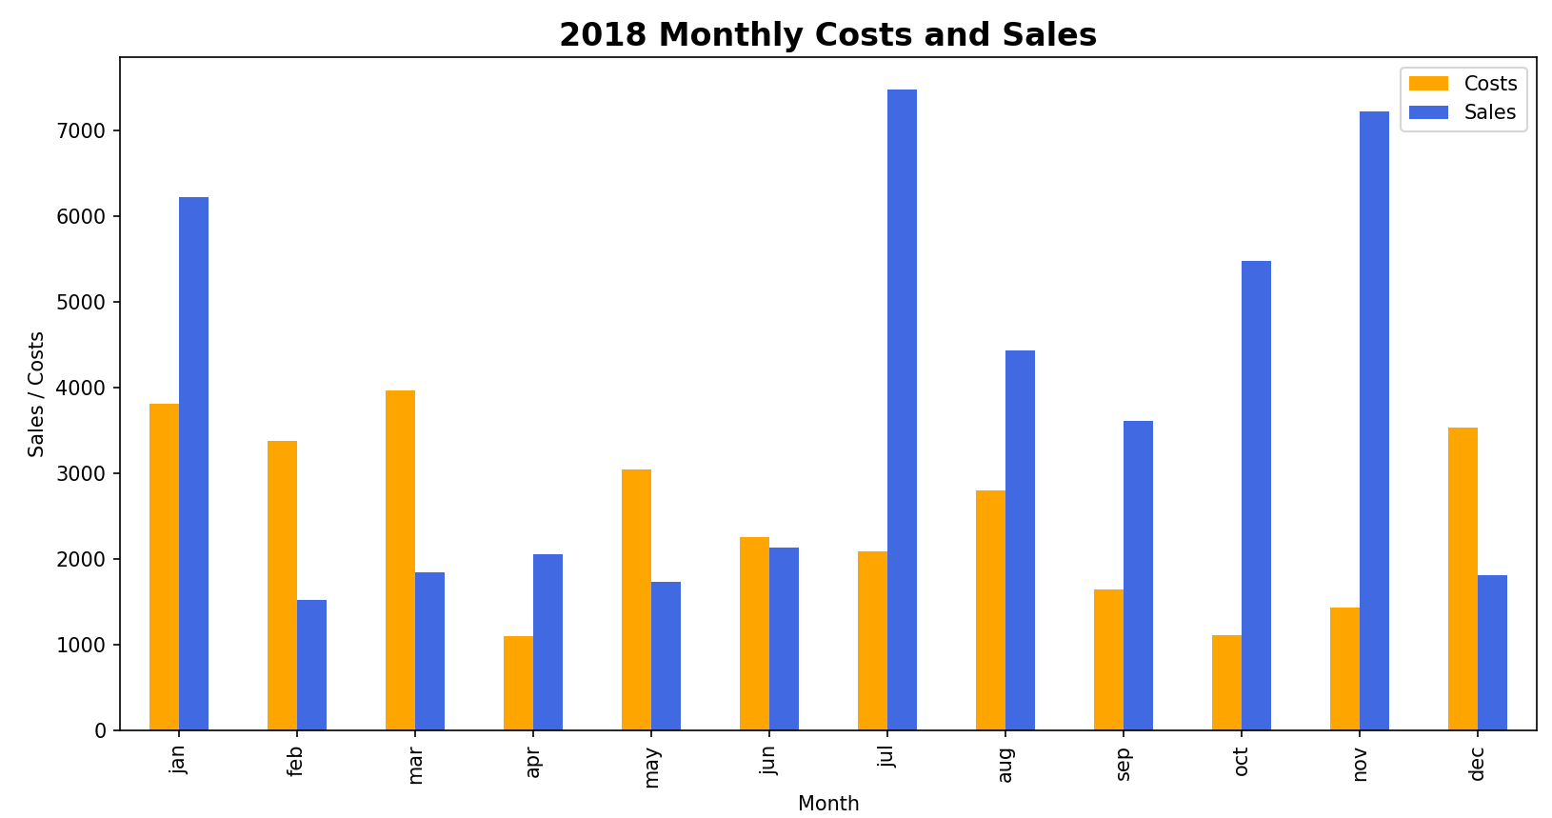

Slide 10
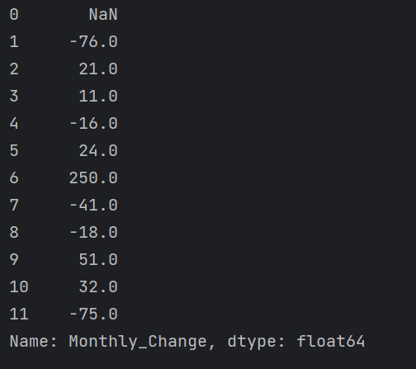
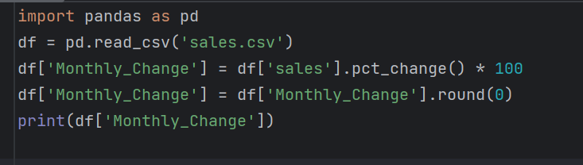
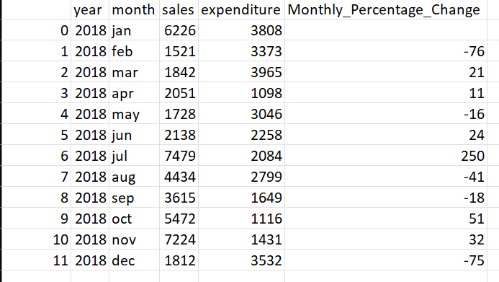
Monthly Sales Difference Pandas Version
Export Results to CSV file

Slide 11
Thank You!

