Slide 1
FINAL PROJECT · MACHINE LEARNING
Customer Churn Prediction
for Subscription Businesses
AT-RISK CUSTOMER
94.9%
Using machine learning to retain more and earn more
churn probability
HIGH RISK
Mayda Morales Harbour Space
→ personal outreach + retention offer
Notes:
Final defense of the churn prediction project. We predict which subscribers will cancel within 30 days so the retention team can act early. On the right is the live demo we will run at the end.

Slide 2
DOMAIN
Subscription businesses run on recurring revenue
1
2
3
SaaS & cloud tools
Content & media
Wellness & apps
Monthly or annual seats; revenue depends on customers renewing, not buying once.
Streaming, news, learning platforms billed on a rolling subscription.
Fitness, meditation, habit apps with recurring memberships.
The shared challenge
Growth is not just about acquiring users — it is about keeping them. When customers cancel silently, recurring revenue erodes and the business must keep buying new users just to stand still.
Notes:
Our domain is subscription businesses — SaaS, content, wellness. They all live on recurring revenue, so keeping customers matters as much as acquiring them.

Slide 3
THE PROBLEM & WHY IT MATTERS
Silent churn quietly drains recurring revenue
Problem statement
Why it matters
Customers cancel with little warning. By the time churn shows up in the numbers, the revenue is already gone and win-back is expensive.
Retention is far cheaper than acquisition.
A 5% lift in retention can raise profits 25–95% (Reichheld & Sasser, 1990).
~5%
12 mo
20%
monthly churn
revenue lost
reduction target
in a healthy subscription business
per churning customer, on average
relative — our business goal
Notes:
The problem is silent churn. It matters because retaining a customer is far cheaper than acquiring a new one — a 5% retention lift can raise profits 25 to 95%. Our goal: cut monthly churn by 20% relative.

Slide 4
MACHINE LEARNING FORMULATION
A supervised, time-aware classification problem
Task
Supervised binary classification
Target
churn_30d — will the customer cancel within 30 days? (1 / 0)
Inputs
Profile + subscription + behavioural engagement signals, known up to today
Primary metric
F2-score — weights recall higher (missing a churner costs more than a false alert)
Secondary
AUC for overall discriminative power
Validation
Time-based split — train on the past, test on the future (no data leakage)
Why F2? F2 blends recall and precision but weights recall ~4× higher — because missing a churner (≈12 months of lost revenue) costs far more than sending a loyal customer an unneeded offer.
Notes:
Formally: supervised binary classification. Target is whether a customer cancels within 30 days. We optimise F2 because recall matters more than precision here — missing a churner costs far more than a false alert — and we validate on a time-based split to mimic production and avoid leakage.

Slide 5
SOLUTION OVERVIEW
An end-to-end pipeline, from raw data to action
1
2
3
4
5
Data
›
Model
›
Evaluate
›
Explain
›
Act
Public Telco base adapted to a SaaS scenario + engagement features
SMOTE for imbalance; Logistic Reg., Random Forest, XGBoost
F2-tuned threshold; AUC, recall, precision on a future test set
SHAP shows why each customer is flagged
Weekly batch scores → risk tiers → retention actions
Deliverables: reproducible pipeline (Python) · executed notebook · trained model · interactive web demo
Notes:
The solution is a full pipeline: adapt the data, handle imbalance and train several models, evaluate on a future test set, explain predictions with SHAP, and turn weekly scores into concrete retention actions.

Slide 6
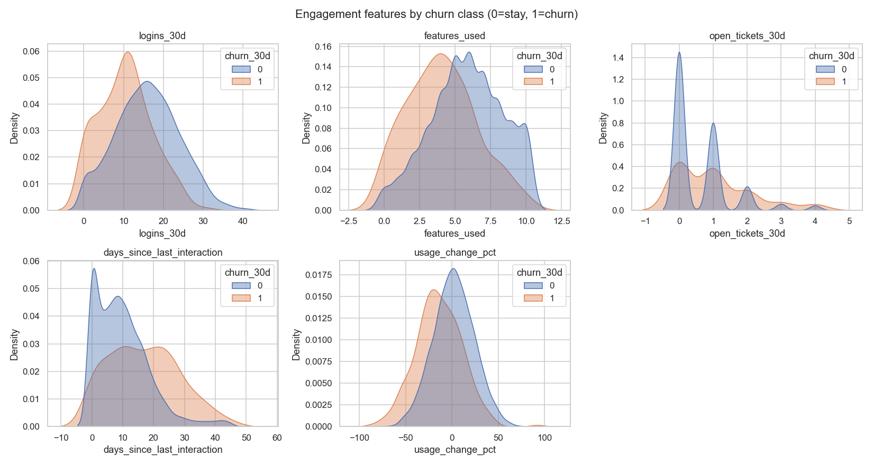
DATASET
Real public data, adapted to a SaaS scenario
Base: Kaggle Telco Customer Churn — 7,043 real, labelled customers.
Adapted: columns reinterpreted (tenure → months subscribed, contract → plan).
Engagement: 5 behavioural features (logins, features used, tickets, recency, usage trend).
Realism: churn downsampled to 5% → final 5,446 customers, ~25 features.
Honest note: engagement features are synthetic but literature-grounded; production would use real telemetry (see feature notes in the repo).
Notes:
We start from the real Kaggle Telco dataset and adapt it to a subscription scenario, adding five engagement features the literature flags as the strongest churn signals, then downsample to a realistic 5% churn. The chart shows churners and non-churners separate on these behaviours.

Slide 7
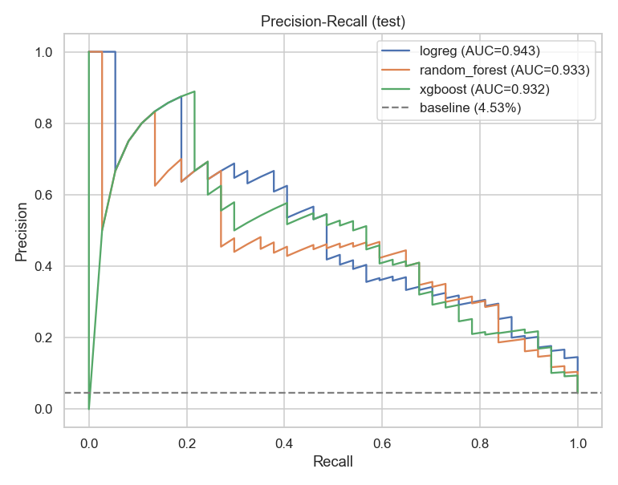
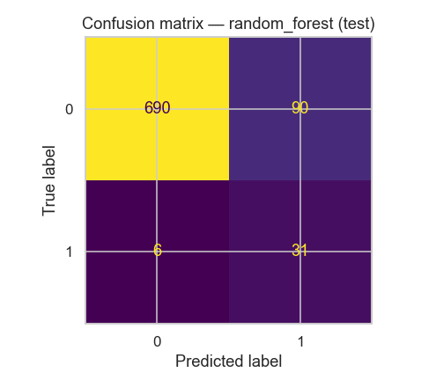
MODELING & RESULTS
Meets the targets: AUC ≈ 0.93, churner recall ≈ 0.84
Model
F2
AUC
Recall
Logistic Reg.
0.56
0.94
0.87
Random Forest ★
0.58
0.93
0.84
XGBoost
0.53
0.93
0.78
★ marks the pick — Random Forest wins on F2 (our primary metric).
All three reach AUC ≈ 0.93 — they separate churners from non-churners well.
High recall (0.84) — catches 84% of the customers who will leave.
F2 is recall-weighted. Low precision (~0.26) is expected at a 5% base rate with a recall-first threshold.
Notes:
Three models trained. Random Forest is the best by F2. It hits the proposal targets — AUC around 0.93 and churner recall around 0.84. Precision is low, which is normal at a 5% base rate when we deliberately favour recall; the PR curve and confusion matrix show the trade-off.

Slide 8
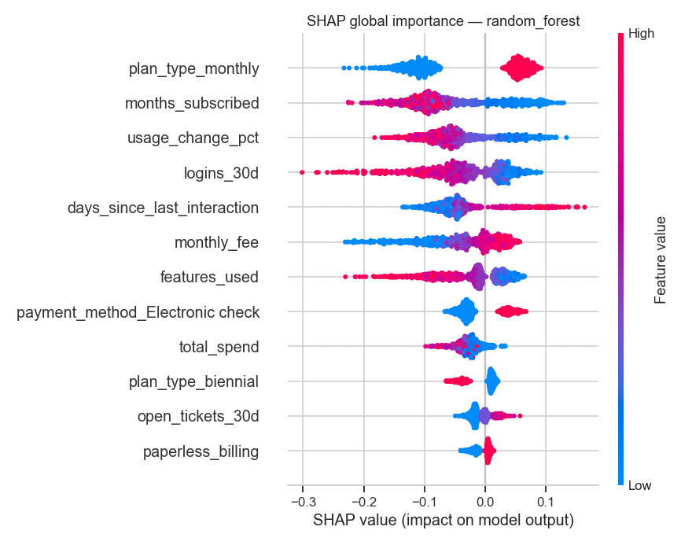
INTERPRETABILITY
SHAP tells the team why a customer is at risk
Actionable, not a black box
Every score comes with the features that drove it.
Top drivers match the domain
Plan type, tenure, usage trend, logins and recency.
Personalised interventions
The success team tailors the offer to the actual reason.
Notes:
Interpretability is non-negotiable for a retention team. SHAP shows, per customer, which features push the risk up or down — and the top drivers line up with the domain, so interventions can be personalised.

Slide 9
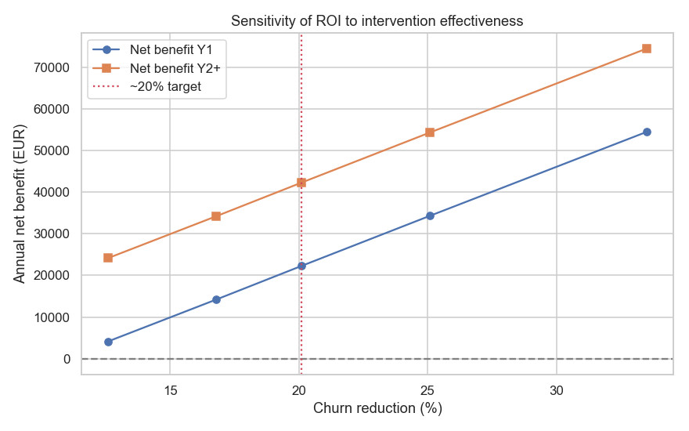
BUSINESS IMPACT & SENSITIVITY
The 20% target is derived, not assumed
churn reduction = recall × intervention success
0.84 × 24% ≈ 20%
€22K
€42K
net benefit · year 1
net benefit · year 2+
Sensitivity finding: because precision is low, we contact ~1,600/mo to save 100. Even €5 outreach cost per contact flips ROI negative — so precision / top-N targeting is the key lever.
Notes:
Addressing the reviewer feedback: instead of asserting 20%, we derive it — reduction equals recall times how often an intervention works. That gives the proposal's 22K first-year and 42K thereafter. The sensitivity analysis also exposes a real limitation: low precision means high outreach volume, so improving precision matters before scaling.

Slide 10
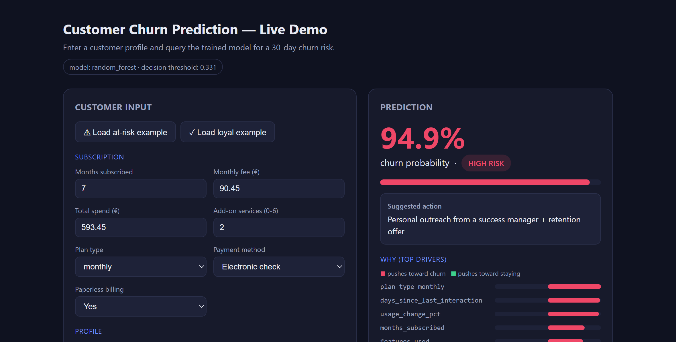
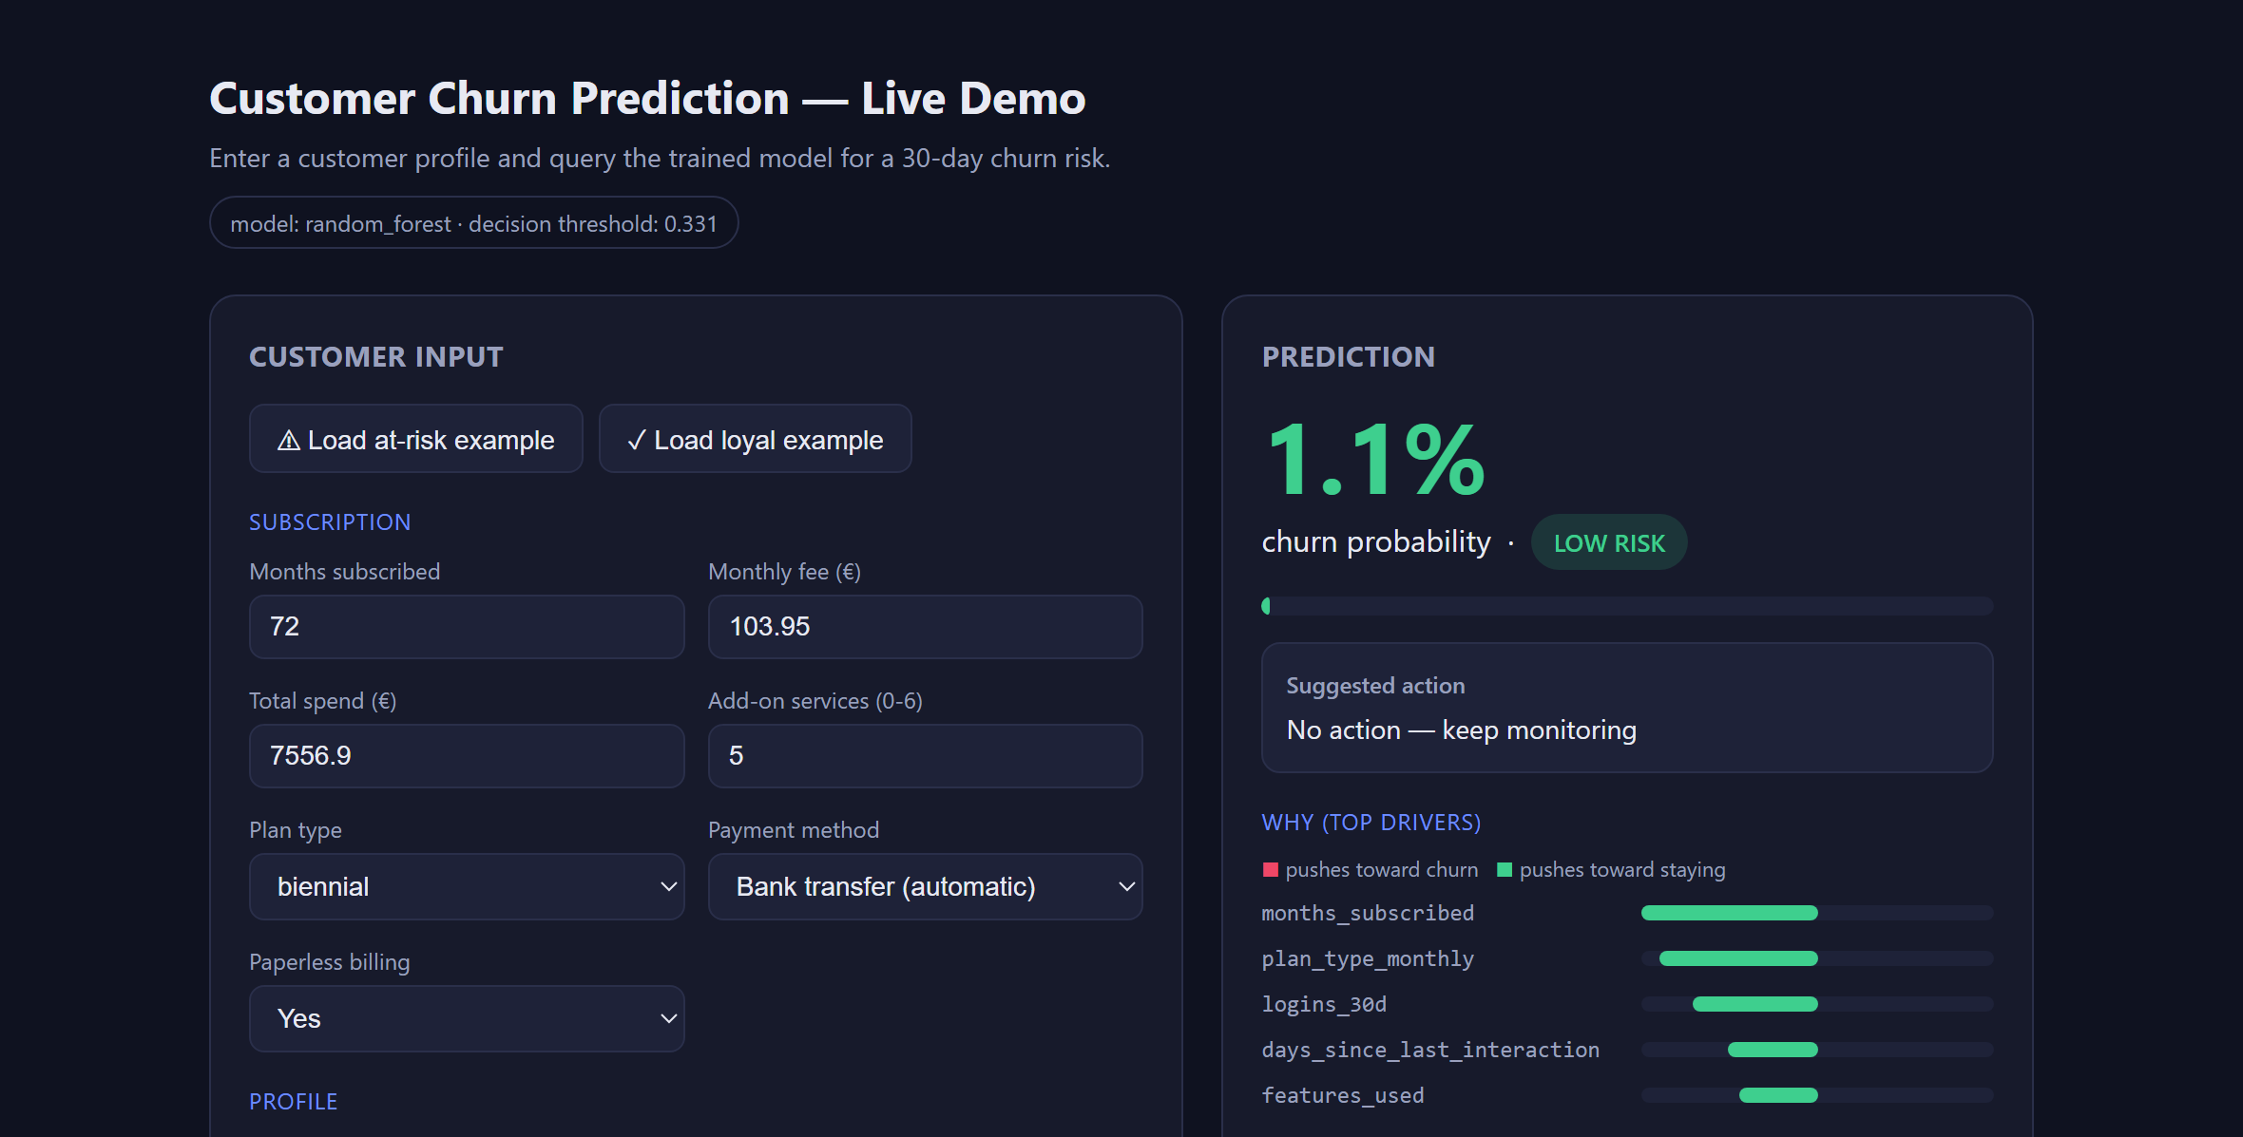
LIVE DEMO
Query the trained model in real time
At-risk customer → 94.9% · HIGH RISK
Loyal customer → 1.1% · LOW RISK
How it works: enter a customer → the model returns churn probability, a risk tier and a suggested action, with the top SHAP drivers explaining why. Run: python app.py → localhost:5000
Notes:
Now the live demo — the actual trained model served by a small Flask app. On the left, an at-risk customer: 94.9% churn, high risk, with the action and the SHAP drivers. On the right, a loyal customer: 1.1%, low risk, drivers pushing toward staying. I'll reproduce both live in the app.

Slide 11
CONCLUSION
Technically sound and financially attractive
What works
Next steps
Meets targets: AUC ≈ 0.93, recall ≈ 0.84
Pilot on 1,000 customers
Explainable (SHAP) and production-shaped
A/B test retention interventions
Derived, transparent ROI + sensitivity
Improve precision; cloud batch scoring
Source code: github.com/maydamv/customer-churn-prediction Thank you — questions welcome.
Notes:
To wrap up: the project meets its technical targets, is explainable and production-shaped, and has a transparent, stress-tested ROI. Next steps are a pilot, A/B testing the interventions, and improving precision before scaling. Code is on GitHub. Thank you.

