Slide 1
Intelligent Task Management System
AI Powered Productivity and Planning Solution
Name: Shreyas Rajendra Mayekar
Course Name : Programming using Python
Date: 12/05/2026

Slide 2
Problem Statement
Managing multiple daily tasks manually is difficult and time-consuming.
Users may forget deadlines and important tasks without proper tracking.
Traditional task management systems lack intelligent planning and productivity features.
Users face difficulty in prioritizing tasks and organizing schedules effectively.
There is a need for an AI-powered system that can manage tasks, analyze productivity, and provide smart recommendations.

Slide 3
Project Objective
To develop an intelligent task management system using Python.
To help users organize, update, and track daily tasks efficiently.
To provide productivity analysis using reports and task statistics.
To integrate AI features such as task prioritization, summaries, and daily planning.
To improve time management and productivity through smart recommendations and overdue task detection.

Slide 4
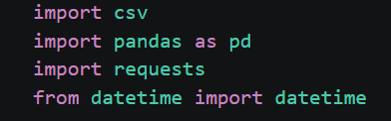
csv is used for reading and writing CSV files.
pandas is used for reports and data analysis.
requests is used to connect with the AI API.
datetime is used for date handling and overdue task checking.

Slide 5
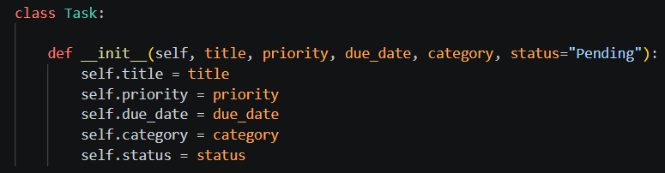
class Task is used to create a task structure.
__init__() is a constructor method that runs automatically when a task is created.
title, priority, due_date, category, and status are parameters used to receive task details.
self refers to the current object.
Similar statements store priority, due date, category, and status.
This code implements Object-Oriented Programming for organized task management.

Slide 6
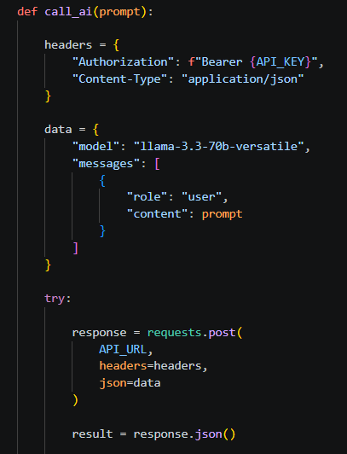
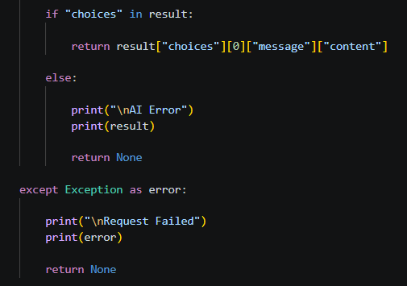
call_ai() is used to communicate with the AI model.
headers store API authentication details.
data contains the model name and user prompt.
requests.post() sends request to the AI API.
Response.json() converts API response into Python dictionary.
if "choices" in result checks whether response is valid.
AI-generated response is returned to the program.

Slide 7
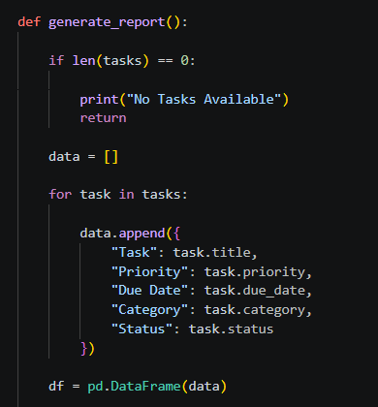
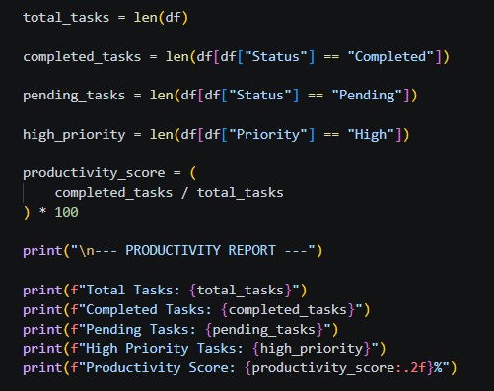
generate_report() creates a productivity report.
Task details are stored in a list.
pd.DataFrame(data) converts the data into table format.
Total, completed, and pending tasks are calculated.
Productivity score is calculated in percentage.
Final report is displayed to the user.

Slide 8
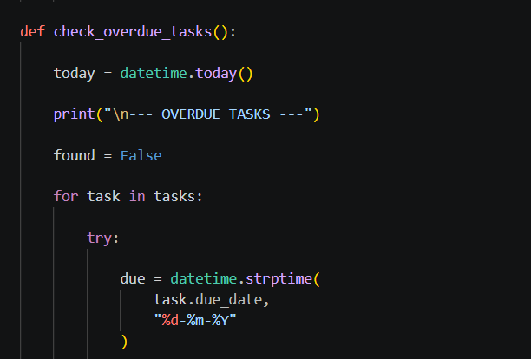
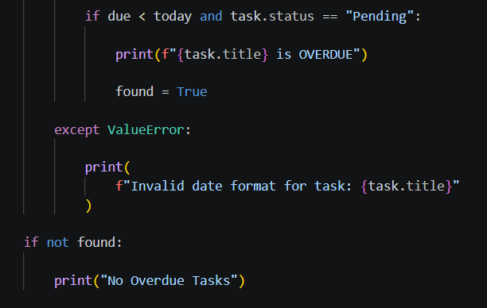
check_overdue_tasks() checks overdue tasks.
datetime.today() gets current date.
strptime() converts due date into date format.
Due date is compared with current date.
Pending tasks with expired dates are marked overdue.
try-except handles invalid date formats.

Slide 9
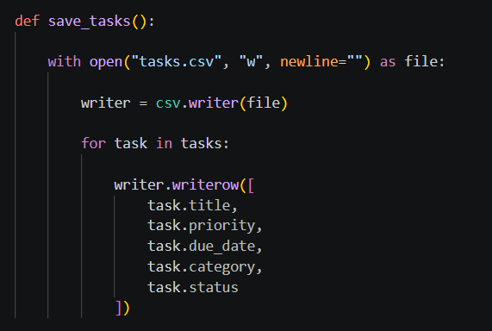
save_tasks() stores task data into a CSV file.
open() opens the file in write mode.
csv.writer() is used to write data into the CSV file.
for task in tasks accesses all tasks one by one.
writer.writerow() stores task details into the file.
This helps save data permanently.

Slide 10
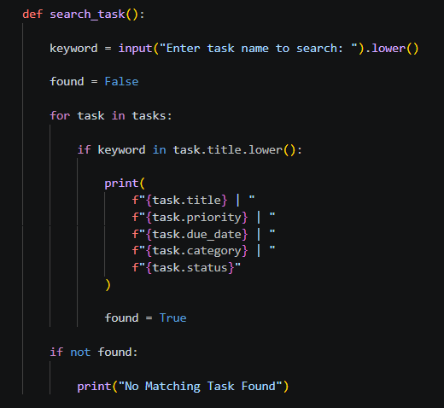
search_task() is used to search tasks.
User enters a keyword.
.lower() converts text into lowercase for easier matching.
Loop checks all tasks one by one.
if keyword in task.title.lower() searches partial text.
Matching tasks are displayed to the user.
If no task is found, a message is shown.

Slide 11
Key Findings
AI-based task prioritization helps users identify important tasks more effectively.
Productivity reports make it easier to track completed and pending tasks.
Overdue task detection helps users avoid missing deadlines.
AI-generated daily planning improves task organization and time management.
Combining task management with AI features creates a smarter and more efficient productivity system.

Slide 12
Conclusion
The Intelligent Task Management System was successfully developed using Python with features such as task management, productivity analytics, overdue task detection, and AI-powered planning. The project effectively demonstrates the use of Object-Oriented Programming, file handling, Pandas, error handling, and API integration. AI features such as productivity advice, task prioritization, summaries, and daily planning make the system more intelligent and user-friendly. The project successfully achieves its objective of improving task organization and productivity management.

