Slide 1
OTT Content, Audience &
Engagement Analytics
“Data-Driven Insights into Content Performance, Audience Behavior & User Engagement”
Name : Shreyas Rajendra Mayekar
Course name : Exploratory Data Analysis using Power BI
Date : 11/09/2026

Slide 2
Problem Statement
OTT platforms generate large amounts of data on users, subscriptions, content consumption, and feedback, but raw data alone does not clearly show what drives engagement, satisfaction, and churn. The project aims to analyze this data to identify audience behavior, content performance, engagement patterns, and factors associated with customer churn.

Slide 3
Project Objective
Analyze user demographics and subscription patterns.
Measure content performance and viewer engagement.
Identify patterns in watch time, sessions, completion, pauses, and rewatching.
Analyze ratings and user feedback.
Identify high-value and highly engaged customers.
Understand churn patterns and provide actionable business recommendations.

Slide 4
Dataset Overview
User Information: User ID, gender, age group, and region.
Subscription Data: Subscription type and monthly fee.
Content Data: Content titles, genres, and content attributes.
Viewing Activity: Sessions, watch time, completion percentage, pauses, and rewatching.
Feedback Data: Ratings and likes.

Slide 5
Tools & Technologies used
Excel – Data cleaning, preprocessing, analysis, and PivotTables
MySQL – Data storage, SQL queries, views, and joins
Python – Data analysis and visualization
Matplotlib & Seaborn – Data visualization
Power BI – Interactive dashboard and business insights
GitHub – Project version control and repository management

Slide 6
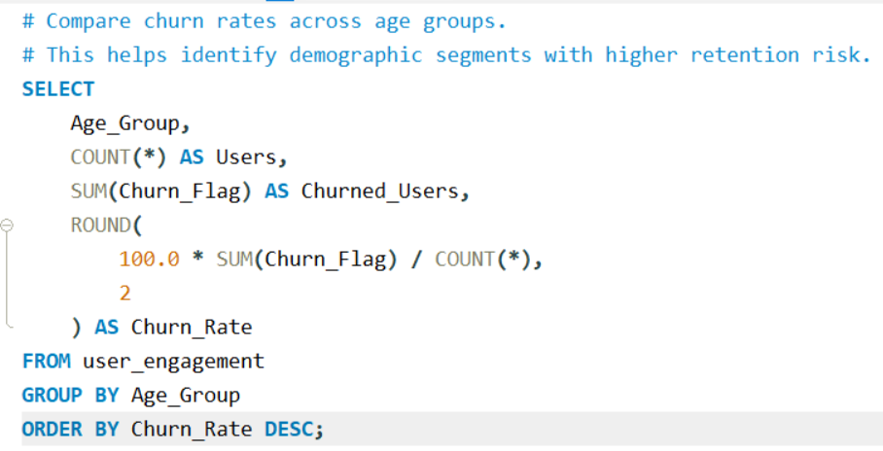
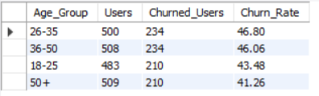
SQL Analysis
Output :

Slide 7
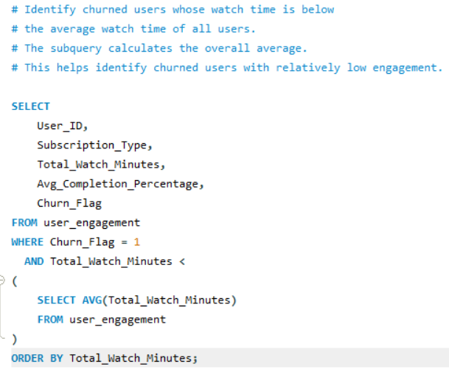
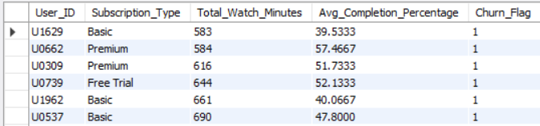
Output :

Slide 8
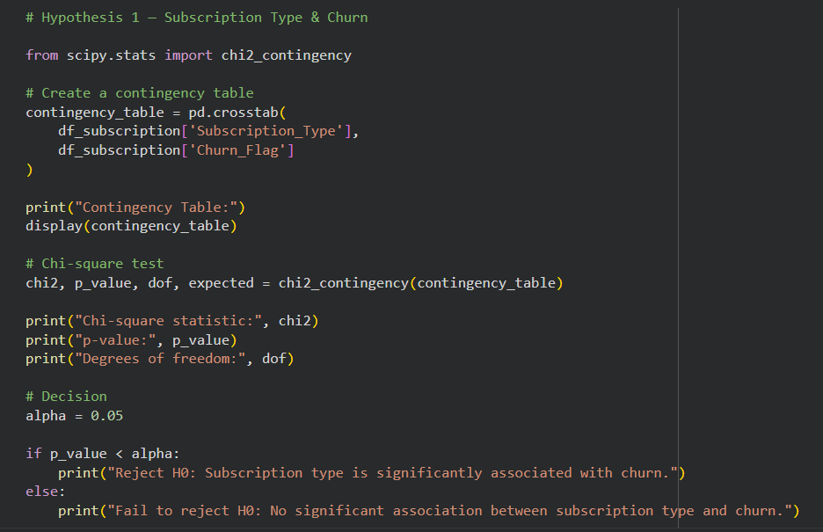
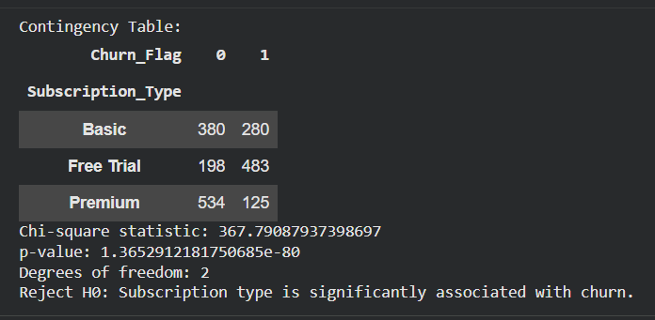
Python Analysis
Output :

Slide 9
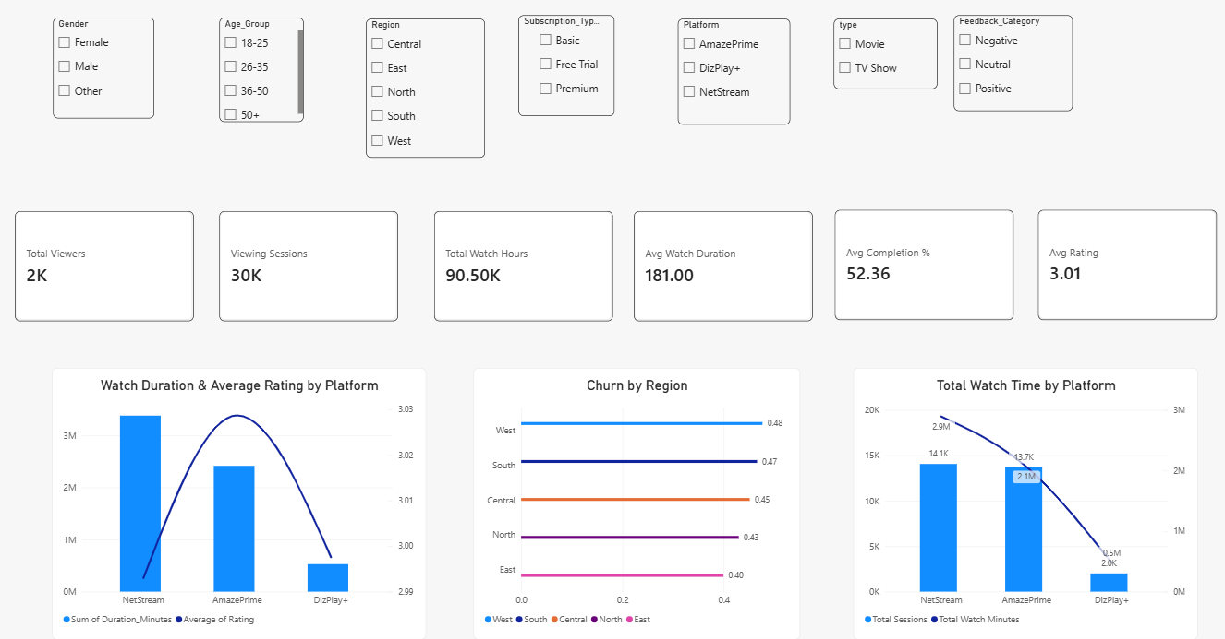
Power BI Dashboard

Slide 10
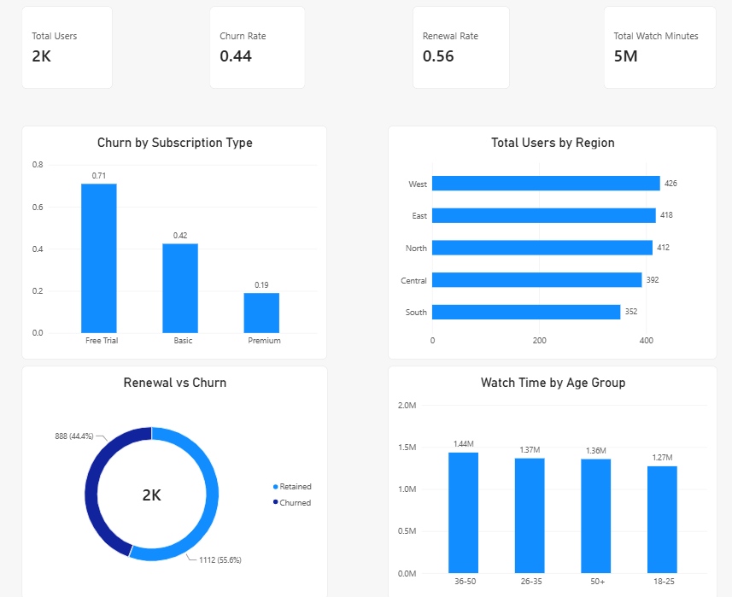

Slide 11
Key Findings
Free Trial Churn: Free Trial users have the highest churn at 71%, compared with 19% for Premium users.
Regional Churn: West (48%) and South (47%) have the highest churn rates.
Age-Based Churn: 26–35 (47%) and 36–50 (46%) users show the highest churn.
Customer Satisfaction: Positive feedback (40.3%) and negative feedback (39.4%) are almost equal, indicating significant dissatisfaction.
Platform Engagement: NetStream has the highest total watch time at approximately 2.9M minutes, followed by AmazePrime (2.1M).
Session Duration: DizPlay+ has the highest average watch time per session at approximately 236 minutes, despite lower overall watch time.

Slide 12
Conclusion
The OTT platform should adopt a customer-focused and data-driven business strategy by strengthening retention programs, improving the overall viewing experience, and delivering more personalized content recommendations. The business should continue investing in high-performing content and genres, while using customer feedback and viewing behavior to identify areas for improvement.
A stronger focus on customer satisfaction, personalized engagement, content optimization, and seamless multi-device experiences can help increase viewer loyalty, reduce churn, and drive sustainable platform growth and revenue.

