Slide 1

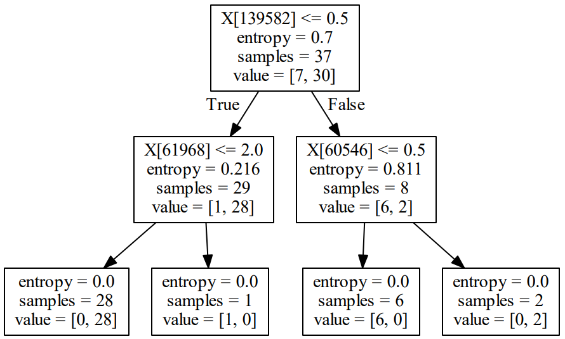
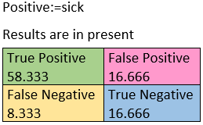
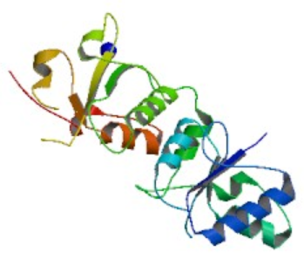
Identifying Crohn’s disease related mutations using learning methods and bioinformatics tools
Batsheva Liran Knecht, May Elbaz and Maya Avidor
Department of Computer Science, Technion - Israel Institute of Technology, Haifa, Israel
Abstract
Results
Crohn's disease is a type of inflammatory bowel disease (IBD) that may affect any part of the gastrointestinal tract from mouth to anus.
While the cause of Crohn's disease is unknown, it is believed to be due to a combination of environmental, immune, and bacterial factors in genetically susceptible individuals.
Diagnoses of the disease includes several invasive tests such as colonoscopy. There is no treatment to cure the disease but there are ways to alleviate it’s symptoms, and to improve the patient’s lifestyle.
Since the cause of the disease remains unclear more research must be done in this field.
Figure 1: bar chart showing accuracy depends on data filters
Goals
We would like to identify Crohn’s disease related mutations in a given organism’s genome
Intermediate Goals:
Creating a classifier algorithm that predicts the existence of the disease in an individual, from a given genome sequence, and increases it’s correctness rates.
Based on the learning tree, finding a precise locations inside the genome that might be related to the mutation.
Getting a better understanding of the relations between different mutations we had found in the genome to this specific disease.
Figure 3:confusion matrix
Figure 2: learning tree with 79% accuracy
Figure 4: protein data bank 3D structure 1JNX- X-ray Chimera
Biological aspect:
The learning tree gave us positions in the genome that might be related to Crohn's disease, inter alia the gene BRCA1.
This gene codes a ligase enzyme that plays a central role in DNA repair by facilitating cellular responses to DNA damage.
BRCA1 mutations carriers have a 4-fold increased risk of colon cancer. Moreover, the risk of colorectal cancer increases by up to 6 times in Crohn's patients.
The gene also Inhibits lipid synthesis. It was also found that Crohn’s patients have lower serum total of cholesterol and triglyceride concentrations than normal.
Methods
To predict if a patient is sick from its genotype, we’ve built a classifier from ID3 algorithm under different parameters tuning, to the genotype data related to the disease.
The data is a vcf file containing the genotype of 66 patients sick or healthy.
Use of pandas and NumPy packages in order to parse the data and use it.
sklearn package to use the ID3 algorithm and a few other learning methods.
Transformation and filtering of the data in different ways, while keeping the best result marked for the learning algorithm (figure 1).
4 fold test for a better selection of the best tree
Repetition of the learning process 10 times while keeping only the best tree’s results.
Biological analyzation of the genes that were used by our classifier with genome browsers such as USCS.
Discussion
As we can see, It is possible to use learning algorithm’s tools to address this sort of biological issues.
Genome-based researches are efficient in finding genetic elements that can testify on an existing disease with a high probability.
By improving the code and adding more examples of different patients, we’ll be able to get more accurate results, and a better understanding of relations between mutations in the genome - to Crohn’s disease.
The biological analysis strengthens the association between the gene we had found to Crohn's disease.
References
https://he.wikipedia.org/wiki/%D7%9E%D7%97%D7%9C%D7%AA_%D7%A7%D7%A8%D7%95%D7%94%D7%9F
https://webcourse.cs.technion.ac.il/236501/Winter2018-2019/ho/WCFiles/DecisionTrees.pdf
https://samtools.github.io/hts-specs/VCFv4.3.pdf
https://genome.ucsc.edu/
http://www.crohns-colitis.info/lobby/%D7%A7%D7%A8%D7%95%D7%94%D7%9F -%D7%95%D7%A7%D7%95%D7%9C%D7%99%D7%98%D7%99%D7%A1-%D7%9B%D7%99%D7%91%D7%99%D7%AA
https://www.ncbi.nlm.nih.gov/pubmed/17426807

