Slide 1
Team members:
Martin Mayembe
Vladyslav
Valentyn
Yash Mange
Iker
Schedules 1

Slide 2
Introduction
Focused on Schedules part of the system
Repository: https://github.com/mayembe-martin/software_architecture_schedules

Slide 3
Core Features
Viewing the timetable (Valentyn)
Viewing the course info (Yash)
Viewing the teacher info – office hours (Iker)
Schedule modification (Vlad)
Statistical reports (Martin)

Slide 4
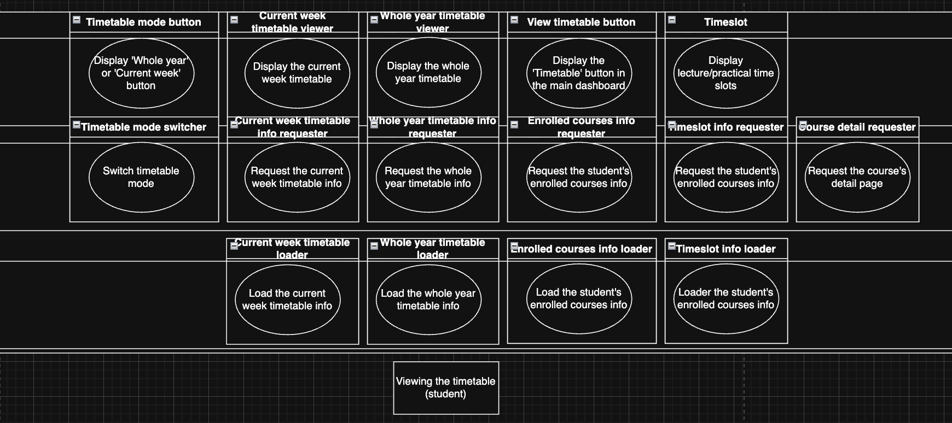
Layered Architecture – Viewing the Timetable

Slide 5
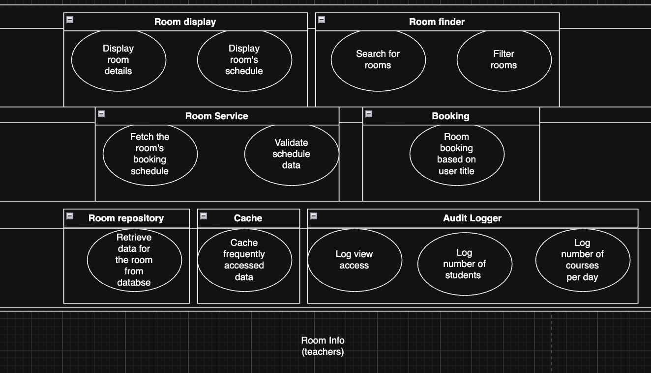
Layered Architecture – Room Info Description

Slide 6
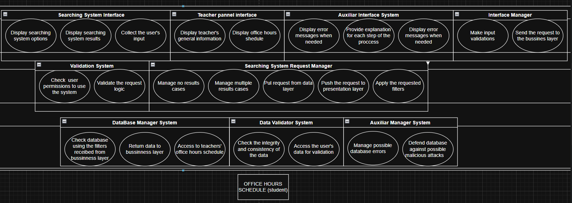
Layered Architecture – Office Hours

Slide 7
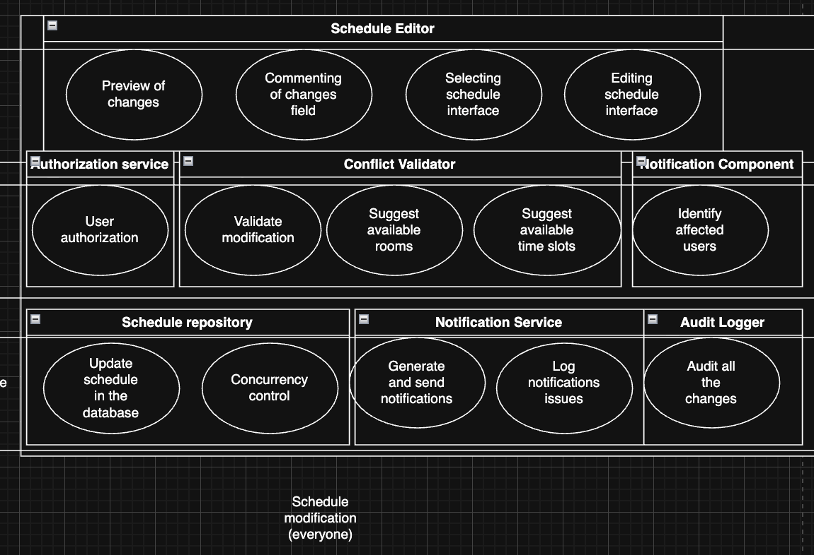
Layered Architecture – Schedule Modification

Slide 8
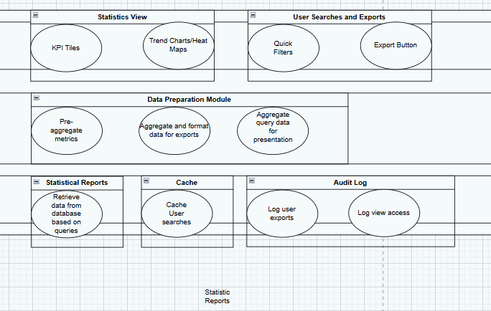

Slide 9
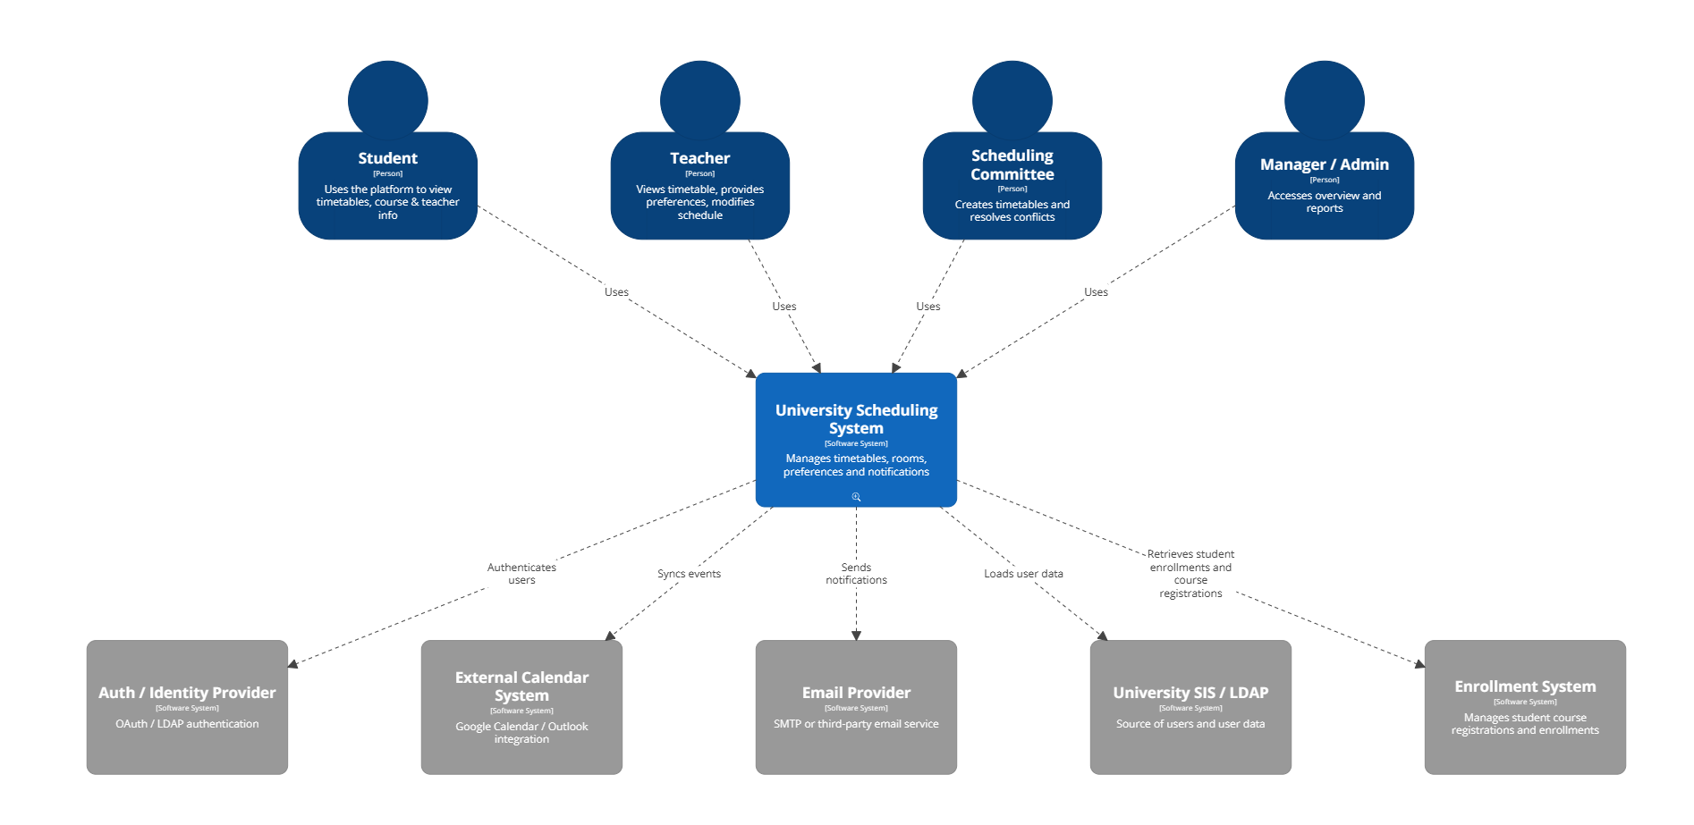
C4 model L1 :

Slide 10
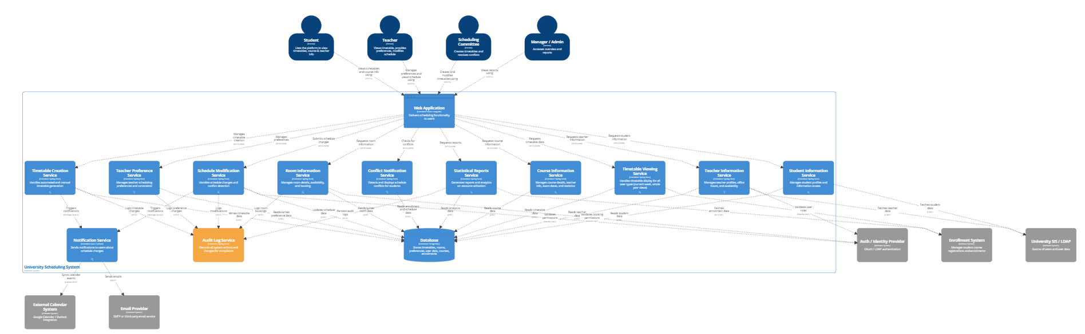
C4 Model L2:

Slide 11
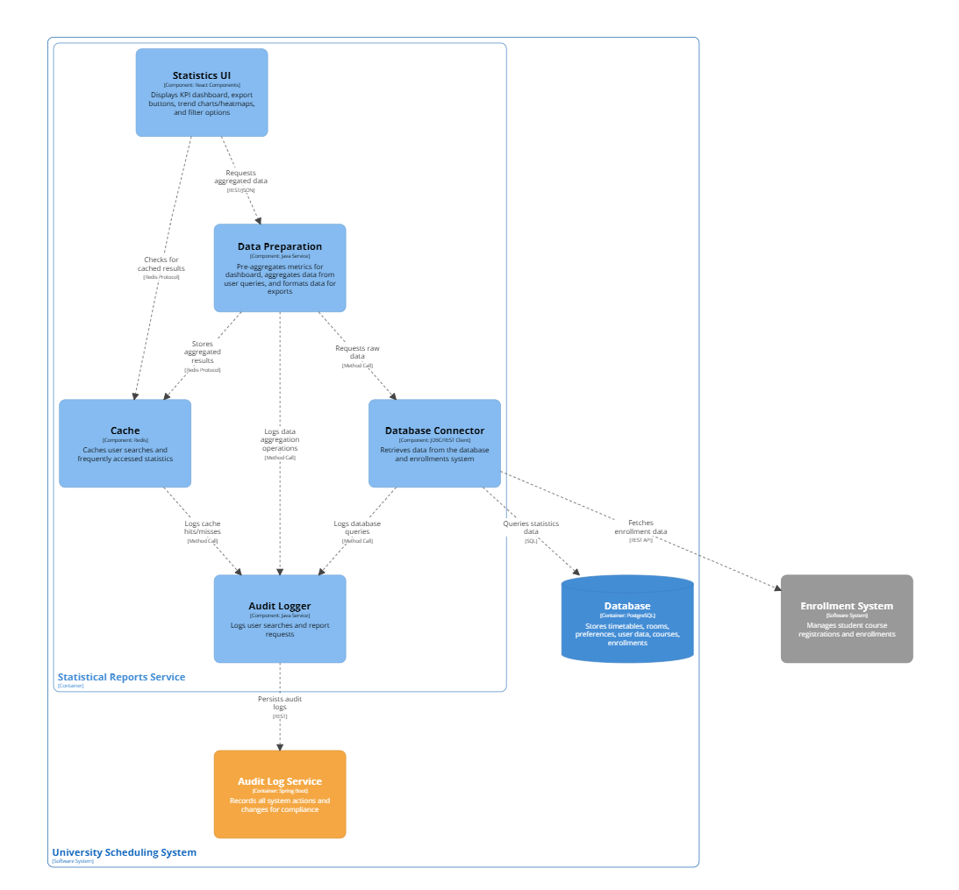
L3 diagram - Statistics

Slide 12
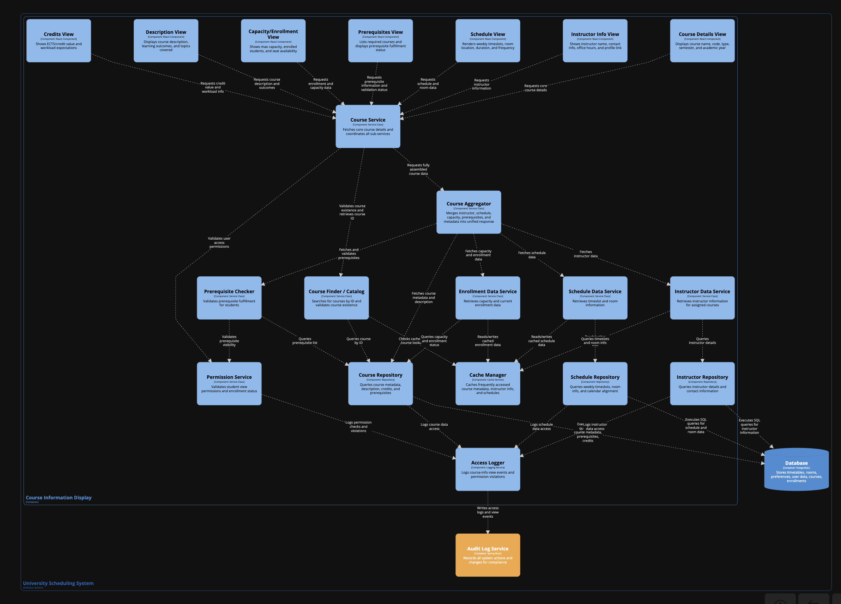
L3 Diagram – Viewing Course info

Slide 13
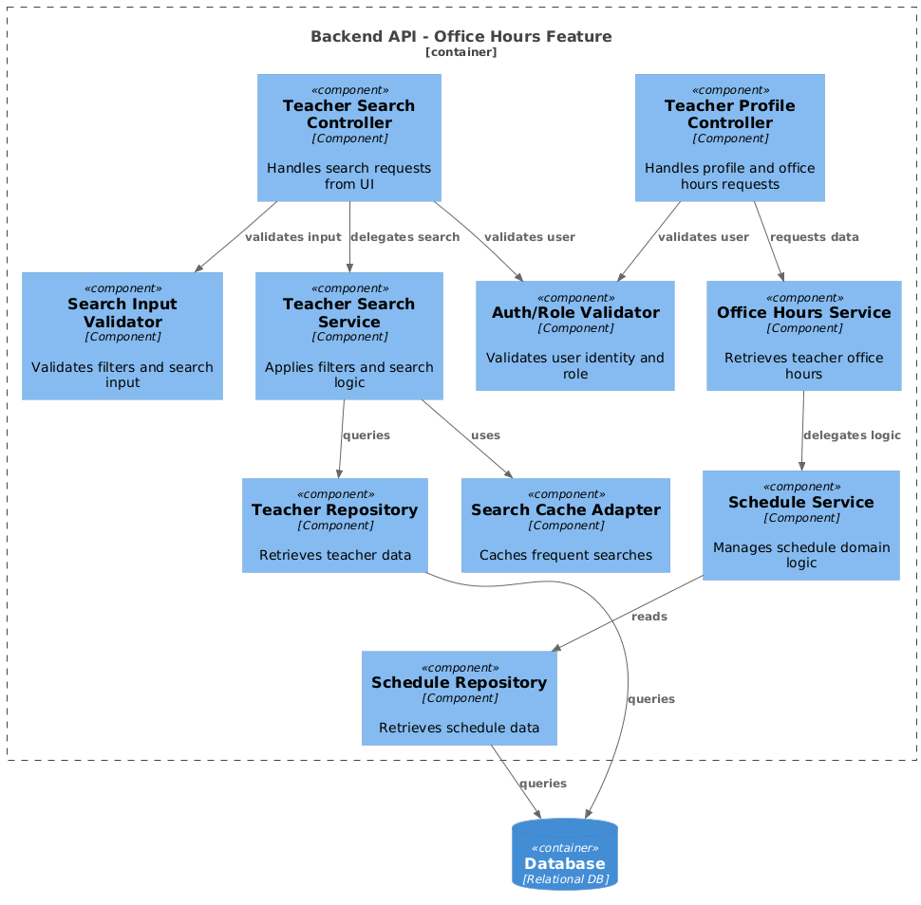
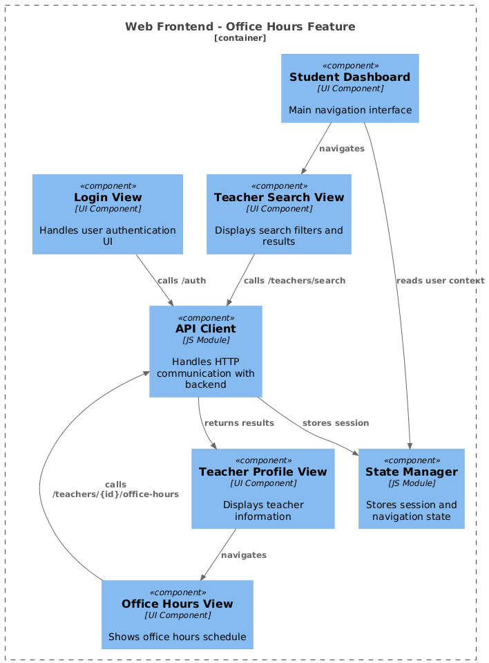
L3 diagram – Office hours

Slide 14
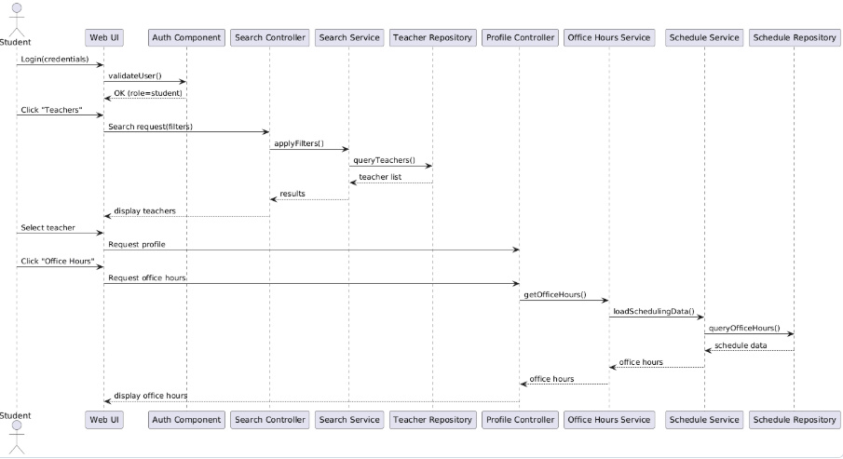
Dynamic diagram – Office hours

Slide 15
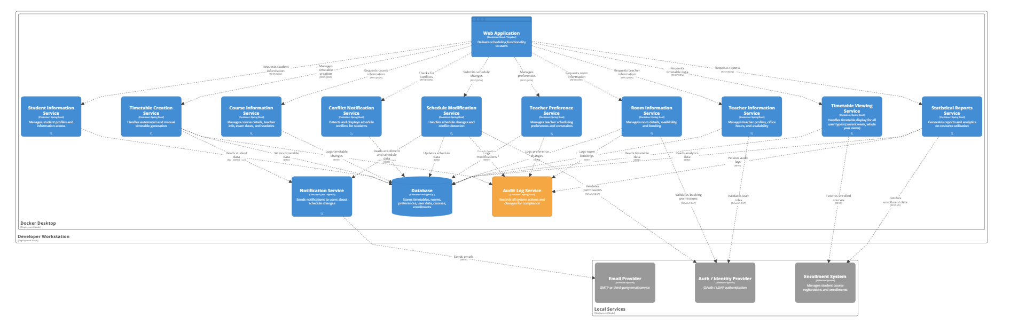
Deployment diagram(Martin)

Slide 16
Thank you

