Slide 1
Schedules 1
Team members: Martin
Vladyslav Valentyn Yash Iker

Slide 2
Core Features
Viewing the timetable (Valentyn)
Viewing the course info (Yash)
Viewing the teacher info – office hours (Iker)
Schedule modification (Vlad)
Statistical reports (Martin)

Slide 3
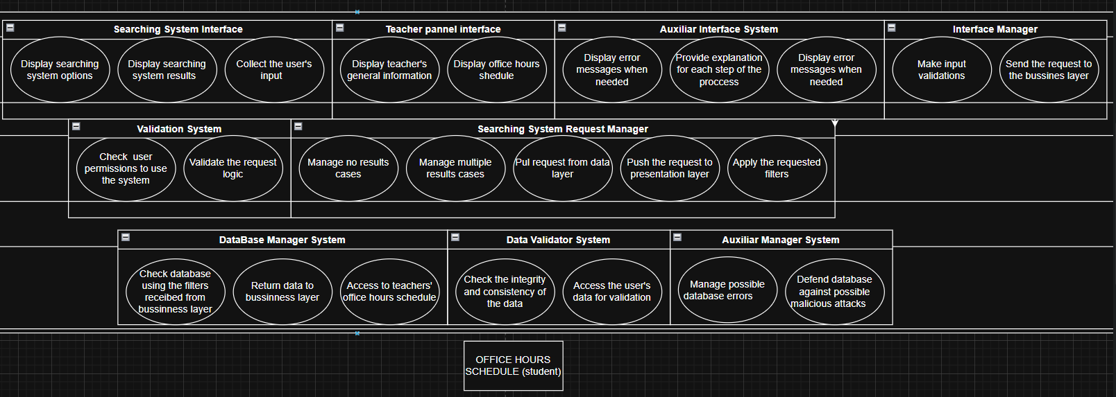
Layered Architecture – Office Hours

Slide 4
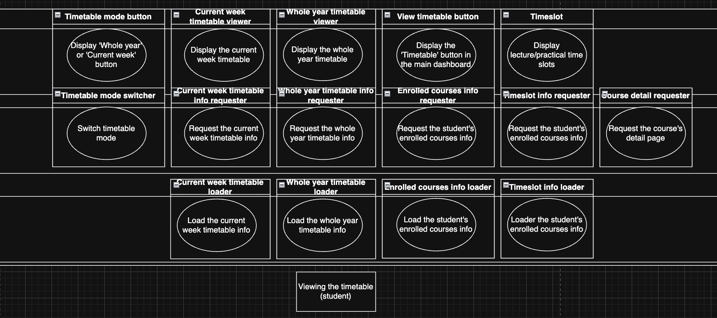
Layered Architecture – Viewing the Timetable

Slide 5
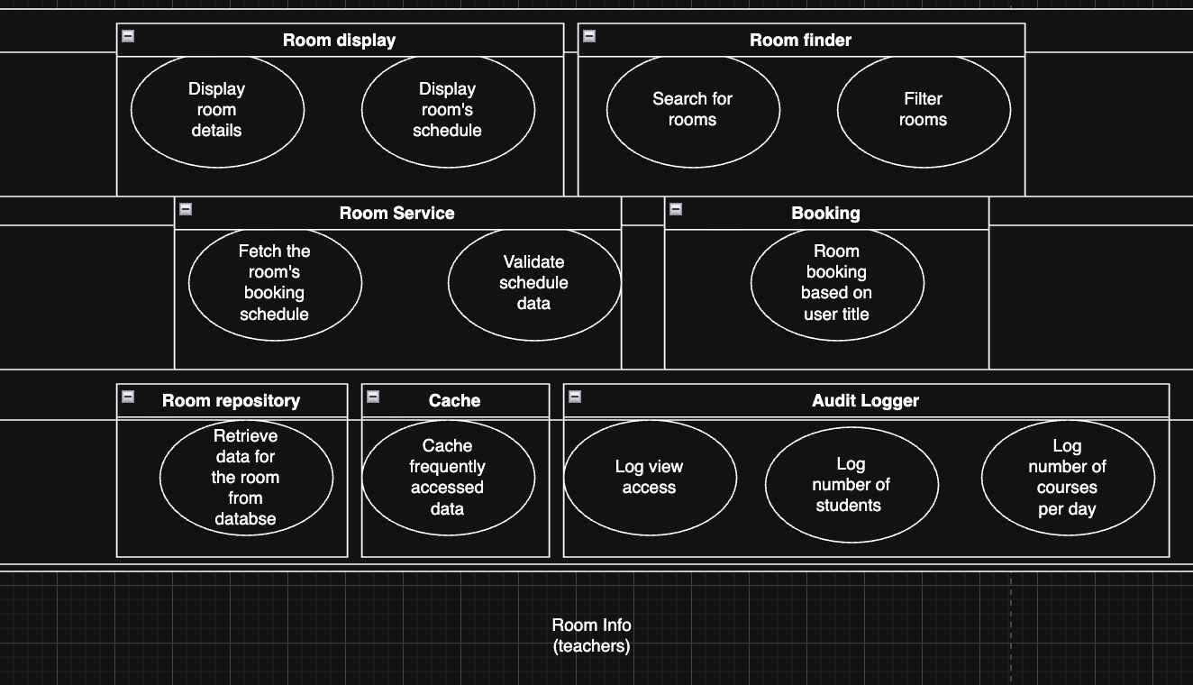
Layered Architecture – Room Info Description

Slide 6
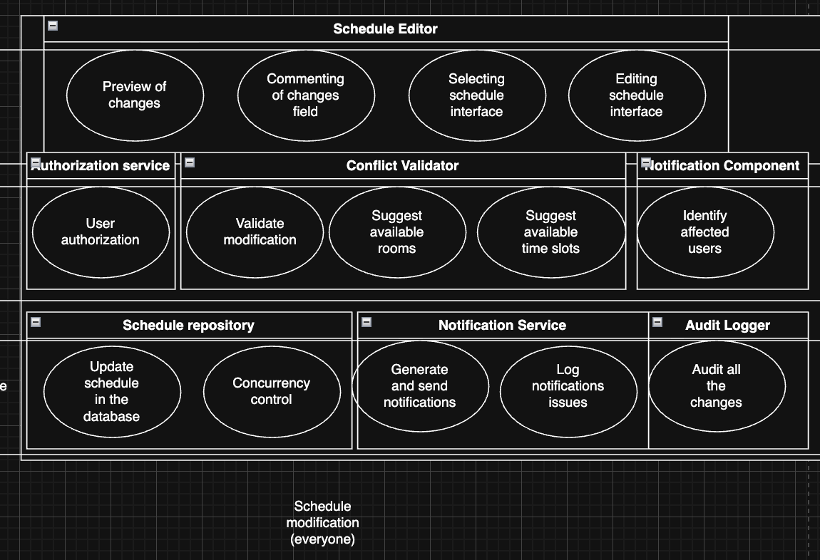
Layered Architecture – Schedule Modification

Slide 7
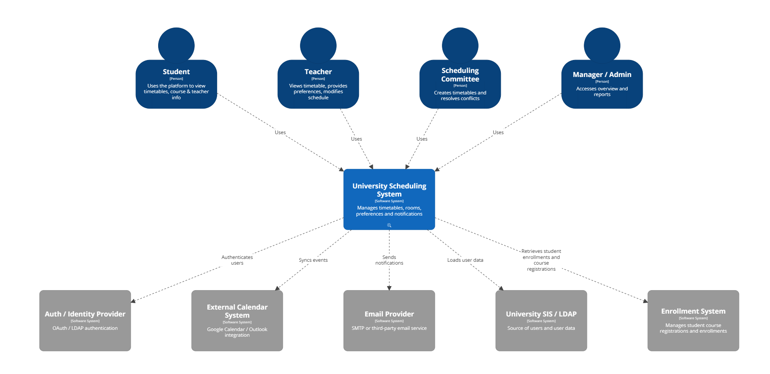
C4 model L1 :

Slide 8
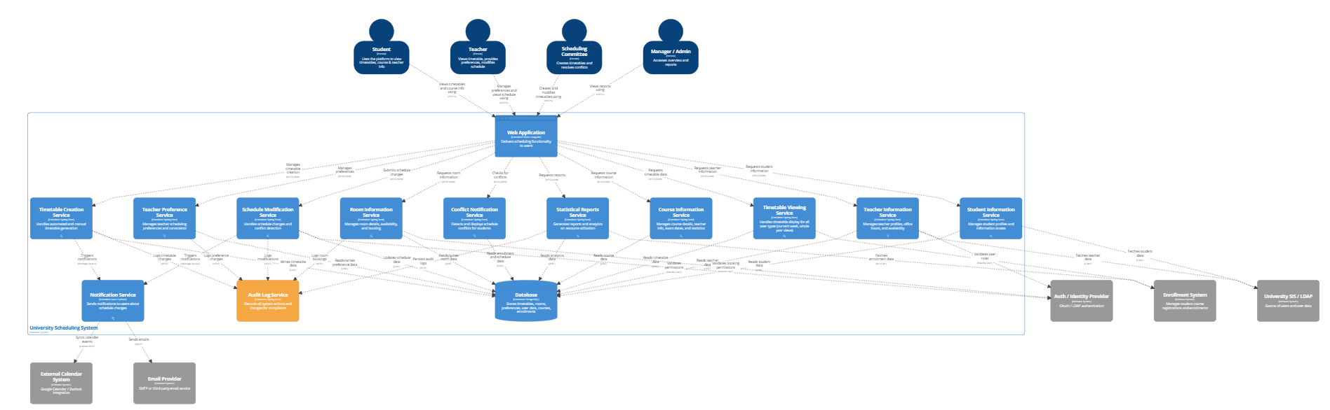
C4 Model L2:

Slide 9
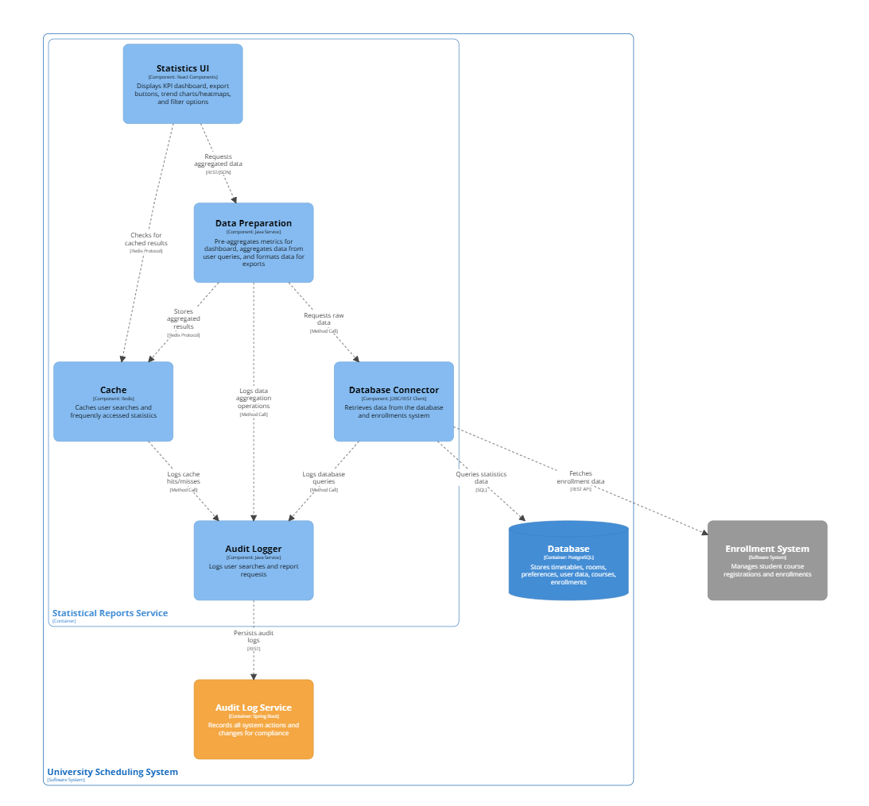
L3 diagram - Statistics

Slide 10
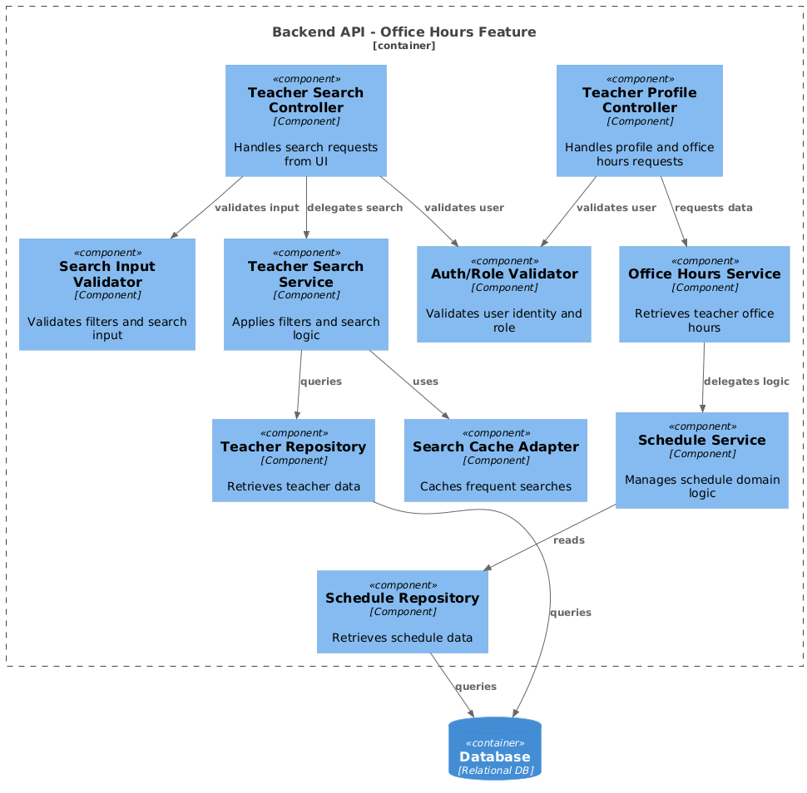
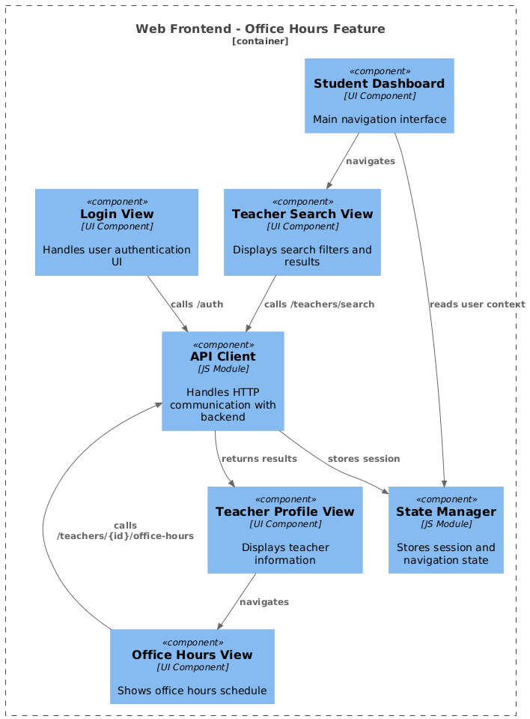
L3 diagram – Office hours

Slide 11
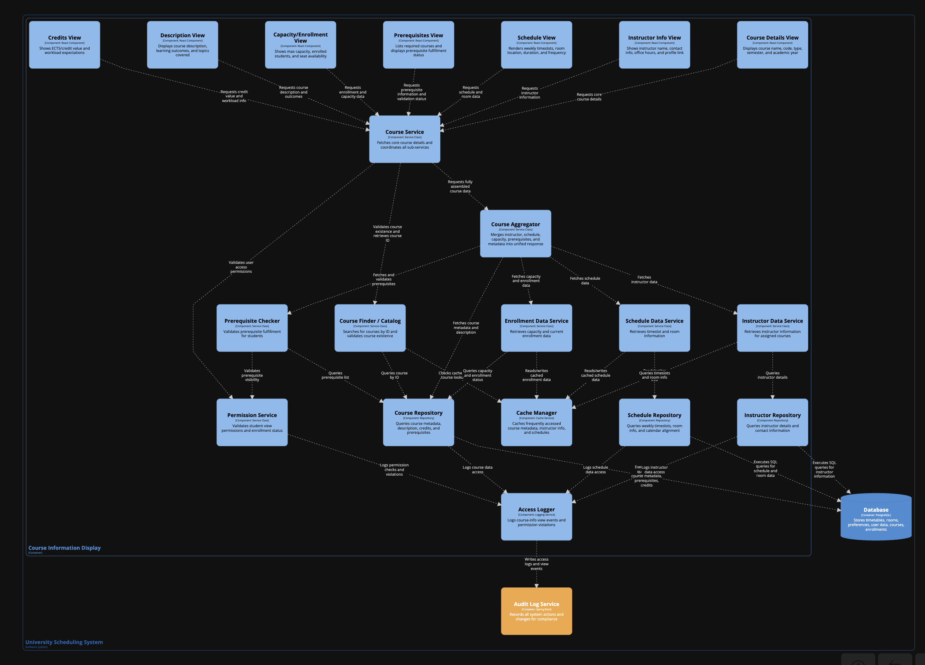
L3 Diagram – Viewing Course info

Slide 12
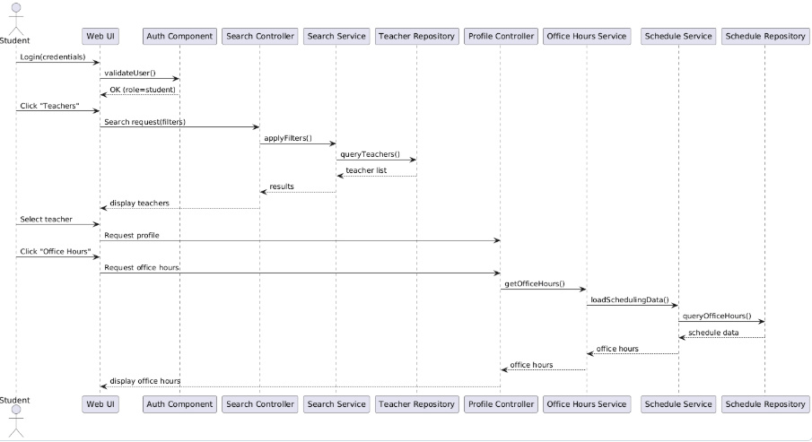
Dynamic diagram – Office hours

Slide 13
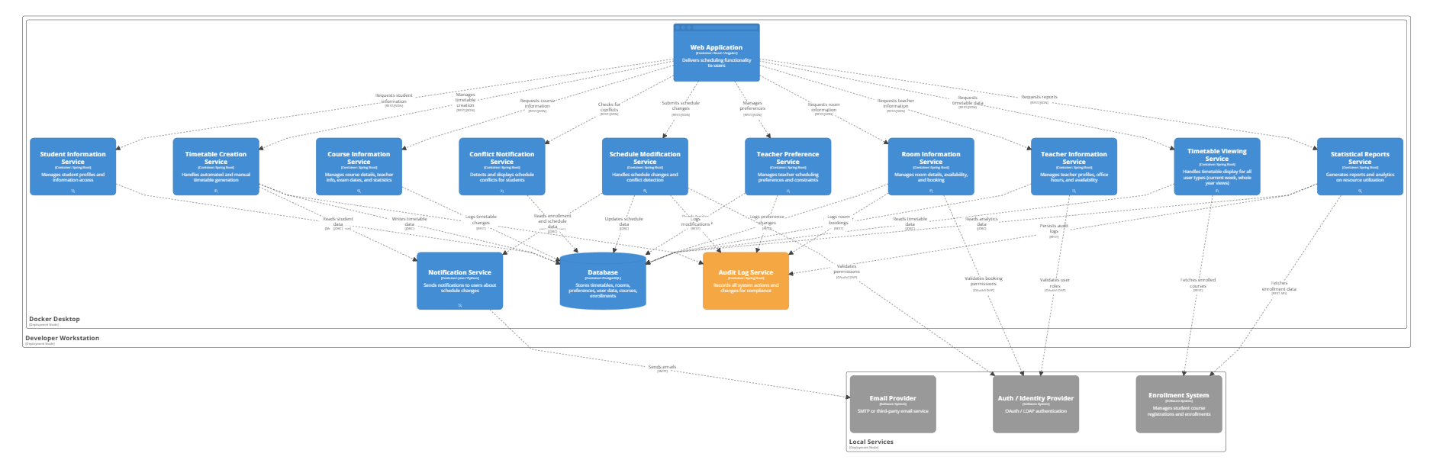
Deployment diagram(Martin)

Slide 14
Thank you

