Slide 1

ARCHITECTURAL EVALUATION: EXAMS MODULE 1
Iker
Martin Mayembe
Valentyn Kornilov
Yash Mange
Vladislav

Slide 2

SECURITY PROBLEM (Valentyn)
Source of stimulus: Grading Management (unauthorized access)
Stimulus: Editing the grades with an unauthorized access
Environment: Run-time
Artifact: Persistence Adapter
Response: Unauthorized access detected
Measure: Notification is sent
An attacker tries to modify the grades by sending a grade edit request to Grading Management component.
Solution: The request is detected, an attacker is not recognized as a teacher, notification is sent.
No architecture modification is needed because a notification is just being sent.

Slide 3
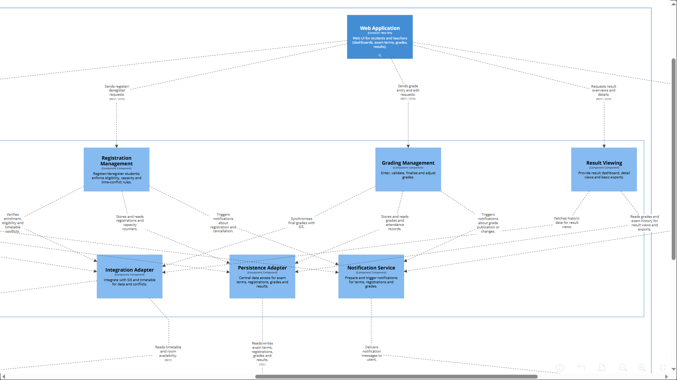





Slide 4

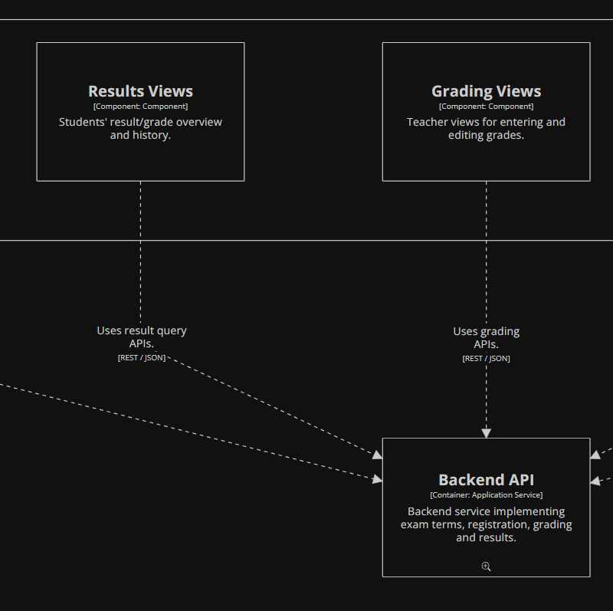
AVALABILITY PROBLEM: Requirements
Source of stimulus: Results Views component (Web Application), requesting updated exam marks for student visualization.
Stimulus: Results Views requests the publication and availability of newly uploaded exam marks from the Web Application.
Environment: Normal system operation, with internal container communication enabled between Web Application and Backend API.
Artifact: Web Application – Grade Publisher Monitor container.
Response: Validation from the Grade Publisher Monitor, if succeded confirmation, if failed notification of failure.
Measure: Validation < 1 min. Mark availability < 15 min.

Slide 5
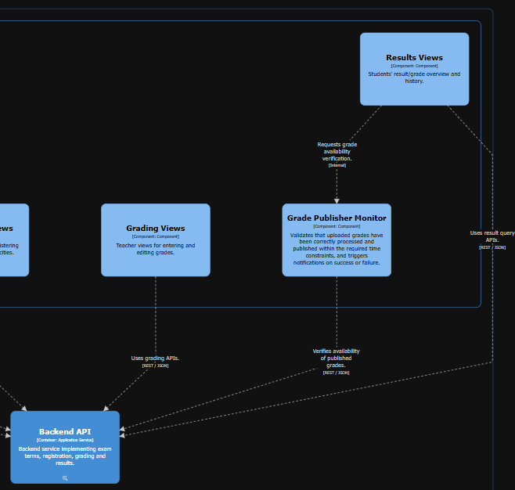
AVAILABILITY PROBLEM: Solution
After the upload of the marks by the teacher, the system performs a validation process lasting up to 1 minute.
This is achieved by implementing a Grade Publisher Monitor container in the Web Application layer of the architecture.
If the validation fails, a notification is sent to the teacher informing that the marks have not been correctly published, so corrective action can be taken in order to meet the 15-minute margin.
If the validation succeeds, the Grade Publisher Monitor sends a confirmation notification to the teacher indicating that the marks have been correctly published.

Slide 6
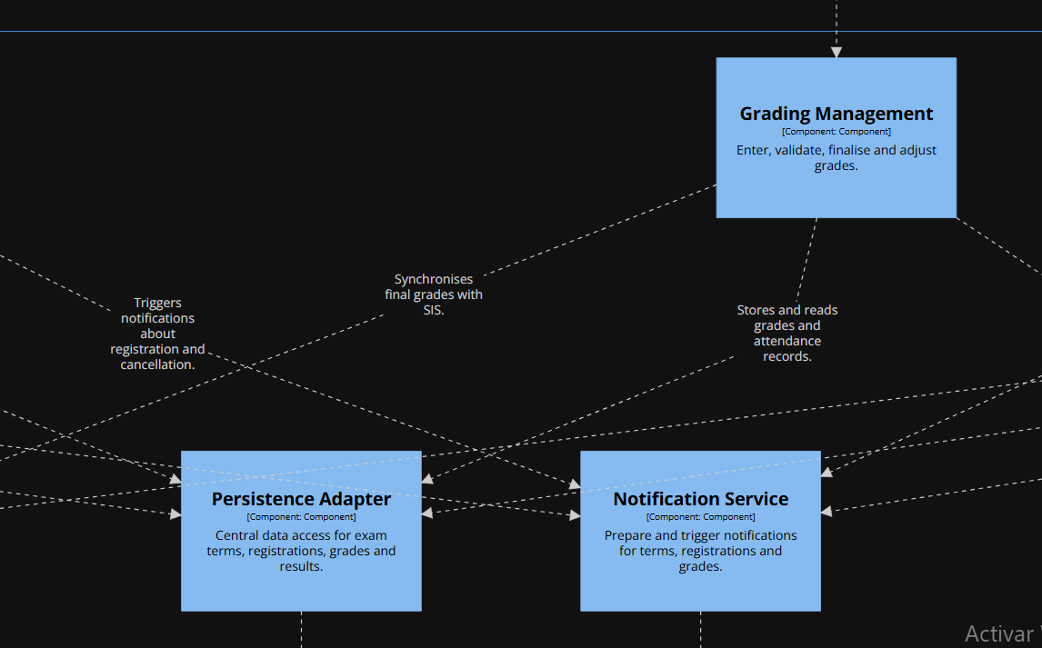
MODIFIABILITY PROBLEM: Requirements
Source of stimulus: IT Department / Maintenance Engineer.
Stimulus: A request to modify the Grading Management functionality to include a new feature.
Environment: System in maintenance mode, with access to the Backend API source code, automated build pipeline, and test environment.
Artifact: Backend API – Grading Management component and its dedicated Grading Persistence Adapter
Response: The IT department modifies only the grading-related business logic and its dedicated persistence adapter.No changes are required in persistence adapters of other services
Measure: Modification < 1 hour. Only grading-related components and adapters are changed.

Slide 7
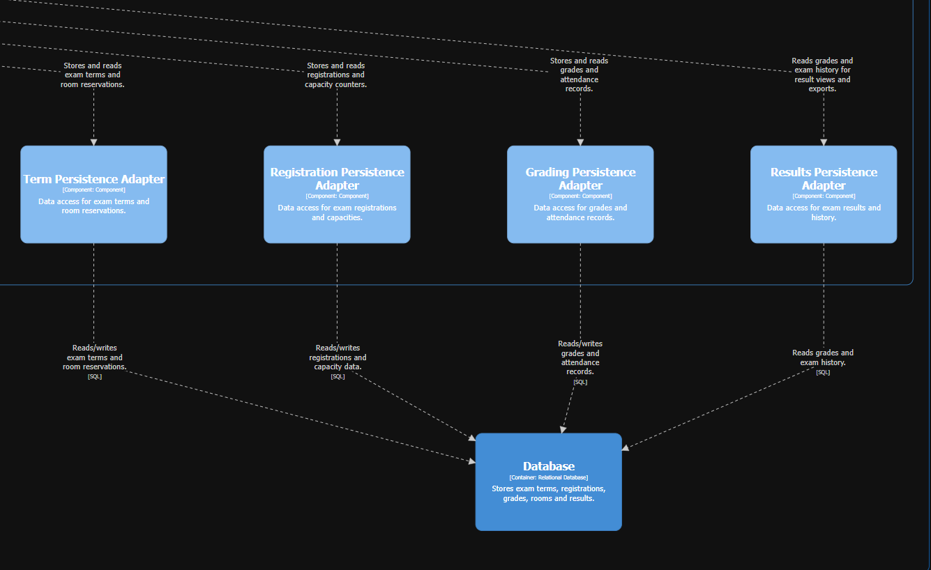
MODIFIABILITY PROBLEM: Solution
To improve modifiability, the single shared Persistence Adapter is split into multiple independent persistence adapters, one per service data flow.
With this separation, changes in the grading data flow affect only the Grading Persistence Adapter and the Grading Management component, other services remain untouched and the time required to do any modification in any data flow is significantly reduced, allowing the change to be implemented within the 1-hour constraint.

Slide 8
REQUIREMENT: TESTABILITY
Each component of the system must take not more than 15 minutes to setup and deploy for testing.
Architectural Extension: None required

Slide 9
1. Easy unit deployment:
CURRENT STRENGTHS:
All modules communicate with each other via the Integration Adaptor
During testing, only the adaptor (which only needs to be deployed once for all components in the backend API) and the module being tested need to be deployed as other modules and the database can be mocked in the integration and persistence adaptors.

Slide 10
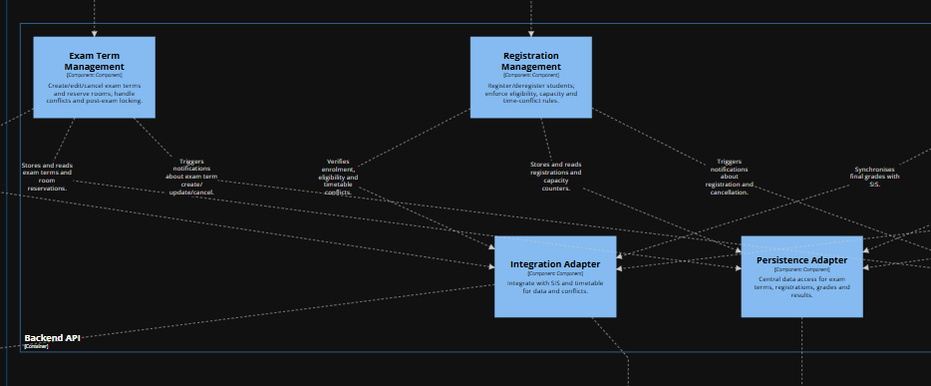
a

Slide 11
REQUIREMENT: PERFORMANCE
When a user makes a request, the system should respond within a maximum of 5 seconds during peak periods (5000 requests per second).
Architectural Extension: Required

Slide 12
1. Integration and Persistence bottlenecks:
CURRENT WEAKNESSES:
During runtime, at least two instances of the Persistence and Integration adaptors must be deployed in order to cushion the load as these may create a bottleneck.
In the case where external systems where the required information must be pulled from, the user should get a response within the system time letting them know that the service they are requesting is currently unavailable. This can already happen via the Notification service.

Slide 13
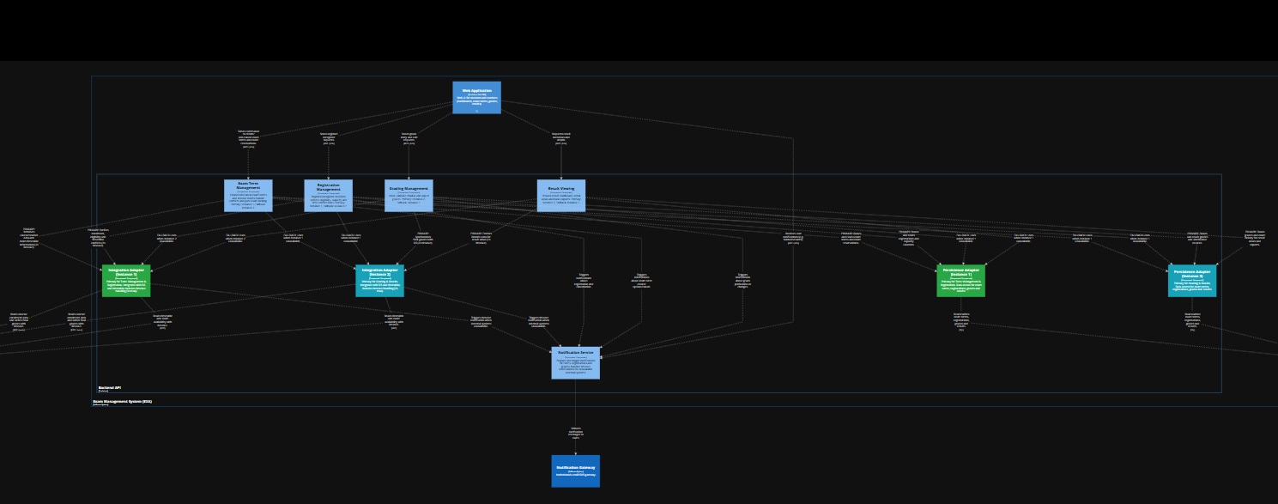

Slide 14
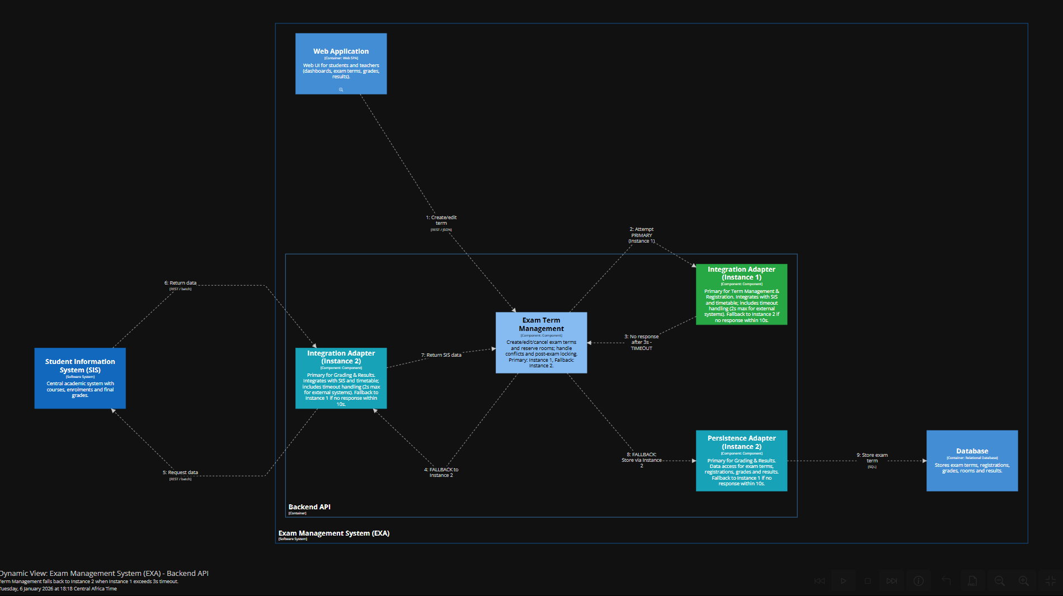

Slide 15
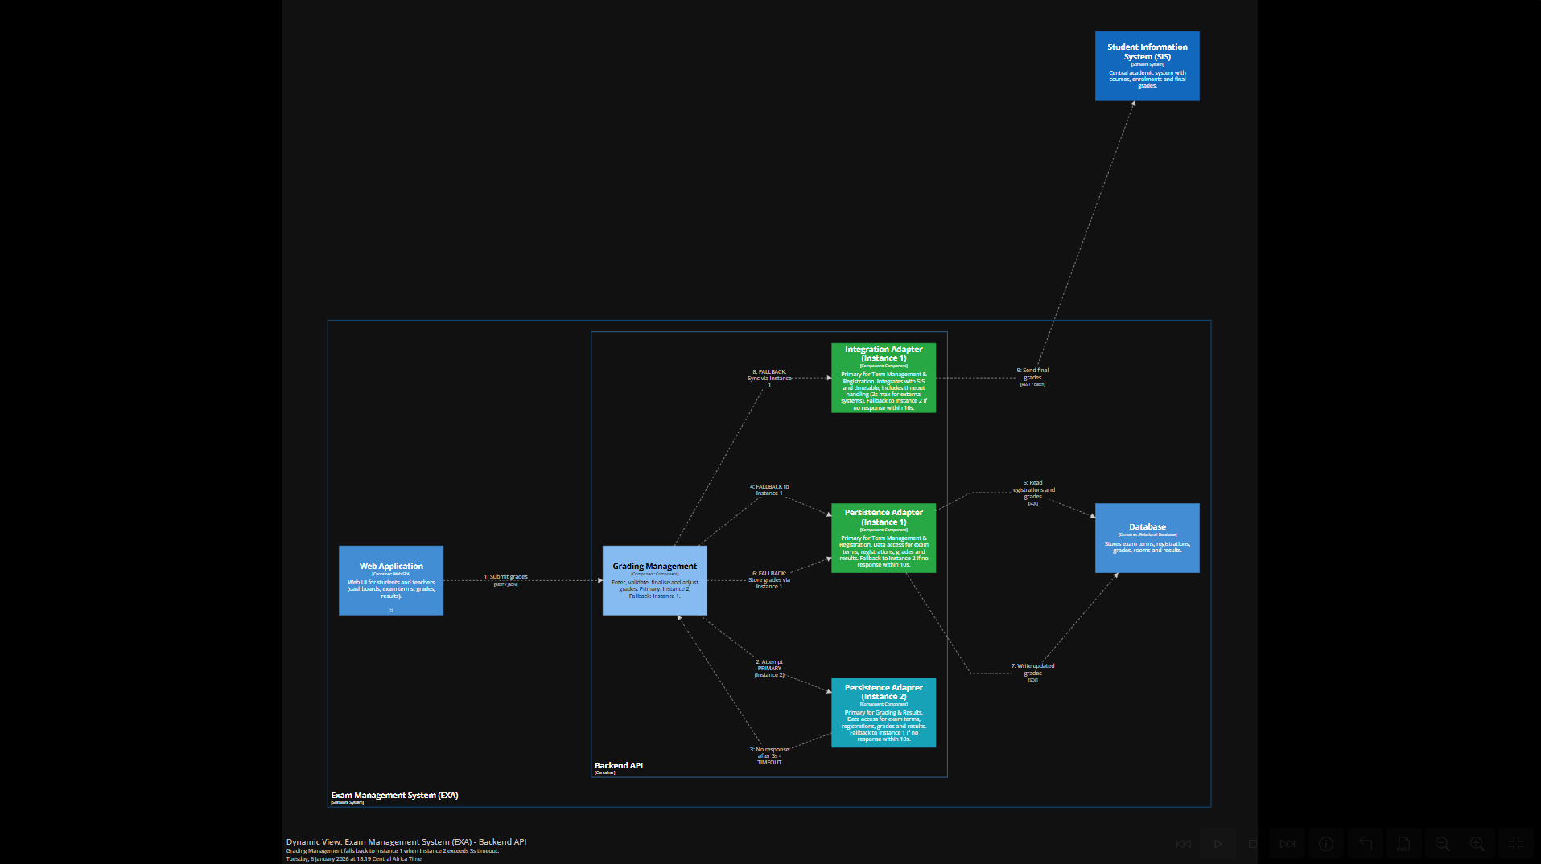

Slide 16
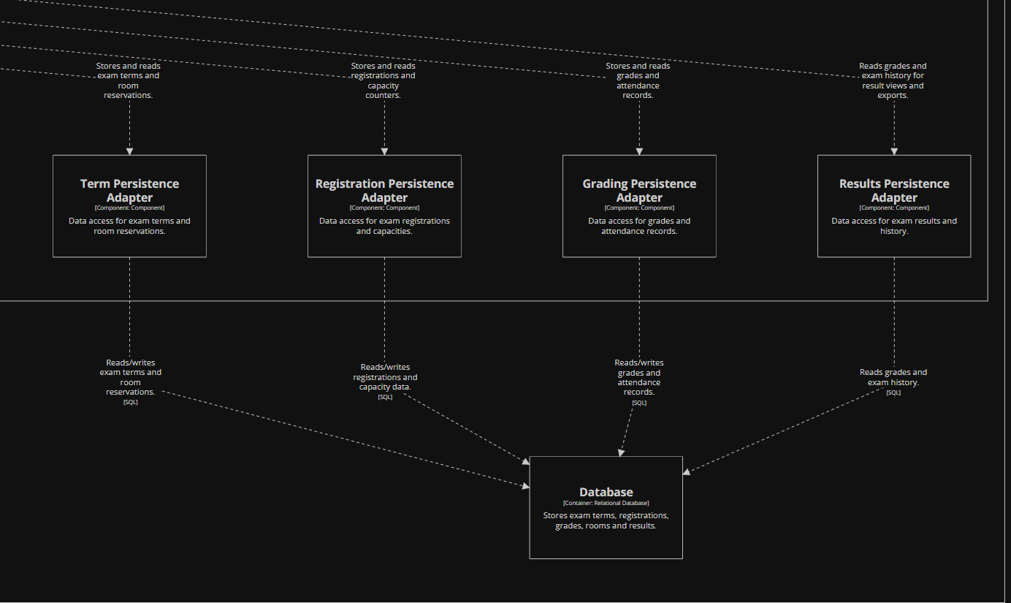
MODIFIABILITY PROBLEM: SOLUTION
The persistent adapter is splited in many independent adapters, as much as services are in the system.
With this, if one service part needs to be modified, it can be done without affecting to the other services or data flows.
In our case, this modification allows an easy Grading System service modification, meeting the one-hour deadline.

Slide 17
RELIABILITY PROBLEM
During peak usage (e.g. after grade publication or before exam registration deadlines), external systems such as the Student Information System (SIS) or the Timetable Service may become temporarily unavailable or respond slowly. When this happens, core EXA functionality (registration, result viewing, or grading workflows) may fail or hang due to synchronous dependencies on these external services.
Field | Description
Quality Attribute | Reliability
Source of Stimulus | External system (Student Information System or Timetable Service)
Stimulus | An external system becomes unavailable or responds slowly
Environment | Normal operation, possibly during peak usage
Artifact | Integration Adapter (Backend API)
Response | The Integration Adapter detects the failure using timeouts, retries, or circuit breakers and prevents the failure from propagating to core business components. The system continues operating in a degraded but controlled mode
Response Measure | Core EXA functionality remains available and failures do not cascade beyond the Integration Adapter

Slide 18
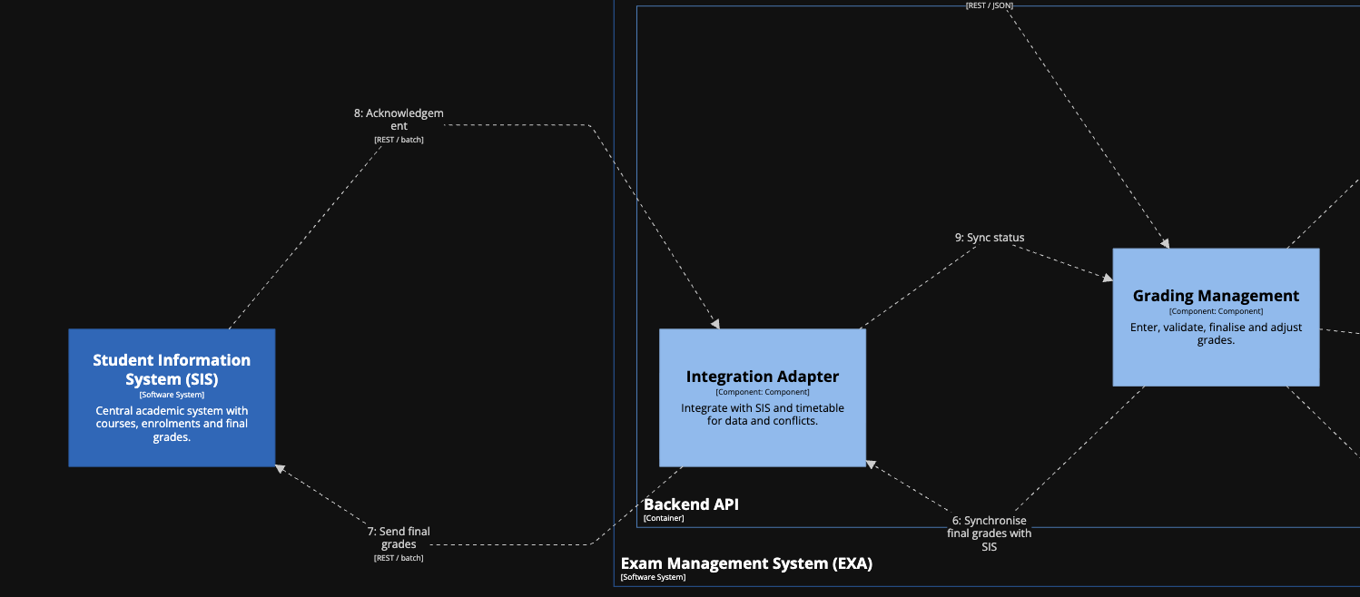
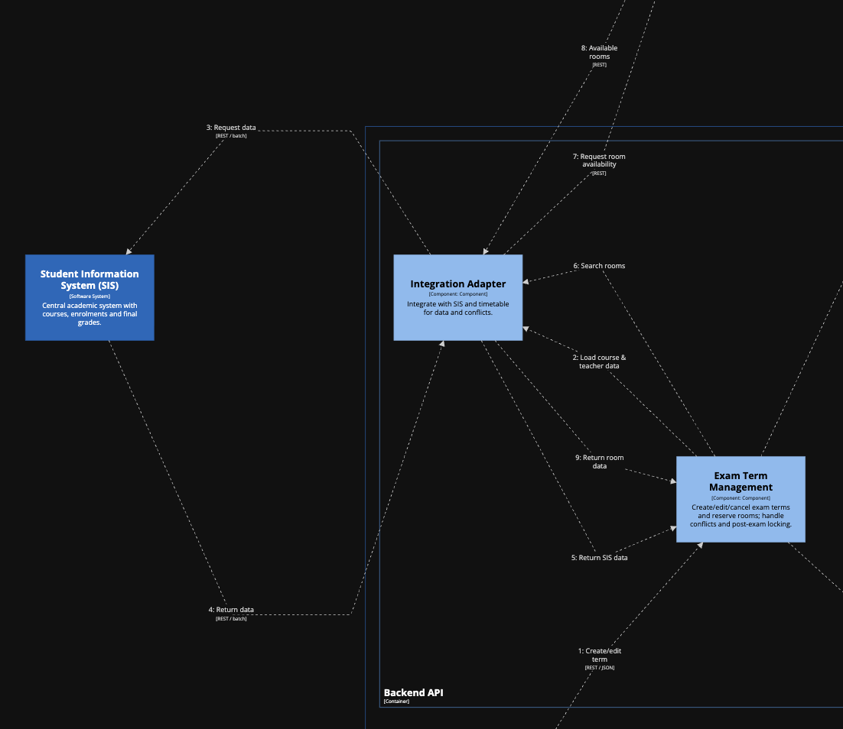
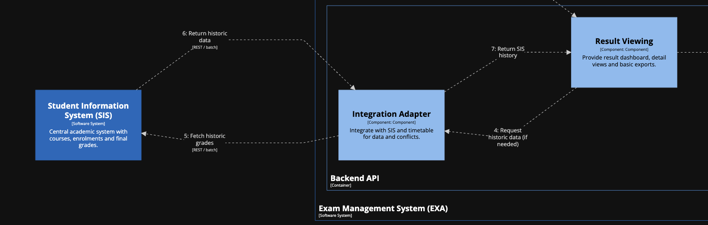
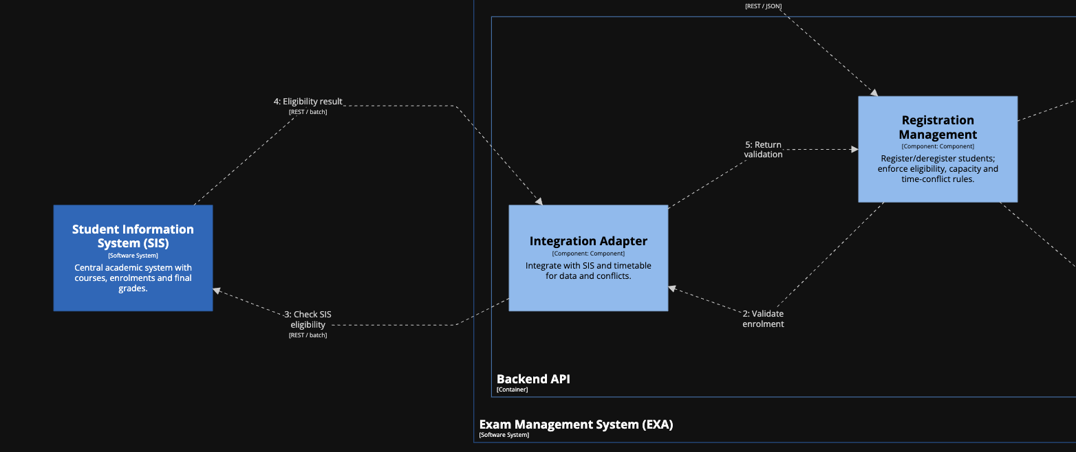

Slide 19
RELIABILITY PROBLEM - SOLUTION
The solution introduces fault-tolerance mechanisms at the Integration Adapter level. All communication with external systems is guarded by :
timeouts
retries with backoff
circuit breakers
If an external system is unavailable, the Integration Adapter either:
returns cached or last-known-valid data where possible or fails fast and allows the calling business component to continue in a degraded but controlled mode.
This prevents cascading failures, ensures that EXA remains operational for core use cases, and significantly improves system reliability even when external dependencies are unstable.
Result :
External system outages are isolated from the rest of EXA.
Core functionality continues to operate in a controlled or degraded mode.
The system remains reliable even when external dependencies are unstable.

Slide 20
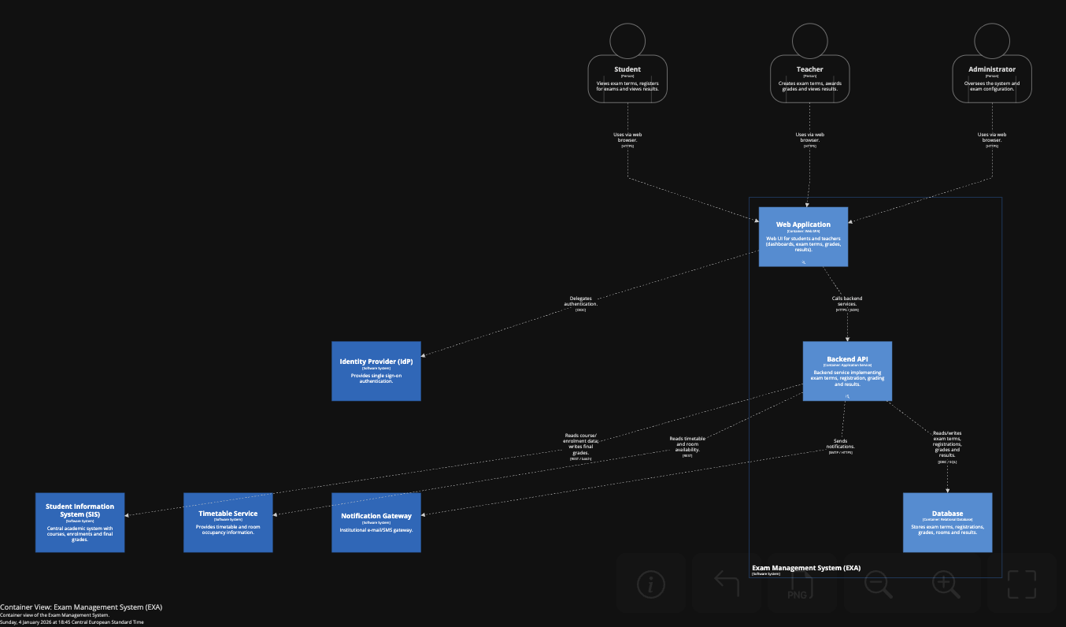
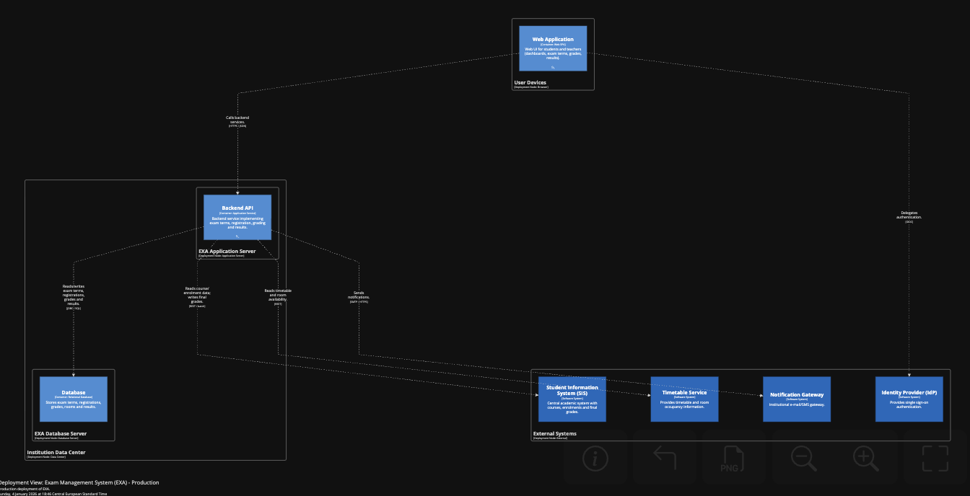
SCALABILITY PROBLEM
At predictable times such as the beginning of the semester or during exam registration openings, hundreds or thousands of students may simultaneously attempt to register for exam terms or view schedules. This leads to sudden spikes in load on the Backend API, particularly on registration-related components and database access.
Field | Description
Quality Attribute | Scalability
Source of Stimulus | Students
Stimulus | A large number of concurrent requests arrive at the system
Environment | Peak usage periods (e.g. exam registration opening)
Artifact | Backend API container, especially Registration Management
Response | The Backend API scales horizontally by running multiple stateless instances behind a load balancer. Requests are distributed across instances and database access is optimized using connection pooling
Response Measure | The system handles large bursts of concurrent requests without request failures or unacceptable response-time degradation

Slide 21
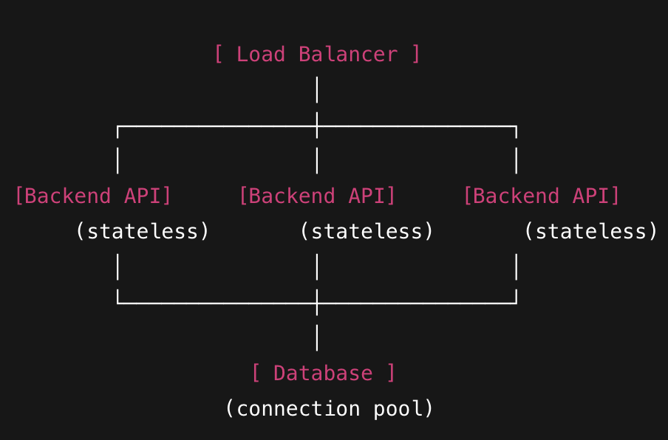
SCALABILITY PROBLEM - SOLUTION
The solution leverages horizontal scalability of the Backend API container. The Registration Management component is designed to be stateless, allowing multiple instances to be deployed behind a load balancer.
Database access is optimized through connection pooling and efficient transaction handling, while predictable peak periods are handled by pre-scaling backend instances ahead of time.
Design backend components (especially Registration Management) to be stateless.
Deploy the Backend API as multiple instances behind a load balancer.
Use:
horizontal scaling
connection pooling
pre-scaling during known peak periods
Result
The system can handle large bursts of concurrent requests.
Performance remains stable during peak usage.
Scalability requirements are met without architectural complexity.

Slide 22
SECURITY PROBLEM
An attacker sends a grade edit request to Grading Management component.
Solution:
The request is detected, an attacker is not recognized as a teacher, notification is sent (or the grades data is restored).
The current architecture does not require an update.

