Slide 1
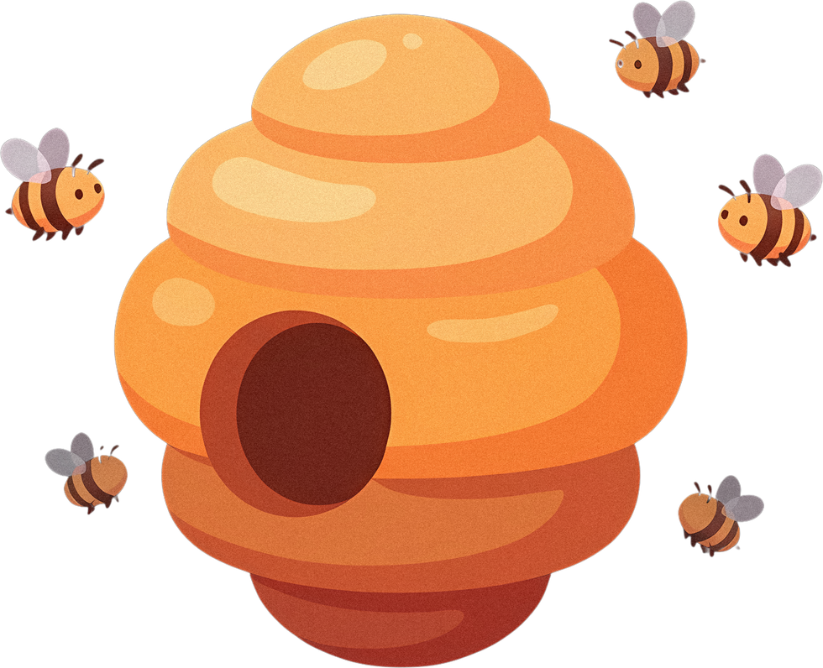
CSE 4111 - MACHINE LEARNING - GROUP PRESENTATION
Artificial
Bee Colony
Finding the global minimum of the 2-D Ackley function
SUBMITTED TO
Dr. Al-Mahmud
Professor, Department of CSE, KUET
SUBMITTED BY - STUDENT IDs
2107001 2107004 2107009
2107015 2107024 2107047
Notes:
SLIDE 1 - Finding the global minimum
Target: 30 seconds
Good morning, sir. Our project finds the lowest point of the two-dimensional Ackley function using the Artificial Bee Colony algorithm. It is the same problem we solved earlier with a Genetic Algorithm, so at the end we can compare the two fairly. We will explain the problem, show how the three kinds of bee work, and present our results.
VISUAL / DELIVERY
Title slide: honeycomb corners, flying bees and the beehive from the template.

Slide 2
01 - THE PROBLEM
Find the lowest point
x₂
01
Choose two numbers
Pick x₁ and x₂ so that f is as small as possible.
02
Stay inside the square
Both coordinates must satisfy −5 ≤ x ≤ +5.
x₁
(0, 0)
03
The answer we are aiming at
x* = (0, 0) and f(x*) = 0.
−5
+5
every point in the square is allowed
The bees only taste the points they choose. Nobody tells them where (0, 0) is.
14 September 2026
ACKLEY x ARTIFICIAL BEE COLONY
02
Notes:
SLIDE 2 - Find the lowest point
Target: 45 seconds
We need two numbers, x-one and x-two, that give the smallest function value. Each number must stay between minus five and plus five. The known answer is zero, zero, where the function value is zero. We use that point only afterwards, to measure how close we got. We never put it into the colony and we never point the search towards it. The bees only choose points and taste how much nectar is there.
VISUAL / DELIVERY
Native coordinate diagram: the allowed square and the known optimum.
Source: Ackley_ABC_Solution.ipynb; every number reproduced by review/experiments.py.

Slide 3
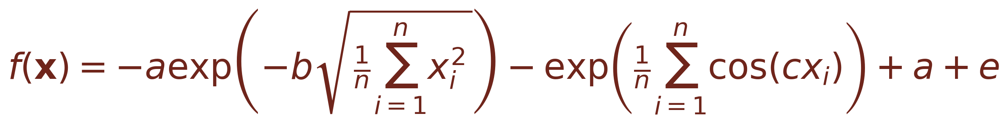
01 - THE PROBLEM
The Ackley function in 2-D
START WITH n VARIABLES
Set n = 2
Expand the two sums
Use a = 20, b = 0.2, c = 2π
THE FUNCTION IN OUR CODE
Check it at the origin: −20 − e + 20 + e = 0
14 September 2026
ACKLEY x ARTIFICIAL BEE COLONY
03
Notes:
SLIDE 3 - The Ackley function in 2-D
Target: 55 seconds
The top formula works for any number of variables. Our problem has two variables, so we set n equal to two. We use the standard constants: a is twenty, b is zero point two, and c is two pi. Each sum now has just two terms, which gives the lower formula used in our code. To check it, put zero into both variables. The first part becomes minus twenty and the second becomes minus e. The remaining terms cancel them, so the value is exactly zero.
VISUAL / DELIVERY
Typeset equations with a three-step substitution guide.
Source: Ackley_ABC_Solution.ipynb; every number reproduced by review/experiments.py.

Slide 4
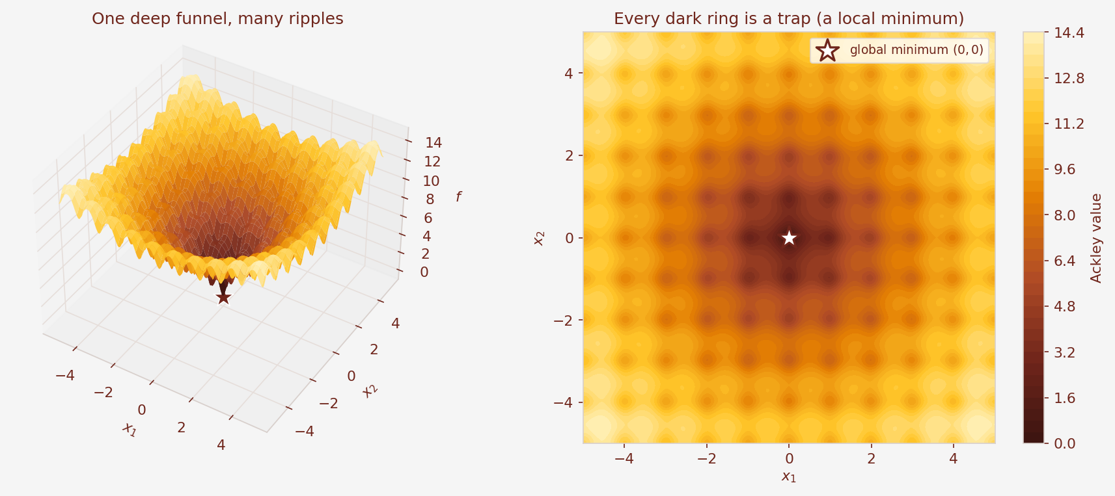
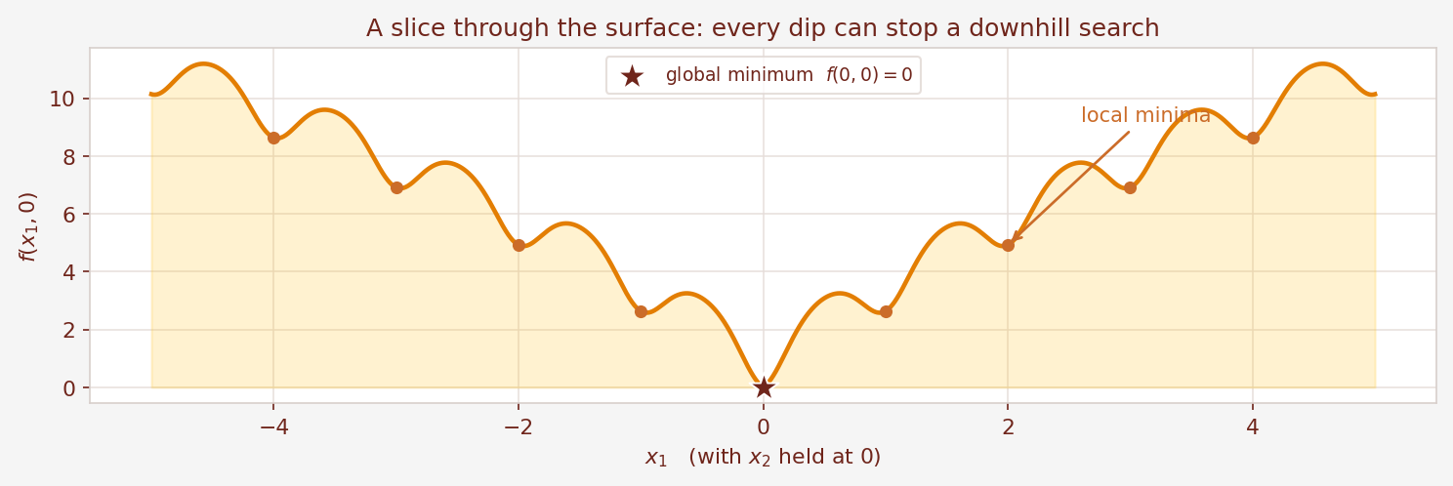
01 - THE PROBLEM
One deep minimum. Many small traps.
01
One wide funnel
The smooth part slopes towards the centre.
02
Many small traps
The cosine part adds dips everywhere.
03
Too big to scan
A 10⁻⁶ grid would need ~10¹⁴ points.
A plain downhill search
can stop in any of the dips.
14 September 2026
ACKLEY x ARTIFICIAL BEE COLONY
04
Notes:
SLIDE 4 - One deep minimum. Many small traps.
Target: 55 seconds
These pictures show why Ackley is difficult. The whole surface slopes towards the centre, but it is also covered in small dips. We call those local minima. They are lower than everything nearby, but they are not the lowest point of the whole surface. A method that simply walks downhill can get stuck in one of them. Checking every point is far too expensive: a grid with one-millionth spacing across this square holds about ten to the fourteen points. So we need a search that can look in several places at once.
VISUAL / DELIVERY
01_ackley_landscape.png and 02_ackley_slice.png.
Source: Ackley_ABC_Solution.ipynb; every number reproduced by review/experiments.py.

Slide 5
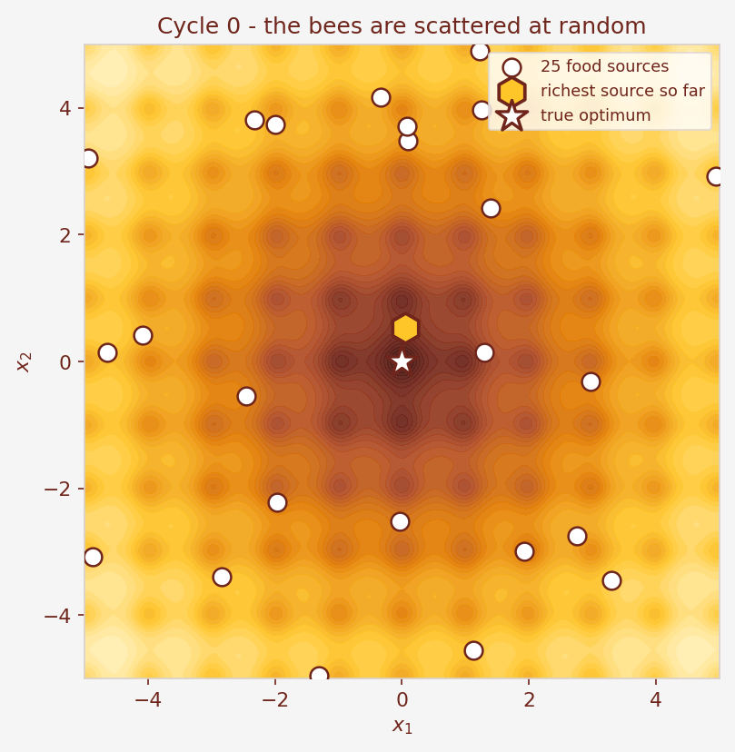
02 - THE BEE COLONY
A colony instead of a population
BEE LANGUAGE → OUR PROGRAM
In the hive | In the program
Food source | one answer [x₁, x₂]
Nectar amount | fitness, bigger is better
Employed bee | improves its own source
Onlooker bee | helps the richest sources
Scout bee | restarts a stuck source
Published by Dervis Karaboga in 2005,
after the foraging behaviour of honey bees.
25 food sources explore at once. Better sources attract more of the colony's effort.
14 September 2026
ACKLEY x ARTIFICIAL BEE COLONY
05
Notes:
SLIDE 5 - A colony instead of a population
Target: 50 seconds
The Artificial Bee Colony copies how real honey bees collect food. It was published by Dervis Karaboga in two thousand five. A food source is one possible answer, stored as the pair x-one and x-two. The nectar amount of a source is its fitness: the better the answer, the more nectar. Three kinds of bee then do three different jobs, and the picture shows our twenty-five sources scattered at the very start.
VISUAL / DELIVERY
03_initial_sources.png next to the biology-to-program table.
Source: Ackley_ABC_Solution.ipynb; every number reproduced by review/experiments.py.

Slide 6
02 - THE BEE COLONY
Three bees, three jobs
EMPLOYED BEES
ONLOOKER BEES
SCOUT BEES
25 bees, one per source
25 bees, no source of their own
only when a source is stuck
Try one point next to your own
source. Keep the better one.
Watch the dance, pick a source
by roulette wheel, search near it.
After 50 failed tries, abandon it
and start somewhere random.
Exploitation
Guided search
Exploration
Exploitation, guided search and exploration — three jobs, repeated every cycle.
14 September 2026
ACKLEY x ARTIFICIAL BEE COLONY
06
Notes:
SLIDE 6 - Three bees, three jobs
Target: 60 seconds
Here are the three jobs. An employed bee sits on one food source and keeps testing points right next to it, keeping whichever is better. That is careful local improvement, which we call exploitation. An onlooker bee does not own a source. It waits in the hive, watches the waggle dances, and chooses which source to visit, with the richer sources more likely to be chosen. That is guided search. A scout bee handles failure: if one source has refused to improve fifty times in a row, the colony gives up on it and starts again somewhere random. That is exploration.
VISUAL / DELIVERY
Native three-panel bee-role diagram with hexagon badges. Reveal one panel per click.
Source: Ackley_ABC_Solution.ipynb; every number reproduced by review/experiments.py.

Slide 7
02 - THE BEE COLONY
The settings we used
THE SIX CONTROL PARAMETERS (SLIDE 20)
THE SAME BUDGET, DIFFERENT MACHINERY
Parameter | Value
Colony size | 50 bees
Employed bees = sources (SN) | 25
Onlooker bees | 25
Dimension (D) | 2
limit | 50
Scouts per cycle | 1 at most
Genetic Algorithm | Artificial Bee Colony
Population 50 | Colony 50 bees
100 generations | 100 cycles
Crossover Pc = 80 % | not used
Mutation Pm = 5 % | not used
Mutation step sigma | free: |x_i - x_k|
Elitism = 1 | memorise the best
Roulette wheel | onlooker phase
limit = SN × D = 25 × 2 = 50
Seed 7, so the run repeats exactly.
Two blank rows: ABC has no crossover
rate and no mutation rate to choose.
14 September 2026
ACKLEY x ARTIFICIAL BEE COLONY
07
Notes:
SLIDE 7 - The settings we used
Target: 50 seconds
The left panel holds the six control parameters listed on slide twenty. The colony has fifty bees, matching the fifty chromosomes of our Genetic Algorithm. Slide twenty says employed bees are half the swarm and onlookers the other half, so we get twenty-five food sources and twenty-five onlookers. The limit is fifty, which is the usual choice of sources times dimension. The right panel maps the Genetic Algorithm settings onto this one. Notice the empty rows: ABC has no crossover rate and no mutation rate at all. There is far less to tune.
VISUAL / DELIVERY
Two settings panels: the six control parameters, and the GA-to-ABC mapping.
Source: Ackley_ABC_Solution.ipynb; every number reproduced by review/experiments.py.

Slide 8
02 - THE BEE COLONY
The ABC cycle
1 Assign the parameters
Step 3 — repeat every cycle
colony 50, SN 25, limit 50, 100 cycles
Employed bee phase
25 bees search next to their own source
2 Initialise 25 sources
Onlooker bee phase
random points, evaluate, remember the best
25 roulette-wheel visits to the richer sources
4 Stop and report
Memorise the best solution
after 100 cycles, or when progress stalls
done BEFORE the scouts run
Scout bee phase
↺ back to step 3
replace any source stuck for 50 tries
Memorising the best before the scouts run is this algorithm's elitism.
14 September 2026
ACKLEY x ARTIFICIAL BEE COLONY
08
Notes:
SLIDE 8 - The ABC cycle
Target: 65 seconds
This is the whole algorithm, exactly as slide eighteen gives it. Step one, set the control parameters. Step two, create twenty-five random food sources and taste all of them. Step three repeats until we stop: send the employed bees, then the onlookers, then memorise the best solution, then send the scouts. Step four, stop and report. One detail matters a lot. We memorise the best solution before the scouts run. If we did it the other way around, a scout could delete the best answer we had found. Memorising first is this algorithm’s version of elitism.
VISUAL / DELIVERY
Native PowerPoint flowchart. Reveal the three phase blocks on click.
Source: Ackley_ABC_Solution.ipynb; every number reproduced by review/experiments.py.

Slide 9
03 - THE EQUATIONS
Every solution is two real numbers
ONE FOOD SOURCE
COORDINATE 1
COORDINATE 2
x₁
x₂
both inside [ −5 , +5 ]
INITIALISE — AND THE SCOUTS REUSE THE SAME LINE
Example sources
[ −4.0 , 2.5 ]
[ −1.5 , −1.0 ]
Value encoding: the food source stores the two coordinates directly.
14 September 2026
ACKLEY x ARTIFICIAL BEE COLONY
09
Notes:
SLIDE 9 - Every solution is two real numbers
Target: 45 seconds
Our representation is the simplest possible. A food source stores the two coordinate values directly, which is the same value encoding the Genetic Algorithm used. Slide twenty-one gives the initialisation equation: take the lower bound, and add a random fraction of the full width. Here that means minus five plus a random number times ten. The nice part is that the scout phase uses exactly the same equation, so we only write it once. Throughout the run both coordinates stay inside the allowed range.
VISUAL / DELIVERY
Editable two-coordinate food-source diagram plus the initialisation equation.
Source: Ackley_ABC_Solution.ipynb; every number reproduced by review/experiments.py.

Slide 10
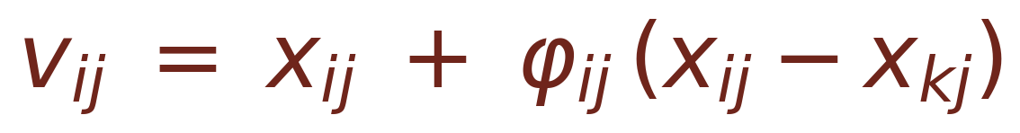
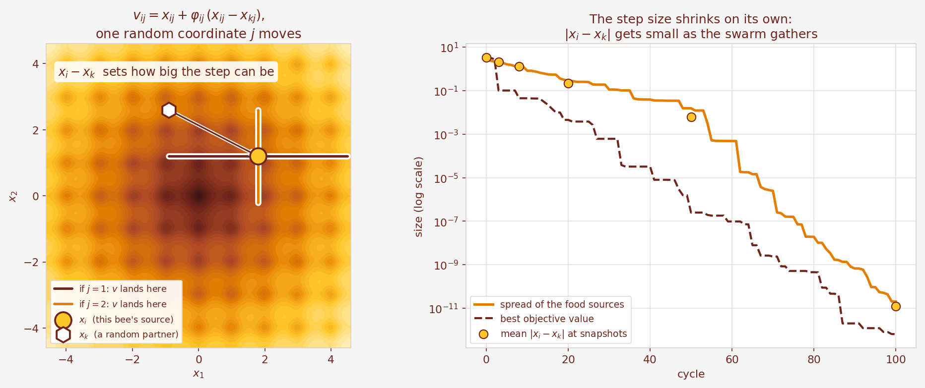
03 - THE EQUATIONS
How a bee searches nearby
φ = rand(−1, 1)
k ≠ i, another source
j = one random coordinate
The step is a fraction of the gap to another bee — so it shrinks by itself.
14 September 2026
ACKLEY x ARTIFICIAL BEE COLONY
10
Notes:
SLIDE 10 - How a bee searches nearby
Target: 70 seconds
This single equation is the heart of the algorithm. To search near its own source, a bee picks another bee at random, picks one of the two coordinates, and moves that coordinate by a random fraction of the gap between the two bees. Phi is a random number between minus one and plus one, so the bee may step towards the other source or away from it. The left picture shows exactly where the new point can land. Now look at the right picture, because this is the clever part. The step size is the gap between two bees. As the colony gathers near the answer, that gap shrinks, so the steps shrink too. Nobody has to design a shrinking schedule. In our Genetic Algorithm we had to invent one by hand.
VISUAL / DELIVERY
07_neighbour_step.png: where the trial point can land, and the self-shrinking step.
Source: Ackley_ABC_Solution.ipynb; every number reproduced by review/experiments.py.

Slide 11
03 - THE EQUATIONS
Keep the better one
old source xᵢ
trial point vᵢ
compare f(xᵢ) with f(vᵢ)
vᵢ is better
vᵢ is worse
Replace the source with vᵢ.
Reset its trial counter to 0.
Keep the old source.
Add one to its trial counter.
trial → 0
trial → trial + 1
Greedy selection: a food source can never get worse. The counter is what scouts watch.
14 September 2026
ACKLEY x ARTIFICIAL BEE COLONY
11
Notes:
SLIDE 11 - Keep the better one
Target: 45 seconds
After a bee makes a trial point, it tastes it and compares. If the new point is better, it replaces the old source and the trial counter for that source goes back to zero. If the new point is worse, the old source stays and the trial counter goes up by one. This is called greedy selection, and it means no food source can ever get worse. The trial counter is a simple record of how long a source has been stuck, and it is the number the scouts watch.
VISUAL / DELIVERY
Native before-and-after diagram with the trial counter.
Source: Ackley_ABC_Solution.ipynb; every number reproduced by review/experiments.py.

Slide 12
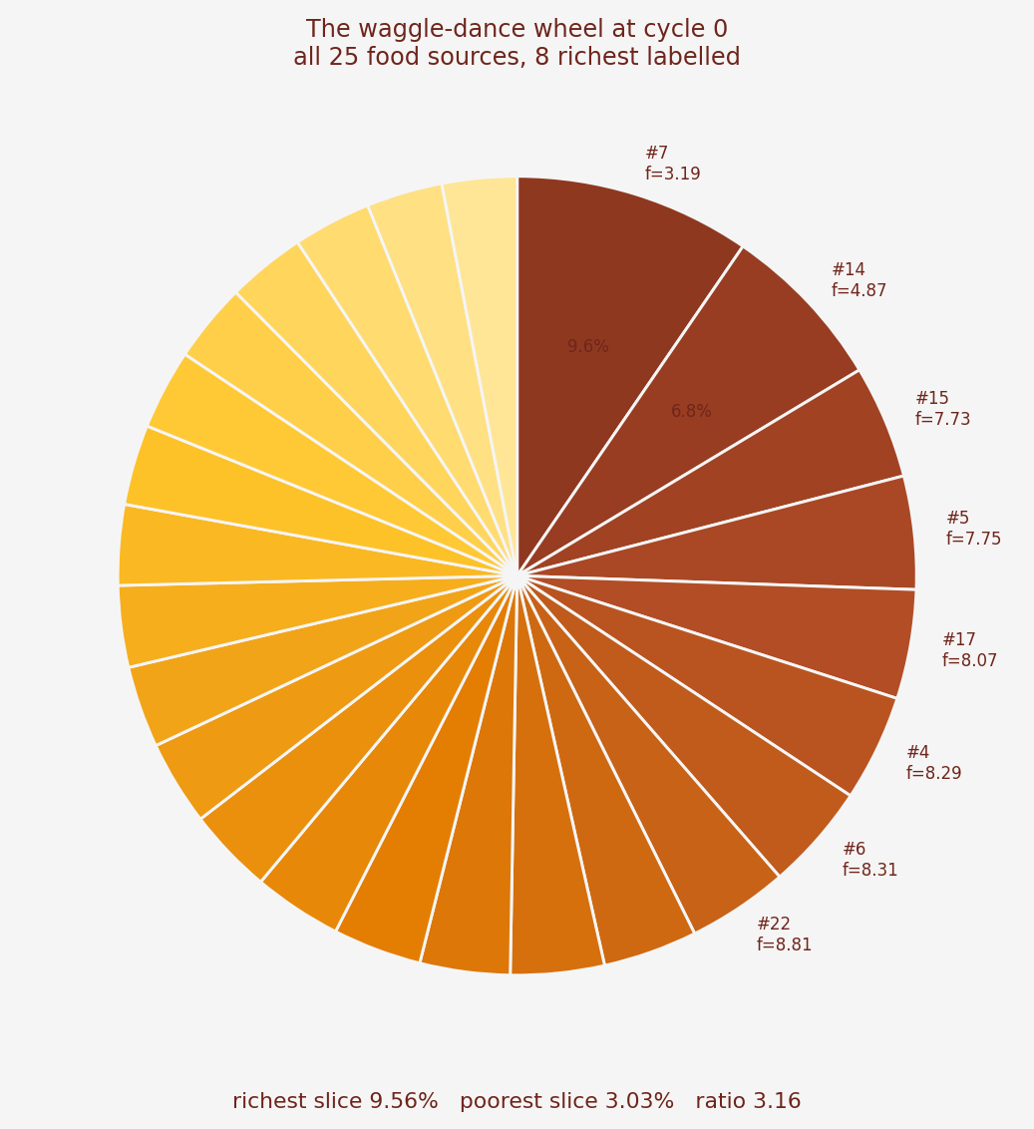
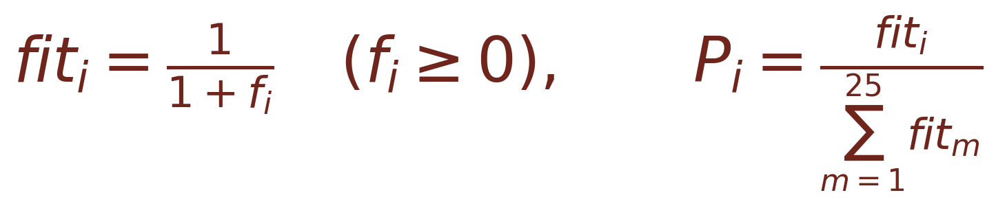
03 - THE EQUATIONS
Better sources get larger slices
LOWER f → MORE NECTAR
Ackley is never negative, so the second branch of
the standard rule is never used here.
Source | f | Share of wheel
#7 (richest) | 3.19 | 9.56 %
#14 | 4.87 | 6.82 %
#15 | 7.73 | 4.59 %
#3 (poorest) | 12.23 | 3.03 %
Each of the 25 onlookers spins this wheel once. Even the poorest source keeps 3 %.
14 September 2026
ACKLEY x ARTIFICIAL BEE COLONY
12
Notes:
SLIDE 12 - Better sources get larger slices
Target: 65 seconds
Roulette selection gives more chances to a bigger number, but for us a smaller Ackley value is better. So we flip it: the nectar amount is one divided by one plus the function value. Ackley is never negative, so this is always between zero and one, and a lower function value always gives more nectar. Slide twenty-five then divides each nectar amount by the total, which gives the probability of each source. The pie chart shows all twenty-five slices at cycle zero. The richest source owns about nine and a half percent of the wheel and the poorest about three percent, so even the worst source keeps a real chance.
VISUAL / DELIVERY
04_roulette_pie_cycle0.png with the cycle-0 table.
Source: Ackley_ABC_Solution.ipynb; every number reproduced by review/experiments.py.

Slide 13
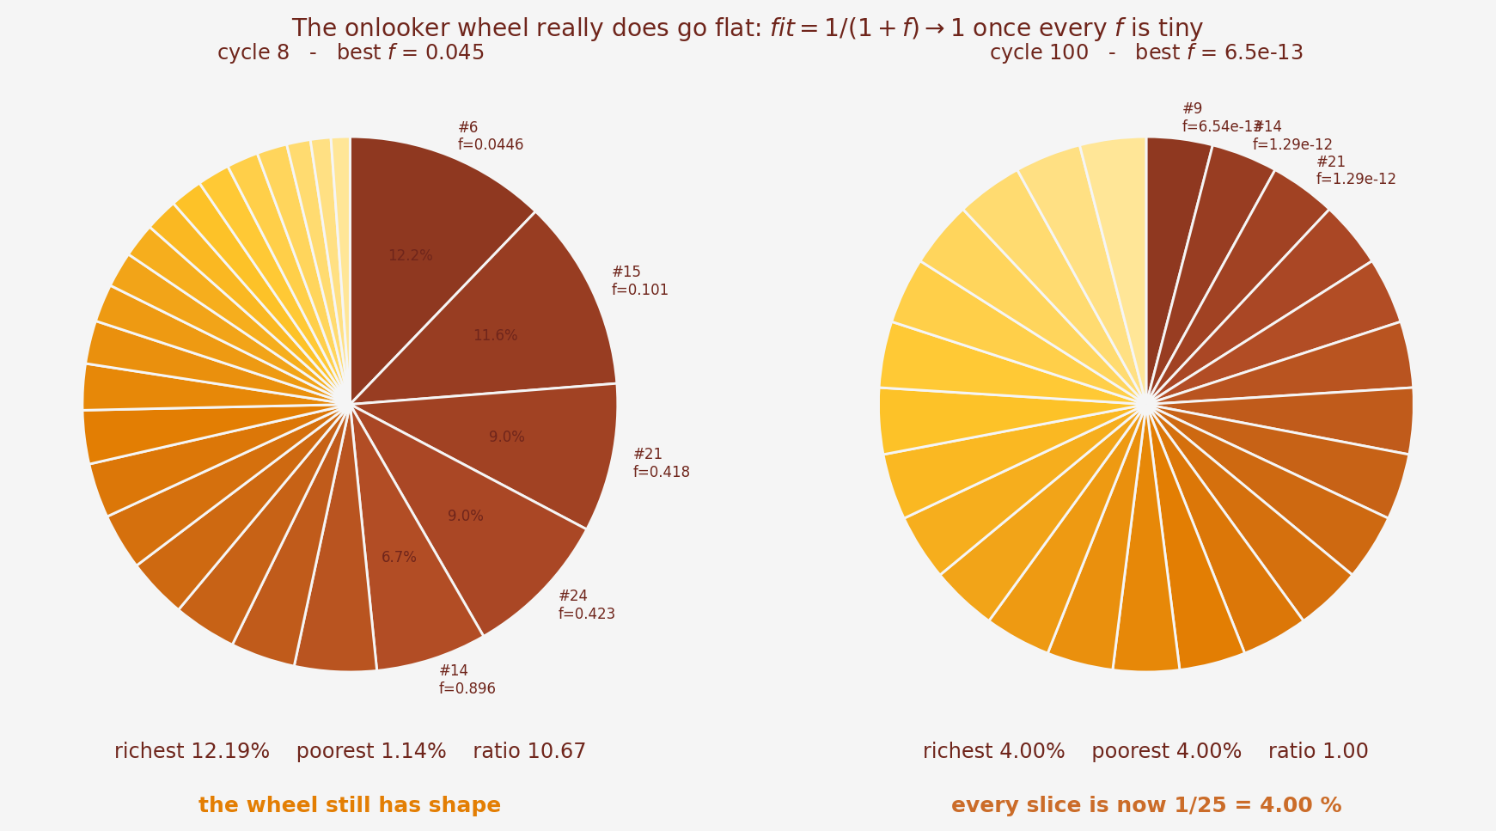
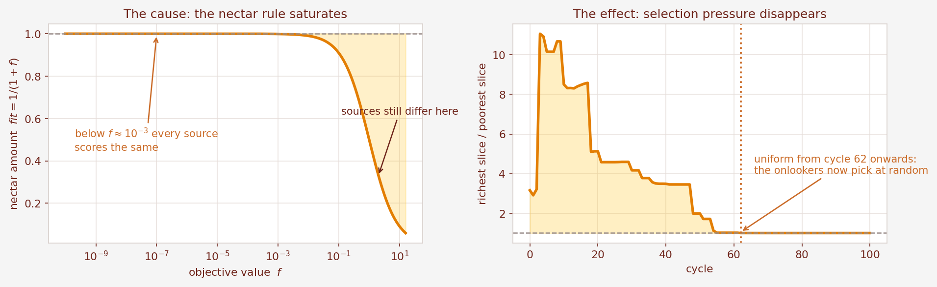
04 - WHAT WE FOUND
Something the slides do not mention
01
The nectar rule has a ceiling
02
So the wheel goes flat
fit = 1/(1+f) can never be larger than 1.
From cycle 62 every slice is exactly 4.00 %.
We measured it instead of guessing. The next slide shows what it actually costs.
14 September 2026
ACKLEY x ARTIFICIAL BEE COLONY
13
Notes:
SLIDE 13 - Something the slides do not mention
Target: 65 seconds
Here is something we noticed that the slides do not mention. The nectar formula is squeezed between zero and one. Once every source has a function value below about one thousandth, every nectar value rounds to one, so every slice of the wheel becomes exactly one twenty-fifth. From cycle sixty-two onwards our onlookers are choosing completely at random. That sounds like a serious bug, so we tested it instead of guessing. We also tried two published alternatives that keep the wheel sharp. The next slide shows the measurement, and the answer is not what we expected.
VISUAL / DELIVERY
05_roulette_early_vs_late.png and 06_wheel_pressure.png.
Source: Ackley_ABC_Solution.ipynb; every number reproduced by review/experiments.py.

Slide 14
04 - WHAT WE FOUND
Which part of ABC actually matters?
Every row changes one thing and runs the same 40 seeds (0–39).
What we changed | median f | worst f | reached 10⁻⁶ | scouts sent
full ABC as taught | 5.476e-13 | 1.034e-11 | 40 / 40 | 0
no onlooker phase | 2.999e-07 | 4.262e-06 | 36 / 40 | 0
no scout phase | 5.476e-13 | 1.034e-11 | 40 / 40 | 0
perturb both coordinates | 2.509e-13 | 4.267e-12 | 40 / 40 | 0
limit = 10 | 2.256e-06 | 1.071e-04 | 16 / 40 | 1,562
limit = 5 | 5.358e-04 | 1.248e-02 | 0 / 40 | 2,107
colony 10 (5 sources) | 2.647e-04 | 4.121e-01 | 11 / 40 | 260
Onlookers do the precision work
Scouts never fired here
A small limit is destructive
Remove them and the median is 500,000x worse.
Turning them off changed nothing at all.
limit = 5 threw away good sources: 0 / 40.
14 September 2026
ACKLEY x ARTIFICIAL BEE COLONY
14
Notes:
SLIDE 14 - Which part of ABC actually matters?
Target: 75 seconds
This table is the most useful thing we did. Each row changes one thing and runs the same forty seeds. Three results stand out. First, the onlooker phase is what makes the answer precise. Taking it away makes the median result five hundred thousand times worse, and four runs miss the target. Second, and this surprised us, the scout phase never fires at all on this problem. Turning it off changes nothing, because the bees always find some improvement before any counter reaches fifty. Third, the limit is the dangerous knob. Set it to five and the colony panics, sends over two thousand scouts, throws away good sources faster than it can refine them, and not a single run reaches the target. The probability rule hardly matters, which also answers the previous slide: by the time the wheel goes flat, every source is already in the right valley.
VISUAL / DELIVERY
Measured ablation table, 40 seeds per row.
Source: Ackley_ABC_Solution.ipynb; every number reproduced by review/experiments.py.

Slide 15
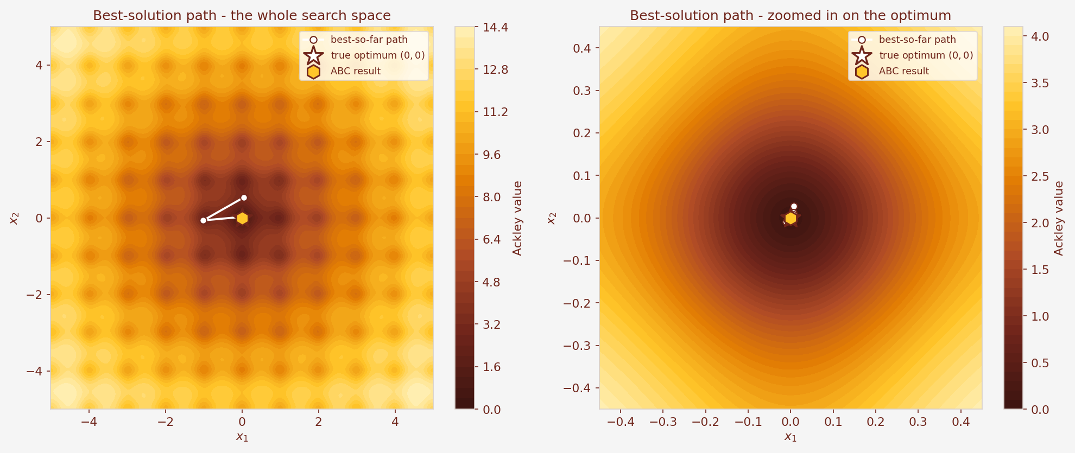
05 - RESULTS
Our result is very close to (0, 0)
6.541 × 10⁻¹³
best Ackley value, seed 7
99 / 100
cycle the best was found
5,025
Ackley evaluations used, 0 scouts
x₁ = +2.278 × 10⁻¹³ x₂ = −3.938 × 10⁻¹⁴ distance = 2.312 × 10⁻¹³
random search: 0.769
14 September 2026
ACKLEY x ARTIFICIAL BEE COLONY
15
Notes:
SLIDE 15 - Our result is very close to (0, 0)
Target: 55 seconds
Here is our main run, with seed seven so anyone can repeat it exactly. The best point sits about two times ten to the minus thirteen away from the true answer, and the function value there is six point five times ten to the minus thirteen. The left picture shows the path of the best answer across the whole square, and the right picture zooms in near the centre. You can see the bees exploring widely at first, then making smaller and smaller corrections. The whole run used five thousand and twenty-five evaluations, and needed no scouts at all.
VISUAL / DELIVERY
09_best_solution_path.png with the headline numbers.
Source: Ackley_ABC_Solution.ipynb; every number reproduced by review/experiments.py.

Slide 16
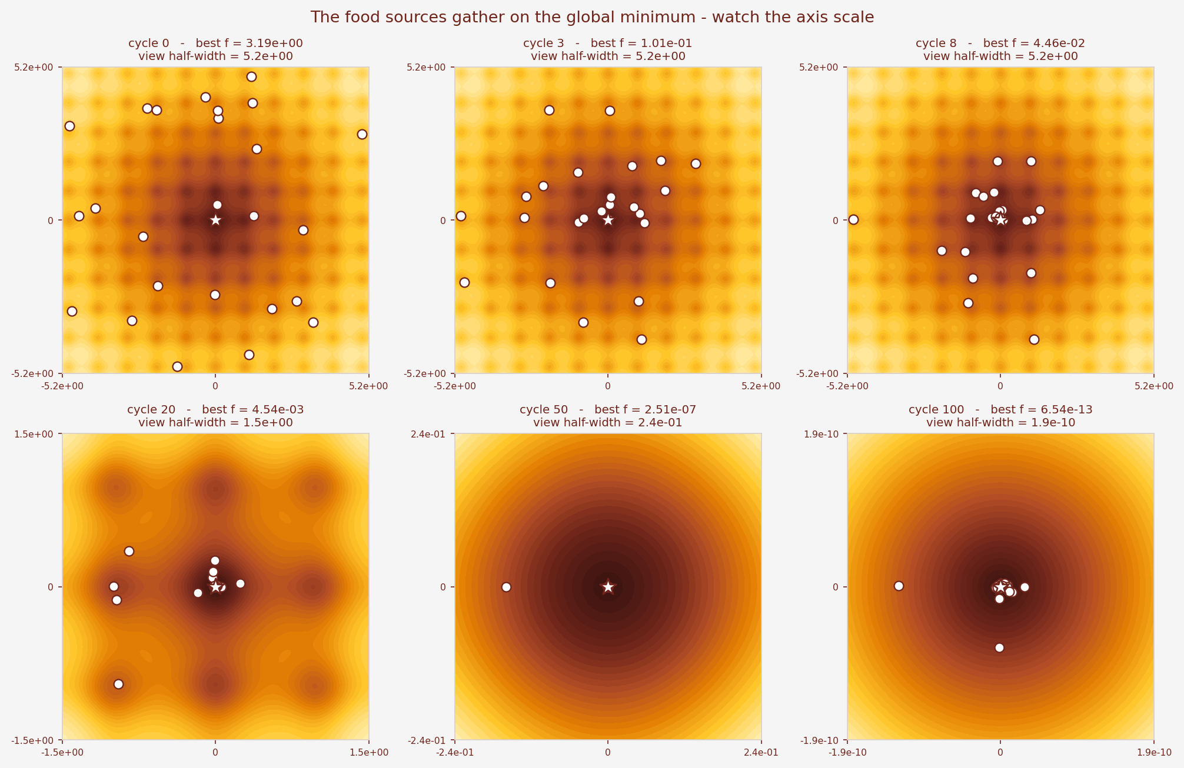
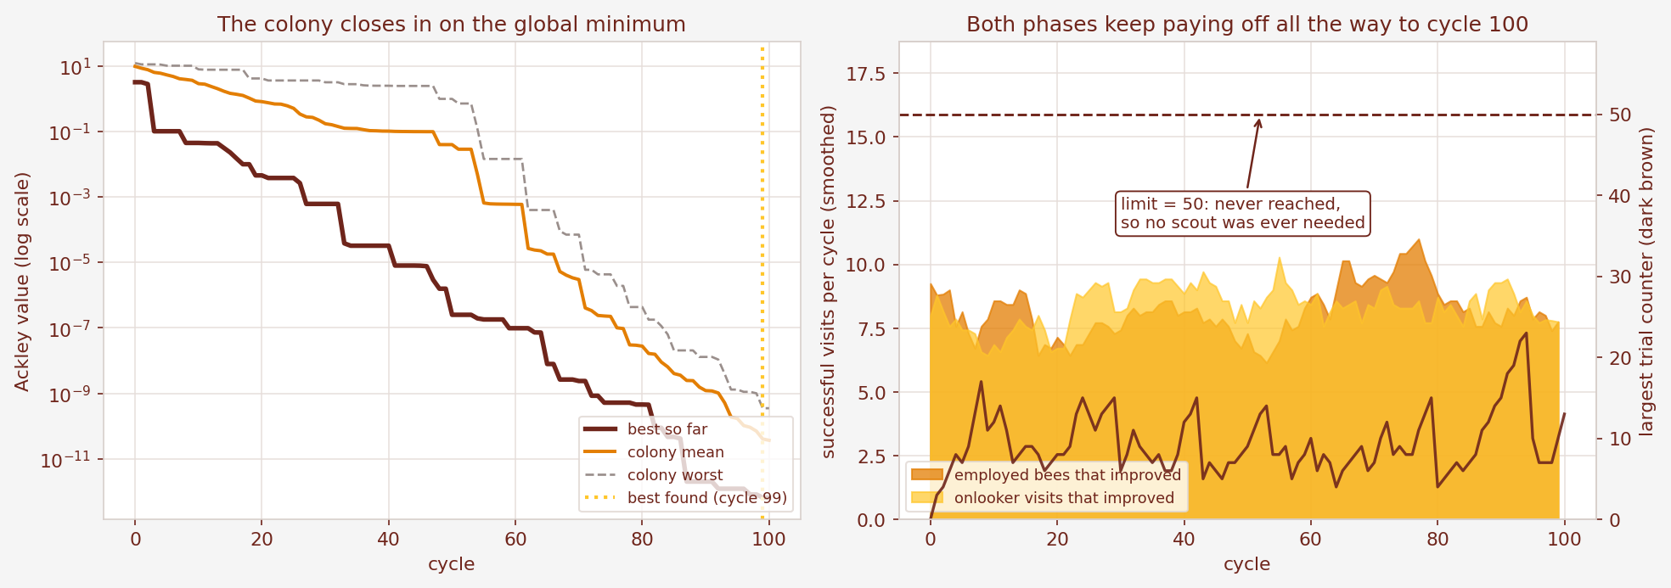
05 - RESULTS
The colony closing in
The best value never rises
it is memorised at the end of every cycle
Both phases keep working
improvements continue right up to cycle 100
The trial counter peaked at 23
the limit of 50 was never reached, so no scout flew
the colony contracts
Read the axis numbers on the snapshots: the last panel is only 2 × 10⁻¹⁰ wide.
14 September 2026
ACKLEY x ARTIFICIAL BEE COLONY
16
Notes:
SLIDE 16 - The colony closing in
Target: 55 seconds
The left graph tracks the best, the average and the worst source. The best line only ever goes down, because we memorise it every cycle. The middle graph shows that both bee phases keep finding improvements all the way to cycle one hundred: the search never actually finishes. The dark brown line is the largest trial counter. It peaked at twenty-three, nowhere near the limit of fifty, which is why no scout was ever sent. In the snapshots, please read the axis numbers. Each panel is zoomed in much further than the one before. By cycle one hundred the whole picture is only about two times ten to the minus ten wide.
VISUAL / DELIVERY
08_convergence_and_work.png and 10_source_snapshots.png.
Source: Ackley_ABC_Solution.ipynb; every number reproduced by review/experiments.py.

Slide 17
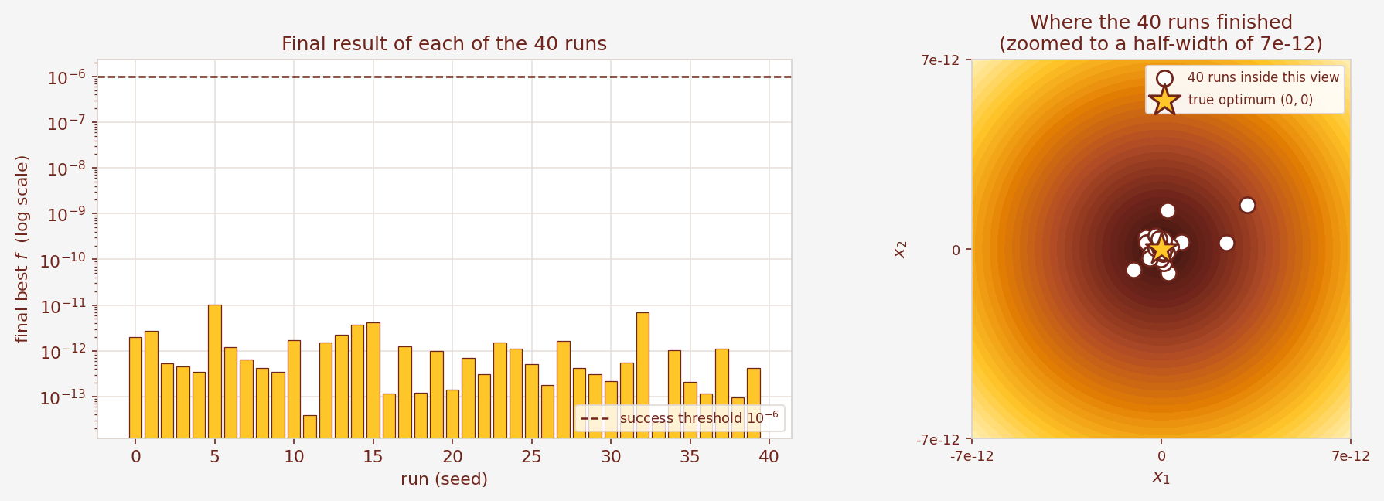
05 - RESULTS
All 40 runs met the target
40 / 40
5.476 × 10⁻¹³
1.034 × 10⁻¹¹
runs finished below 10⁻⁶
median final value
worst final value
Evidence of reliability on this problem — not a guarantee for every possible run.
14 September 2026
ACKLEY x ARTIFICIAL BEE COLONY
17
Notes:
SLIDE 17 - All 40 runs met the target
Target: 55 seconds
One good run proves very little, so we ran forty, changing only the random seed. Every single one finished below our target of ten to the minus six. The median was five point five times ten to the minus thirteen and even the worst run reached ten to the minus eleven. The right panel is zoomed to a width of about seven times ten to the minus twelve, which is the only way to see the forty points separately. For comparison, pure random search with exactly the same number of evaluations only reached zero point seven seven. This is good evidence of reliability, but it is forty runs on one problem, not a guarantee.
VISUAL / DELIVERY
11_reliability_40_runs.png.
Source: Ackley_ABC_Solution.ipynb; every number reproduced by review/experiments.py.

Slide 18
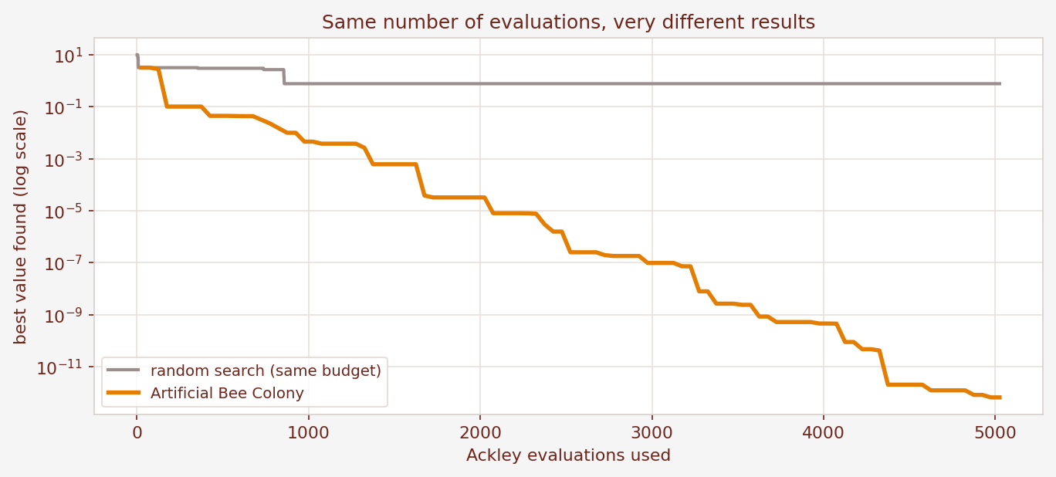
06 - CONCLUSION
Bees next to genes
 | Genetic Algorithm | Artificial Bee Colony
Ackley evaluations | 5,050 | 5,025
Median of 40 runs | 1.636e-12 | 5.476e-13
Worst of 40 runs | 3.137e-11 | 1.034e-11
Runs below 1e-6 | 40 / 40 | 40 / 40
Parameters to tune | 5 | 1
The same evaluation budget, spent differently
The Genetic Algorithm needed a crossover rate, a mutation rate, a mutation-step
rule, elitism and a duplicate cap. ABC needed one number: the limit.
Same reliability, three times closer,
one parameter to tune instead of five.
One function, two dimensions, 40 seeds. Evidence — not a claim about every problem.
14 September 2026
ACKLEY x ARTIFICIAL BEE COLONY
18
Notes:
SLIDE 18 - Bees next to genes
Target: 60 seconds
Because we solved the same problem twice, we can compare honestly. Both methods are reliable: forty out of forty runs for each. The bee colony landed about three times closer to zero, using one and a half percent more evaluations. But the clearer difference is on the last row. For the Genetic Algorithm we had to choose a crossover rate, a mutation rate, a mutation step rule, elitism, and a duplicate cap. For the bee colony we chose one number, the limit, and the step size took care of itself. That is what slide thirty-one means by "few control parameters". We should be careful though: this is one function, in two dimensions, with one budget.
VISUAL / DELIVERY
Side-by-side comparison table and 13_budget_comparison.png.
Source: Ackley_ABC_Solution.ipynb; every number reproduced by review/experiments.py.

Slide 19
06 - CONCLUSION
What we learned
01
Three simple roles are enough
02
The step size comes free
Repeated 100 times, they reach 13 decimal places.
It is the distance between two bees, so it shrinks.
03
Test it, do not trust the diagram
04
Say what you did not test
The scout phase never ran once on this problem.
One function, two dimensions, 40 seeds.
Thank you. Questions?
2107001 · 2107004 · 2107009 · 2107015 · 2107024 · 2107047
14 September 2026
ACKLEY x ARTIFICIAL BEE COLONY
19
Notes:
SLIDE 19 - What we learned
Target: 50 seconds
To finish, four things we learned. First, three very simple bee roles, repeated one hundred times, are enough to find the answer to thirteen decimal places. Second, the step size comes free from the distance between bees, which removes the hardest thing we had to tune in the Genetic Algorithm. Third, and most important for us as students, we should test an algorithm rather than trust its diagram. The scout phase looks essential on every flowchart, and on this problem it never ran once. And fourth, we should state our limits honestly: this is one function, in two dimensions, measured over forty seeds. Thank you, sir. We are happy to take questions.
VISUAL / DELIVERY
Closing panels with the hive illustration.
Source: Ackley_ABC_Solution.ipynb; every number reproduced by review/experiments.py.

