Slide 1
Finding the Global Minimum of the
2-D Ackley Function
Solving a Classic, Multi-Modal Optimization Problem Using a Genetic Algorithm
SUBMITTED BY
SUBMITTED TO
Afifa Sultana – 2107087
Dr. Al-Mahmud
Professor
Department of Computer Science and Engineering
Khulna University of Engineering and Technology
Sadia Mostafa – 2107095
Newaz Mohammad Hamim – 2107106
Shormi Ghosh – 2107109
Biposhyan chakma– 2107121
CSE 4111 - Machine Learning
September 13, 2026
Page 1 of 16

Slide 2
Problem Statement and Objective
The task is to use a Genetic Algorithm to find the global minimum of the two-dimensional Ackley function.
The decision variables x₁ and x₂ must both lie inside the search interval [-5, 5].
The genetic algorithm is never given the answer directly. It has to discover a point close to (0, 0) purely by repeatedly improving a population of candidate solutions, generation after generation.
SEARCH RANGE
x₁, x₂ ∈ [-5, 5]
KNOWN GLOBAL OPTIMUM
(x₁, x₂) = (0, 0)
MINIMUM FUNCTION VALUE
f(0, 0) = 0
CSE 4111 - Machine Learning
September 13, 2026
Page 2 of 16

Slide 3
The Ackley Function
General definition, then derived for this assignment's two-variable case
General n-dimensional form:
f(x) = -a·exp[-b√((1/n)Σxᵢ²)] - exp[(1/n)Σcos(cxᵢ)] + a + e
1
Fix the assignment's constants
Set n = 2 (two variables), a = 20, b = 0.2, and c = 2π.
2
Expand the summation for two genes
(1/n)Σxᵢ² becomes (x₁²+x₂²)/2, and (1/n)Σcos(cxᵢ) becomes (cos(2πx₁)+cos(2πx₂))/2.
3
Substitute back into the general form
This produces the exact two-dimensional Ackley function used in the code and in this project.
Two-dimensional Ackley function used in this assignment:
f(x₁,x₂) = -20·exp[-0.2√((x₁²+x₂²)/2)] - exp[(cos(2πx₁)+cos(2πx₂))/2] + 20 + e
CSE 4111 - Machine Learning
September 13, 2026
Page 3 of 16

Slide 4
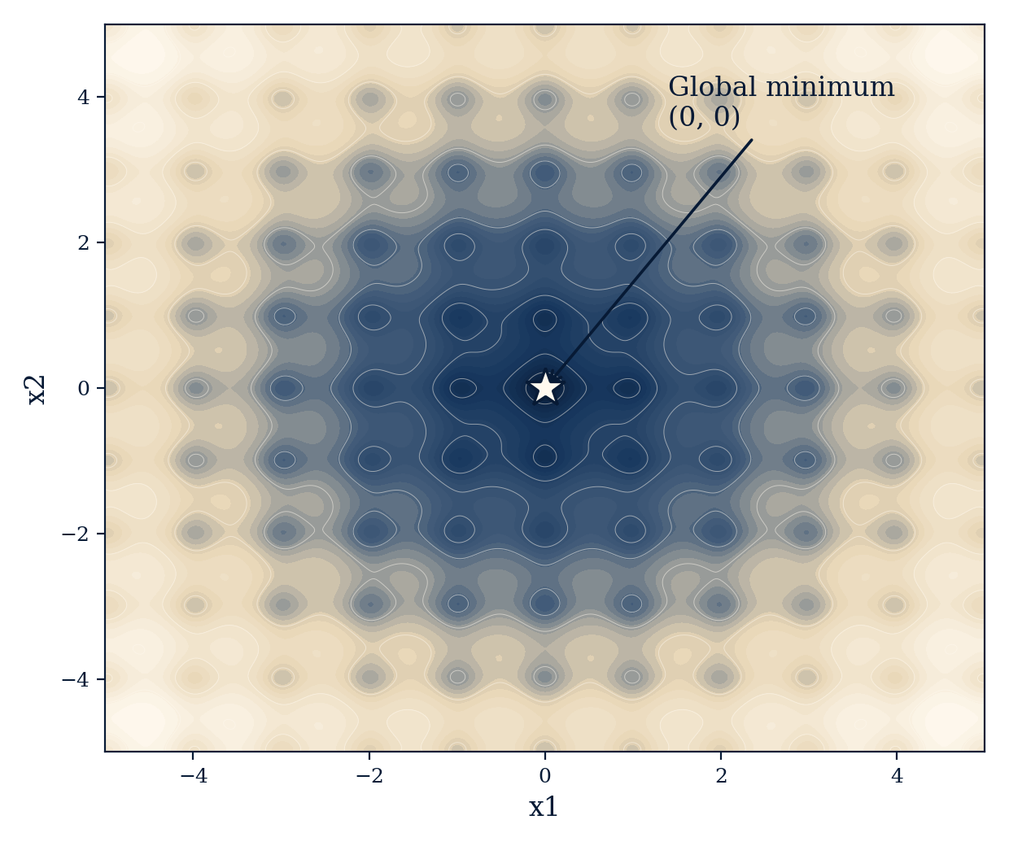
Why the Ackley Function Is a Hard Optimization Problem
The exponential term creates one wide, smooth basin that generally points every candidate toward the origin.
The cosine term layers many small ripples across that basin, so the whole surface is covered with local minima, visible above as the ring-like dips surrounding the centre.
A simple hill-climbing or gradient-based search can easily settle inside one of these local dips and never reach the true minimum.
A genetic algorithm instead keeps a whole population of candidate points spread across the search space, so it keeps exploring even while some individuals fall into local minima.
CSE 4111 - Machine Learning
September 13, 2026
Page 4 of 16

Slide 5
Representing a Solution: Chromosome Encoding
Chromosome = [ x₁, x₂ ]
Because the problem has two variables, one chromosome contains exactly two genes.
This is real-value (value) encoding: the actual floating-point numbers are stored directly, never translated into binary strings.
Every gene must stay inside the boundary [-5, 5] throughout the entire search.
x₁
x₂
Gene 1
Gene 2
EXAMPLE
[-4.0, 2.5]
means x₁ = -4.0 and x₂ = 2.5
CSE 4111 - Machine Learning
September 13, 2026
Page 5 of 16

Slide 6
GA Parameter Settings
The exact configuration used to run the genetic algorithm on the Ackley function
Population size
50 chromosomes
Search range
x₁, x₂ ∈ [-5, 5]
Generations
100 cycles
Encoding
Real-value
Crossover probability
0.80 (80%)
Selection method
Roulette wheel
Mutation probability
0.05 per gene
Crossover type
1-point
Elitism
Top 1 preserved
Mutation type
Gaussian
CSE 4111 - Machine Learning
September 13, 2026
Page 6 of 16

Slide 7
Complete Solving Steps — Part 1
How the genetic algorithm actually finds the minimum (steps 1 to 5)
1
Generate the initial population
Create 50 random chromosomes, each a point [x₁, x₂] scattered inside the search square [-5,5] × [-5,5].
2
Evaluate with the Ackley function
Substitute each chromosome's two genes into f(x₁,x₂). A smaller value means a better candidate, since this is a minimization problem.
3
Convert the objective value into fitness
Roulette-wheel selection needs higher fitness to mean better, so the code uses fitness = 1/(1+f), reversing the direction correctly.
4
Identify and preserve the elite
Find the chromosome with the smallest Ackley value and copy it unchanged into the next generation, so it can never be lost.
5
Select parents by roulette wheel
Normalize fitness into probabilities. Stronger chromosomes are more likely to be chosen, but weaker ones still keep some chance, preserving diversity.
CSE 4111 - Machine Learning
September 13, 2026
Page 7 of 16

Slide 8
Complete Solving Steps — Part 2
How the genetic algorithm actually finds the minimum (steps 6 to 11)
6
Apply one-point crossover
With 80% probability, cut both parents between gene 1 and gene 2 and swap the second parts: [a,b] and [c,d] give [a,d] and [c,b].
7
Apply Gaussian mutation
Each gene independently has a 5% chance of receiving a small, normally distributed random change, helping the search escape local minima.
8
Enforce the valid range
If mutation pushes a gene outside [-5, 5], clip it back to the nearest boundary, so every chromosome stays valid.
9
Rebuild a population of exactly 50
One elite slot plus 49 offspring keep the population size constant; elitism never grows it to 51.
10
Repeat for 100 generations
The whole cycle of evaluation, selection, crossover, mutation, and elitism runs again, so good gene combinations keep getting more chances to survive.
11
Return the best chromosome
After 100 generations, report the best [x₁, x₂] found and its Ackley value, which should now sit very close to zero.
CSE 4111 - Machine Learning
September 13, 2026
Page 8 of 16

Slide 9
Algorithm Flow
The full evolutionary cycle, from a random start to the reported best solution
Initialize 50 chromosomes
Gaussian mutation (5%)
Evaluate Ackley value
Clip genes to [-5, 5]
Convert value to fitness
continues →
Build next population of 50
Keep best 1 (elitism)
Repeat for 100 generations
Roulette-wheel selection
Return best [x₁, x₂]
1-point crossover (80%)
CSE 4111 - Machine Learning
September 13, 2026
Page 9 of 16

Slide 10
Numerical Walkthrough: One Generation Example
A small illustrative population of four chromosomes
Chromosome | Ackley value f | Fitness = 1/(1+f) | Quality
A = [-4.0, 2.5] | 10.0 | 0.0909 | Weak
B = [1.0, -1.0] | 3.0 | 0.2500 | Better
C = [0.2, 0.1] | 0.8 | 0.5556 | Best of these four
D = [3.0, 2.0] | 8.0 | 0.1111 | Weak
Chromosome C has the largest fitness because its Ackley value is the smallest, so it has the highest chance of becoming a parent.
Suppose roulette-wheel selection chooses C = [0.2, 0.1] and B = [1.0, -1.0]. One-point crossover can then produce [0.2, -1.0] and [1.0, 0.1], and mutation might turn a child into [1.0, 0.03].
Across later generations, this repeated selection, crossover, and mutation gradually produces values such as [0.2, 0.03] and [0.05, 0.03], moving ever closer to [0, 0].
CSE 4111 - Machine Learning
September 13, 2026
Page 10 of 16

Slide 11
Code Walkthrough — Core Building Blocks
The line of thought behind each foundational function
1
ackley_function(x)
Takes one chromosome and reads x[0] and x[1] as x₁ and x₂. term1 builds the exponential part with the squared variables, term2 builds the cosine part, and the function returns the Ackley value that must be minimized.
2
initialize_population()
np.random.uniform(-5, 5, (50, 2)) generates a 50×2 array. Each row is one chromosome [x₁, x₂], so the first generation contains 50 random candidate points.
3
calculate_fitness(population)
Evaluates the Ackley function for every chromosome to get real objective values, then applies fitness = 1/(1+value), so a lower Ackley value produces a higher fitness.
4
roulette_selection(population, fitness)
Divides each fitness by the total to get selection probabilities, then np.random.choice picks an index. Stronger chromosomes are favoured, but selection stays stochastic.
CSE 4111 - Machine Learning
September 13, 2026
Page 11 of 16

Slide 12
Code Walkthrough — Genetic Operators and Main Loop
How the operators combine into one evolutionary cycle
1
crossover(parent1, parent2)
Children start as plain copies of the parents. With 80% probability the code cuts between gene 1 and gene 2 and uses np.concatenate to swap the tail sections between the two parents.
2
mutation(chromosome)
Each gene mutates independently with 5% probability by adding a small Gaussian value from np.random.normal(0, 0.1); np.clip then keeps every gene inside [-5, 5].
3
create_new_population(...)
np.argsort(values) finds and copies the elite chromosome first. A loop then repeatedly selects, crosses, and mutates parents until the new population reaches exactly 50 members.
4
genetic_algorithm()
The main evolutionary loop: it initializes the population, evaluates it every generation, tracks the best chromosome found so far, records it for the convergence curve, and builds the next generation for 100 rounds.
CSE 4111 - Machine Learning
September 13, 2026
Page 12 of 16

Slide 13
Why This Combination of GA Operators Works
Operator | What It Does | Why It Matters Here
Selection | Prefers chromosomes with larger fitness. | Pushes the population toward regions with lower Ackley values.
Crossover | Combines genes from two parents. | Reuses useful coordinates already discovered by the population.
Mutation | Adds small random changes. | Introduces new values and helps escape local minima.
Elitism | Copies the best chromosome unchanged. | Prevents the best solution found so far from being lost.
Repeated generations | Runs the same evolutionary cycle again and again. | Gradually concentrates the search around the global optimum.
CSE 4111 - Machine Learning
September 13, 2026
Page 13 of 16

Slide 14
Results: Expected vs Obtained
Comparing the theoretical global optimum with the genetic algorithm's actual run
THEORETICAL GLOBAL MINIMUM
OBTAINED BY THE GA (SEEDED RUN)
x₁* = 0
x₂* = 0
f(x₁*, x₂*) = 0
x₁ ≈ -0.00113062
x₂ ≈ 0.00024329
f(x₁, x₂) ≈ 0.00330668
This is a successful result: both coordinates and the function value are extremely close to zero, showing the population converged tightly around the true global optimum.
A genetic algorithm is stochastic, so it does not have to return exactly [0, 0] on every run. The goal is to converge sufficiently close to the global optimum, which this run clearly achieves.
CSE 4111 - Machine Learning
September 13, 2026
Page 14 of 16

Slide 15
Convergence Curve Across 100 Generations
Best-so-far Ackley value plotted after every generation
The curve drops sharply within the first twenty generations and then flattens as the population settles near the global minimum. Because elitism always protects the best chromosome, this best-so-far curve never rises.
CSE 4111 - Machine Learning
September 13, 2026
Page 15 of 16

Slide 16
Final Understanding of the Whole Solution
The genetic algorithm begins with no knowledge of where the optimum lies. It only knows the search range and the Ackley function itself.
The fitness transformation makes low Ackley values desirable for roulette selection, so selection repeatedly gives better chromosomes more opportunities to reproduce.
Crossover combines coordinates from selected parents, mutation creates new nearby coordinates, and elitism keeps the best point safe from every generation onward.
After many generations, these mechanisms shift the population toward the region that consistently produces the smallest objective values — centred at (0, 0) — so the best chromosome approaches [0, 0] and its function value approaches 0.
CSE 4111 - Machine Learning
September 13, 2026
Page 16 of 16

Slide 17
THANK YOU
CSE 4111 - Machine Learning
September 13, 2026
Page 16 of 16

