Slide 1
CSE 4111 · MACHINE LEARNING
GENETIC ALGORITHM · GROUP PRESENTATION
Finding the
Global Minimum
The 2-D Ackley function using a Genetic Algorithm
SUBMITTED TO
Dr. Al-Mahmud
Professor, Department of CSE, KUET
SUBMITTED BY
2107001 · 2107004 · 2107009
2107015 · 2107024 · 2107047
14 September 2026
ACKLEY × GENETIC ALGORITHM
01 / 18
Notes:
SLIDE 1 — Finding the global minimum
Target: 30 seconds
Good morning, sir. Our project is about finding the lowest point of the two-dimensional Ackley function using a Genetic Algorithm. We will explain the problem, show how our algorithm works, and discuss the results. We will also show two changes that improved our first version.
VISUAL / DELIVERY
Original template DNA illustration.
Source: Ackley_GA_Solution.ipynb; numerical results independently reproduced.

Slide 2
01 · THE PROBLEM
Find the Lowest Point
The Goal
x₂
Choose x₁ and x₂ to make f as small as possible.
The Search Range
Both coordinates stay between −5 and +5.
x₁
(0, 0)
The Known Answer
x* = (0, 0) and f(x*) = 0
−5
+5
The search evaluates candidate points; it is not given the answer coordinates.
14 September 2026
ACKLEY × GENETIC ALGORITHM
02 / 18
Notes:
SLIDE 2 — Find the lowest point
Target: 45 seconds
We need to find two numbers, x-one and x-two, that give the smallest function value. Each number must stay between minus five and plus five. The known answer is zero, zero, where the function value is zero. We use this point to check our result. We do not insert it into the population or direct the search toward it. The search chooses points and evaluates their function values.
VISUAL / DELIVERY
Native coordinate diagram: allowed square and known optimum.
Source: Ackley_GA_Solution.ipynb; numerical results independently reproduced.

Slide 3
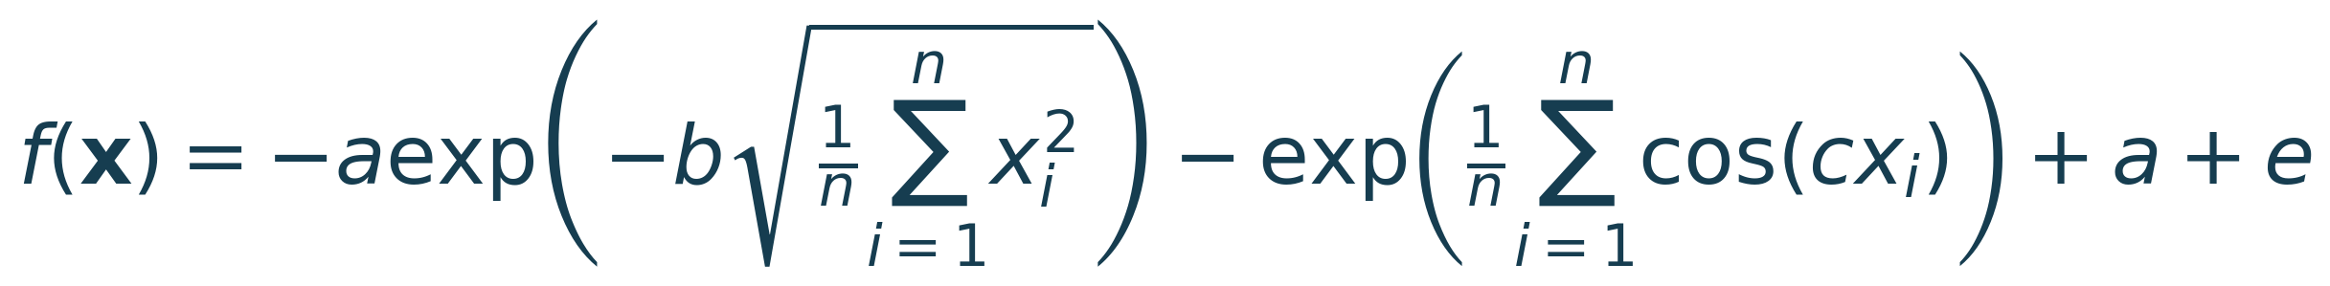
01 · THE PROBLEM
The Ackley Function in 2-D
START WITH n VARIABLES
Set n = 2
Expand the two sums
Use a=20, b=0.2, c=2π
THE FUNCTION IN OUR CODE
At the origin: −20 − e + 20 + e = 0
14 September 2026
ACKLEY × GENETIC ALGORITHM
03 / 18
Notes:
SLIDE 3 — The Ackley function in 2-D
Target: 55 seconds
The top formula works for any number of variables. Our problem has two variables, so we set n equal to two. We use the standard constants: a is twenty, b is zero point two, and c is two pi. Each sum now contains just two terms. This gives the lower formula used in our code. To check the answer, put zero into both variables. The first part becomes minus twenty, and the second becomes minus e. The remaining terms cancel them, so the mathematical value is zero.
VISUAL / DELIVERY
Typeset equations, with a three-step substitution guide.
Source: Ackley_GA_Solution.ipynb; numerical results independently reproduced.

Slide 4
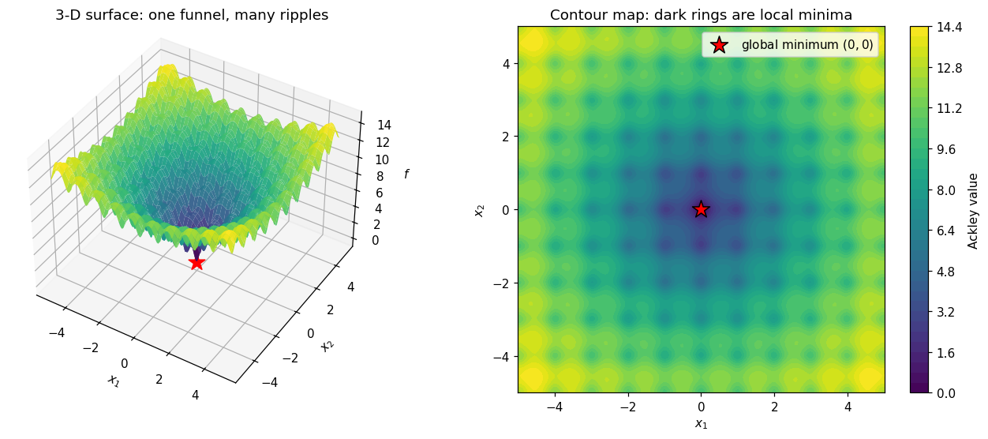
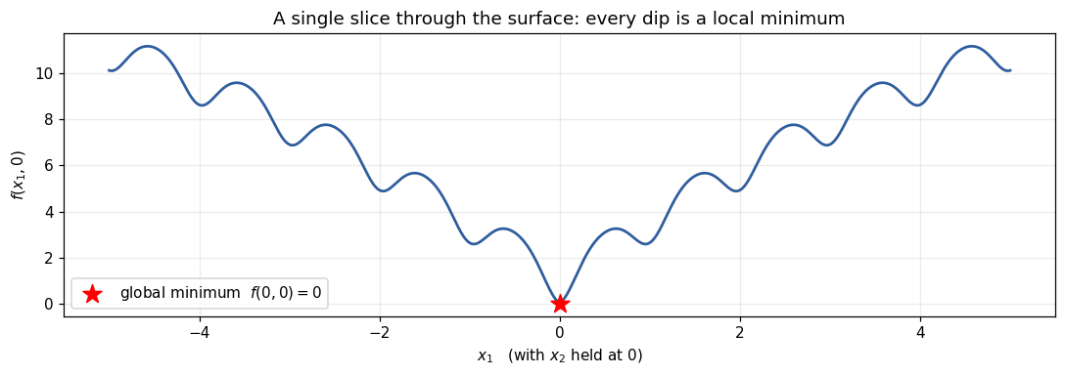
01 · THE PROBLEM
One Deep Minimum. Many Small Traps.
A wide funnel
The smooth part points toward the centre.
Many local dips
The cosine part adds small traps.
Expensive to scan
A 10⁻⁶ grid needs about 10¹⁴ points.
A downhill method can stop
in a local minimum.
14 September 2026
ACKLEY × GENETIC ALGORITHM
04 / 18
Notes:
SLIDE 4 — One deep minimum. Many small traps.
Target: 55 seconds
These pictures show why Ackley is difficult. The overall surface slopes toward the centre, but it also contains many small dips. We call these local minima. They are lower than nearby points, but they are not the lowest point of the whole surface. A method that follows the local downhill direction can get stuck in one of them. Trying every point is also expensive. A grid with one-millionth spacing across this square would contain about ten to the fourteen points. We need a search that can explore several areas.
VISUAL / DELIVERY
01_ackley_landscape.png; 02_ackley_slice.png.
Source: Ackley_GA_Solution.ipynb; numerical results independently reproduced.

Slide 5
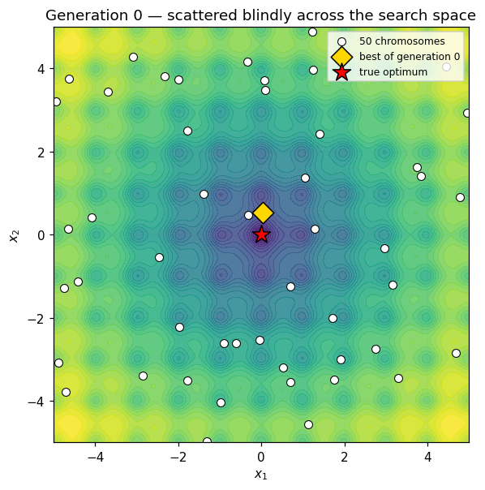
02 · THE GENETIC ALGORITHM
Search with a Population
BIOLOGY → OUR PROGRAM
Term | Meaning
Population | 50 candidate points
Chromosome | One pair [x₁, x₂]
Gene | One coordinate
Fitness | Selection weight
Evaluate → select → mix → mutate → repeat
A population explores many points. Better candidates get more chances to reproduce.
14 September 2026
ACKLEY × GENETIC ALGORITHM
05 / 18
Notes:
SLIDE 5 — Search with a population
Target: 50 seconds
A Genetic Algorithm is inspired by natural selection. We start with fifty possible answers, shown by the points in this figure. Each answer is called a chromosome. It stores two genes: x-one and x-two. We evaluate all fifty points. Better points get a higher chance of becoming parents. We then mix the parents and make small random changes to their children. Repeating this process can move the population toward better areas. The method does not need a derivative, but it does not guarantee success on every problem.
VISUAL / DELIVERY
03_initial_population.png.
Source: Ackley_GA_Solution.ipynb; numerical results independently reproduced.

Slide 6
02 · THE GENETIC ALGORITHM
One Solution = Two Real Numbers
VALUE ENCODING
GENE 1
GENE 2
x₁
x₂
One chromosome
Example A | Example B
[−4.0, 2.5] | [−1.5, −1.0]
Each gene stays in [−5, +5]. Real-valued encoding still has finite computer precision.
14 September 2026
ACKLEY × GENETIC ALGORITHM
06 / 18
Notes:
SLIDE 6 — One solution = two real numbers
Target: 40 seconds
Our representation is simple. Each chromosome stores the two actual coordinate values. This is called value encoding. For example, minus four and two point five form one candidate answer. We use real-valued numbers instead of a fixed-length binary chromosome. This avoids choosing a binary grid size in advance. It does not give unlimited accuracy, because computers still use finite precision. Throughout the run, both coordinates stay inside the allowed range.
VISUAL / DELIVERY
Editable two-gene chromosome diagram.
Source: Ackley_GA_Solution.ipynb; numerical results independently reproduced.

Slide 7
02 · THE GENETIC ALGORITHM
The Settings We Used
ASSIGNMENT SETTINGS
OUR IMPLEMENTATION CHOICES
Parameter | Value
Population | 50
Max. generations | 100
Crossover | 80%
Mutation | 5% per gene
Elitism | 1
Choice | Value
Mutation type | Gaussian
Step size σ | clip(f_best/4, 10⁻¹², 2)
Exact-copy limit | 15 of 50
Tolerance / patience | 10⁻¹⁰ / 20 rounds
Main random seed | 7
Value encoding · roulette selection
One-point crossover
Probability is fixed;
step size adapts to the result.
14 September 2026
ACKLEY × GENETIC ALGORITHM
07 / 18
Notes:
SLIDE 7 — The settings we used
Target: 45 seconds
The left side contains the assignment settings: fifty chromosomes, up to one hundred generations, eighty percent crossover, five percent mutation per gene, and one elite. We also use the required value encoding, roulette selection, and one-point crossover. The right side shows our choices. We use Gaussian mutation, adjust its step size using the current best value, and limit duplicate chromosomes. We also choose a stopping tolerance and use seed seven for the main run. The seed lets us repeat the same experiment.
VISUAL / DELIVERY
Two clearly separated settings panels.
Source: Ackley_GA_Solution.ipynb; numerical results independently reproduced.

Slide 8
02 · THE GENETIC ALGORITHM
The Search Loop
1 Initialise
2 Check stopping rules
50 random points → evaluate → sort
If yes: report best and finish
NO: CONTINUE
4 Make 50 children
3 Set σ and probabilities
Crossover → mutate → clip → evaluate
Then select 50 parents by roulette
5 Choose the next 50
6 Repeat
1 elite + 49 seats, with the copy limit
Use the survivors as the next population
↺ Return to the stopping check
50 parents + 50 children → preserve the elite and fill the next population of 50.
14 September 2026
ACKLEY × GENETIC ALGORITHM
08 / 18
Notes:
SLIDE 8 — The search loop
Target: 65 seconds
This is the full search loop. First, we create fifty random points, evaluate them, and sort them from best to worst. We check whether it is time to stop. If not, we calculate the mutation step and the roulette probabilities. We select parents, apply crossover, then mutate and clip the children. After evaluating fifty children, we have fifty parents and fifty children. We keep the elite and fill the other forty-nine places from the remaining candidates, while applying the duplicate limit. This gives the next population of fifty. Then the loop repeats.
VISUAL / DELIVERY
Editable PowerPoint flowchart. Reveal the reproduction and survivor blocks on click.
Source: Ackley_GA_Solution.ipynb; numerical results independently reproduced.

Slide 9
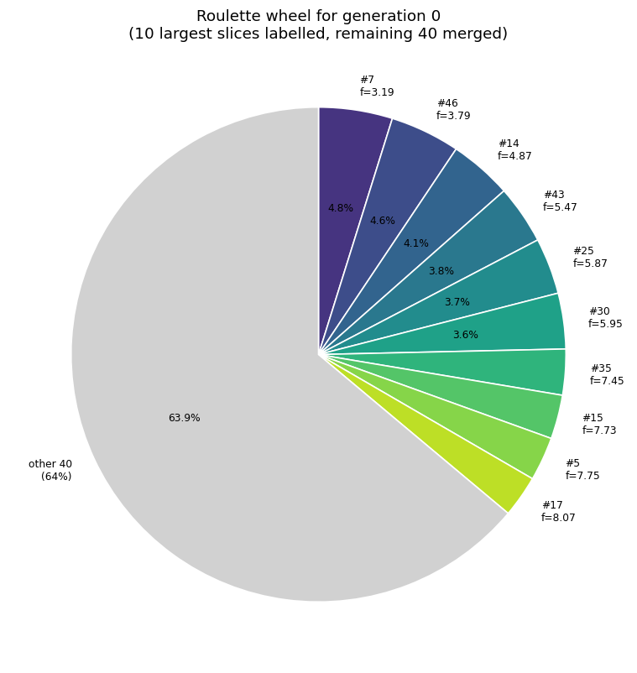
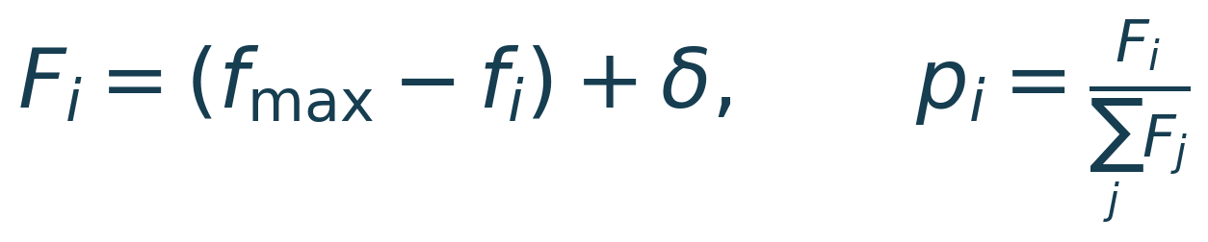
03 · THE OPERATORS
Better Points Get Larger Slices
Lower objective → higher fitness
δ = 0.10(f_max − f_min) + 10⁻¹²
Chromosome | f | Probability
#7 (best) | 3.19 | 4.83%
#46 | 3.79 | 4.57%
#14 | 4.87 | 4.10%
#45 (worst) | 13.39 | 0.44%
The code uses 50 probabilities. The chart groups the remaining 40 into one grey slice.
14 September 2026
ACKLEY × GENETIC ALGORITHM
09 / 18
Notes:
SLIDE 9 — Better points get larger slices
Target: 70 seconds
Roulette selection needs a small adjustment for our problem. A smaller Ackley value is better, but roulette selection gives more chances to a larger fitness value. So we subtract each value from the worst value and add a small positive offset. Then we divide by the total fitness to get probabilities. The probabilities add up to one. In our initial population, chromosome seven has the best value, about three point one nine. It gets about four point eight three percent of the wheel. The worst still gets a small chance. The figure shows the ten largest slices separately and groups the other forty together. The actual selection still uses fifty separate probabilities.
VISUAL / DELIVERY
04_roulette_pie_gen0.png; generation-0 table.
Source: Ackley_GA_Solution.ipynb; numerical results independently reproduced.

Slide 10
03 · THE OPERATORS
Crossover Swaps the Second Gene
PARENTS
CHILDREN
80%
swap tails
−4.0
2.5
−4.0
−1.0
−1.5
−1.0
−1.5
2.5
x₁
x₂
20%: children are unchanged copies of the parents.
Only one legal cut exists. Crossover re-pairs values that are already in the population.
14 September 2026
ACKLEY × GENETIC ALGORITHM
10 / 18
Notes:
SLIDE 10 — Crossover swaps the second gene
Target: 50 seconds
Crossover mixes two parents. With only two genes, there is just one place to cut: between x-one and x-two. We swap the second genes. In this example, the first child gets minus four from the first parent and minus one from the second. The other child gets the remaining pair. This happens with eighty percent probability. Otherwise, the children are copies of the parents. Notice that all four numbers already existed. Crossover changes how they are paired, but does not create a new coordinate value.
VISUAL / DELIVERY
Editable, colour-coded parent and child genes. Reveal the children on click.
Source: Ackley_GA_Solution.ipynb; numerical results independently reproduced.

Slide 11
03 · THE OPERATORS
Mutation Creates New Values
1 Check each gene
Each coordinate has its own 5% chance.
ILLUSTRATION · NOT A RECORDED DRAW
[−1.5, −1.0]
2 Add a random change
xᵢ ← xᵢ + N(0, σ²)
↓ first gene changes
[−0.5, −1.0]
3 Repair the boundary
Clip the changed coordinate to [−5, +5].
Boundary example: 5.3 → 5.0
The 5% probability stays fixed. The size of the change is controlled by σ.
14 September 2026
ACKLEY × GENETIC ALGORITHM
11 / 18
Notes:
SLIDE 11 — Mutation creates new values
Target: 50 seconds
Mutation gives us new coordinate values. We check each gene separately. Each gene has a five percent chance of changing. When it changes, we add a random value from a Gaussian distribution. The example shows only the first gene changing; it is an illustration, not the recorded random output. After a change, we clip the value to the allowed range. For example, five point three becomes five. The mutation probability always stays at five percent. The amount of change depends on sigma, which we explain next. Fresh random replacements in the survivor step can also add new values.
VISUAL / DELIVERY
Editable before-and-after chromosome and boundary-repair diagram.
Source: Ackley_GA_Solution.ipynb; numerical results independently reproduced.

Slide 12
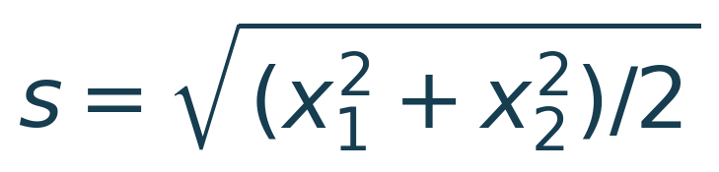
03 · THE OPERATORS
Let Progress Control the Step Size
Best value f | Step size σ
5 | 1.25
2.6 | 0.65
10⁻³ | 2.5 × 10⁻⁴
10⁻¹² | 10⁻¹² (floor)
Timed schedule
Steps shrink even when
the run is still stuck.
Our adaptive rule
σ = clip(f_best / 4, 10⁻¹², 2)
Near the origin: f ≈ 4s
f/4 estimates a local coordinate scale for Ackley; it is not the exact distance to the answer.
14 September 2026
ACKLEY × GENETIC ALGORITHM
12 / 18
Notes:
SLIDE 12 — Let progress control the step size
Target: 80 seconds
Our first version reduced the step size according to the generation number. The problem is that the steps become small even if the run is still stuck in a local dip. Our final version uses the current best function value divided by four. We keep sigma between ten to the minus twelve and two. A poor result therefore keeps larger steps, while a good result gets smaller steps for fine tuning. For example, a best value of two point six gives sigma zero point six five. The factor one quarter comes from the local shape of Ackley. Near the origin, the function is about four times the root-mean-square size of the coordinates. This is a rule chosen for Ackley, not a general distance formula. It uses function knowledge, but does not give the search the answer coordinates.
VISUAL / DELIVERY
Rule card and exact example table.
Source: Ackley_GA_Solution.ipynb; numerical results independently reproduced.

Slide 13
03 · THE OPERATORS
Keep the Best. Limit Exact Copies.
50
+
50
=
100
parents
children
candidates
1
49 more seats
Keep the elite
Best remaining candidates, with ≤15 exact copies.
If needed, fill empty seats with fresh random points.
Best parent is protected.
Elitism protects the best-so-far value. The copy limit keeps more distinct candidates.
14 September 2026
ACKLEY × GENETIC ALGORITHM
13 / 18
Notes:
SLIDE 13 — Keep the best. Limit exact copies.
Target: 55 seconds
We choose the next generation from the parents and children together. First, we reserve the best parent. This is elitism, and it means our best-so-far result cannot get worse. Then we fill the other forty-nine seats in order of quality. We allow at most fifteen exact copies of the same chromosome. This prevents one identical point from taking all fifty places. If too few candidates fit the rule, the code fills the remaining seats with fresh random points and evaluates them. The copy limit helps keep different chromosomes in the population, although they may still be very close together.
VISUAL / DELIVERY
Editable 100 → 1 elite + 49 survivors diagram. Reveal the survivor rules on click.
Source: Ackley_GA_Solution.ipynb; numerical results independently reproduced.

Slide 14
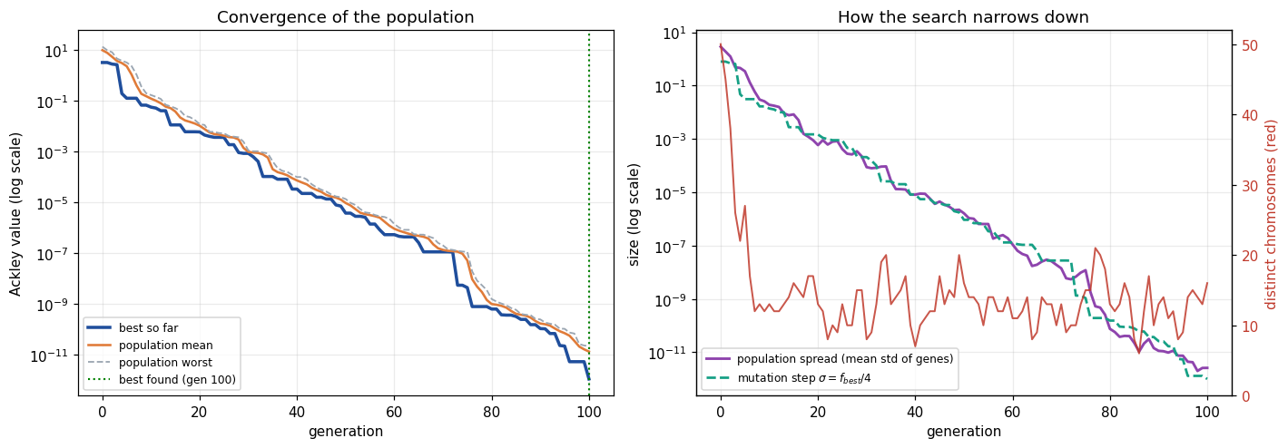
04 · RESULTS AND CHECKS
Stop after 100 Rounds; or Little Progress
100 generations
20 small improvements in a row
OR
maximum number of rounds
each improvement < 10⁻¹⁰
Note: the plotted σ label is shorthand; the code clips σ to [10⁻¹², 2].
Seed 7: f ≈ 0.00587 at generation 20; the best result arrives at generation 100.
14 September 2026
ACKLEY × GENETIC ALGORITHM
14 / 18
Notes:
SLIDE 14 — Stop after 100 rounds—or little progress
Target: 45 seconds
We stop after one hundred generations, or when the improvement is below ten to the minus ten for twenty generations in a row. One generation without improvement is normal in a random search, so we do not stop immediately. The graph uses a logarithmic scale to show improvements over many orders of magnitude. In the main run, the value is already about zero point zero zero six at generation twenty, but that is not our final precision. The best result is found at generation one hundred. A small improvement is a stopping rule, not proof that the exact optimum has been reached.
VISUAL / DELIVERY
05_convergence_and_diversity.png. Caption clarifies that σ is clipped in code.
Source: Ackley_GA_Solution.ipynb; numerical results independently reproduced.

Slide 15
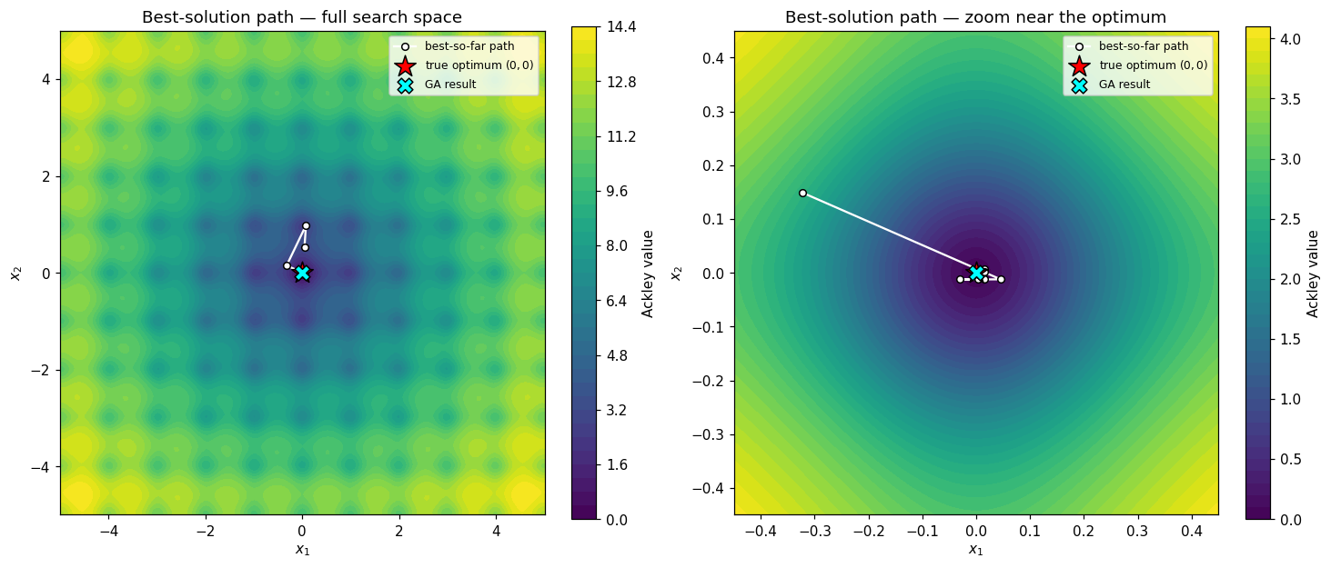
04 · RESULTS AND CHECKS
Our result is Very Close to (0, 0)
1.088 × 10⁻¹²
100
5,050
final objective value · seed 7
generation of the best result
function evaluations
x₁ = −3.436 × 10⁻¹³ x₂ = −1.730 × 10⁻¹³ distance = 3.847 × 10⁻¹³
Both coordinates have absolute error < 10⁻¹². The result is approximate.
Random search with the same seed and 5,050 evaluations: f = 0.7693. This is one comparison.
14 September 2026
ACKLEY × GENETIC ALGORITHM
15 / 18
Notes:
SLIDE 15 — Our result is very close to (0, 0)
Target: 65 seconds
These are the numbers from our main run with seed seven. Both coordinates are within ten to the minus twelve of zero. The final function value is about one point one times ten to the minus twelve. The best point was found at generation one hundred, using five thousand and fifty function evaluations. Its distance from the true answer is about three point eight times ten to the minus thirteen. For comparison, random search with the same seed and evaluation budget reached about zero point seven seven. The GA gives a much smaller objective value in this comparison. This is one baseline experiment, not a universal speed or accuracy guarantee. Our result is very close to zero, but it is still an approximation.
VISUAL / DELIVERY
06_best_solution_path.png.
Source: Ackley_GA_Solution.ipynb; numerical results independently reproduced.

Slide 16
04 · RESULTS AND CHECKS
Two Changes Solve Different Problems
Same 40 seeds in every row
Step rule | Copy cap | Median f | Worst f | In valley | Distinct
Timed | None | 5.52 × 10⁻⁹ | 2.58 | 39 / 40 | 3
Timed | 15 | 6.76 × 10⁻⁹ | 2.58 | 39 / 40 | 9
Adaptive | None | 5.00 × 10⁻¹³ | 2.31 × 10⁻¹¹ | 40 / 40 | 8
Adaptive | 15 | 1.64 × 10⁻¹² | 3.14 × 10⁻¹¹ | 40 / 40 | 13
In valley: distance to (0, 0) < 0.5. Distinct: median number of unique chromosomes
over the second half of each run, then the median across runs.
Adaptive step → smaller errors
Copy limit → more distinct points
14 September 2026
ACKLEY × GENETIC ALGORITHM
16 / 18
Notes:
SLIDE 16 — Two changes solve different problems
Target: 80 seconds
We tested four versions using the same forty seeds. The top two rows use a timed mutation schedule. Both leave one run stuck at about two point five eight, whether the copy limit is present or not. The bottom two rows use the adaptive step. All forty runs then finish in the correct valley. Their median values are also much smaller. Now look at the last column. The copy limit increases the number of different chromosomes: from three to nine with the timed schedule, and from eight to thirteen with the adaptive step. So the adaptive step mainly improves the result, while the copy limit mainly improves diversity. The adaptive version without the cap actually has the lower median error here. We keep the cap to maintain more distinct candidates.
VISUAL / DELIVERY
Four-row comparison table, with the final version highlighted.
Source: Ackley_GA_Solution.ipynb; numerical results independently reproduced.

Slide 17
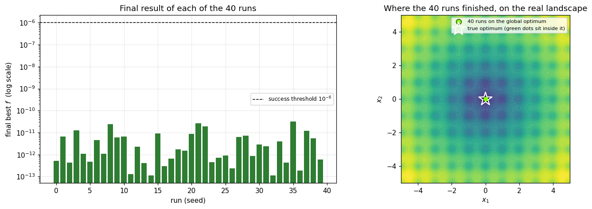
04 · RESULTS AND CHECKS
All 40 runs Met the Accuracy Target
40 / 40
1.636 × 10⁻¹²
3.137 × 10⁻¹¹
passed f < 10⁻⁶ · seeds 0–39
median final value
worst final value
Best f = 1.106 × 10⁻¹³. Points visually overlap the optimum; they are approximate.
All tested seeds met the target. This is evidence of reliability, not a guarantee for every run.
14 September 2026
ACKLEY × GENETIC ALGORITHM
17 / 18
Notes:
SLIDE 17 — All 40 runs met the accuracy target
Target: 55 seconds
To check reliability, we ran the final version with forty different seeds, from zero to thirty-nine. We defined success as a function value below ten to the minus six. All forty runs passed. The median was about one point six times ten to the minus twelve, and even the worst was about three point one times ten to the minus eleven. The points overlap near the origin in the figure, but they are not mathematically exact zero. These tests show that the method worked consistently in our experiments. They do not guarantee that every future run will succeed.
VISUAL / DELIVERY
09_reliability_40_runs.png. Points visually overlap the optimum; they are approximate.
Source: Ackley_GA_Solution.ipynb; numerical results independently reproduced.

Slide 18
05 · CONCLUSION
What We Learned
A good result needs a well-tested search.
Select + mix
Mutate + adapt
Better parents; useful coordinate combinations.
New values; steps that shrink with progress.
Preserve + diversify
Check many seeds
Keep the best; limit exact copies.
40/40 below the target in our tests.
Thank you. Questions?
14 September 2026
ACKLEY × GENETIC ALGORITHM
18 / 18
Notes:
SLIDE 18 — What we learned
Target: 40 seconds
To conclude, our Genetic Algorithm found a point very close to the known minimum. The main run reached a function value of about ten to the minus twelve, and all forty reliability tests met our accuracy target. Each part had a job: selection favoured better points, crossover mixed coordinates, mutation created new values, and elitism protected the best result. The adaptive step improved precision, while the copy limit kept more distinct candidates. Our main lesson is to test a random algorithm with many seeds, rather than judging it from one good run. Thank you, sir. We are ready for questions.
VISUAL / DELIVERY
Native summary cards and the original DNA illustration.
Source: Ackley_GA_Solution.ipynb; numerical results independently reproduced.

