Slide 1

KHULNA UNIVERSITY OF ENGINEERING & TECHNOLOGY
CSE 4112 / MACHINE LEARNING LABORATORY / FINAL PRESENTATION
A Speaker-Attributed Sentiment Dataset
for Bangla Financial Television Talk Shows
Dataset Report v1.0. Forty-five talk-show episodes turned into speaker turns, each labelled for the stance its speaker takes on the economy.
GROUP 1 / STUDENTS
Nafiz Ahmed (2107001) · Tawhidul Hasan (2107004) · Sarwad Hasan Siddiqui (2107006) · Saif Ahmed Shejan (2107009) · Maruf Shafiq (2107010) · Dewan Salman Rahman Zisan (2107015)
DIARIZATION
SPEECH RECOGNITION
LABELS / MODEL
DATASET
pyannote community-1
Whisper-medium, Bangla
LLM judge / BanglaBERT
v1.0, 15 Sep 2026

Slide 2
FIGURE 1(a) / PRACTICAL APPLICATION FRAMEWORK
How the data is used in practice
One label per episode averages disagreement away. This framework keeps speakers apart.
QUESTION
INPUT
DATASET
MODEL
SIGNAL
Who in the panel is negative?
45 episodes, 28.6 h, 3 channels
2,414 turns; 1,630 supervised
BanglaBERT + aggregation
Speaker sentiment index
INTENDED USERS AND PRACTICAL OUTCOME
Media analysts
Track whether expert sentiment is turning.
Policy monitors
See which sectors draw negative stance.
Bangla NLP researchers
Study speaker-level sentiment in ASR text.
02

Slide 3
FIGURE 1(b) / TECHNICAL PIPELINE FRAMEWORK
Every stage, its model and its framework
STAGE 1
STAGE 2
STAGE 3
STAGE 4
Acquire
Condition
Diarize + ASR
Fuse
45 episodes, 28.6 h
16 kHz, VAD, dedup
pyannote, Whisper
2,414 speaker turns
ffmpeg
pyloudnorm, Demucs
faster-whisper
Python, schema 2.0
STAGE 5
STAGE 6
STAGE 7
STAGE 8
Label
Partition
Model
Evaluate
LLM judge, human rubric
1,009 / 297 / 324
BanglaBERT, aggregation
F1 0.670; speaker 0.653
make_datasets.py
JSON schema
PyTorch + HF
scikit-learn
Stage I, signal to corpus (1-4); Stage II, supervision to evaluation (5-8). Framework in blue.
03

Slide 4

LIVE DEMO / ONE CLIP THROUGH THE PIPELINE
Fourteen seconds, from sound to a speaker verdict
1 / AUDIO, AND WHO IS SPEAKING
click to play
speaker 0
speaker 3, from 2328.8 s
2326.0 s
2340.0 s
2 / WORDS, EACH WITH A TIMESTAMP
একটু
খেয়াল
করে
দেখি
যে
আমরা
এখানে
অনেকবার
… 33 in all
2328.58
2329.34
2329.60
2329.76
2330.06
2330.28
2330.56
2330.86
3 / ONE SPEAKER TURN, AND WHAT IT EXPRESSES
… সেই লক্ষ্যে যেটা আমরা দেখি সেরকম কিন্তু বড় কোন পরিবর্তন হয়নি
negative
one of his eight turns
4 / THE SPEAKER, ACROSS THE WHOLE EPISODE
his eight turns, in order
stance across the episode
one turn says negative, the speaker overall does not
mixed
+0.15
3 positive 3 neutral 2 negative
−1
0
+1
03a

Slide 5
FRAMEWORKS / MODELS AND LIBRARIES
Which model and framework does what
Stage | Model / method | Framework / library | Produces
Audio hygiene | Loudness norm; music separation | ffmpeg, pyloudnorm, Demucs | 16 kHz mono WAV
Diarization | pyannote community-1, wespeaker | pyannote.audio, PyTorch | who spoke when
ASR | Whisper-medium, Bangla fine-tune | faster-whisper, CTranslate2 4.6.1 | words + timings
Fusion | Midpoint, then max-overlap rule | Python, schema 2.0 | speaker turns
Labelling | Claude Opus 5 as judge | fixed rubric, JSON schema | turn, speaker labels
Baseline | TF-IDF word 1-2 + LogReg | scikit-learn | reference score
Main model | BanglaBERT, ELECTRA 110M | PyTorch 2.11, HF transformers | turn labels
Aggregation | top_k, hard_vote, weighted votes | Python, NumPy | speaker verdict
Analysis | Metrics, tables, figures | pandas, matplotlib, seaborn | results, plots
Runtime: Google Colab, CUDA GPU, float16 ASR. Seeds 17 pipeline, 13 split, 42 modelling. Retrieval demo: Gradio.
04

Slide 6
03 / DATASET SPECIFICATIONS
The dataset at a glance
45
28.6 h
2,414
219K
1,630
EPISODES
AUDIO
SPEAKER TURNS
WORDS
SUPERVISED TURNS
Item | Specification
Unit of observation | Speaker turn (2,414); secondary unit is the speaker-episode (212)
Data types | Processed WAV, ASR transcripts, diarization, word-speaker fusion, turns, labels
File formats | WAV 16 kHz mono, JSON, RTTM, JSONL, CSV, Jupyter notebook
Turn labels | negative / neutral / positive; illegible is excluded from supervision
Speaker labels | negative / mixed / neutral / positive, plus stance_score in [-1, 1]
Source | ATN Bangla, RTV, Desh TV, GTV, Kaler Kantho, Star News, Dhaka Stream
05

Slide 7
04 / VALUE OF THE DATA
Why this corpus is worth reusing
Sentiment per speaker
Host, economist and industry voice keep separate labels instead of one averaged episode score.
Spoken Bangla finance
Bangla sentiment sets are written social-media text; this is broadcast speech after ASR.
Several ML tasks
Turn sentiment, speaker stance, host vs guest role, and robustness to noisy ASR.
Every artefact kept
RTTM, per-word ASR probabilities, fusion alignments, judge rationales with quotes.
Extensible
Retained audio suits acoustic models; a 52-target lexicon enables speaker x target sentiment.
Defects documented
Leakage risks and unmeasured metrics are published, so it doubles as a teaching case.
06

Slide 8
05 / BACKGROUND AND MOTIVATION
Expert opinion on the economy, locked in audio
Banking stress, reserves and inflation are debated nightly, in unindexed Bangla audio.
Gap one: the genre
BLP, BLUB, BAN-ABSA and BABSA are written social-media or review text, not broadcast speech.
Gap two: the unit
Corpora label utterances or documents; analysts need "this economist is negative on banking".
Attribution comes before sentiment
Panels overlap and interrupt, so who spoke is recovered from audio before any sentiment.
Zero human sentiment labels existed
An LLM judge became the supervision source, with its limits reported, not hidden.
07

Slide 9
06 / DATA ACQUISITION
Six collectors, forty-five episodes
56
46
45
REGISTRY ROWS
PROCESSED
UNIQUE EPISODES
INCLUSION AND COVERAGE
Removed: duplicate episode
2107010::ep006 matched 2107004::ep006 by transcript hash and was dropped before splitting.
• Multi-speaker panel or interview format
• Predominantly economic topic, intelligible audio
• 4 to 14 episodes per roll; 28.6 h in total
• Channels: ATN Bangla, RTV Business and others
• Pipeline runs August-September 2026, seed 17
Flagged: two off-genre episodes
A law-and-order interview (2107015::ep002) and a spliced news bulletin, labelled illegible throughout.
08

Slide 10
06 / INSTRUMENTS AND VERSIONS
Every stage pinned to a model revision
Stage | Component and revision | Key settings
Audio hygiene | Resample to 16 kHz mono WAV | loudness and clipping report per episode
Diarization | pyannote community-1 @3533c8cf, wespeaker resnet34-LM | min cluster 20, min segment 0.75 s, min airtime 9 s, stitch gap 2.0 s
ASR | bengaliAI Whisper-medium @da605cc1, CTranslate2 | beam 5, repetition penalty 0.8, 28 s chunks, per-word probabilities
Fusion | Schema 2.0 | midpoint then max overlap; first speaker wins
Labelling | Claude Opus 5 judge | fixed rubric, structured JSON output
Modelling | csebuetnlp/banglabert @9ce791f3 | PyTorch 2.11, transformers, hand-written loop
09

Slide 11
06 / ANNOTATION PROTOCOL
One judge call per speaker, one rubric for panels
1
Stance, not emotion: a calm account of a bank collapse is negative
Coherent, auditable labels
Verdict and turn labels come back in one call, each with an evidence quote: 58% verbatim, 42% close paraphrase.
2
Direction is not polarity: "increased" is good for reserves, bad for inflation
3
A pointed question is neutral: hosts elicit, they do not assert
4
Advice is neutral: a recommendation is neutral, a complaint negative
Single judging pass
pass_agreement is 1.0 by construction. Three-pass judging and a 180-turn human check come next.
5
Reported speech: is not the speaker's own stance
6
illegible is a label: ASR-destroyed turns are dropped, not guessed
10

Slide 12
06 / HUMAN REVIEW AND CORRECTION
Machine-labelled, but not machine-accepted
Rubric written by people
The six genre rules came from reading transcripts, not from the model.
Diarization audited
Roll 2107009 re-run with pyannote: ep001 went from 263 fragments to 47 turns.
Units screened
212 speaker units, 62 rejected before judging, 150 judged, 147 valid.
Stale labels discarded
After the rebuild 53 judgements carried over, 97 re-judged, 19 dropped.
Illegible excluded
181 of 1,811 turn labels are illegible and left out of supervision.
Evidence audited
All 715 quotes checked: 58% verbatim spans, 42% close paraphrases.
What review did not include
No human re-labelled individual turns: all 42 annotation drafts still read human_verified: false.
11

Slide 13
07 / DATA RECORDS AND PROVENANCE
Raw audio is never overwritten
Folder / file | Contents | Kind
<roll>/*.mp3 | Source broadcast audio, not redistributed | Raw
results/raw/ | registry.csv, episode metadata, SHA-256 | Metadata
results/processed/ | 16 kHz mono WAV, hygiene report | Processed
results/diarization/ | RTTM speaker segments | Processed
results/asr/, fused/ | Word timings; word-to-speaker alignment | Processed
speaker_sentiment/data/ | turns, speakers, judgements, splits | ML-ready
artifacts/, models/ | Run config, file checksums, model hashes | Metadata
Stable IDs: roll::episode::turnNNNN. Every split groups on global_episode = roll::episode.
12

Slide 14
07 / DATA DICTIONARY
What one row of turns.jsonl holds
Variable | Meaning | Type | Values / missing rule
turn_id | Unique turn identifier | string | roll::ep::turnNNNN, never null
global_episode | Grouping key used for splitting | string | roll::epNNN, never null
speaker_id | Episode-local diarization cluster | int | -1 = unassigned
start_sec, end_sec | Turn boundaries | float | seconds, >= 0
text | Normalised Bangla transcript | string | "" if empty
asr_confidence | Mean word log-probability | float | <= 0, null if no words
diarization_trusted | False for fallback episodes | bool | true / false
role | Inferred conversational role | string | host, guest, minor, unassigned
label | Judge turn label | string | neg / neu / pos; illegible dropped
judge_confidence | Judge's confidence in the label | float | 0 to 1
evidence | Verbatim supporting quote | string | substring of text
13

Slide 15
07 / DATASET COMPOSITION
Guests carry the evaluation, hosts ask
212
150
1,811
181
SPEAKER UNITS
JUDGED UNITS
TURN LABELS
ILLEGIBLE, 10.0%
TURN LABELS BY ROLE, 1,630 SUPERVISED TURNS
Roles separate cleanly
Hosts: mean 39 words, mostly neutral. Guests: mean 146 words, carry the stance.
Guest
602
192
171
965
Host
266
374
663
Minor
2
negative 53.4%
neutral 34.7%
positive 11.9%
Speaker verdicts
negative 110, neutral 18, positive 11, mixed 8; 147 valid units.
14

Slide 16
08 / PREPROCESSING AND CURATION
Rebuilding speaker turns from decode windows
5,395
merge
2,414
28 S ASR WINDOWS
SAME SPEAKER, IN ORDER
SPEAKER TURNS
Many of the 5,395 windows last 27.2 to 28.0 s, and every window boundary cuts a word.
Cleaning
Duplicate removed by hash; repetition loops and too-short turns flagged.
Missing data
Unattributed words keep speaker_id -1, role unassigned. Never imputed.
Noise
181 illegible turns stay in turns.jsonl but leave labels and splits.
Normalisation
NFC + csebuetnlp normalizer; max_len 256 truncates about 10% of turns.
No augmentation
No synthetic or oversampled turns; class weights handle imbalance.
De-identification
Speakers are episode-local indices, never linked to names.
15

Slide 17
08 / LEAKAGE CONTROL
Split by episode, never by row
Turns from one talk show share the panel, topic, presenter phrasing and ASR error signature. A row split would let the model recognise the episode, not the stance.
What is done
global_episode is the grouping key; make_datasets.py asserts disjointness, and the duplicate was removed before splitting.
Known residual risk
A majority of episodes have a placeholder or empty programme title, so train and test share "business talk". Accepted knowingly.
train_eps = {r["global_episode"] for r in splits["train"]}
for name in ("val", "test"):
overlap = train_eps & {r["global_episode"] for r in splits[name]}
assert not overlap, f"{name} shares episodes with train"
16

Slide 18
09 / TECHNICAL VALIDATION
What was checked, and what could not be
Dimension | Evidence
Completeness | 56 rows to 46 processed to 45 unique; every episode has all artefacts
Consistency | Schema 2.0 validation; counts recomputed and cross-checked
Integrity | SHA-256 per source and output file; transcript-hash dedup
Measurement | Fixed decoding and diarization settings across all episodes
Reproducibility | Seeds 17, 13 and 42; test inference 47 s on CPU, predictions identical
Bias | Positive is 11.9% of turns; 110 of 147 verdicts negative
85.0%
87.1%
EXACT
DIRECTION
Speaker verdicts rebuilt bottom-up from their own turn labels match the judge's holistic verdict; up from 78.7% / 83.6% in build 1.
Gates still open
WER, DER and annotation kappa are SKIPPED: no gold transcript, gold RTTM or second annotator exists.
17

Slide 19
09 / COMPARISON WITH EXISTING DATASETS
Where this dataset sits
Dataset | Domain / modality | Language | Unit labelled
BLUB / BanglaBERT | Mixed written text | Bangla | Sentence / document
BLP-2023 Task 2 | Social media, written | Bangla | Post
BAN-ABSA / BABSA | News and reviews, written | Bangla | Aspect-sentence
MELD / IEMOCAP | TV / acted dialogue, multimodal | English | Utterance
Earnings-call corpora | Financial speech, transcribed | English | Document / speaker
This dataset | TV talk show, audio + ASR | Bangla | Speaker turn + speaker-episode
Dual-level labels
One call gives both levels; 85.0% bottom-up agreement.
Speaker-episode unit
Ships speakers with a continuous stance score.
First of its kind
First Bangla speaker-attributed finance speech set we found.
18

Slide 20
10 / MACHINE LEARNING USE
Task, split and models
MODELS COMPARED
Primary task
(role, turn text) to negative / neutral / positive
Secondary task
Aggregate turns into a speaker verdict and stance
Majority class
Predicts the most frequent training class. The floor.
EPISODE-DISJOINT SPLIT, SEED 13
TF-IDF + logistic regression
Word 1-2 grams, C = 2, balanced weights; val 0.578. scikit-learn.
Split | Episodes | Turns | Neg | Neu | Pos
Train | 29 | 1,009 | 530 | 365 | 114
Validation | 7 | 297 | 162 | 93 | 42
Test | 9 | 324 | 178 | 108 | 38
BanglaBERT
ELECTRA, 110M, in PyTorch + transformers. Main model.
Speaker units: 94 train, 23 validation, 30 test.
19

Slide 21
10 / MODEL ARCHITECTURE
From a speaker turn to a speaker verdict
INPUT
TOKENIZE
ENCODER
HEAD
TURN LABEL
Role + turn
WordPiece
BanglaBERT
[CLS] + linear
Softmax
sentence pair
normalized; max_len 256
ELECTRA, 110M
3 logits
neg / neu / pos
COLLECT
AGGREGATE
SPEAKER VERDICT
Turn predictions
Aggregation rule
Verdict + stance
all turns of one speaker-episode
top_k, hard_vote, weighted votes
4 classes; stance in [-1, 1]
Framework
PyTorch 2.11 + Hugging Face transformers; csebuetnlp normalizer; custom loop.
Why the role goes in
A host's pointed question is neutral, so the same words can take a different label.
20

Slide 22
10 / TRAINING SETUP
How BanglaBERT was trained
CONFIGURATION
RUN
Setting | Value
Backbone | BanglaBERT, max_len 256
Epochs / batch size | 6 / 16 (384 steps)
Optimizer | AdamW, weight decay 0.01
Learning rate | 2e-5 encoder, 1e-4 head
Schedule / warmup | linear, 10% warmup (38 steps)
Gradient clipping | max-norm 1.0
Loss | weighted CE, label smoothing 0.1
Sample weights | judge confidence x pass agreement
Seed | 42 (split 13, pipeline 17)
Item | Value
Framework | PyTorch 2.11 + HF
Mixed precision | torch.amp on CUDA
Hardware | NVIDIA Tesla T4, Colab
Training turns | 1,009
Training time | not logged
Test inference | 47 s on CPU
Best epoch | 4 of 6, restored
Selected on | val macro-F1 0.704
21

Slide 23
10 / LOSS AND METRICS
Key formulas
METRIC
FORMULA
MEANING
Weighted CE loss
L = −(1/N) Σᵢ sᵢ · α(yᵢ) · log p(yᵢ | xᵢ)
α: class weight; sᵢ: sample weight; label smoothing
Softmax
p(c | x) = exp(z(c)) / Σₖ exp(z(k))
z: logits from the [CLS] head
Precision
P(c) = TP(c) / (TP(c) + FP(c))
of turns predicted c, share correct
Recall
R(c) = TP(c) / (TP(c) + FN(c))
of turns judged c, share found
F1
F1(c) = 2 · P(c) · R(c) / (P(c) + R(c))
balance of precision and recall
Macro-F1
[F1(neg) + F1(neu) + F1(pos)] / 3
classes weigh equally; headline
Stance correlation
r = cov(ŝ, s) / (σ(ŝ) · σ(s))
predicted vs judged stance score
Exact accuracy
(1/U) Σᵤ 1[v̂ᵤ = vᵤ]
speaker verdicts matched
22

Slide 24
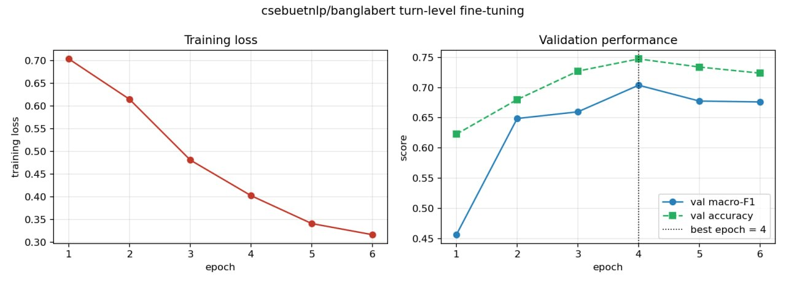
10 / TRAINING CURVES
How the run behaved, epoch by epoch
Validation peaks at epoch 4 and then slips while training loss keeps falling: mild overfitting.
4
0.704
0.747
0.317
BEST EPOCH
BEST VAL MACRO-F1
BEST VAL ACCURACY
FINAL TRAIN LOSS
23

Slide 25
10 / RESULTS, TURN LEVEL
Well above the floor on unseen episodes
Macro-F1 is the headline: positive, the class an index needs most, is only 38 of 324 test turns.
TEST MACRO-F1, 324 TURNS FROM 9 HELD-OUT EPISODES
Majority class
0.236
TF-IDF + LogReg
0.529
BanglaBERT (role_turn)
0.670
Accuracy / kappa: BanglaBERT 0.701 / 0.496, TF-IDF 0.623 / 0.339.
Positive-class F1: BanglaBERT 0.581, TF-IDF 0.269.
Read it as agreement with the judge
Scores are measured against LLM labels, not human truth: the model matches the judge on 70% of held-out turns.
24

Slide 26
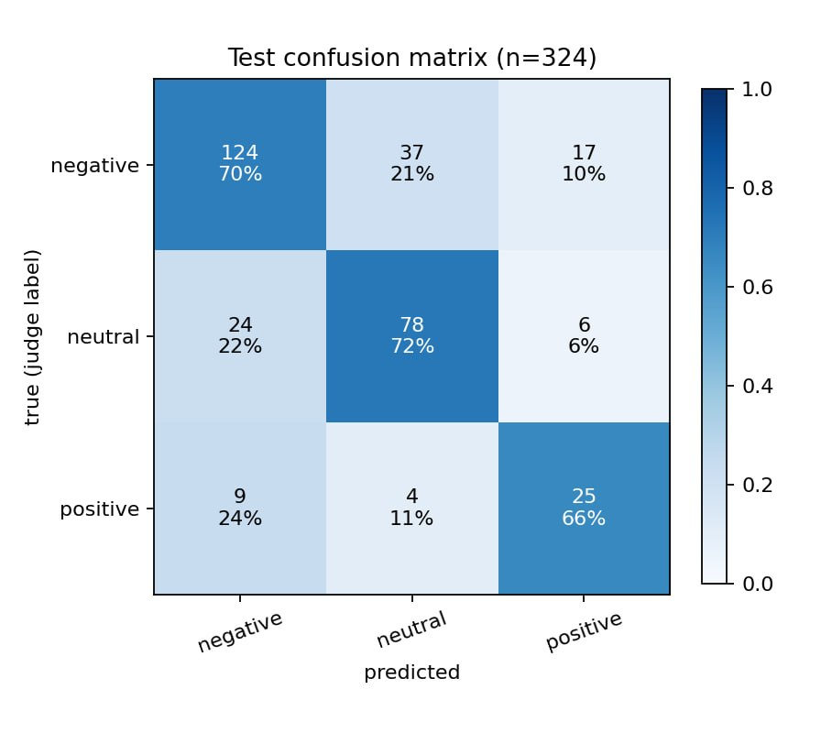
10 / RESULTS, PER CLASS
Which classes the model gets right
PER-CLASS SCORES, 324 TEST TURNS
Class | Precision | Recall | F1 | Support
negative | 0.790 | 0.697 | 0.740 | 178
neutral | 0.655 | 0.722 | 0.687 | 108
positive | 0.521 | 0.658 | 0.581 | 38
macro avg | 0.655 | 0.692 | 0.670 | 324
accuracy |  |  | 0.701 | 324
Reading the matrix
Largest error: 37 negative turns called neutral, 29 of them from hosts. Positive is weakest, with precision 0.52.
25

Slide 27
10 / RESULTS, SPEAKER LEVEL
Speaker level: the selected rule holds up
30 TEST SPEAKER UNITS, FIVE AGGREGATION RULES
0.653
0.867
Rule | Exact | Direction | Stance r | Macro-F1
hard_vote | 0.867 | 0.867 | 0.451 | 0.567
top_k | 0.800 | 0.800 | 0.628 | 0.667
dur_weighted | 0.767 | 0.800 | 0.567 | 0.480
word_weighted | 0.767 | 0.800 | 0.569 | 0.480
unweighted | 0.633 | 0.667 | 0.691 | 0.447
HIERARCHICAL
HARD_VOTE
Chosen before testing
hard_vote won on 117 train + val units (0.752); 26 of 30 test verdicts match.
A sanity check
30 units is small: one unit moves macro-F1 by about 0.03.
26

Slide 28
10 / RESULTS, HIERARCHICAL SPEAKER MODEL
The speaker-level figure the report quotes
ATTENTION POOLING, 5-FOLD GROUPKFOLD, 147 UNITS
0.653
0.530
Class | Precision | Recall | F1 | Units
negative | 0.882 | 0.682 | 0.769 | 110
neutral | 0.519 | 0.778 | 0.622 | 18
positive | 1.000 | 0.455 | 0.625 | 11
mixed | 0.067 | 0.250 | 0.105 | 8
ACCURACY
MACRO-F1
Folds range 0.500 to 0.828.
Every unit tested once
Each speaker is test data once; the 30-unit split is only a sanity check.
Mixed is not learnable yet
Only 8 mixed units in the whole corpus give F1 0.105; treat it as unsupported.
27

Slide 29
10 / PREDICTION EXAMPLES
Seeing it work: real test predictions
সরকার সমস্যাগুলা খুব ইমিডিট সমাধান করবে বলে আমার বিশ্বাস
I believe the government will solve these problems very quickly.
CORRECT / GUEST
JUDGE positive
MODEL positive 0.95
গ্যাস বিদ্যুত ছিল না ... অনেক কলকারখানা আসলে বন্ধ হয়ে গেছে
There was no gas or electricity, so many factories have actually shut down.
CORRECT / HOST
JUDGE negative
MODEL negative 0.79
এই বাজেট এবং মুদ্রানীতি মানুষের জীবনযাত্রার ব্যয় কমাতে সক্ষম হবে কি না
Will this budget and monetary policy lower people's cost of living? (a question)
CORRECT / HOST
JUDGE neutral
MODEL neutral 0.92
যে কোনো বিনিয়োগ হচ্ছে না
No investment of any kind is happening. A judgement, read as neutral.
ERROR / HOST
JUDGE negative
MODEL neutral 0.87
Excerpts are verbatim ASR text; "..." marks a cut. MODEL shows the predicted class probability.
28

Slide 30
10 / ERROR ANALYSIS
Where the model gets it wrong
Hosts read as neutral
37 negative turns called neutral; 29 are hosts, often phrased as questions.
Long guest turns
17 negative called positive; 15 guests, median 213 words, may be truncated.
Positive is thin
17 negative and 6 neutral turns called positive: precision 0.52.
DOES TRANSCRIPT QUALITY OR ROLE MATTER?
Transcript quality
Best ASR quartile 0.729 vs worst 0.651, but Q3 dips: a weak trend.
Hosts
All 3 positive host turns missed (F1 0.00), hence macro-F1 0.468 at 0.707 accuracy.
Test stratum | n | Accuracy | Macro-F1
ASR confidence Q1, worst | 83 | 0.675 | 0.651
ASR confidence Q2 | 79 | 0.709 | 0.658
ASR confidence Q3 | 82 | 0.683 | 0.622
ASR confidence Q4, best | 80 | 0.738 | 0.729
Guest turns | 184 | 0.696 | 0.610
Host turns | 140 | 0.707 | 0.468
29

Slide 31
11-13 / USAGE, LIMITATIONS, ETHICS
Using the dataset responsibly
Use it correctly
• Filter diarization_trusted for attribution
• Group on global_episode
• Tune speakers with GroupKFold over 147 units
• Run Python with -X utf8 on Windows
Known limitations
• No human labels: one LLM pass
• WER, DER and kappa unmeasured
• 1,630 turns, 147 speaker units
• Mixed 8 units; backbone ablation not run
Ethics and privacy
• Copyrighted audio not redistributed
• Speakers are indices, never named
• All labels AI-generated, disclosed
• Annotations CC BY 4.0; not for trading
Thank you
NEXT STEP
Three-pass judging and a 180-turn human verification sample.
30

