Slide 1
MACHINE LEARNING LABORATORY / CSE 4112
Speaker-Attributed Financial
Discourse Analysis of
Bangla Talk Shows
One pipeline from raw broadcast audio to a polarity judgement about a named financial target: who spoke, what they said, and how they judged the economy.
ROLLS
DIARIZATION
SPEECH RECOGNITION
SENTIMENT
2107001, 2107004, 2107006,2107009, 2107010, 2107015
pyannote
speaker-diarization-community-1
Whisper medium,
Bengali adapted
TF-IDF + LogReg
(BanglaBERT not run)

Slide 2
01 / THE DATA
The corpus at a glance
30
16.88
1,867
130,750
3,532
EPISODES
HOURS
SPEAKER TURNS
WORDS
UTTERANCES
Roll | Episodes | Words | Programmes
2107001 | 4 | 21,500 | Business Talk, ATN
2107004 | 6 | 29,383 | Star Biz, Dhaka Stream
2107006 | 5 | 25,736 | RTV Business Talk
2107009 | 5 | 23,447 | Money Talks, Desh TV
2107010 | 5 | 23,960 | Star Biz Dialogue
2107015 | 5 | 27,724 | ATN, Gtv
Total | 26 | 130,750 | 16.88 hours
02

Slide 3
01 / THE DATA
Why this audio is the hard case
Long-form broadcast panel discussion breaks most of the assumptions a speech model is trained on.
• Panel format, so two people frequently talk over each other
• Studio stings and background music between segments
• Guests joining by phone at much lower bandwidth
• Heavy code switching: English finance terms inside Bangla sentences, for example রেভিনিউ and ফিসকাল পলিসি
• Episodes run 24 to 48 minutes, far past what a speech model reads in one pass
Episode identifiers are namespaced by roll, so ep001 from one contributor and ep001 from another stay distinct, and speaker identities are never merged across recordings.
03

Slide 4
02 / ARCHITECTURE
Five stages, each writing output the next one reads
STAGE 1
STAGE 2
STAGE 3
STAGE 4
STAGE 5
Audio
Diarization
Recognition
Fusion
Sentiment
conditioning
1,867 turns
130,750 words
3,532 utterances
3,109 pairs
Diarization runs on the whole episode and does not depend on the transcript.
Speech recognition runs in 28 second chunks and does not depend on the speaker labels.
Fusion is the only stage that needs both, which is why its errors are the ones that compound.
04

Slide 5
03 / STAGE 1, AUDIO
Getting broadcast audio into a state a model can read
Both speech models expect 16 kHz mono at a predictable loudness. Broadcast MP3 is none of those things.
Gain is applied selectively
Only when an episode is genuinely off target and the true peak leaves headroom. Normalising everything blindly would clip the loud ones.
Setting | Value
source rate | 44.1 and 48 kHz
source channels | 2, stereo
target rate | 16 kHz mono
loudness standard | EBU R128 integrated
loudness target | -16 LUFS
measured range | -28.3 to -16.0 LUFS
true peak guard | checked before gain
Why it matters downstream
Diarization clusters speaker embeddings by distance.
05

Slide 6
04 / STAGE 2, DIARIZATION
Deciding who is speaking, before knowing what was said
Setting | Value
backbone | pyannote community-1
embedding | wespeaker resnet34-LM
min_duration_off | 0.1 s
min_cluster_size | 20
minimum segment | 0.75 s
stitch gap | 0.17 s
minimum speaker airtime | 9.0 s
scoring collar | 0.25 s
1,867
3
1 to 7
TURNS
MEDIAN SPK
RANGE
The default embedding is swapped for wespeaker resnet34-LM, which separates voices better on noisy broadcast audio.
No diarization error rate is reported
06

Slide 7
04 / STAGE 2, DIARIZATION
What the post-processing thresholds are for
• Segments under 0.75 s are dropped, so a cough or a jingle does not become a speaker
• Gaps under 0.17 s are stitched, so one sentence does not split into three turns
• Any speaker with under 9 s of total airtime is deleted, which removes spurious clusters
• Both the raw and the post-processed output are kept, so the effect of each threshold can be inspected rather than assumed
Speaker identity stays episode local
Speaker 2 in one episode has no relationship to Speaker 2 in another. The labels are cluster identifiers, not people, and they are never joined across recordings.
07

Slide 8
05 / STAGE 3, SPEECH RECOGNITION
Transcribing 40 minute episodes with a 30 second model
Setting | Value
checkpoint | Whisper medium, bn
runtime | CTranslate2, float16
language | bn, forced
chunk length | 28.0 s
beam size | 5
condition on previous | False
source separation | on detection
2,184
4,006
130,750
CHUNKS
SEGMENTS
WORDS
Why a Bengali adapted checkpoint
It produces মূল্যস্ফীতি, খেলাপি ঋণ and বৈদেশিক মুদ্রার রিজার্ভ as clean tokens rather than phonetic approximations. The whole downstream lexicon depends on that.
08

Slide 9
05 / STAGE 3, SPEECH RECOGNITION
Why each decoding setting is set that way
28 s rather than 30 s
leaves headroom inside the receptive field, so the window edge never lands exactly at the model limit
Language forced to Bengali
stops the detector switching to Hindi or Assamese on a noisy chunk
No conditioning on previous text
stops a hallucination in one chunk being fed as context into the next, which is how one error becomes a whole bad minute
Source separation on detection
measures spectral flux per chunk and separates music only when present, rather than degrading clean speech
09

Slide 10
06 / TRANSCRIPT QUALITY
Defect one: chunk boundary truncation
Bangla never begins a word with a dependent vowel sign. When a segment does, the stitcher has eaten the opening consonant.
400 OF 3,532
উন্নতি লক্ষ্য করা যাচ্ছে
The word should be কিছুটা. The first token of 11.3 percent of utterances is not a real word.
Fix
Chunks are currently cut back to back with no overlap. Cutting them with a 2 to 3 second overlap and stitching on the shared region removes the boundary word entirely. This is a rerun setting, not new code.
10

Slide 11
06 / TRANSCRIPT QUALITY
Defect two: decoder repetition loops
The decoder locks onto one token and emits it for many seconds.
46 OF 3,532
বাজার বাজার বাজার বাজার বাজার বাজার
These carry no readable meaning, so they are dropped from supervision rather than quietly labelled neutral.
Likely cause, and it is in the configuration
The run sets a repetition penalty of 0.8. A penalty above 1.0 suppresses tokens already produced. A value below 1.0 does the opposite and makes repeating them more likely. Raising it above 1.0 is the direct fix.
11

Slide 12
07 / STAGE 4, FUSION
Attaching every word to a speaker
Diarization gives intervals with speaker labels. Recognition gives words with timestamps. Neither knows about the other.
• Take the midpoint of the word. If it falls inside one speaker interval, that speaker owns it
• If the midpoint falls in a gap, fall back to the interval with the largest overlap
• If two speakers overlap in time, the one who started first keeps the word
• Consecutive words from one speaker are grouped into an utterance, the unit used downstream
The midpoint is used rather than the word start because start timestamps drift at chunk boundaries and the midpoint is the more stable of the two.
3,532
85.1%
UTTERANCES
WORDS ASSIGNED
12

Slide 13
08 / STAGE 5, TARGETS
Finding what a sentence is actually about
Bangla attaches case and definiteness as suffixes, so exact string matching sees six unrelated words where there is one target.
Surface form | Count
ব্যাংক | 164
ব্যাংকের | 139
ব্যাংকিং | 99
ব্যাংকে | 50
ব্যাংকগুলো | 10
ব্যাংকগুলোর | 10
one stem covers | 555
A prefix rule is blunt, so each entry carries an exclusion list.
Stem | Blocked | Reason
সুদ | সুদান | interest vs Sudan
ভালো | ভালোবাসা | good vs love
সুবিধা | অসুবিধা | benefit vs drawback
ঋণ | ঋণখেলাপি | credit vs default
13

Slide 14
08 / STAGE 5, TARGETS
Target lexicon coverage
52
3,109
48
TARGETS
TARGET PAIRS
SEEN IN CORPUS
Target type | Pairs | Examples
MACRO_INDICATOR | 1,121 | মূল্যস্ফীতি, রিজার্ভ, বিনিয়োগ
REGULATOR | 980 | বাংলাদেশ ব্যাংক, বাজেট
SECTOR | 901 | গ্যাস, কৃষি, শিল্প
MARKET | 107 | শেয়ারবাজার, পুঁজিবাজার
One utterance produces one row per distinct target it mentions, so a sentence naming both inflation and reserves is scored twice, once for each.
14

Slide 15
09 / THE POLARITY IDEA
A rising number is not good or bad until you know what is rising
Ordinary sentiment analysis treats an increase word as positive. In economic talk that is wrong about half the time.
বৈদেশিক মুদ্রার রিজার্ভ বেড়েছে
মূল্যস্ফীতি বেড়েছে
Foreign exchange reserves have increased.
Inflation has increased.
Reserves carry orientation +1. The increase cue keeps its sign.
Inflation carries orientation -1. The same cue flips.
POSITIVE
NEGATIVE
Because each target is scored separately, one sentence can carry two labels at once. A sentence level model cannot represent that.
15

Slide 16
09 / THE POLARITY IDEA
Every target carries an orientation
ORIENTATION +1
ORIENTATION -1
ORIENTATION 0
A rise is good news
A rise is bad news
An entity, no direction
14 targets: reserves, remittance, GDP, exports, investment, employment, revenue, output, the market index.
9 targets: inflation, consumer prices, bad loans, foreign debt, capital flight, the policy rate, public spending.
29 targets such as banks, the government or the energy sector. Scored only by evaluative words.
16

Slide 17
10 / SUPERVISION
Creating labels that can be traced back to words
# every cue token within 12 tokens of the target
polarity = cue.polarity
# direction words depend on the target
if cue.kind == "direction":
if orientation == 0: skip
polarity *= orientation
# adjectives and verbs can be negated, nouns cannot
if cue.negatable and negator within 3 tokens:
polarity *= -1
# nearer evidence counts for more
decay = 1 / (1 + distance / 4)
score += polarity * cue.weight * decay
Decision
Above +0.55 is positive.
Below -0.55 is negative.
Anything between is non evaluative.
The cue set holds 104 stems, each with a weight and a negation flag.
17

Slide 18
10 / SUPERVISION
Two corrections found by reading the output
Negation has scope. A first version flipped any cue near a negator, and scored crisis as positive.
সংকট কাটছে না
The crisis is not passing. The না negates the verb, not the noun, and it is still bad news. Only adjectives and verbs are now marked negatable.
Bangla builds a negated verb complex. The particle can sit three tokens from the word it negates.
স্থিতিশীল করতে পারবেন না
You will not be able to stabilise it. Scored positive until the negation window was widened to three.
18

Slide 19
10 / SUPERVISION
What the rule set produced
3,019
284
2,583
152
TRAINING LABELS
NEGATIVE 9.4%
NON EVAL 85.6%
POSITIVE 5.0%
Rows flagged as repetition loops, and rows under six words, are excluded from supervision rather than silently labelled neutral. That is 90 of 3,109 pairs.
Only 152 positive examples exist in the whole corpus. That thinness is why the positive class is the weakest in every result that follows.
19

Slide 20
11 / SPLIT
Split by episode, never by row
Two utterances from the same talk show share the panel, the topic, the host's phrasing and the same recognition error pattern. If rows from one episode land in both training and test, the model can recognise the episode instead of the sentiment.
What a random row split would do
The reported score would rise, and none of that rise would survive contact with a new episode.
What is done instead
All four test episodes are held out whole, and the split asserts that no episode appears in more than one partition.
20

Slide 21
11 / SPLIT
How the corpus divides
Split | Episodes | Pairs | Human | Negative | Non eval | Positive
Train | 19 | 2,026 | 99 | 164 | 1,771 | 91
Validation | 3 | 320 | 22 | 24 | 278 | 18
Test | 4 | 673 | 59 | 96 | 534 | 43
Validation is used only to pick the stopping epoch and is never fitted on. Because the human labelled slice inside validation is small, model selection uses the rule label agreement score, which is the honest consequence of having limited human labels.
21

Slide 22
12 / CODE
Preprocessing: detecting the transcript defects
# A word may never begin with a dependent sign. When a
# segment does, the chunk stitcher ate a consonant.
def leading_truncated(text):
s = text.lstrip()
return bool(s) and s[0] in COMBINING
# Longest run of one token, plus its lexical variety.
def repetition_score(text):
t = text.split()
longest = run = 1
for i in range(1, len(t)):
run = run + 1 if t[i] == t[i-1] else 1
longest = max(longest, run)
return longest, len(set(t)) / len(t)
22

Slide 23
12 / CODE
Target aware polarity scoring
for i, token in enumerate(tokens):
distance = min(abs(i - t) for t in target_idx)
if distance > WINDOW:
continue
polarity = cue["polarity"]
if cue["kind"] == "direction":
# A rise is only good or bad relative to
# what is rising.
if orientation == 0:
continue
polarity *= orientation
decay = 1.0 / (1.0 + distance / 4.0)
score += polarity * cue["weight"] * decay
23

Slide 24
12 / CODE
The split, with a leak check
for row in rows:
ep = row["global_episode"]
name = ("test" if ep in TEST_EPISODES
else "val" if ep in VAL_EPISODES
else "train")
splits[name].append(row)
# A leak check is cheap and catches a bad edit to the
# episode lists before it can inflate a score.
train_eps = {r["global_episode"] for r in splits["train"]}
for name in ("val", "test"):
overlap = train_eps & {r["global_episode"]
for r in splits[name]}
assert not overlap, f"{name} shares episodes"
24

Slide 25
12 / CODE
Training, validation and test
# Sentence pair is what makes the task target aware:
# [CLS] target [SEP] utterance [SEP]
enc = tokenizer(target_text(row), row["text"],
truncation=True, max_length=128)
# 86% of rows are non evaluative. Unweighted, the model
# predicts that one class for everything.
loss_fn = CrossEntropyLoss(weight=class_weights)
for epoch in range(1, args.epochs + 1):
for batch in train_loader:
loss = loss_fn(model(**batch).logits, labels)
loss.backward(); optimizer.step()
if evaluate(model, val_rows) > best: # stopping epoch
best = evaluate(model, val_rows); save(model)
25

Slide 26
13 / METRICS
Why plain accuracy is not the headline
The class balance decides the metric. With 85.6 percent of rows in one class, the obvious metric is actively misleading.
Accuracy, rejected as a headline
A model that answers non evaluative every single time scores 85.6 percent on this corpus and has learned nothing at all.
Macro F1, the headline
Averages F1 over the three classes with equal weight, so the 152 positive rows count as much as the 2,583 neutral ones. That same all neutral model scores 0.31 here.
26

Slide 27
13 / METRICS
The other three, and what each one catches
Per class precision and recall
Macro F1 hides which class is broken. Splitting it out revealed that positive precision is the real weakness, at 0.417.
Cohen kappa
Agreement corrected for chance. The rule set reaches 0.392, which is fair agreement. Raw agreement of 59.4 percent would sound far better than it is.
Confusion matrix
The only view that says which direction the errors run. A single F1 cannot tell a model that misses negatives apart from one that invents positives.
Deliberately not reported: word error rate, diarization error rate, and speaker attribution accuracy. Each needs a human made reference, and this project has none.
27

Slide 28
14 / RESULTS
Measured against 180 transcripts read by hand
A stratified sample of 180 target pairs was read in context and labelled by hand. 59 fall inside the held out test episodes.
MACRO F1 ON THE 59 HELD OUT PAIRS
Always non evaluative
0.177
Char n-gram baseline
0.466
Rule labeller
0.566
BanglaBERT pair model
not run
1.0
The result that matters
The trained model scores below the rule set that generated its training labels, 0.466 against 0.566. A student trained on noisy labels will not beat its teacher unless it can generalise past the teacher's mistakes.
28

Slide 29
14 / RESULTS
Rule labeller, per class, all 180 pairs
Class | Precision | Recall | F1 | Support
negative | 0.850 | 0.607 | 0.708 | 84
non evaluative | 0.517 | 0.484 | 0.500 | 64
positive | 0.417 | 0.781 | 0.543 | 32
macro average | 0.594 | 0.624 | 0.584 | 180
Accuracy 0.594. Cohen kappa 0.392.
Negative precision is high at 0.850, so when the system says negative it is usually right. Positive precision at 0.417 is where the damage sits: it calls things positive that are not.
29

Slide 30
14 / RESULTS
Baseline confusion matrix on 59 held-out pairs
 | said negative | said non eval | said positive
is negative | 10 | 21 | 2
is non evaluative | 3 | 13 | 0
is positive | 0 | 6 | 4
Read the top right
The largest error is 21 human-negative pairs predicted as non-evaluative. The model is missing negative judgements rather than confidently finding them.
30

Slide 31
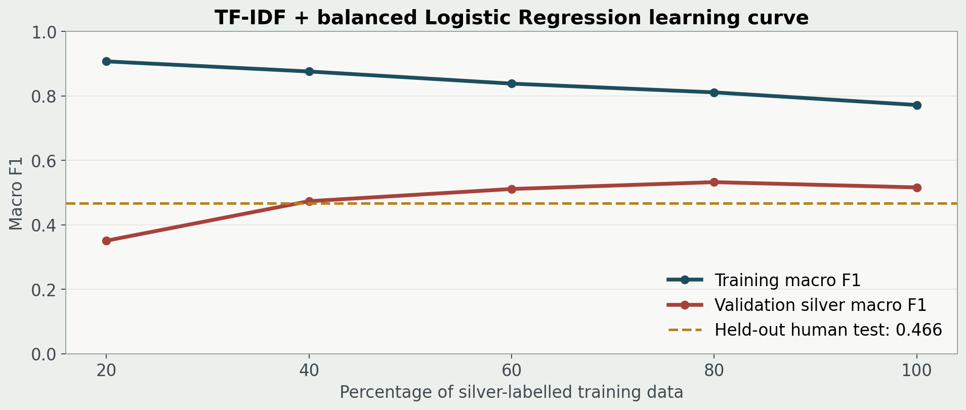
15 / VISUAL EVIDENCE
Learning curve for the trained baseline
The saved Logistic Regression run has no neural epoch-loss history. This reproducible curve shows how macro F1 changes as more silver-labelled training data is added.
Dashed line: final held-out human test macro F1 = 0.466. It is not used for model selection.
31

Slide 32
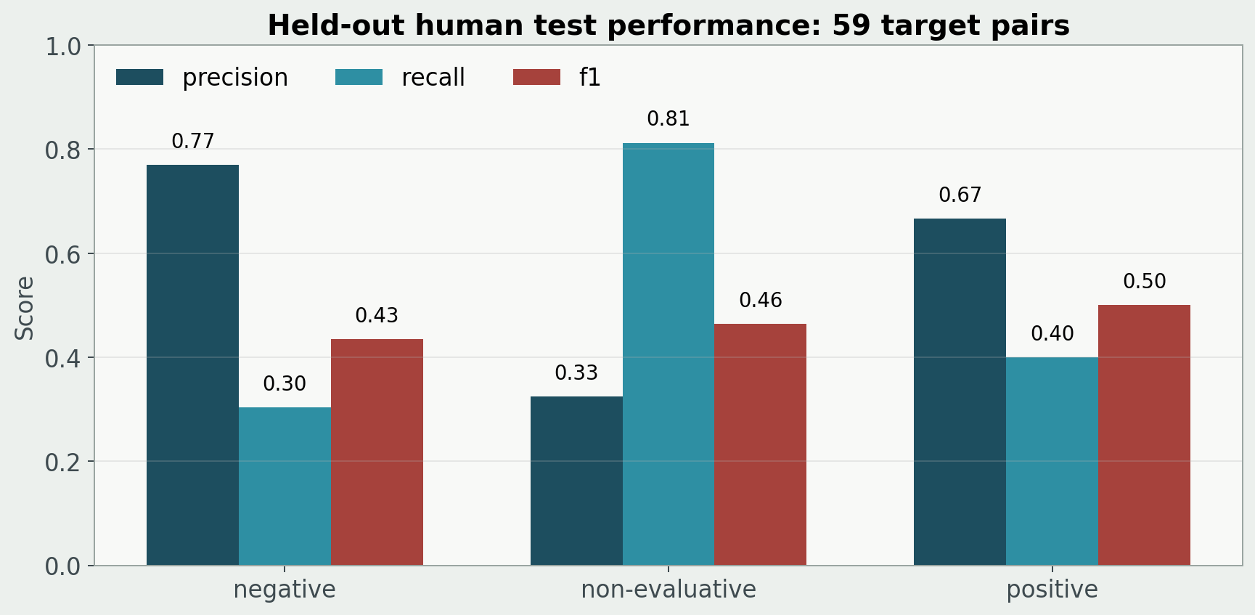
15 / VISUAL EVIDENCE
What the held-out score is made of
The baseline was evaluated on 59 human-reviewed target pairs from four unseen episodes.
Negative precision is strong, but negative recall is low; non-evaluative recall is high but imprecise.
32

Slide 33
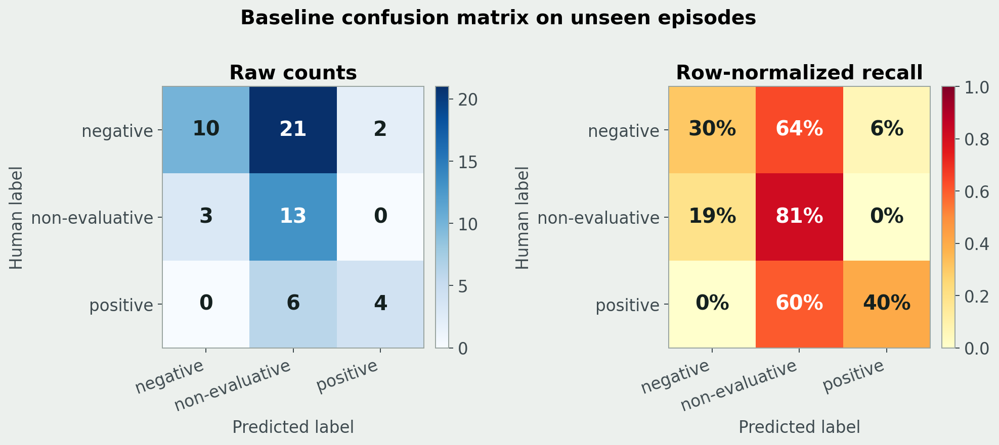
15 / VISUAL EVIDENCE
Confusion matrix: two colour views
Rows are human labels and columns are baseline predictions. Counts and row-normalized recall show different characteristics of the same result.
The largest error is human negative predicted as non-evaluative: 21 of 59 test pairs.
33

Slide 34
16 / ERROR ANALYSIS
Where the errors actually are
Human said | System said | Count
non evaluative | positive | 24
negative | non evaluative | 22
negative | positive | 11
non evaluative | negative | 9
positive | non evaluative | 7
The structural cause
Class imbalance. 85.6 percent of rows are non evaluative and only 91 positive examples reach training. Far too few for a 110 million parameter model, and thin even for logistic regression.
34

Slide 35
15 / ERROR ANALYSIS
Cause one: advice read as praise
24 errors, the largest single class. A speaker says what should happen, and the rule set counts the good word as a judgement about the present.
অর্থনীতি স্থিতিশীল করতে হবে
The economy must be stabilised. This is a demand, not a compliment. The system reads the word for stable and answers positive.
The fix is short
Bangla marks obligation with a small closed set of endings, chiefly করতে হবে, উচিত, দরকার and প্রয়োজন. Detecting those and suppressing the polarity claim is a rule, not a research problem.
35

Slide 36
15 / ERROR ANALYSIS
Cause two and cause three
Negative meaning with no cue word. 22 errors.
বিনিয়োগ বাইশ পয়েন্ট চার পার্সেন্টে নেমে গেছে
Investment has come down to 22.4 percent. Clearly negative, and not one word of it is in the 104-stem cue list.
Negation carried by a suffix.
বাজেট বাস্তবায়ন হয়নি
The budget was not implemented. Bangla negates the past tense by attaching নি to the verb, so there is no separate particle for the window to find.
36

Slide 37
15 / ERROR ANALYSIS
The obvious suspect, tested and ruled out
The natural assumption is that recognition noise flows downstream and breaks the sentiment. It was measured.
Stratum | n | Macro F1
Cleaner transcripts, confidence above median | 90 | 0.550
Noisier transcripts, confidence below median | 90 | 0.619
No leading truncation | 161 | 0.584
Leading truncation present | 19 | 0.562
The cleaner half scores no better than the noisier half. At 90 pairs a side that gap sits inside the noise, so the honest reading is that transcript quality does not separate sentiment accuracy here. The label rules, not the transcripts, are the bottleneck.
37

