Slide 1

Do it yourself: R Package
Michael Mayer

Slide 2
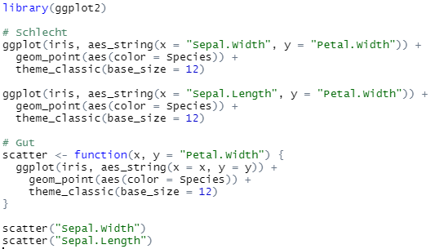
Functions are the Basis of R
R Packages mainly consist of functions (demo in R)
Define own functions → structures code and improves maintainability
Examples (bad and good)
Bad
Good

Slide 3
Separate Functions from Analysis
If your analysis uses several self-written functions, it often makes sense to
put them in a separate script called "functions.R" and
source it in the analysis script by
source("functions.R")
Example of a "functions.R" file
# Scatter of y against x
scatter <- function(x, y = "Petal.Width") {
ggplot(iris, aes_string(x = x, y = y)) +
geom_point(aes(color = Species)) +
theme_classic(base_size = 12)
}
# Does something cool
something_cool <- function(…) {
…
}

Slide 4
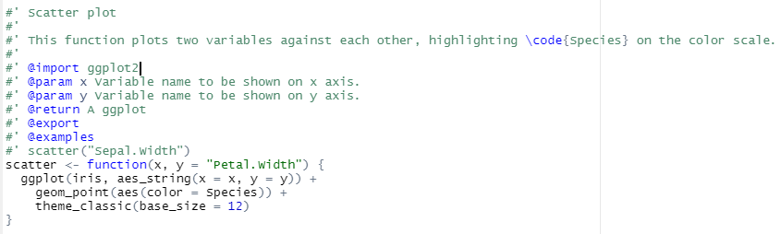
Document, Document, Document
Good documentation of a function is essential
Human beings are forgetful
At some point, the project will be handed over to someone else
Recommended: Roxygen style https://cran.r-project.org/web/packages/roxygen2/vignettes/roxygen2.html
Example (incl. short demo in R)

Slide 5

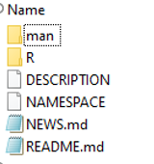
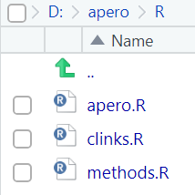
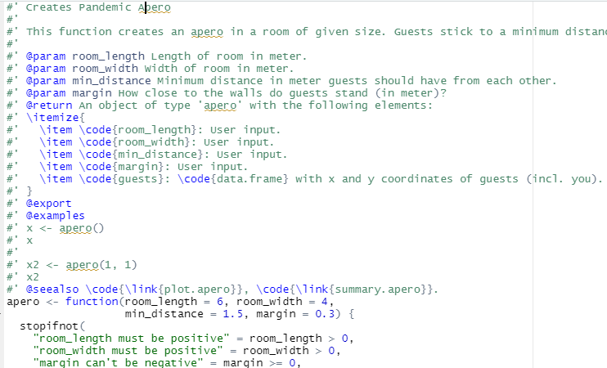
Well-documented Functions are almost a Package
When is it worth to turn a "functions.R" script into a package?
If the same functions are used across multiple projects.
Collaboration with external persons.
You want to publicly share something useful with others (via Github or CRAN)
Typical Content of an R package
Demo of "apero" package. Note: In Switzerland, we have "Apéro" all the time…
https://services.marketing.mobiliar.ch/de/downloads/bildwelt/media/711628

Slide 6
Remark: print(), summary(), plot(), …
R has a very simple system for object-specific functions
Example 1
summary() on a data.frame does something different than on a numeric vector.
Example 2 (copy to R)
employee <- function(given_name, family_name) {
out <- list(
given_name = given_name,
family_name = family_name
)
class(out) <- "employee"
out
}
print.employee <- function(x) {
cat("You are", x$given_name, x$family_name)
}
me <- employee("Michael", "Mayer")
me # or print(me)

Slide 7
Creating the "apero" Package
Two packages are of key importance to build your own package
usethis: Cares about content of package
devtools: Turns content into package
Preparation
You need R, RStudio, and RTools.
Put your R functions into one or multiple R scripts.
Document them in Roxygen style.
Then continue as in https://github.com/mayer79/apero → script "packaging.R"
Demo
By Prof. Jenny Bryan et al.

Slide 8
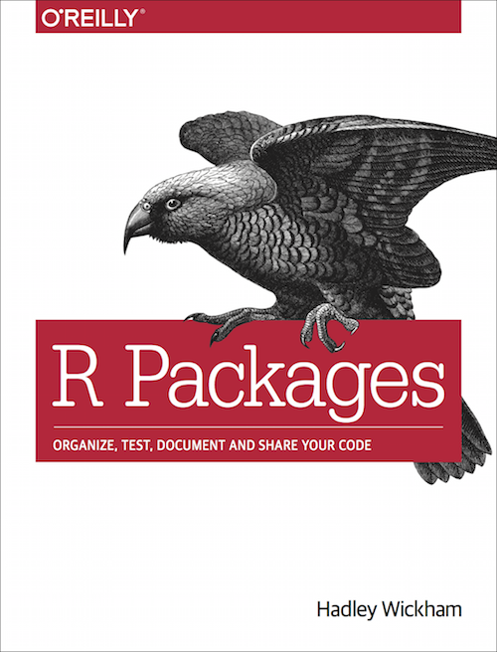
Some final Words
In R code of package, never ever use
source()
library(), require()
setwd()
Hadley’s book free online
https://r-pkgs.org/
Everything on https://github.com/mayer79/apero
devtools::install_github("mayer79/apero")
Test with your own code!

