Slide 1
Neuromorphic Computing Midterm Presentation: FPGA Hardware Acceleration of CNN based SDR Analysis
Corey L. Butts, Joshua Mayersky
buttscl@mail.uc.edu, mayersjd@mail.uc.edu
(330) 883-9679
03/11/2021

Slide 2
Project Timeline

Slide 3
Corey’s Project Progress
Python Simulations
High level simulation of model
Tested model using different hyper parameters
Frequency analysis of models trained on low pass filter
Saved weights and biases of trained models
Optimized model for hardware implementation

Slide 4
Quick Review
Antenna
Power Amplifier
RFTuner
ADC
Digital Mixer
Lowpass Filter
Signal Processing
Digital Local Oscillator
Implemented on FPGA

Slide 5
Quick Review
Training
Observer
Neural Network
Antenna
Power Amplifier
RFTuner
ADC
Digital Mixer
Lowpass Filter
Signal Processing
Digital Local Oscillator
Implemented on FPGA

Slide 6
Quick Review
Trained Network
Observer
Neural Network
Error
Antenna
Power Amplifier
RFTuner
ADC
Digital Mixer
Lowpass Filter
Signal Processing
Digital Local Oscillator
Trojan

Slide 7
Quick Review
Observer
Neural Network
Antenna
Power Amplifier
RFTuner
ADC
Digital Mixer
Lowpass Filter
Signal Processing
Digital Local Oscillator
Implemented on FPGA

Slide 8
Quick Review
Antenna
Power Amplifier
RFTuner
ADC
Digital Mixer
Observer
Neural Network
Signal Processing
Digital Local Oscillator
Implemented on FPGA

Slide 9
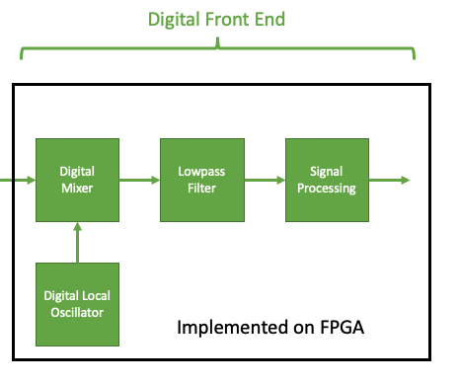
SDR Digital Front End
Digital Down Converter (DDC)

Slide 10
What A DDC Does
ADCs typically sample at a very high frequency
Requires an unnecessarily fast DSP since the data we are concerned about is usually much lower frequency
DDC lowers the frequency the digitized signal
Still preserves the original signal
Reduces DSP speed requirements
Down conversion is used to demodulate AM signals

Slide 11
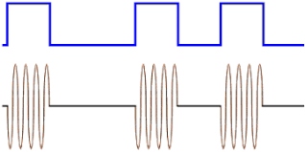
On Off Keying (OOK)
A type of Amplitude Modulation
Presence of the carrier wave denotes a ’1’
Absence of the carrier wave denotes a ‘0’

Slide 12
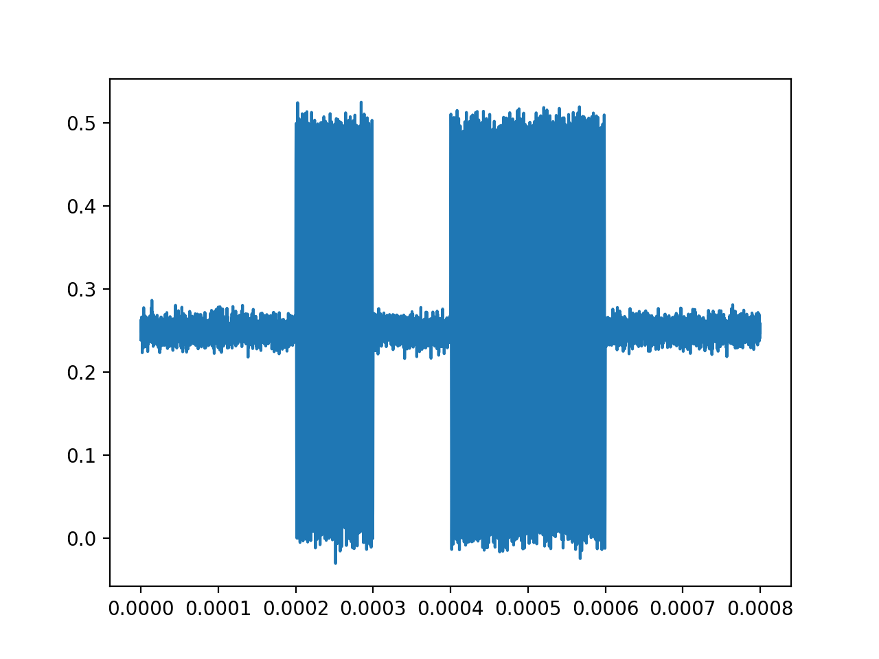
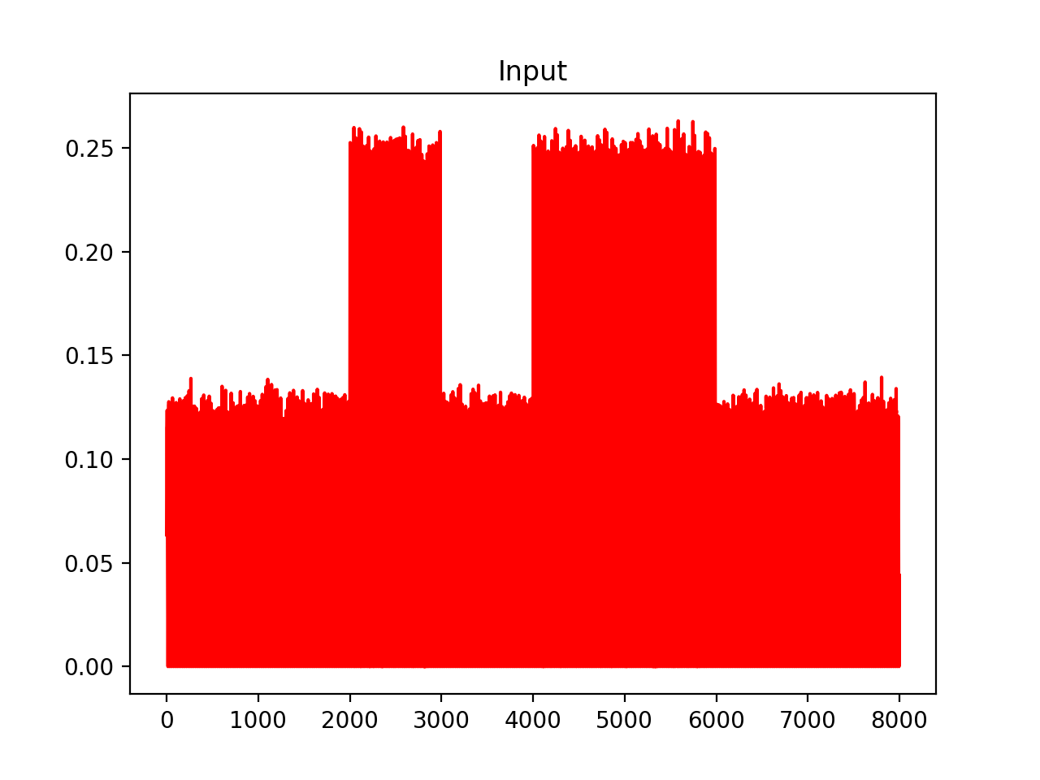
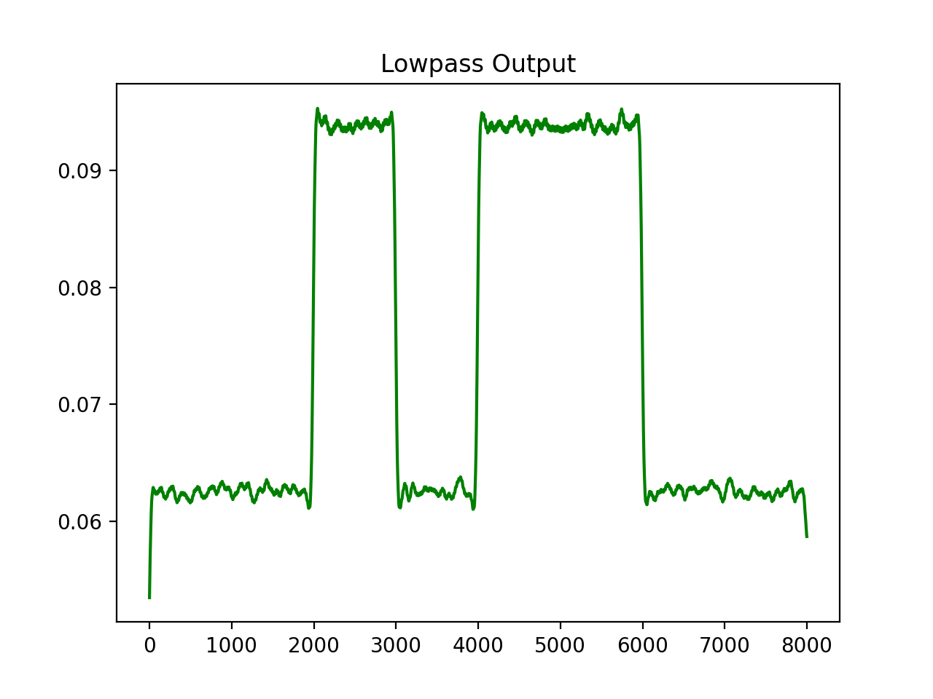
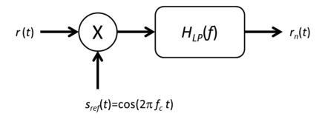
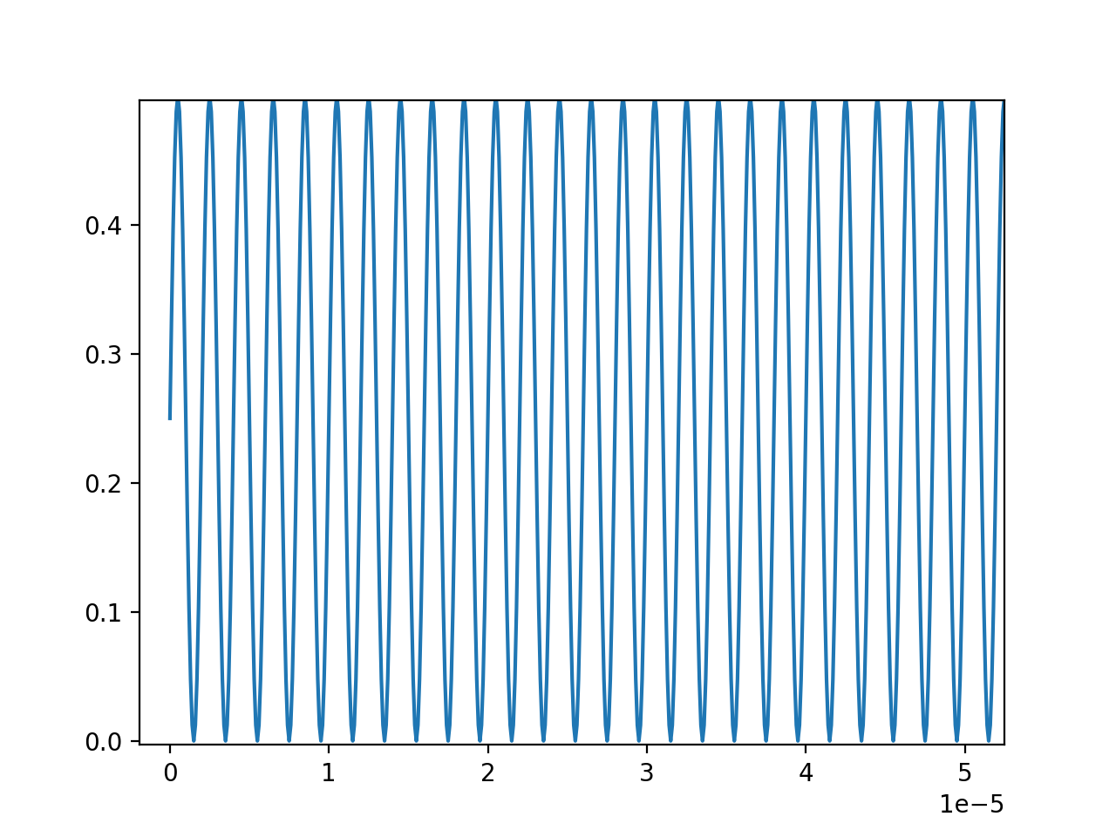
Down Conversion Example Using OOK Data
Mixer
Lowpass Filter

Slide 13
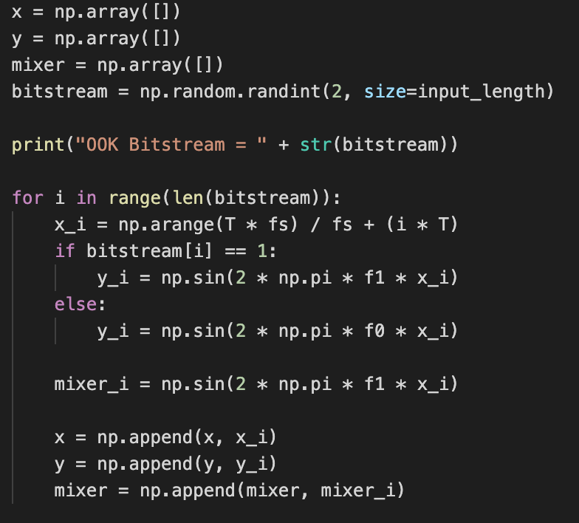
Generating Data
Generate a binary signal modulated using OOK
Create a random bitstream array (e.g. [0 1 0 0 1 0 1 1 0 1 0 1 0 0 1 1])
Create an empty NumPy array
Loop through bitstream appending a linear signal for ‘0’ and a sine wave for ‘1’ to the array

Slide 14
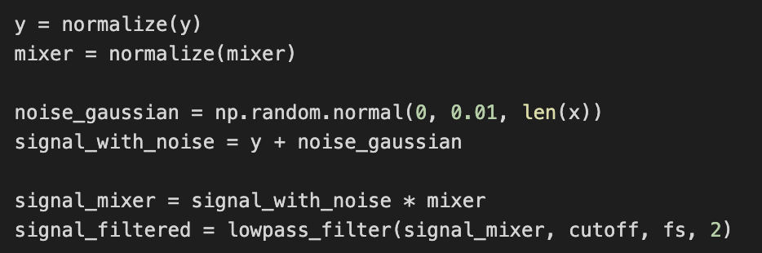
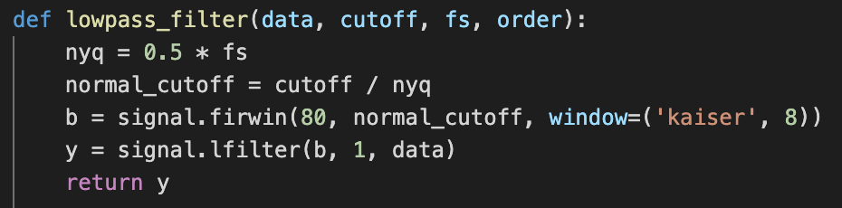
Generating Data
Model a DDC using SciPy and NumPy
Mixer multiplies modulated signal with carrier sine wave
Low pass FIR filter removes high frequency component

Slide 15
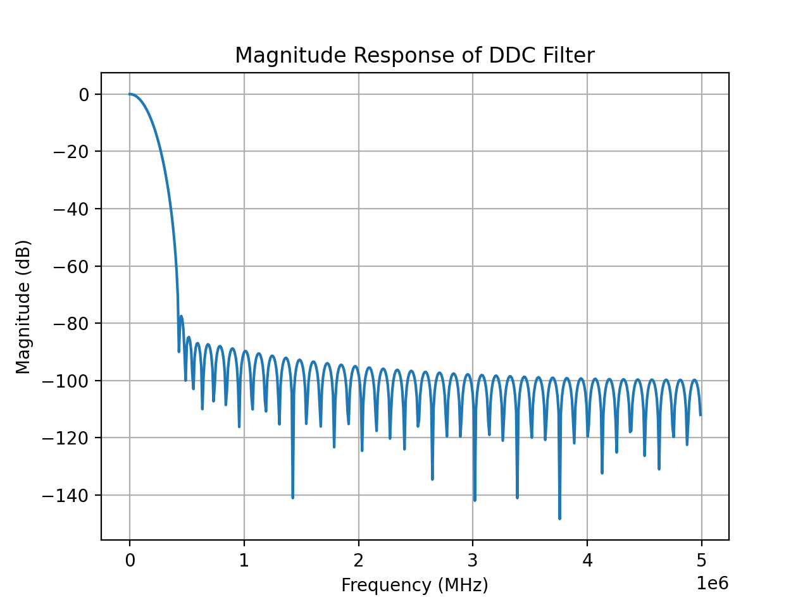
Lowpass FIR Filter
Cutoff
Frequency
(100kHz)
Carrier
Frequency
(500kHz)

Slide 16
Observer
Neural Network

Slide 17
Model Architecture Block Diagram
1-D CNN Layer
(64 Filters)
Max Pooling
(window size = 2)
Dense Layer
(50 Units)
Input
x[n]
Output
(1 Unit)
x[n-1]
Flatten
y[n]
…
x[n-64]

Slide 18
Training Procedure
Generate OOK data
x_train = mixer output
y_train = lowpass output
Train for ~500 epochs with Adadelta optimizer
Finds local minimums fast
Train for ~250 epochs with Adam optimizer (learning rate = 1e-5)
Reduces loss even further without overfitting
Graphical visualization of optimizer performance. Adapted from “LSTM Optimizer Choice?” by Bikal Basnet, 2016, retrieved from https://deepdatascience.wordpress.com/2016/11/18/which-lstm-optimizer-to-use/^{[5]}

Slide 19
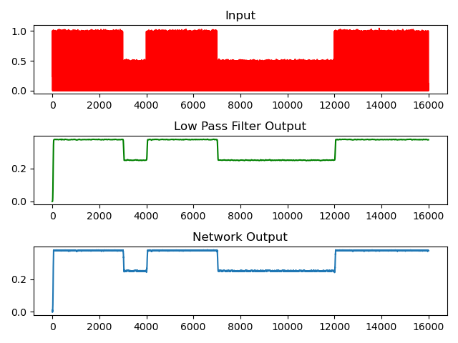
Results OOK Low Pass Filter Dataset

Slide 20
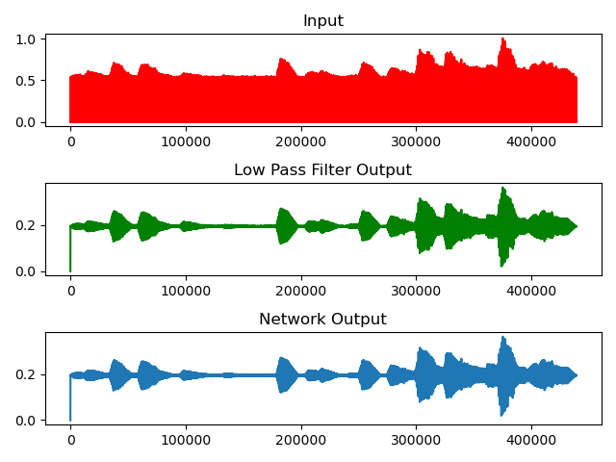
Results Audio Low Pass Filter Dataset

Slide 21
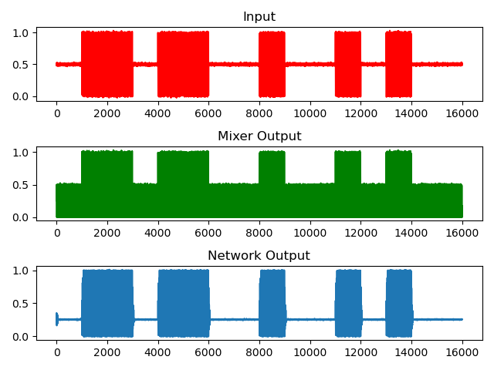
Results OOK Mixer Dataset

Slide 22
Conclusion
The Model works but its effectiveness is dependent on the dataset
Has difficulty changing a constant signal to a sine wave
Does the model understand the component functionality?

Slide 23
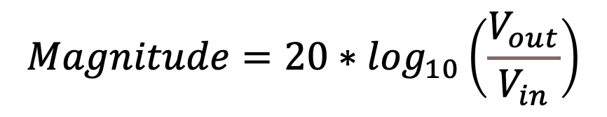
Frequency Response Comparison
Determine how well the CNN models the low pass filter’s functionality
Input a set of sine waves (1kHz – 1MHz) to each model variation
Get the magnitude using the following equation:
$$Magnitude=20∗\log_{10}\left(\frac{V_{out}}{V_{in}}\right)$$

Slide 25
Potential Issues With Current Configuration
Project goal: implement matrix multiplication operations in convolutional layer using FeFETs
2 Issues
64 filters in CNN layer
Weights & biases = 99,493
More filters means more area taken by FeFET circuit
Data type = float (32b)
Input size (bitwise) exponentially increases area taken by FeFET circuit

Slide 26
Float to Half
half = 16b = float/2
float: 0.12345678
half: 0.1235
Reducing the precision of the input, weights and biases = much smaller circuit area
Accuracy of the network is not sacrificed
Evaluation speed slightly increased (191ms → 147ms)

Slide 27
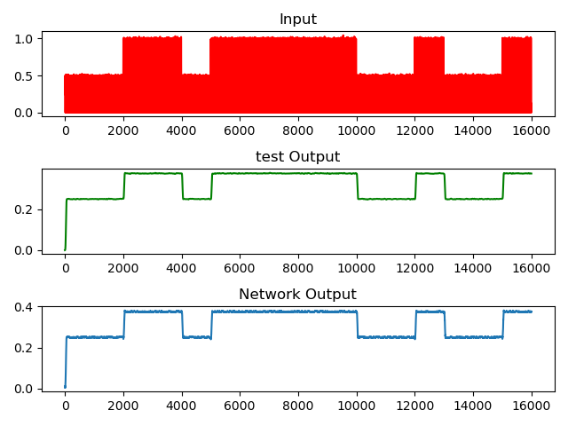
Results: Float to Half

Slide 28
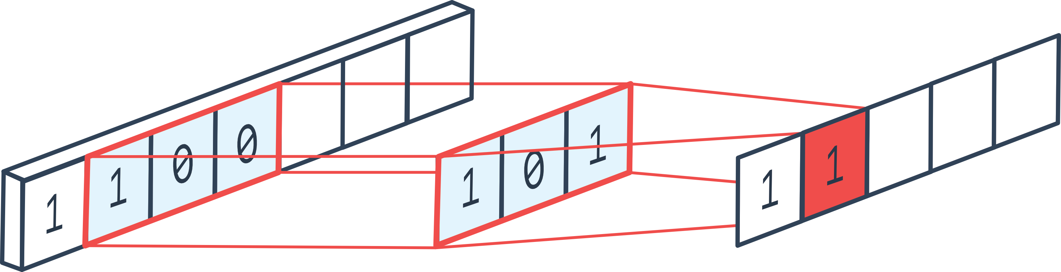
Reducing Filters
Less filters = less operations
More speed (which is great in an SDR application)
Reduces size of matrix multiplication circuit
Using 8 filters → weights & biases = 5,737 << 99,493
Evaluation speed further increased (147ms → 88ms)

Slide 29
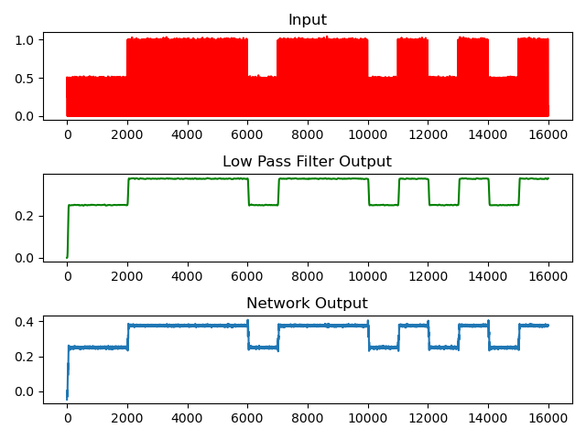
Results: Reducing Filters OOK Dataset

Slide 30

Results: Reducing Filters OOK Dataset

Slide 31
Future Project Deliverables
Implement CNN in:
FPGA
Jetson Nano
Confirm FeFET output accuracy
Benchmark performance of FPGA and Jetson Nano Convolutional layer against FeFET implementation

