Slide 1
FPGA Hardware Acceleration of CNN based SDR Analysis
Corey L. Butts, Joshua Mayersky
buttscl@mail.uc.edu, mayersjd@mail.uc.edu
(330) 883-9679
04/27/2021

Slide 2
Project Timeline

Slide 3
Project Summary
Machine learning model
Learn SDR component functionality by training on input/output signal data
Implemented using a one-dimensional convolutional neural network (1DCNN)
Goal: compare 3 implementations of the convolutional layer
SoC (Jetson Nano)
FPGA
MMA (Neuromorphic Hardware)

Slide 4
FPGA CNN Acceleration Summary
FPGA allows you to program hardware circuits for specified functionality
Allows for the implementation of parallelism
CNNs utilize the convolution operation (multiplication and addition)
These operations can be implemented as circuits allowing for each operation to be done in parallel

Slide 5
FPGA Conv2 Block Diagram
Conv2
16
Input0
16
Input1
32
16
Output
Filter0
16
Filter1
Output = (Input0 * Filter0) + (Input1 * Filter1)

Slide 6
FPGA Implementation
Each Conv2 block implements a hardware circuit used to multiply and add the 4 16-bit numbers
Each number in the feature maps can now be computed in parallel as opposed to serially
Conv2
Conv2
Conv2
Conv2
Output0
Conv2
Conv2
Conv2
Conv2
4 Filters
Output1
…
Conv2
Conv2
Conv2
Conv2
Output31

Slide 7
Final Project Contributions
Concluded FPGA development
Implemented bias in Conv layer filters
Expanded model from 8 input samples to 32 input samples
Explored pros and cons of using floating vs fixed point precision
Benchmarked FPGA Conv layer using sample input data from Python script

Slide 8
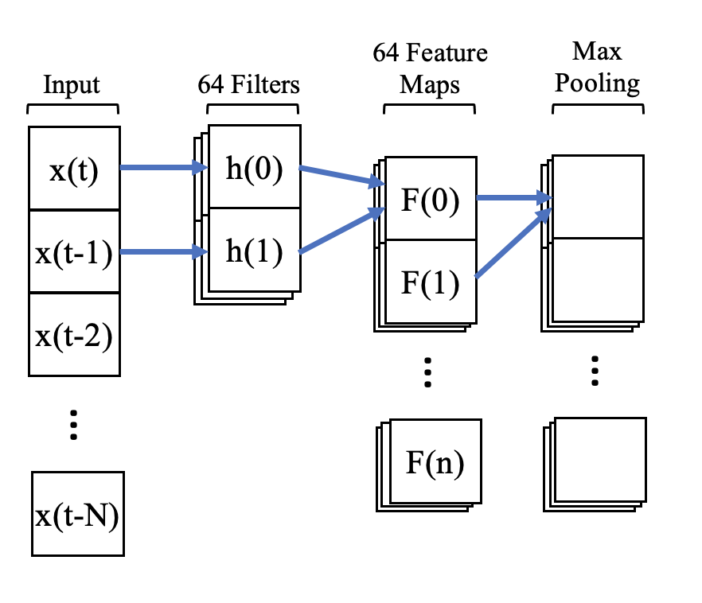
Implementing Bias
CNN filters also have an additional parameter, called a bias, that is added to the resulting convolution
CNN
$$F\left(0\right)=x\left(t\right)h\left(0\right)+x\left(t−1\right)h\left(1\right)+b$$

Slide 9
FPGA Implementation With Bias
16
Conv2
Input0
16
Input1
16
32
Filter0
Output
16
Filter1
16
Bias
Output = (Input0 * Filter0) + (Input1 * Filter1) + Bias

Slide 10
Scaling the Model
To easily test functionality, the model was scaled down
Input size: 32 samples → 8 samples
Sample data type: 16-bit float → 8-bit integer
Problem: scaling up requires the implementation of floating point arithmetic

Slide 11
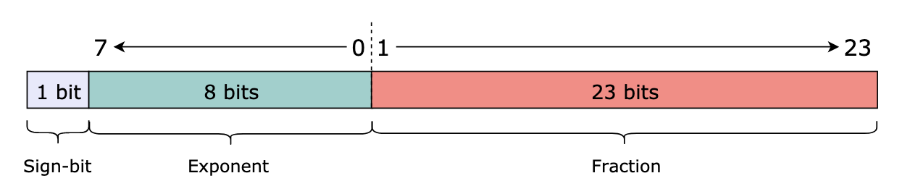
Floating Point Binary Representation
Floats are represented in binary in 3 sections:
Sign: Indicates the sign (-/+)
Exponent: Used to compute the exponent portion of the number
Fraction: Used to compute the fractional portion of the number

Slide 12
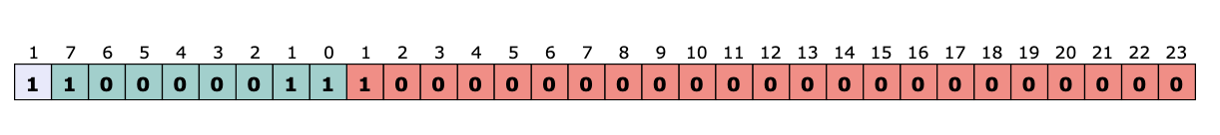
Floating Point Binary Example
$$Number={(−1)}^{sign}×(1+fraction)×2^{exponent−127}$$
sign = 1
exponent = 2⁷ + 2¹ + 2⁰ = 128 + 2 + 1 = 131
fraction = 2⁻¹ = 0.5
Number = (-1)¹ x (1 + 0.5) x 2^{131– 127} = -24.0

Slide 13
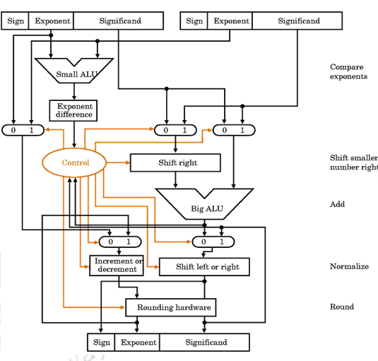
Floating Point Arithmetic
Can’t be done in the way integer arithmetic can
Requires more complex hardware
Higher utilization
Increased circuit delay
Not enough time to implement :(

Slide 14
Solution: Use VHDL ”real” type
Instead of using logic vectors to represent floats use “real” type
VHDL’s float type
Can just do normal arithmetic without complex hardware implementation (e.g. y <= a*b)

Slide 15
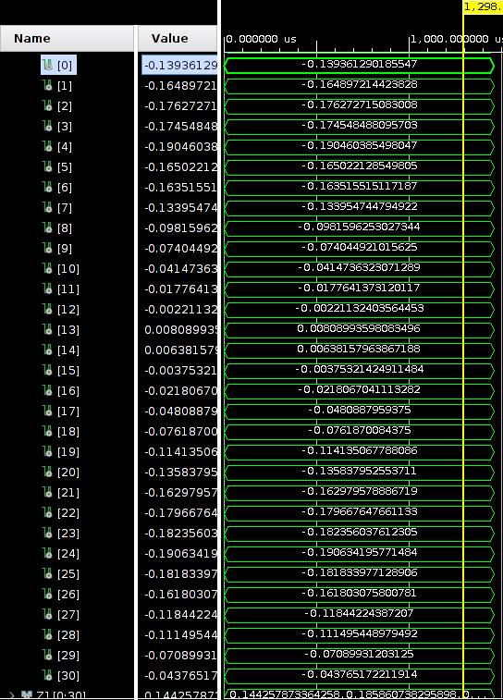
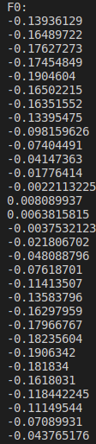
Results

Slide 16
Conclusion
Accurate to the python simulations
Average mean squared error = 0
VHDL real types cannot be synthesized!
Only for simulation purposes
Even though this design is simple to implement and accurate it cannot be used on a real FPGA

Slide 17
Fixed Point Arithmetic
Decimal number is represented by 2 integers
Integer part
Fractional part
Allows for the use of integer arithmetic
Simpler hardware
Faster
Less space required to store values
Comes at the loss of precision
Might not be entirely needed given our application

Slide 18
FPGA Fixed Point Implementation
Each input is now a 16-bit signed fixed point value
1-bit sign
2-bit integer part
Doesn’t need to be as big considering most values range from -1 to 1
13-bit fractional part
Output is still 32 bits but is divided similarly to the input
1-bit sign
4-bit integer part
27-bit fractional part

Slide 19
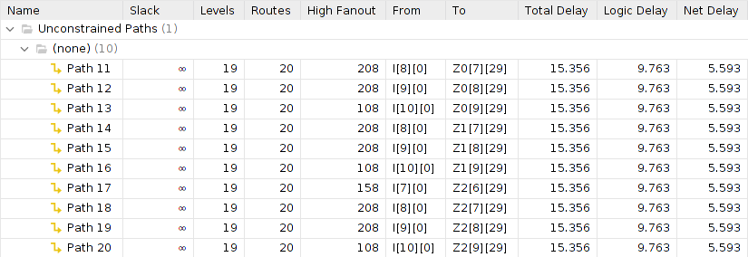
Results: Utilization and Timing

Slide 20
Results: Accuracy
Python FeatureMap[0] = -0.13936129
Binary value outputted = 0 0000 00010001001101010001111011₍₂₎ → 0.03361₍₁₀₎
Inaccuracy could potentially be due to the following:
Issues in converting from float to fixed point
Misuse of the ”signed” VHDL data type
Overflow

Slide 21
Final Thoughts
Areas of functional improvement
Implement floating point arithmetic
Fix issues with fixed point arithmetic and compare to float implementation
FPGA acceleration of CNN shows promising results

