Slide 1
Neuromorphic Computing Midterm Presentation: FPGA Hardware Acceleration of CNN based SDR Analysis
Corey L. Butts, Joshua Mayersky
buttscl@mail.uc.edu, mayersjd@mail.uc.edu
(330) 883-9679
(513) 225-7917
03/11/2021

Slide 2
Project Timeline

Slide 3
Corey’s Project Progress
Python Simulations
High level simulation of model
Tested model using different hyper parameters
Frequency analysis of models trained on low pass filter
Saved weights and biases of trained models
Optimized model for hardware implementation

Slide 4
Quick Review
Antenna
Power Amplifier
RFTuner
ADC
Digital Mixer
Lowpass Filter
Signal Processing
Digital Local Oscillator
Implemented on FPGA

Slide 5
Quick Review
Training
Observer
Neural Network
Antenna
Power Amplifier
RFTuner
ADC
Digital Mixer
Lowpass Filter
Signal Processing
Digital Local Oscillator
Implemented on FPGA

Slide 6
Quick Review
Trained Network
Observer
Neural Network
Error
Antenna
Power Amplifier
RFTuner
ADC
Digital Mixer
Lowpass Filter
Signal Processing
Digital Local Oscillator
Trojan

Slide 7
Quick Review
Observer
Neural Network
Antenna
Power Amplifier
RFTuner
ADC
Digital Mixer
Lowpass Filter
Signal Processing
Digital Local Oscillator
Implemented on FPGA

Slide 8
Quick Review
Antenna
Power Amplifier
RFTuner
ADC
Digital Mixer
Observer
Neural Network
Signal Processing
Digital Local Oscillator
Implemented on FPGA

Slide 9
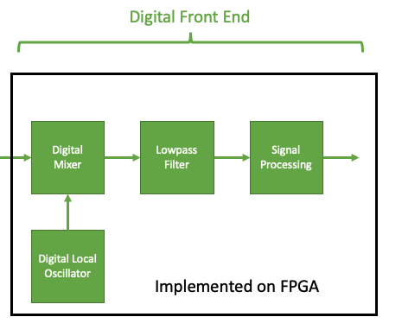
SDR Digital Front End
Digital Down Converter (DDC)

Slide 10
What A DDC Does
ADCs typically sample at a very high frequency
Requires an unnecessarily fast DSP since the data we are concerned about is usually much lower frequency
DDC lowers the frequency the digitized signal
Still preserves the original signal
Reduces DSP speed requirements
Down conversion is used to demodulate AM signals

Slide 11
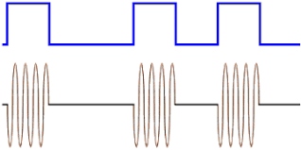
On Off Keying (OOK)
A type of Amplitude Modulation
Presence of the carrier wave denotes a ’1’
Absence of the carrier wave denotes a ‘0’

Slide 12
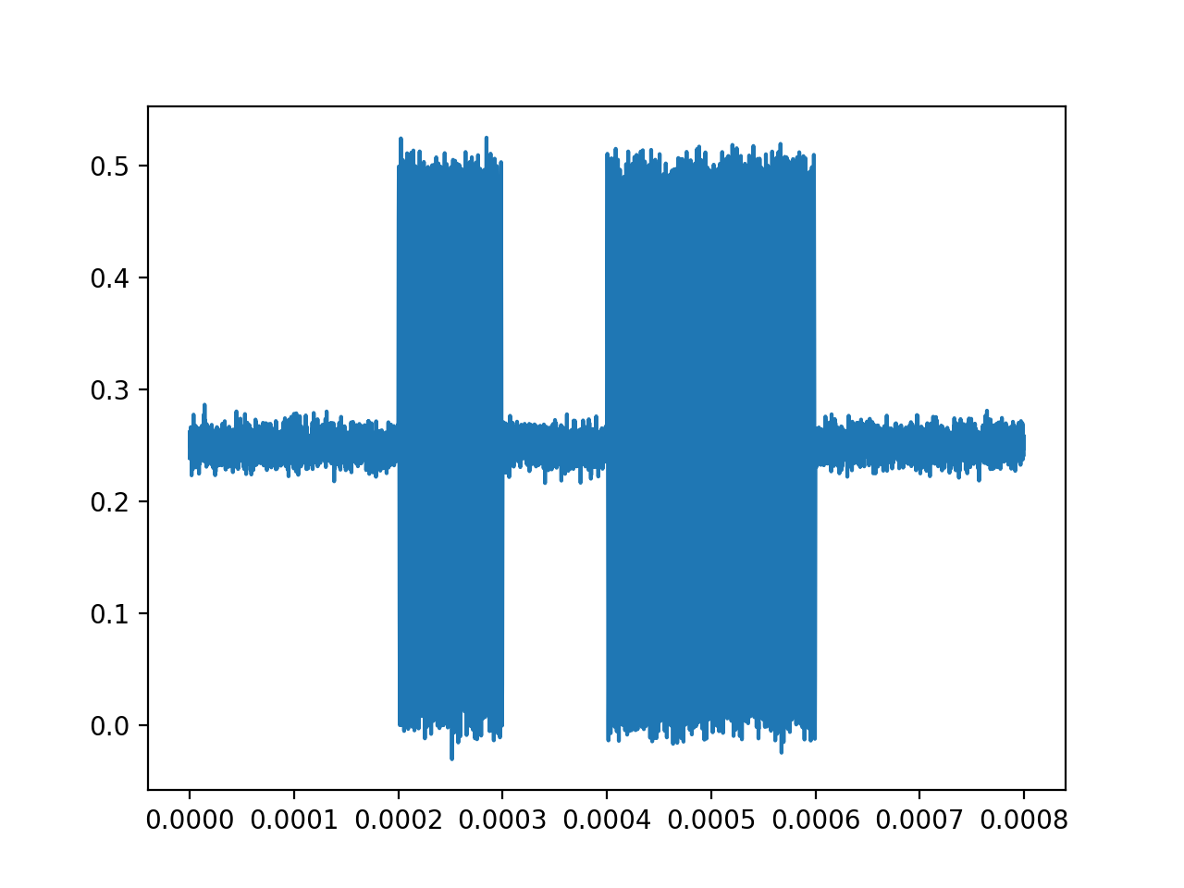
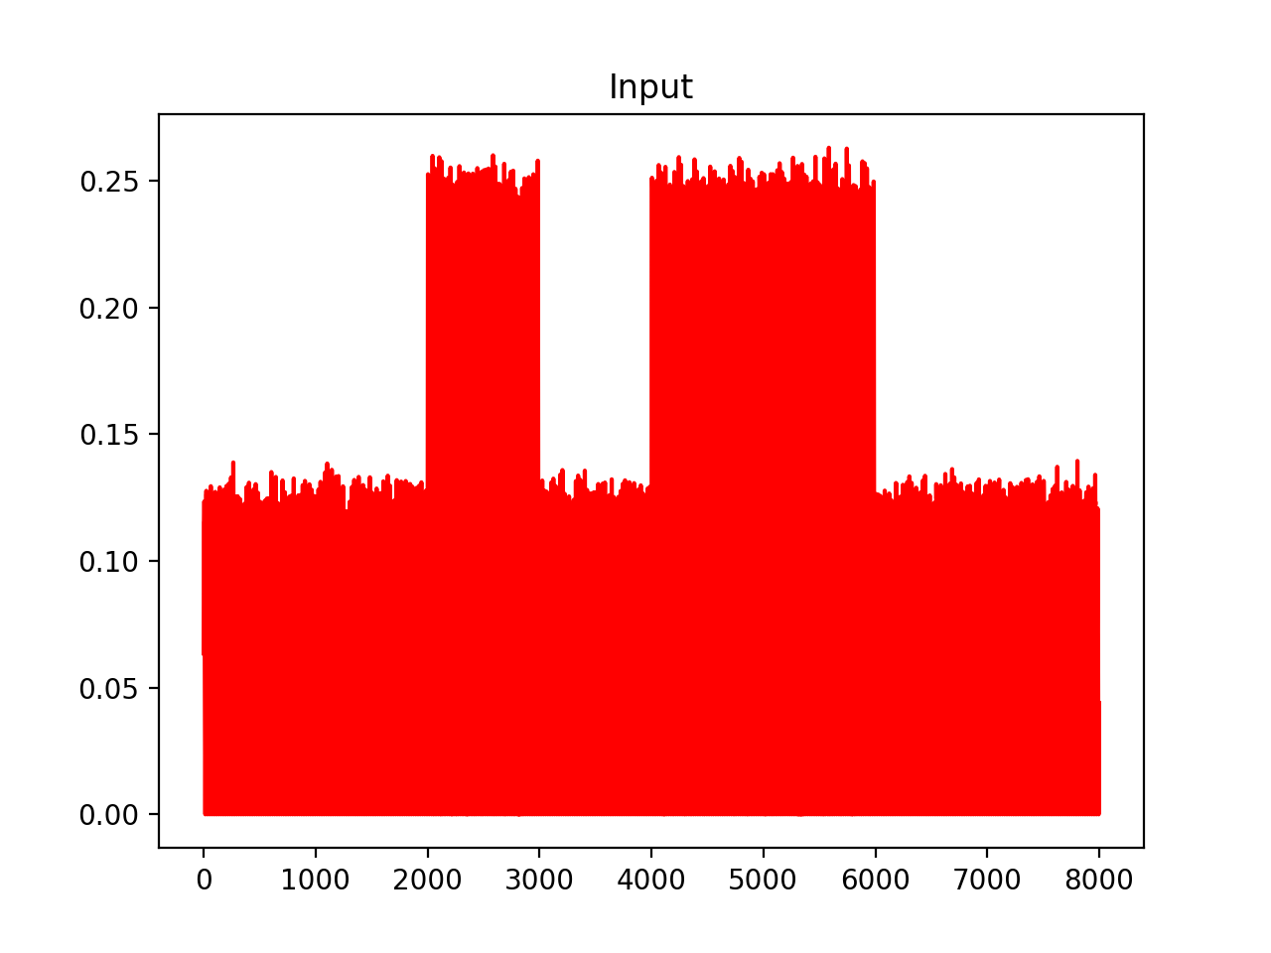
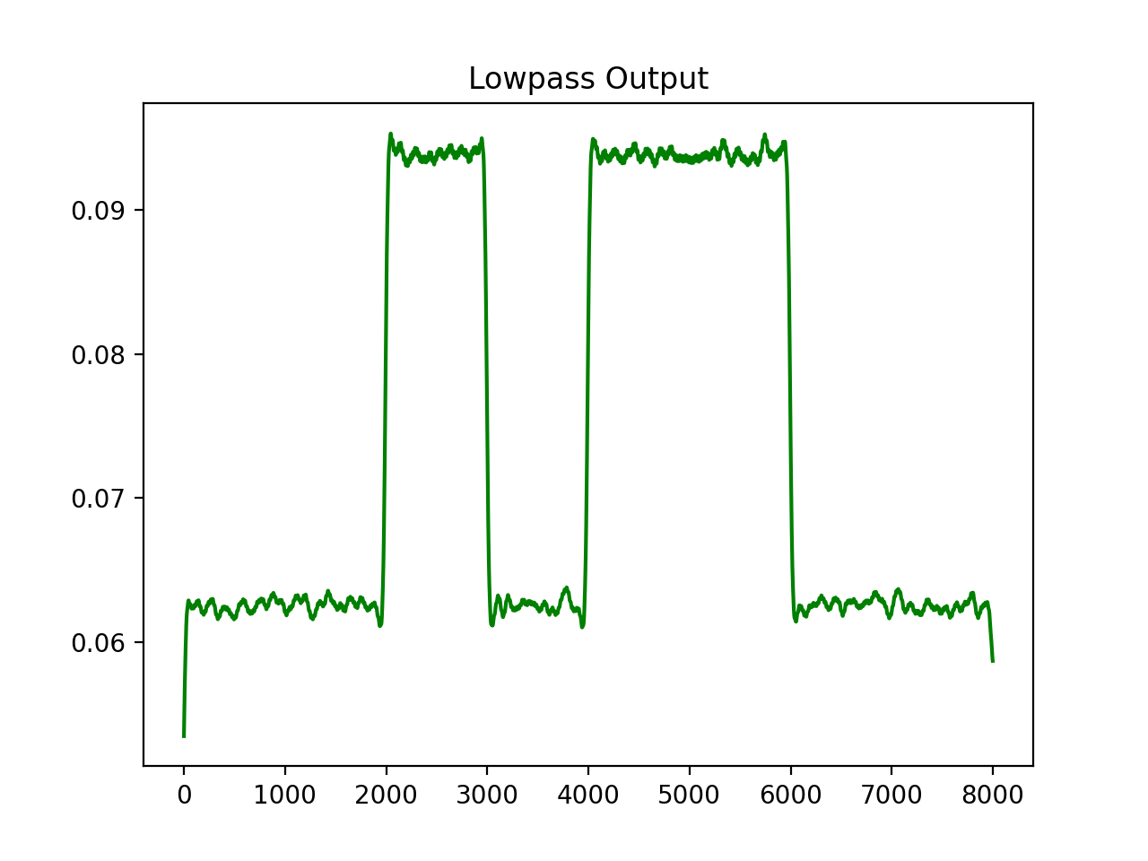
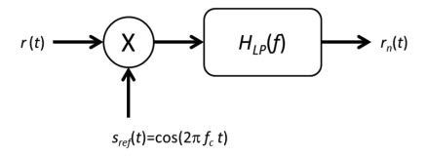
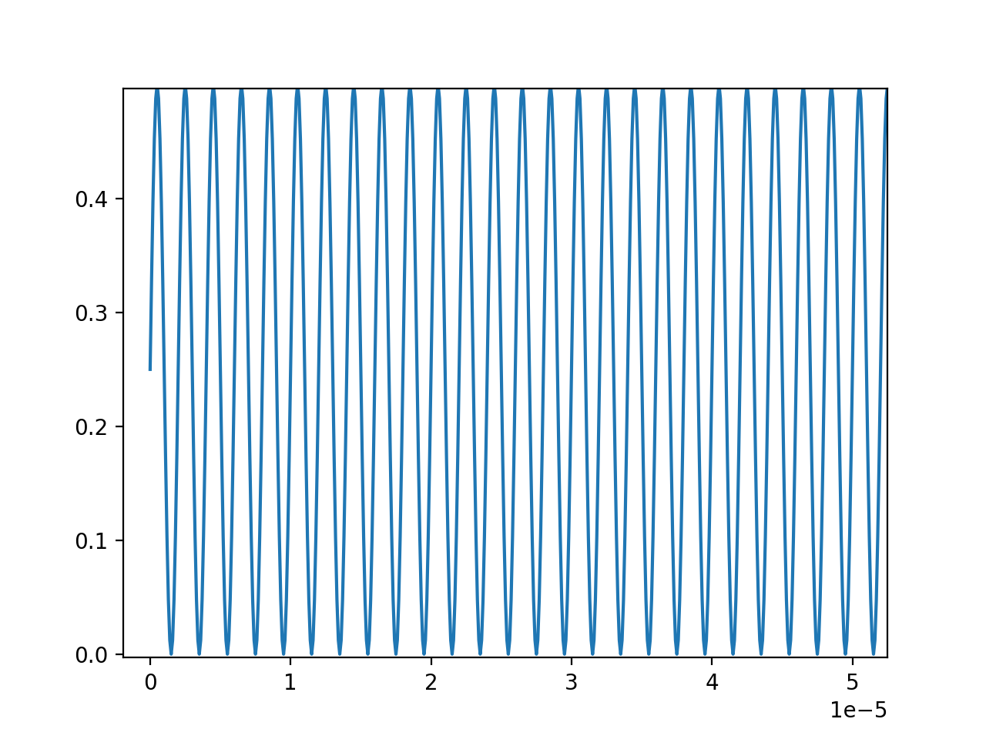
Down Conversion Example Using OOK Data
Mixer
Lowpass Filter

Slide 13
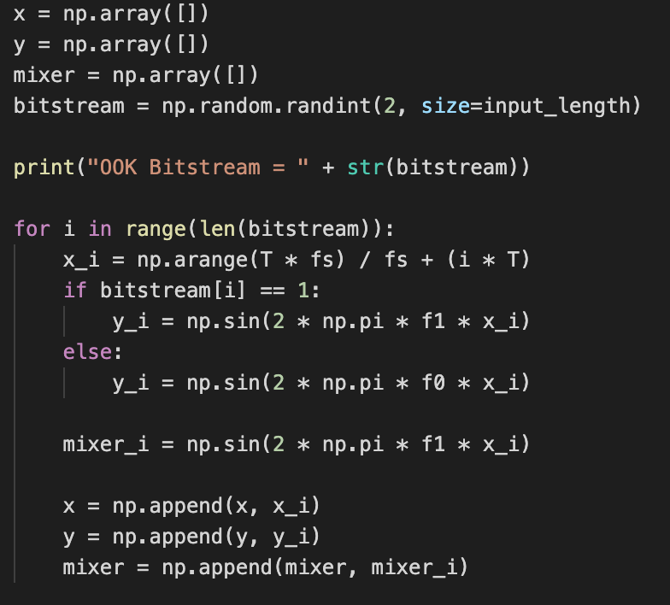
Generating Data
Generate a binary signal modulated using OOK
Create a random bitstream array (e.g. [0 1 0 0 1 0 1 1 0 1 0 1 0 0 1 1])
Create an empty NumPy array
Loop through bitstream appending a linear signal for ‘0’ and a sine wave for ‘1’ to the array

Slide 14
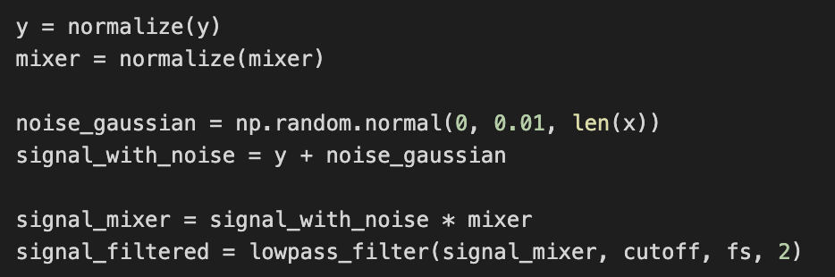
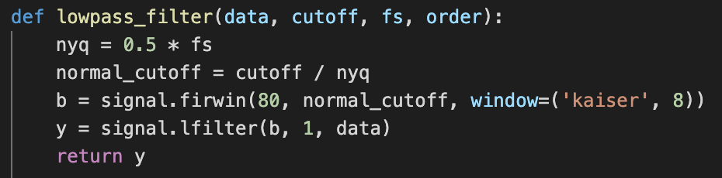
Generating Data
Model a DDC using SciPy and NumPy
Mixer multiplies modulated signal with carrier sine wave
Low pass FIR filter removes high frequency component

Slide 15
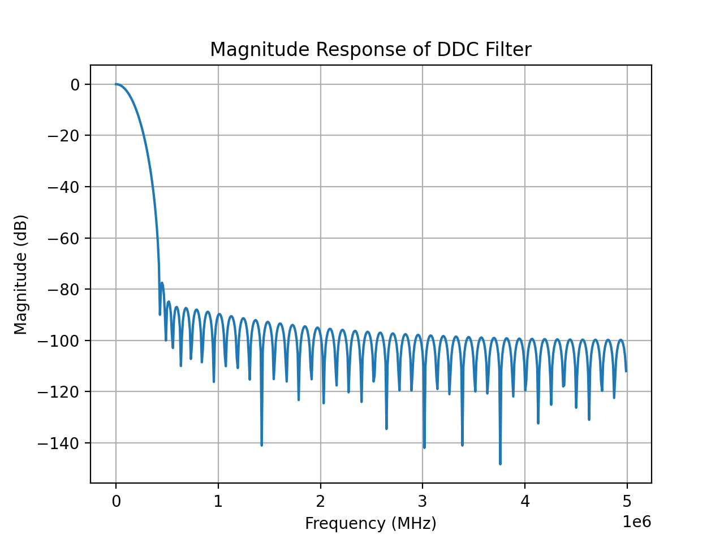
Lowpass FIR Filter
Cutoff
Frequency
(100kHz)
Carrier
Frequency
(500kHz)

Slide 16
Observer
Neural Network

Slide 17
Model Architecture Block Diagram
1-D CNN Layer
(64 Filters)
Max Pooling
(window size = 2)
Dense Layer
(50 Units)
Input
x[n]
Output
(1 Unit)
x[n-1]
Flatten
y[n]
…
x[n-64]

Slide 18
Training Procedure
Generate OOK data
x_train = mixer output
y_train = lowpass output
Train for ~500 epochs with Adadelta optimizer
Finds local minimums fast
Train for ~250 epochs with Adam optimizer (learning rate = 1e-5)
Reduces loss even further without overfitting
Graphical visualization of optimizer performance. Adapted from “LSTM Optimizer Choice?” by Bikal Basnet, 2016, retrieved from https://deepdatascience.wordpress.com/2016/11/18/which-lstm-optimizer-to-use/^{[5]}

Slide 19
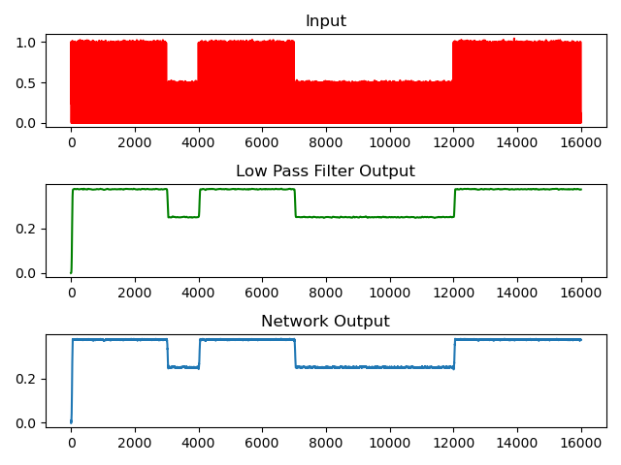
Results OOK Low Pass Filter Dataset

Slide 20
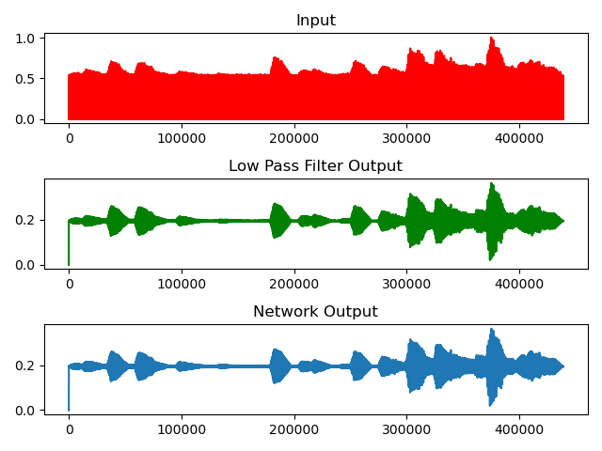
Results Audio Low Pass Filter Dataset

Slide 21
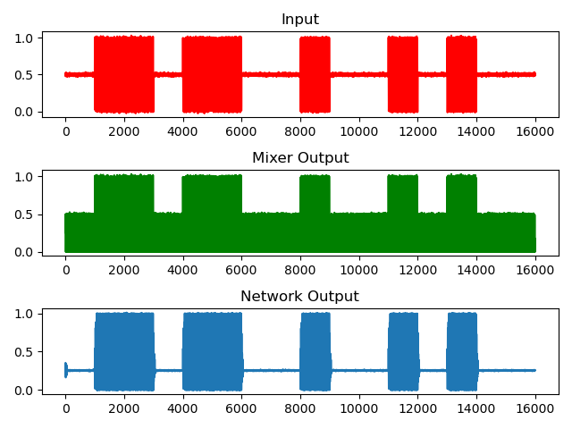
Results OOK Mixer Dataset

Slide 22
Conclusion
The Model works but its effectiveness is dependent on the dataset
Has difficulty changing a constant signal to a sine wave
Does the model understand the component functionality?

Slide 23
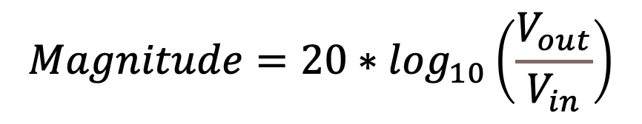
Frequency Response Comparison
Determine how well the CNN models the low pass filter’s functionality
Input a set of sine waves (1kHz – 1MHz) to each model variation
Get the magnitude using the following equation:
$$Magnitude=20∗\log_{10}\left(\frac{V_{out}}{V_{in}}\right)$$

Slide 25
Potential Issues With Current Configuration
Project goal: implement matrix multiplication operations in convolutional layer using FeFETs
2 Issues
64 filters in CNN layer
Weights & biases = 99,493
More filters means more area taken by FeFET circuit
Data type = float (32b)
Input size (bitwise) exponentially increases area taken by FeFET circuit

Slide 26
Float to Half
Half = 16b = float/2
Reducing the data type of the input, weights and biases would significantly reduce the circuit area
Accuracy of the network is not sacrificed
Evaluation speed slightly increased (191ms → 147ms)

Slide 27
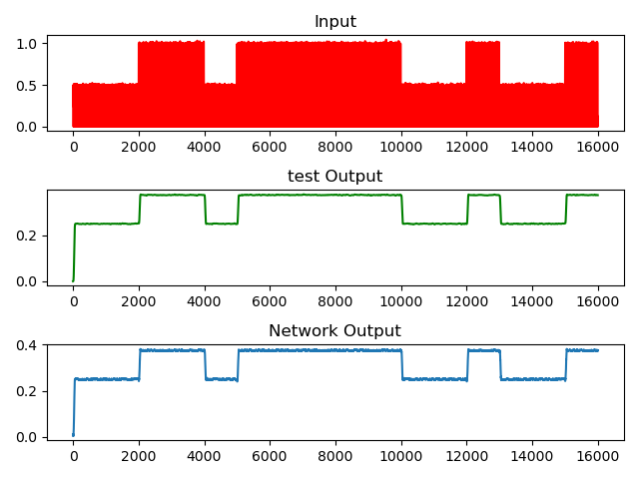
Results: Float to Half

Slide 28
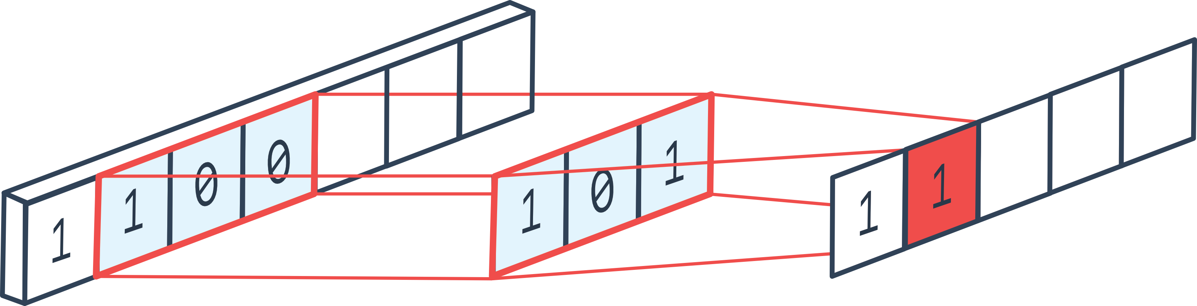
Reducing Filters
Less filters = less operations
More speed (which is great in an SDR application)
Reduces size of matrix multiplication circuit
Using 8 filters → weights & biases = 5,737 << 99,493
Evaluation speed further increased (147ms → 88ms)

Slide 29
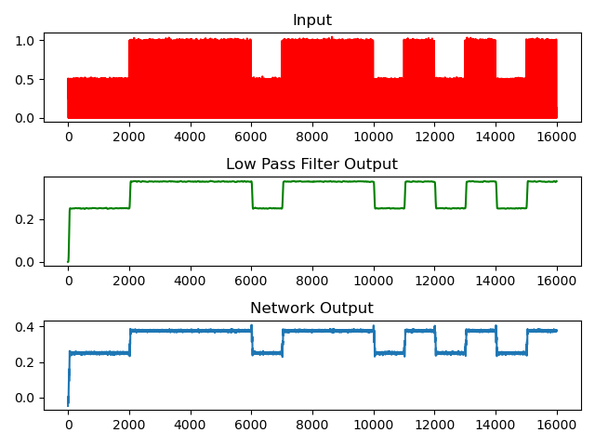
Results: Reducing Filters OOK Dataset

Slide 30

Results: Reducing Filters OOK Dataset

Slide 31
Future Deliverables
Implement CNN in:
FPGA
Jetson Nano
Confirm FeFET output accuracy
Benchmark performance of FPGA and Jetson Nano Convolutional layer against FeFET implementation

Slide 32
Josh’s Project Progress
Literature surveys on circuit designs for FeFET based Matrix Multiplication Acceleration (MMA)
MMA circuit design
Preliminary MMA circuit HSPICE simulations

Slide 33
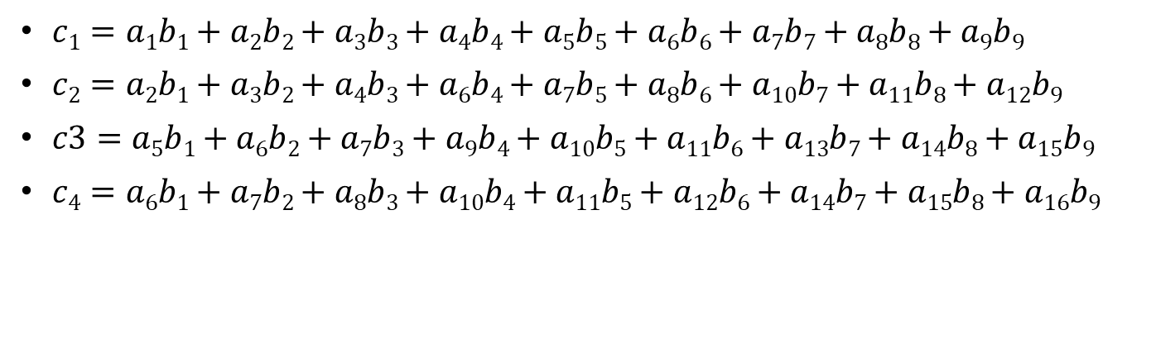
Review: Convolution Operation
a1 | a2 | a3 | a4
a5 | a6 | a7 | a8
a9 | a10 | a11 | a12
a13 | a14 | a15 | a16
b1 | b2 | b3
b4 | b5 | b6
b7 | b8 | b9
c1 | c2
c3 | c4
$c1=a1b1+a2b2+a3b3+a4b4+a5b5+a6b6+a7b7+a8b8+a9b9$
$c2=a2b1+a3b2+a4b3+a6b4+a7b5+a8b6+a10b7+a11b8+a12b9$
$c3=a5b1+a6b2+a7b3+a9b4+a10b5+a11b6+a13b7+a14b8+a15b9$
$c4=a6b1+a7b2+a8b3+a10b4+a11b5+a12b6+a14b7+a15b8+a16b9$

Slide 34
Block Diagram of MMA
Inputs from SDR
Digital Mixer
Map to One-hot-vector enable signals
Filter Kernel
Digital Multiplier (MMA)
Output
to Pooling Layer
FeFETS are used in the Filter Kernel operations as programmable voltage-controlled resistor weights

Slide 35
FeFET for Digital AND Operation^{[13][14]}
FeFET V_{T} | Input (Gate) | Output
High (0) | 0 | Low Current (0)
High (0) | 1 | Low Current (0)
Low (1) | 0 | Low Current (0)
Low (1) | 1 | High Current (1)
Low V_{T}
High V_{T}
I_{D}
V_{G}
At a given gate voltage (the input), the difference in the drain current of the low and high VT states of the FeFET effectively perform the function of an AND gate
We can convert the trained weights to binary and program 1 bit per FeFET
0 as High V_{T}
1 as Low V_{T}

Slide 36
Architectural Diagram of MMA^{[13][14][15]}
BL₁
SL₁
BL₂
SL₂
en₁
a₁
WL₁
Implements a₁b₁+a₂b₂
a_{i} are 1-bit numbers
b_{i} are 2-bit numbers
We must transform the multi-bit numbers to use this
One-hot vector
b₁₁
b₁₂
en₂
a₂
WL₂
b₂₁
b₂₂
CLK
V_{dd}
CLK
SA
SA
en₁
en₂
Counter
Counter

Slide 37
Example of MMA Mapping Process
 | a₁ | b₁ | a₂ | b₂
Decimal | 1 | 1 | 2 | 3
Binary | 01 | 01 | 10 | 11
S = a₁b₁+a₂b₂
= 1(1) + 2(3)
= 7
BL₁
BL₂
 | SA₁ | SA₂
Clk: 1-2 | 0 | 1 | = 1*2⁰
Clk: 3-4 | 1 | 1 | = 3*2¹
 | clk: 3-4 | clk: 1-2
a1 | 0 | 1
a2 | 1 | 0
WL₁
0
b₁₁
1
b₁₂
WL₂
1
b₂₁
1
b₂₂
S = 1*(2⁰) + 3*(2¹)
= 7
SA and Counter

Slide 38
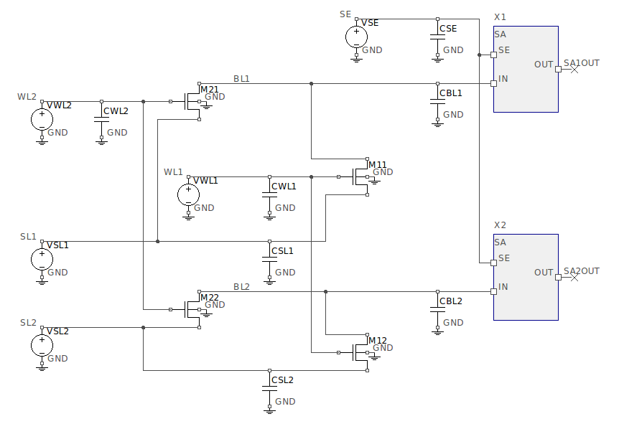
Circuit Simulation
UC Berkeley’s BSIM4 MOSFET model
L_{n}, L_{p} = 45nm
W_{n} = 120nm
W_{p} = 240nm
Varying VT parameter to simulate FeFET
Low V_{T}: 0.1V
High V_{T}: 0.9V
Base V_{T} for MOSFETS: 0.15V
Load caps of 5fF
Done
FeFET Crossbar
Sense Amplifiers
To do:
Counter/Adder

Slide 39
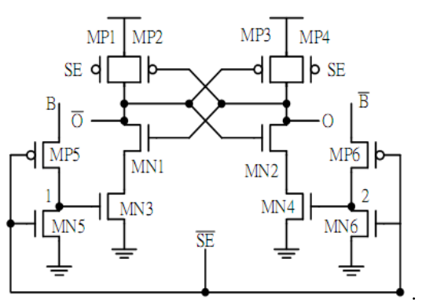
Circuit Simulation: Sense Amplifier^{[16] [17]}
SE = 0: Precharge
SE = 1: Read operation
SE may be tied to CLK in later simulations
B: Input signal (Bit-line)
I added CMOS inverters to provide inverted SE and B signals.

Slide 40
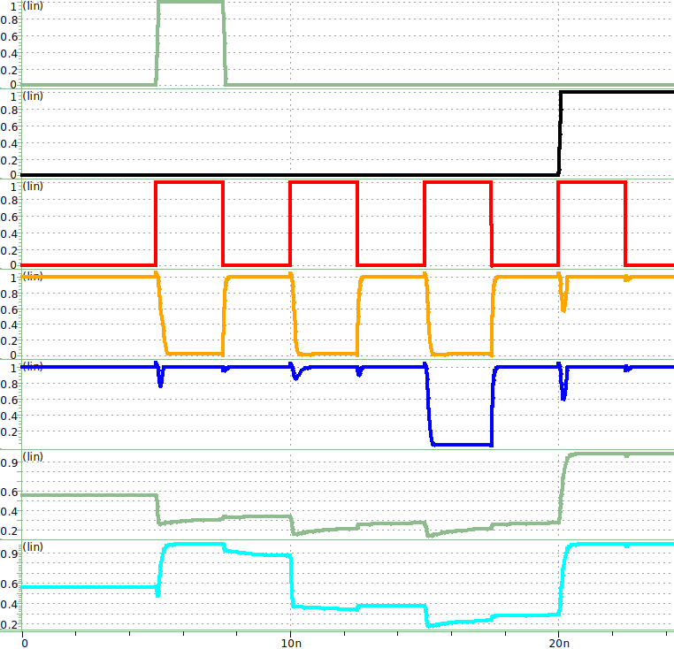
Circuit Simulation
WL₁
WL₂
Same example as before
SE
SA₁
 | a₁ | b₁ | a₂ | b₂
Decimal | 1 | 1 | 2 | 3
Binary | 01 | 01 | 11 | 11
SA₂
BL₁
 | clk: 3-4 | clk: 1-2
a1 | 0 | 1
a2 | 1 | 0
BL₁
BL₂
BL₂
WL₁
clk₁
clk₂
clk₃
clk₄
0
b₁₁
1
b₁₂
 | SA₁ | SA₂
clk: 1-2 | 0 | 1 | = 1*2⁰
clk: 3-4 | 1 | 1 | = 3*2¹
WL₂
1
b₂₁
1
b₂₂
SA₁
SA₂

Slide 41
Performance Metrics

Slide 42
Future Project Deliverables
MMA architecture utilizing FeFETs
Finish implementation of the counters and adders
Drop trained weights into FeFET crossbar
Mapping of the input values to vectors for MMA
Finalize circuit-level SPICE simulations
Interface with python simulations

Slide 43
References
[1] Ding, R., Tian, X., Bai, G., Su, G. & Wu, X. Hardware implementation of convolutional neural network for face feature extraction. in Proceedings of International Conference on ASIC (IEEE Computer Society, 2019). doi:10.1109/ASICON47005.2019.8983575
[2] Dong, Z. et al. Convolutional Neural Networks Based on RRAM Devices for Image Recognition and Online Learning Tasks. IEEE Transactions on Electron Devices 66, 793–801 (2019).
[3] Soloviev, R., Telpukhov, D., Mkrtchan, I., Kustov, A. & Stempkovskiy, A. Hardware Implementation of Convolutional Neural Networks Based on Residue Number System. in Moscow Workshop on Electronic and Networking Technologies, MWENT 2020 - Proceedings (Institute of Electrical and Electronics Engineers Inc., 2020). doi:10.1109/MWENT47943.2020.9067498
[4] Park, B., Ishiwara, H., Okuyama, M., Sakai, S., Yoon, S. Ferroelectric-Gate Field Effect Transistor Memories Device Physics and Applications. in Topics in Applied Physics 131, (2020).
[5] Valueva, M. V., Nagornov, N. N., Lyakhov, P. A., Valuev, G. V. & Chervyakov, N. I. Application of the residue number system to reduce hardware costs of the convolutional neural network implementation. Mathematics and Computers in Simulation 177, 232–243 (2020).
[6] Chung, J., Choi, W., Park, J. & Ghosh, S. Domain Wall Memory-Based Design of Deep Neural Network Convolutional Layers. IEEE Access 8, 19783–19798 (2020).
[7] Yao, P. et al. Fully hardware-implemented memristor convolutional neural network. Nature 577, 641–646 (2020).
[8] Gong, L., Wang, C., Li, X., Chen, H. & Zhou, X. MALOC: A fully pipelined FPGA accelerator for convolutional neural networks with all layers mapped on chip. IEEE Transactions on Computer-Aided Design of Integrated Circuits and Systems 37, 2601–2612 (2018).
[9] Solovyev, R. A., Stempkovsky, A. L. & Telpukhov, D. V. Study of Fault Tolerance Methods for Hardware Implementations of Convolutional Neural Networks. Optical Memory and Neural Networks (Information Optics) 28, 82–88 (2019).
[10] Hacene, G. B., Gripon, V., Arzel, M., Farrugia, N. & Bengio, Y. Quantized guided pruning for efficient hardware implementations of deep neural networks. in NEWCAS 2020 - 18th IEEE International New Circuits and Systems Conference, Proceedings 206–209 (Institute of Electrical and Electronics Engineers Inc., 2020). doi:10.1109/NEWCAS49341.2020.9159769
[11] Gysel, P. Ristretto: Hardware-Oriented Approximation of Convolutional Neural Networks. (2016).
[12] Chen, W., Wang, Y., Yang, C. & Li, Y. Hardware acceleration implementation of three-dimensional convolutional neural network on vector digital signal processors. in 2020 4th International Conference on Robotics and Automation Sciences, ICRAS 2020 122–129 (Institute of Electrical and Electronics Engineers Inc., 2020). doi:10.1109/ICRAS49812.2020.9135062
[13] Long, Y., Na, T., Rastogi, P., Rao, K., Khan, A., Yalamanchili, S., Mukhopadhyay, S. A ferroelectric FET based power-efficient architecture for data-intensive computing. IEEE/ACM International Conference on Computer-Aided Design, Digest of Technical Papers, ICCAD, (2018). doi:10.1145/3240765.3240770
[14] Long, Y., Kim, D., Lee, E., Saha, P., Mudassar, Burhan A., She, X., Khan, A., Mukhopadhyay, S. A Ferroelectric FET-Based Processing-in-Memory Architecture for DNN Acceleration. IEEE Journal on Exploratory Solid-State Computational Devices and Circuits, 5, 2, 113-122 (2019). doi: 10.1109/JXCDC.2019.2923745
[15] Long, Y., Lee, E., Kim, D., Mukhopadhyay, S. Flex-PIM: A Ferroelectric FET based Vector Matrix Multiplication Engine with Dynamical Bitwidth and Floating Point Precision. Proceedings of the International Joint Conference on Neural Networks (2020). doi: 10.1109/IJCNN48605.2020.9206672.
[16] Shalini, Kumar, A., Design Of High Speed And Low Power Sense Amplifier for SRAM Applications. International Journal of Scientific & Engineering Research. 4, 7, 402-406 (2013).
[17] Okobiah, O., Mohanty, S.P., Kougianos, E., Poolakkaparambil, M. Towards Robust Nano-CMOS Sense Amplifier Design: A Dual-Threshold versus Dual-Oxide Perspective in ACM Great Lakes Symposium on VLSI, GLSVLSI, Proceedings 145-150 (2011).

