Slide 1
FPGA Hardware Acceleration of CNN based SDR Analysis
Corey L. Butts, Joshua Mayersky
buttscl@mail.uc.edu, mayersjd@mail.uc.edu
(330) 883-9679
04/01/2021

Slide 2
Project Timeline

Slide 3
SDR Implementation Block Diagram
Trained Network
Analog
Observer
Neural Network
Error
Digital
MMA/SoC/FPGA
Antenna
Serial
Power Amplifier
RFTuner
ADC
Digital Mixer
Lowpass Filter
Signal Processing
Digital Local Oscillator
FPGA
RF Front End
Digital Front End

Slide 4
Model Architecture
Flatten
CNN Layer
Max Pooling
Dense Layer
(50 Units)
Input
x(t)
Output
(1 Unit)
x(t-1)
y(t)
…
x(t-64)

Slide 5
Model Architecture
Flatten
CNN Layer
Max Pooling
Dense Layer
(50 Units)
Input
x(t)
Output
(1 Unit)
x(t-1)
y(t)
…
x(t-64)

Slide 6
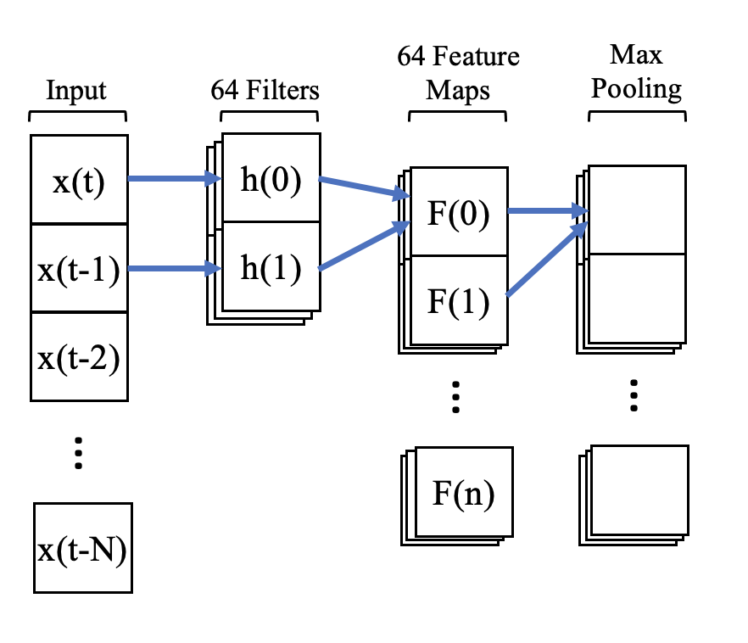
Conv Layer Hardware Implementations
3 Implementations:
MMA (HSpice)
SoC (Jetson Nano)
FPGA (Zynq-7000)
Feed inputs through each implementation and compare throughput
CNN

Slide 7
Implementing Conv Layer
Model was previously simulated in Python
Implementing the conv layer requires the weights of the Python model and the ability to verify output to a given input

Slide 8
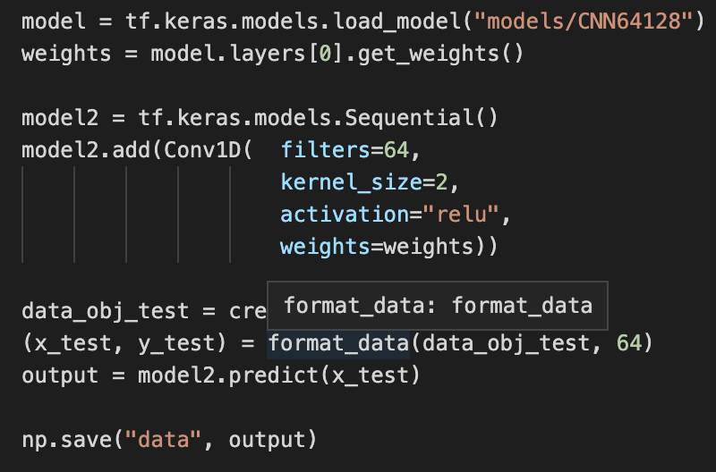
Python Script
Outputs the weights of a given model
Creates a set of input and output data to verify implementations

Slide 9
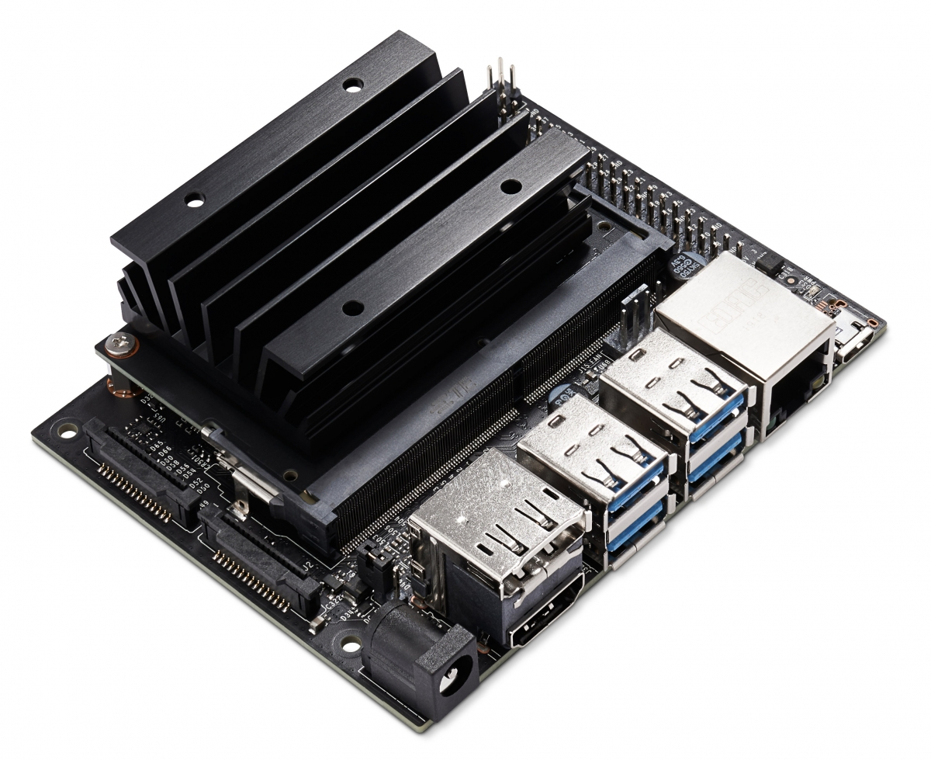
Jetson Nano
Nvidia’s low power ARM computer built specifically for inferencing
Runs on Linux (easy to port TensorFlow model)
Supports PCIe

Slide 10
Implementation Progress
Imported the model using TensorFlow
Generated input data
Tested model functionality (it works!)
Obtained throughput: 816.59 samples/s
Not great compared to MacBook (44903.46 samples/s)
Vanilla TensorFlow is not optimized for Jetson Nano hardware

Slide 11
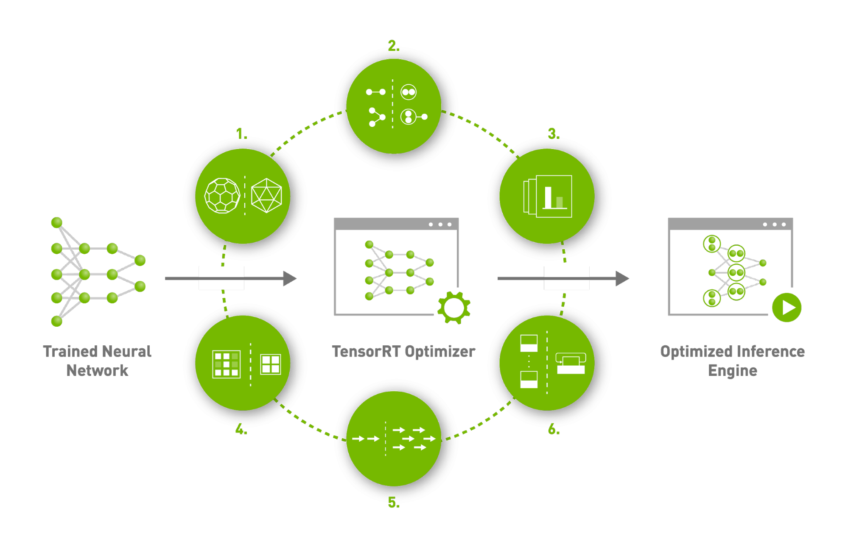
TensorRT
Nvidia’s API for accelerating inferencing models on Jetson Nano
Boasts 6x performance boost
Documentation is not great
Currently working on freezing the model

Slide 12
Future Project Deliverables
Implement TensorRT and see if it improves throughput
Implement model on FPGA

Slide 13
Josh’s Project Progress
MMA circuit design
Fully implemented 2bitx3bit multiplication.
Decoding circuitry for word-line loading
Sense-amplifiers and counters at the end of the bit lines
Adders, multipliers, decoders, flip-flops to perform the necessary arithmetic to get the final answer
MMA circuit HSPICE simulations

Slide 14
Block Diagram of simulated MMA
Encoding inputs as voltage sources
Decoder for word-line loading
Sense amps on bit-lines
Counters (BSC)
Adders to adjust counting value
Multiply by bit-position
Capture values in DFFs
Shift and add DFFs
Final answer in binary

Slide 15
Josh’s Project Progress
Input encoding
No changes here since last update
Each bit of input is a separate voltage source
I would like to change this to be parallelly loaded into registers
Word line decoding
Word lines are loaded based on a clock-cycle counter (BRC) and after the sense-amps have been pre-charged
Sense-amps
No changes here since last update
BSC for sense-amp
A binary synchronous counter has been added to the output of the sense-amps in order to keep track of the AND operations
Adding to adjust counting value
I need to shift the MSBs of each counter output to the next counter and add them together
Multiplication of count value by the appropriate bit-place
This is done by using the clock counting and a decoder
The multiplied values are captured in flip-flops, then shifted and added together

Slide 16
Circuit Simulation
 | clk: 3-4 | clk: 1-2
a₁ | 1 | 1
a₂ | 1 | 1
BL₂
BL₁
BL₀
 | a₁ | b₁ | a₂ | b₂
Decimal | 3 | 7 | 3 | 7
Binary | 11 | 111 | 11 | 111
WL₀
1
b₁₂
1
b₁₁
1
b₁₀
(3*7)+(3*7) = 42
WL₁
1
b₂₁
1
b₂₁
1
b₂₀
SA₂
SA₁
SA₀
clk1 | 1 | 1 | 1
clk2 | 10 | 10 | 10
clk3 | 1 | 1 | 1
clk4 | 10 | 10 | 10

Slide 17
Circuit Simulation
clk1 | 1 | 1 | 1
clk2 | 10 | 10 | 10
clk3 | 1 | 1 | 1
clk4 | 10 | 10 | 10
10 10 10
1
+10
11
1
+10
11
clk: 1-2 | 1 | 1 | 1 | 0 | = 14*2⁰
clk: 3-4 | 1 | 1 | 1 | 0 | = 14*2¹
(14*2⁰)+(14*2¹) = 42
11 1 0

Slide 18
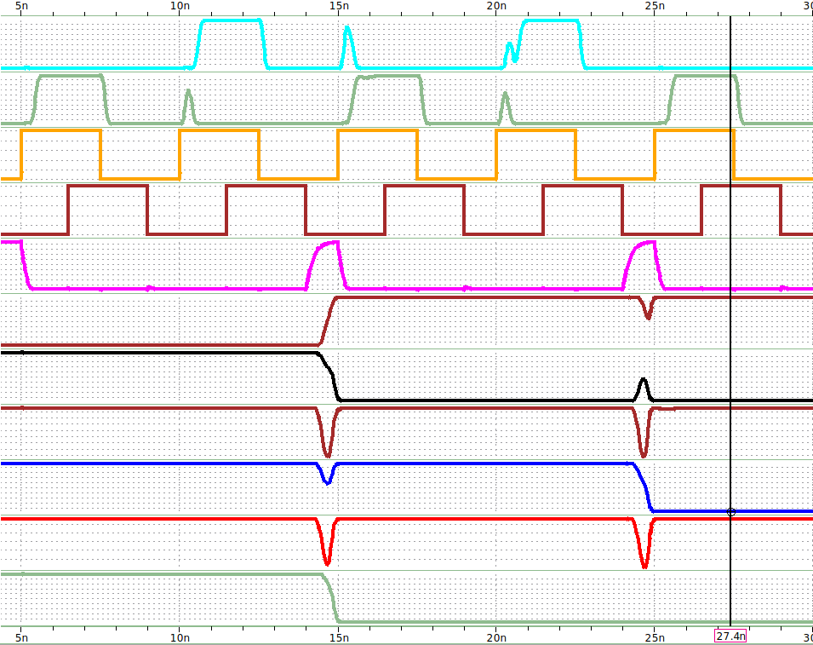
Circuit Simulation
WL₁
WL₀
SE
CLK
CAP
F₅
 | a₁ | b₁ | a₂ | b₂
Decimal | 3 | 7 | 3 | 7
Binary | 11 | 111 | 11 | 111
F₄
F₃
F₂
F₁
F₀
 | clk: 3-4 | clk: 1-2
a₁ | 1 | 1
a₂ | 1 | 1
BL₂
BL₁
BL₀
clk₁
clk₂
clk₃
clk₄
WL₀
1
b₁₂
1
b₁₁
1
b₁₀
clk | F₅ | F₄ | F₃ | F₂ | F₁ | F₀
1 | 0 | 1 | 1 | 1 | 1 | 1
2 | 0 | 1 | 1 | 1 | 1 | 1
3 | 1 | 0 | 1 | 1 | 1 | 0
4 | 1 | 0 | 1 | 1 | 1 | 0
5 | 1 | 0 | 1 | 0 | 1 | 0
WL₁
1
b₂₁
1
b₂₁
1
b₂₀
SA₂
SA₁
SA₀

Slide 19
Performance Metrics

Slide 20
Future Project Deliverables
MMA architecture utilizing FeFETs
Extend weights to full 16-bit width (Bit/Source lines), and full 96 weights (Word line)
Drop trained weights into FeFET crossbar
Mapping of the input values to vectors for MMA
Load in inputs into registers then utilize existing one-hot vector decoder to load each value on the word-lines
Finalize circuit-level SPICE simulations
Interface with python simulations

