Slide 1
Neuromorphic Computing Midterm Presentation: FPGA Hardware Acceleration of CNN based SDR Analysis
Corey L. Butts, Joshua Mayersky
buttscl@mail.uc.edu, mayersjd@mail.uc.edu
(330) 883-9679
(513) 225-7917
04/27/2021

Slide 2
FeFET-MMA Summary
The FeFET-MMA is meant to perform the convolution operation in hardware for the purpose of accelerating the calculation
MMA architecture is based on the idea of performing digital AND operations on the input and weight bits using the weight encoded as variable threshold voltage FeFETs
The outputs of the AND operations are tracked and counted, and fed into combinational and sequential logic to determine the final convoluted answer
FeFET V_{T} | Input (Gate) | Output
High (0) | 0 | Low Current (0)
High (0) | 1 | Low Current (0)
Low (1) | 0 | Low Current (0)
Low (1) | 1 | High Current (1)
Low V_{T}
High V_{T}
I_{D}
V_{G}

Slide 3
Block Diagram of MMA
Encoding inputs as voltage sources
Decoder for word-line loading
Sense amps on bit-lines
Counters (BSC)
Adders to adjust counting value
Multiply by bit-position
Capture values in DFFs
Shift and add DFFs
Add filter bias
Final answer in binary
Spice netlist is ~1500 lines of code
Implements four kernel filters
Each has two 16bit weights, operates on two 16bit inputs

Slide 4
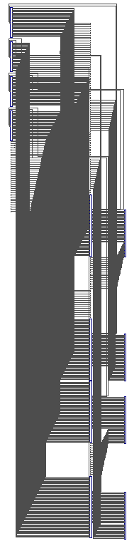
MMA Architecture
Kernel 0
16bit input
36bit output
Kernel 1
36bit output
Kernel 2
36bit output
Kernel 3
36bit output
16bit input

Slide 5
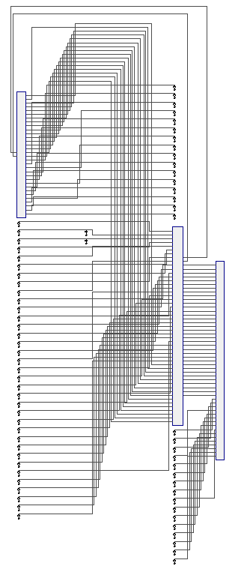
MMA Architecture
16bit input
Crossbar
16bits
2bits
16bit input
Peripheral Control Circuitry
35bits
Final Bias Adder
16bit bias
36bit output

Slide 6
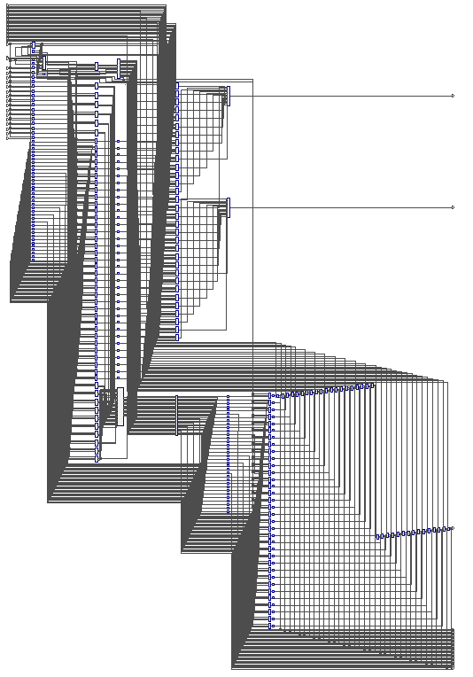
MMA Architecture
16bit
16bit
2bits
Crossbar
Word-line Decoder
16bits
SA Array
SA Counters
Controller
SA Adder
Clk
Counters
Bit-place Multiplier
Bit-place Decoder
DFF-1 Array
DFF Adder
DFF-2 Array
35bits

Slide 7
Caveats
I made a number of assumptions throughout this project about how the binary numbers that are fed into the circuit are formatted that dictated how the circuit was designed
Unsigned binary numbers
Integer operations
As a result, it cannot handle negative numbers without overhauling the design
It also cannot properly handle fractional numbers
With more time I could implement this thoroughly
In the meantime I do have a temporary workaround in place

Slide 8
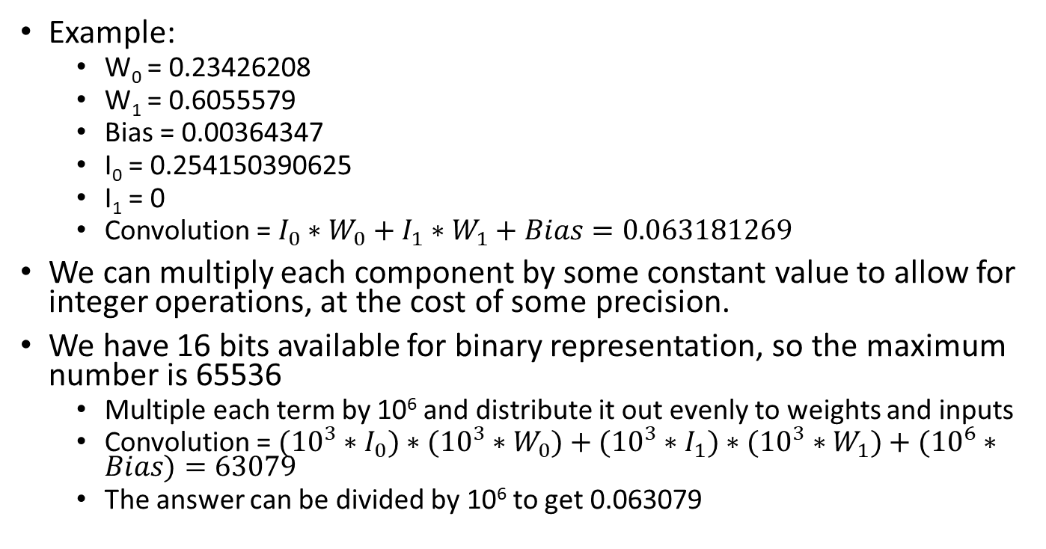
Caveats – Floating Point Operation Workaround
Example:
W₀ = 0.23426208
W₁ = 0.6055579
Bias = 0.00364347
I₀ = 0.254150390625
I₁ = 0
Convolution = $I_{0}∗W_{0}+I_{1}∗W_{1}+Bias=0.063181269$
We can multiply each component by some constant value to allow for integer operations, at the cost of some precision.
We have 16 bits available for binary representation, so the maximum number is 65536
Multiple each term by 10⁶ and distribute it out evenly to weights and inputs
Convolution = $({10}^{3}∗I_{0})∗({10}^{3}∗W_{0})+({10}^{3}∗I_{1})∗{({10}^{3}∗W}_{1})+({10}^{6}∗Bias)=63079$
The answer can be divided by 10⁶ to get 0.063079

Slide 9
Simulation Setup
Original | Filter 0 | Filter 1 | Filter 2 | Filter 3
Weight₀ | 0.23426208 | 0.549507 | -0.24479 | -0.38059
Weight₁ | 0.6055579 | -0.03461 | 0.773546 | -0.45489
Bias | 0.00364347 | 0.016176 | 0.01421 | 0.006968
Modified | Filter 0 | Filter 1 | Filter 2 | Filter 3
Weight₀ | 234 | 550 | 245 | 381
Weight₁ | 606 | 35 | 774 | 455
Bias | 3643 | 16176 | 14210 | 6968
Original | Test 0 | Test 1 | Test 2 | Test 3 | Test 4
Input₀ | 0.254150390625 | 0.33447265625 | 0.40771484375 | 0.454833984375 | 0.47021484375
Input₁ | 0 | 0.254150390625 | 0.33447265625 | 0.40771484375 | 0.454833984375
Modified | Test 0 | Test 1 | Test 2 | Test 3 | Test 4
Input₀ | 254 | 334 | 408 | 455 | 470
Input₁ | 0 | 254 | 334 | 408 | 455

Slide 10
Simulation Results - Accuracy
Expected | Test 0 | Test 1 | Test 2 | Test 3 | Test 4
Filter₀ | 63079 | 235723 | 301519 | 357361 | 389353
Filter₁ | 155876 | 208766 | 252266 | 280706 | 290601
Filter₂ | 76440 | 292636 | 372686 | 441477 | 481530
Filter₃ | 103742 | 249792 | 314386 | 365963 | 393063
Actual | Test 0 | Test 1 | Test 2 | Test 3 | Test 4
Filter₀ | 62567 | 235723 | 301519 | 356849 | 389353
Filter₁ | 155876 | 208524 | 252266 | 280706 | 290089
Filter₂ | 75928 | 292124 | 372174 | 441477 | 481530
Filter₃ | 103742 | 249280 | 314386 | 365963 | 392551
Of the 20 convolution operations, 11 were correct
Of the 9 that are incorrect, the average error is 0.299%
Each answer is off by 512
1 bit place: 2⁹ is stuck at 0

Slide 11
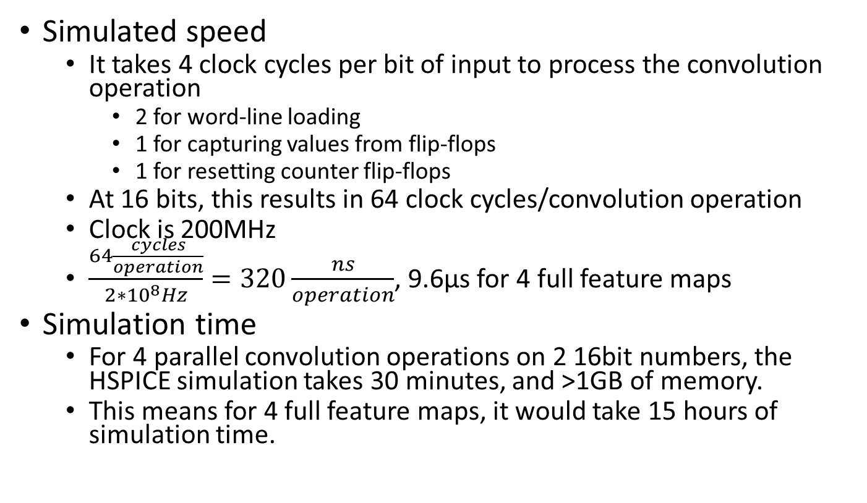
Simulation Results - Speed
Simulated speed
It takes 4 clock cycles per bit of input to process the convolution operation
2 for word-line loading
1 for capturing values from flip-flops
1 for resetting counter flip-flops
At 16 bits, this results in 64 clock cycles/convolution operation
Clock is 200MHz
$\frac{64\frac{cycles}{operation}}{2∗{10}^{8}Hz}=320\frac{ns}{operation}$, 9.6µs for 4 full feature maps
Simulation time
For 4 parallel convolution operations on 2 16bit numbers, the HSPICE simulation takes 30 minutes, and >1GB of memory.
This means for 4 full feature maps, it would take 15 hours of simulation time.

Slide 12
Simulation Results - Comparisons
SoC: ~12,500 samples/second
FPGA: ~66,000,000 samples/second
Simulated 100% accuracy, but implementation suffered
FeFET: ~416,667 samples/second
Simulated ~99% accuracy, but implementation suffered

Slide 13
Final Thoughts
Areas of functional improvement
Floating point operation
This will involve changing how the binary numbers are fed into the matrix, as well as the multiplier for bit place determination
Attention must be paid to the mantissa and exponent components of the binary number, with appropriate shifting to align with other inputs and weights
Each set of clock cycles that is loading the I_{X} bits to the matrix is calculating the 2^{X} bit of the final answer
To represent fractional numbers, the values will need to be right-shifted to account for negative exponents
Negative numbers
Areas of optimization
Bit-place overhead
Capacitive loading
Assumption is generic load capacitors; this could be tuned based on fan-out
Transistor sizing
Speed
Low power design
There’s some erroneous signal switching that could be reduced
Clock gating to reduce unnecessary state changes

