Slide 1
Neuromorphic Computing Midterm Presentation: FPGA Hardware Acceleration of CNN based SDR Analysis
Corey L. Butts, Joshua Mayersky
buttscl@mail.uc.edu, mayersjd@mail.uc.edu
(330) 883-9679
(513) 225-7917
04/27/2021

Slide 2
Project Timeline

Slide 3
Project Summary
Machine learning model
Learn SDR component functionality by training on input/output signal data
Implemented using a one-dimensional convolutional neural network (1DCNN)
Goal: compare 3 implementations of the convolutional layer
SoC (Jetson Nano)
FPGA
MMA (Neuromorphic Hardware)

Slide 4
FPGA CNN Acceleration Summary
FPGA allows you to program hardware circuits for specified functionality
Allows for the implementation of parallelism
CNNs utilize the convolution operation (multiplication and addition)
These operations can be implemented as circuits allowing for each operation to be done in parallel

Slide 5
FPGA Conv2 Block Diagram
Conv2
16
Input0
16
Input1
32
16
Output
Filter0
16
Filter1
Output = (Input0 * Filter0) + (Input1 * Filter1)

Slide 6
FPGA Implementation
Each Conv2 block implements a hardware circuit used to multiply and add the 4 16-bit numbers
Each number in the feature maps can now be computed in parallel as opposed to serially
Conv2
Conv2
Conv2
Conv2
Output0
Conv2
Conv2
Conv2
Conv2
4 Filters
Output1
…
Conv2
Conv2
Conv2
Conv2
Output31

Slide 7
Final Project Contributions
Concluded FPGA development
Implemented bias in Conv layer filters
Expanded model from 8 input samples to 32 input samples
Explored pros and cons of using floating vs fixed point precision
Benchmarked FPGA Conv layer using sample input data from Python script

Slide 8
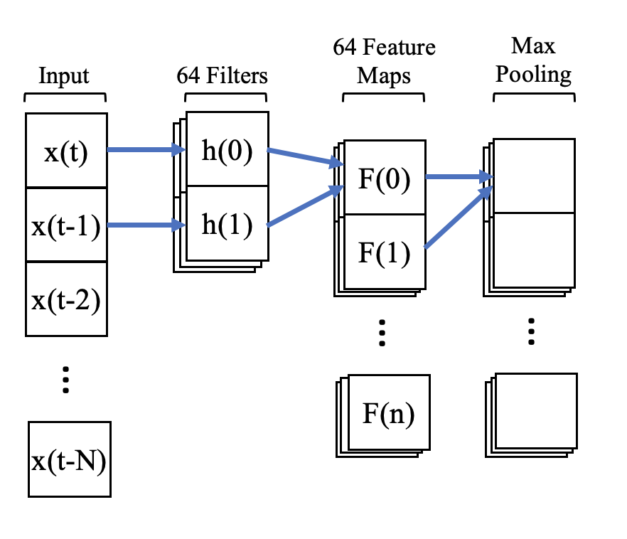
Implementing Bias
CNN filters also have an additional parameter, called a bias, that is added to the resulting convolution
CNN
$$F\left(0\right)=x\left(t\right)h\left(0\right)+x\left(t−1\right)h\left(1\right)+b$$

Slide 9
FPGA Implementation With Bias
16
Conv2
Input0
16
Input1
16
32
Filter0
Output
16
Filter1
16
Bias
Output = (Input0 * Filter0) + (Input1 * Filter1) + Bias

Slide 10
Scaling the Model
To easily test functionality, the model was scaled down
Input size: 32 samples → 8 samples
Sample data type: 16-bit float → 8-bit integer
Problem: scaling up requires the implementation of floating point arithmetic

Slide 11
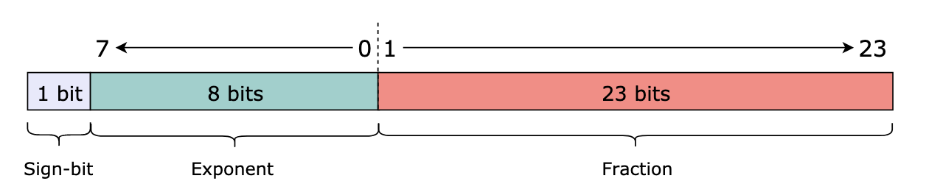
Floating Point Binary Representation
Floats are represented in binary in 3 sections:
Sign: Indicates the sign (-/+)
Exponent: Used to compute the exponent portion of the number
Fraction: Used to compute the fractional portion of the number

Slide 12
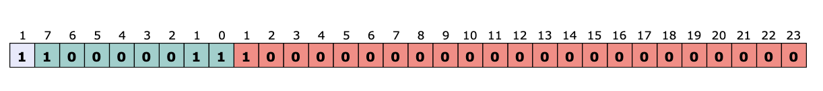
Floating Point Binary Example
$$Number={(−1)}^{sign}×(1+fraction)×2^{exponent−127}$$
sign = 1
exponent = 2⁷ + 2¹ + 2⁰ = 128 + 2 + 1 = 131
fraction = 2⁻¹ = 0.5
Number = (-1)¹ x (1 + 0.5) x 2^{131– 127} = -24.0

Slide 13
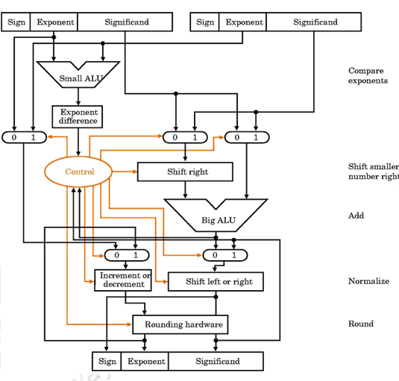
Floating Point Arithmetic
Can’t be done in the way integer arithmetic can
Requires more complex hardware
Higher utilization
Increased circuit delay
Not enough time to implement :(

Slide 14
Solution: Use VHDL ”real” type
Instead of using logic vectors to represent floats use “real” type
VHDL’s float type
Can just do normal arithmetic without complex hardware implementation (e.g. y <= a*b)

Slide 15
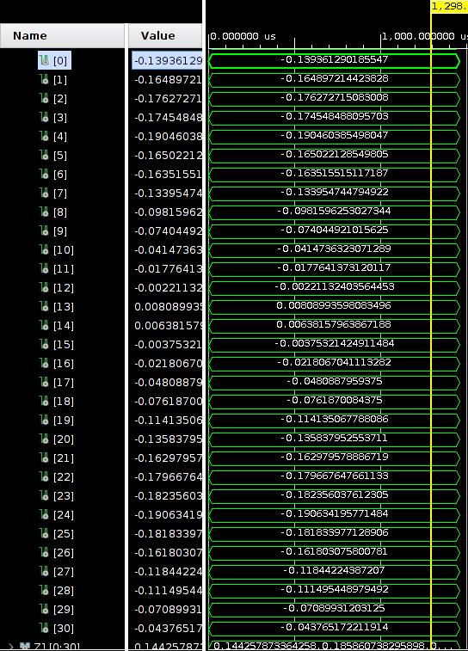
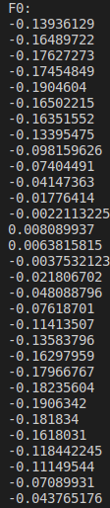
Results

Slide 16
Conclusion
Accurate to the python simulations
Average mean squared error = 0
VHDL real types cannot be synthesized!
Only for simulation purposes
Even though this design is simple to implement and accurate it cannot be used on a real FPGA

Slide 17
Fixed Point Arithmetic
Decimal number is represented by 2 integers
Integer part
Fractional part
Allows for the use of integer arithmetic
Simpler hardware
Faster
Less space required to store values
Comes at the loss of precision
Might not be entirely needed given our application

Slide 18
FPGA Fixed Point Implementation
Each input is now a 16-bit signed fixed point value
1-bit sign
2-bit integer part
Doesn’t need to be as big considering most values range from -1 to 1
13-bit fractional part
Output is still 32 bits but is divided similarly to the input
1-bit sign
4-bit integer part
27-bit fractional part

Slide 19
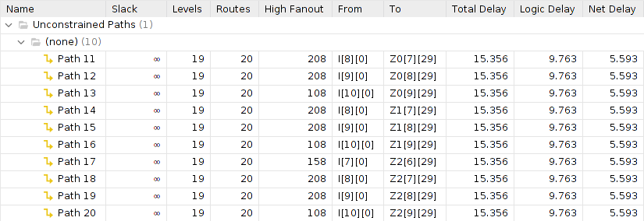
Results: Utilization and Timing

Slide 20
Results: Accuracy
Python FeatureMap[0] = -0.13936129
Binary value outputted = 0 0000 00010001001101010001111011₍₂₎ → 0.03361₍₁₀₎
Inaccuracy could potentially be due to the following:
Issues in converting from float to fixed point
Misuse of the ”signed” VHDL data type
Overflow

Slide 21
Final Thoughts
Areas of functional improvement
Implement floating point arithmetic
Fix issues with fixed point arithmetic and compare to float implementation
FPGA acceleration of CNN shows promising results

Slide 22
FeFET-MMA Summary
The FeFET-MMA is meant to perform the convolution operation in hardware for the purpose of accelerating the calculation
MMA architecture is based on the idea of performing digital AND operations on the input and weight bits using the weight encoded as variable threshold voltage FeFETs
The outputs of the AND operations are tracked and counted, and fed into combinational and sequential logic to determine the final convoluted answer
FeFET V_{T} | Input (Gate) | Output
High (0) | 0 | Low Current (0)
High (0) | 1 | Low Current (0)
Low (1) | 0 | Low Current (0)
Low (1) | 1 | High Current (1)
Low V_{T}
High V_{T}
I_{D}
V_{G}

Slide 23
Block Diagram of MMA
Encoding inputs as voltage sources
Decoder for word-line loading
Sense amps on bit-lines
Counters (BSC)
Adders to adjust counting value
Multiply by bit-position
Capture values in DFFs
Shift and add DFFs
Add filter bias
Final answer in binary
Spice netlist is ~1500 lines of code
Implements four kernel filters
Each has two 16bit weights, operates on two 16bit inputs

Slide 24
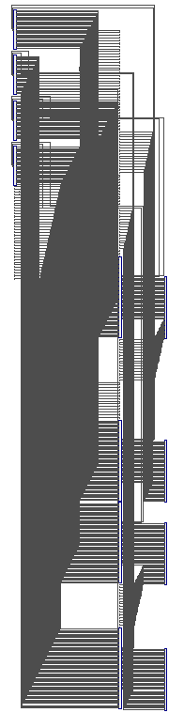
MMA Architecture
Kernel 0
16bit input
36bit output
Kernel 1
36bit output
Kernel 2
36bit output
Kernel 3
36bit output
16bit input

Slide 25
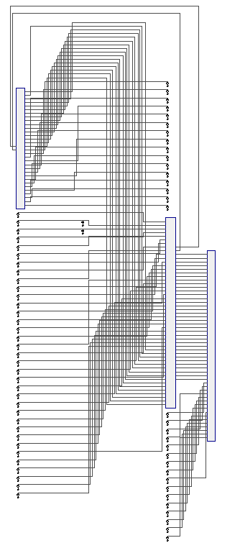
MMA Architecture
16bit input
Crossbar
16bits
2bits
16bit input
Peripheral Control Circuitry
35bits
Final Bias Adder
16bit bias
36bit output

Slide 26
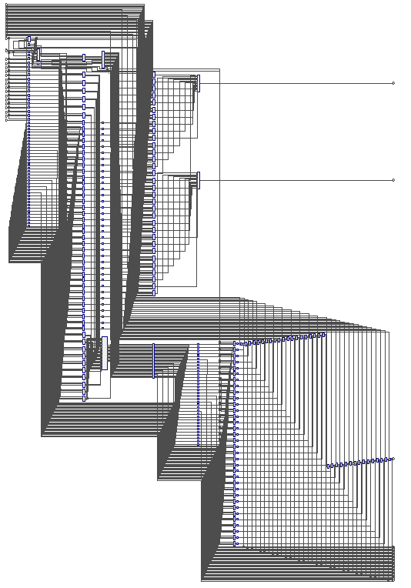
MMA Architecture
16bit
16bit
2bits
Crossbar
Word-line Decoder
16bits
SA Array
SA Counters
Controller
SA Adder
Clk
Counters
Bit-place Multiplier
Bit-place Decoder
DFF-1 Array
DFF Adder
DFF-2 Array
35bits

Slide 27
Caveats
I made a number of assumptions throughout this project about how the binary numbers that are fed into the circuit are formatted that dictated how the circuit was designed
Unsigned binary numbers
Integer operations
As a result, it cannot handle negative numbers without overhauling the design
It also cannot properly handle fractional numbers
With more time I could implement this thoroughly
In the meantime I do have a temporary workaround in place

Slide 28
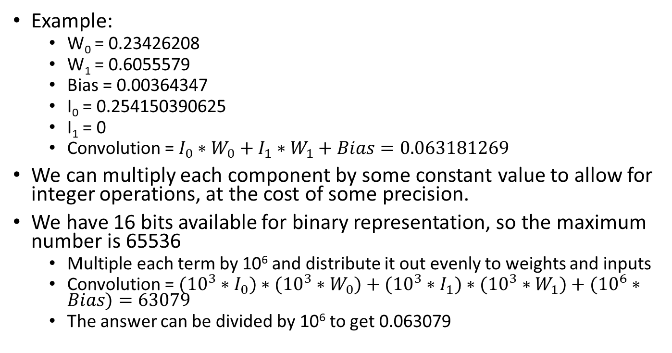
Caveats – Floating Point Operation Workaround
Example:
W₀ = 0.23426208
W₁ = 0.6055579
Bias = 0.00364347
I₀ = 0.254150390625
I₁ = 0
Convolution = $I_{0}∗W_{0}+I_{1}∗W_{1}+Bias=0.063181269$
We can multiply each component by some constant value to allow for integer operations, at the cost of some precision.
We have 16 bits available for binary representation, so the maximum number is 65536
Multiple each term by 10⁶ and distribute it out evenly to weights and inputs
Convolution = $({10}^{3}∗I_{0})∗({10}^{3}∗W_{0})+({10}^{3}∗I_{1})∗{({10}^{3}∗W}_{1})+({10}^{6}∗Bias)=63079$
The answer can be divided by 10⁶ to get 0.063079

Slide 29
Simulation Setup
Original | Filter 0 | Filter 1 | Filter 2 | Filter 3
Weight₀ | 0.23426208 | 0.549507 | -0.24479 | -0.38059
Weight₁ | 0.6055579 | -0.03461 | 0.773546 | -0.45489
Bias | 0.00364347 | 0.016176 | 0.01421 | 0.006968
Modified | Filter 0 | Filter 1 | Filter 2 | Filter 3
Weight₀ | 234 | 550 | 245 | 381
Weight₁ | 606 | 35 | 774 | 455
Bias | 3643 | 16176 | 14210 | 6968
Original | Test 0 | Test 1 | Test 2 | Test 3 | Test 4
Input₀ | 0.254150390625 | 0.33447265625 | 0.40771484375 | 0.454833984375 | 0.47021484375
Input₁ | 0 | 0.254150390625 | 0.33447265625 | 0.40771484375 | 0.454833984375
Modified | Test 0 | Test 1 | Test 2 | Test 3 | Test 4
Input₀ | 254 | 334 | 408 | 455 | 470
Input₁ | 0 | 254 | 334 | 408 | 455

Slide 30
Simulation Results - Accuracy
Expected | Test 0 | Test 1 | Test 2 | Test 3 | Test 4
Filter₀ | 63079 | 235723 | 301519 | 357361 | 389353
Filter₁ | 155876 | 208766 | 252266 | 280706 | 290601
Filter₂ | 76440 | 292636 | 372686 | 441477 | 481530
Filter₃ | 103742 | 249792 | 314386 | 365963 | 393063
Actual | Test 0 | Test 1 | Test 2 | Test 3 | Test 4
Filter₀ | 62567 | 235723 | 301519 | 356849 | 389353
Filter₁ | 155876 | 208524 | 252266 | 280706 | 290089
Filter₂ | 75928 | 292124 | 372174 | 441477 | 481530
Filter₃ | 103742 | 249280 | 314386 | 365963 | 392551
Of the 20 convolution operations, 11 were correct
Of the 9 that are incorrect, the average error is 0.299%
Each answer is off by 512
1 bit place: 2⁹ is stuck at 0

Slide 31
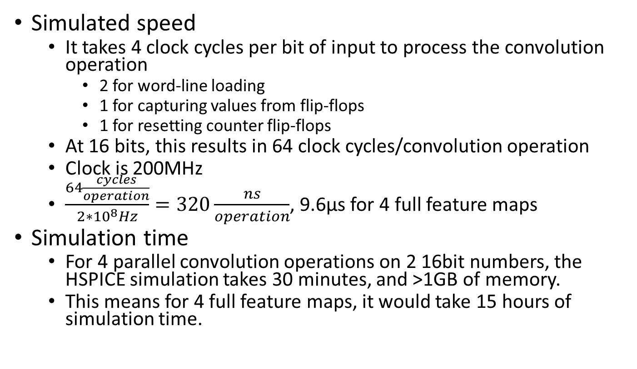
Simulation Results - Speed
Simulated speed
It takes 4 clock cycles per bit of input to process the convolution operation
2 for word-line loading
1 for capturing values from flip-flops
1 for resetting counter flip-flops
At 16 bits, this results in 64 clock cycles/convolution operation
Clock is 200MHz
$\frac{64\frac{cycles}{operation}}{2∗{10}^{8}Hz}=320\frac{ns}{operation}$, 9.6µs for 4 full feature maps
Simulation time
For 4 parallel convolution operations on 2 16bit numbers, the HSPICE simulation takes 30 minutes, and >1GB of memory.
This means for 4 full feature maps, it would take 15 hours of simulation time.

Slide 32
Simulation Results - Comparisons
SoC: ~12,500 samples/second
FPGA: ~66,000,000 samples/second
Simulated 100% accuracy, but implementation suffered
FeFET: ~416,667 samples/second
Simulated ~99% accuracy, but implementation suffered

Slide 33
Final Thoughts
Areas of functional improvement
Floating point operation
This will involve changing how the binary numbers are fed into the matrix, as well as the multiplier for bit place determination
Attention must be paid to the mantissa and exponent components of the binary number, with appropriate shifting to align with other inputs and weights
Each set of clock cycles that is loading the I_{X} bits to the matrix is calculating the 2^{X} bit of the final answer
To represent fractional numbers, the values will need to be right-shifted to account for negative exponents
Negative numbers
Areas of optimization
Bit-place overhead
Capacitive loading
Assumption is generic load capacitors; this could be tuned based on fan-out
Transistor sizing
Speed
Low power design
There’s some erroneous signal switching that could be reduced
Clock gating to reduce unnecessary state changes

