Slide 1
Neuromorphic Computing Project Proposal: FPGA Hardware Acceleration of CNN based SDR Analysis
Corey L. Butts, Joshua Mayersky
buttscl@mail.uc.edu, mayersjd@mail.uc.edu
(330) 883-9679
02/18/2021

Slide 2
Project Timeline

Slide 3
Corey’s Project Progress
Implemented CNN layers
Conv layer
Pooling Layer
Dense Layer
Implemented forward pass for all layers
Using MNIST at first to benchmark against TensorFlow

Slide 4
Conv Layer
Uses a filter to process each section of the dataset
Multiply each value in the section by the corresponding filter value
Sum all of the products

Slide 5
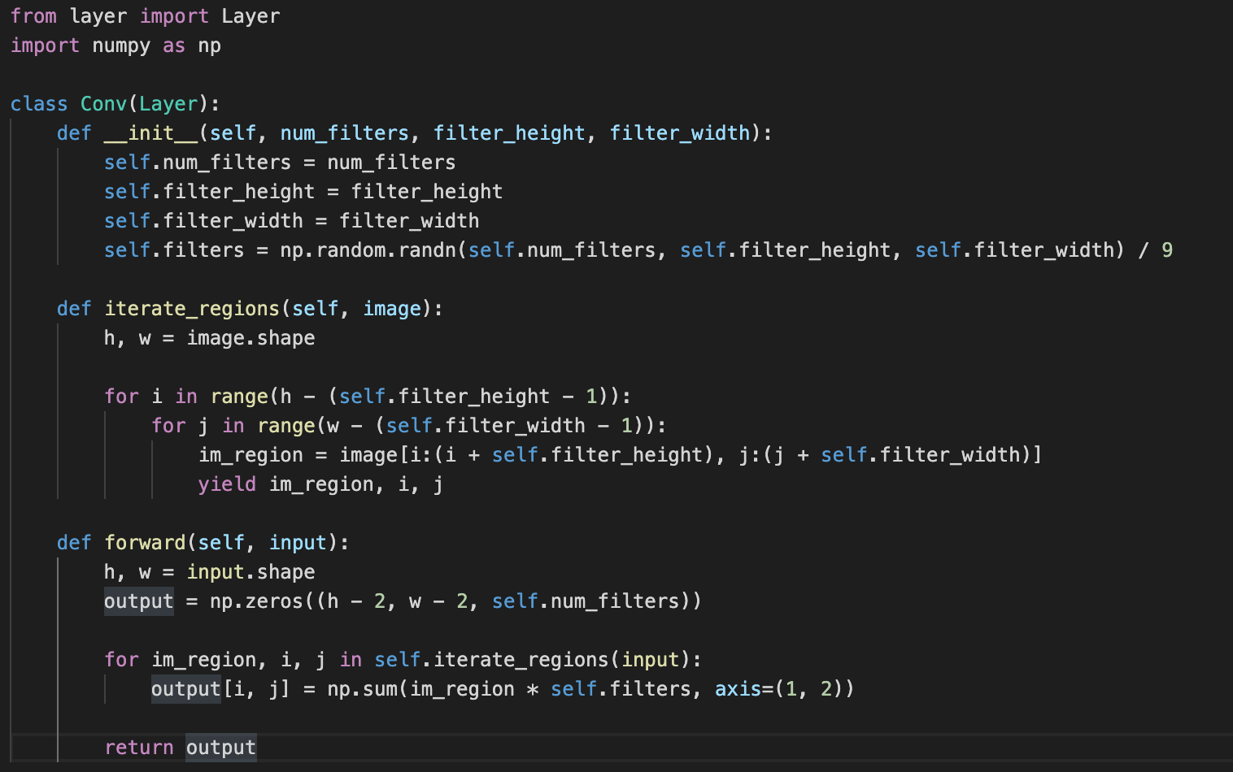

Slide 6
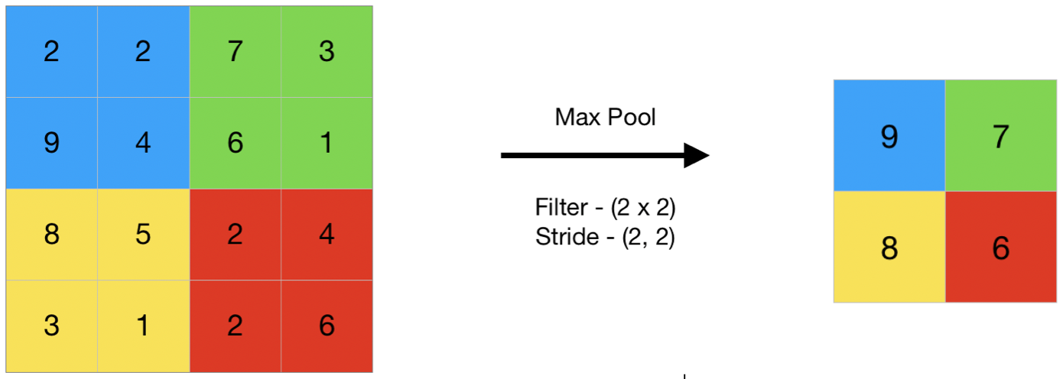
Pooling Layer
Takes either the max or average of each section to reduce data size
Max pooling typically is more effective than average pooling

Slide 7
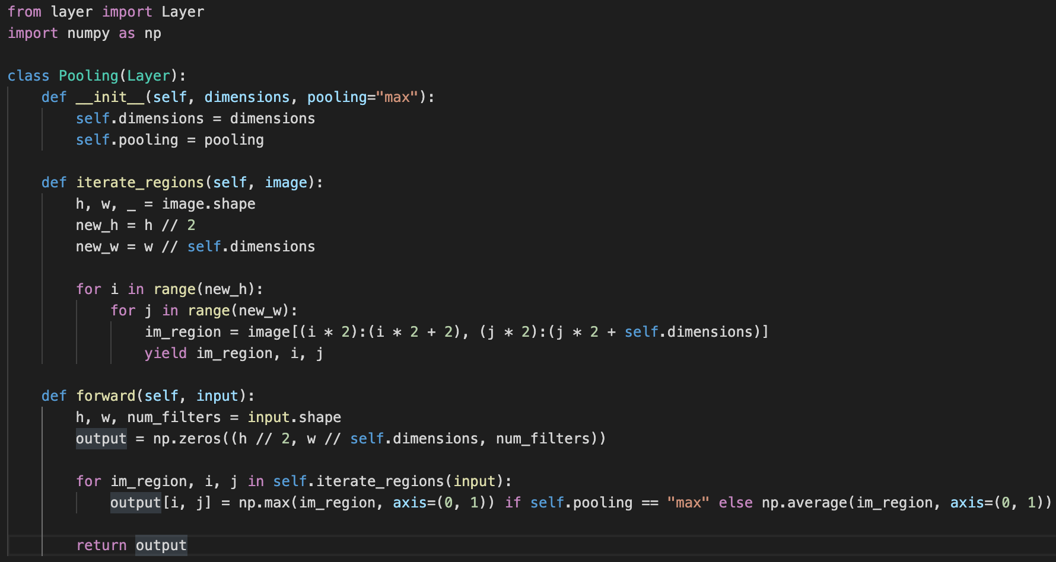

Slide 8
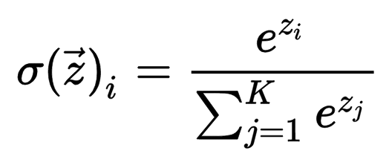
Dense Layer
Multi layer perceptron layer
Activation = softmax

Slide 9
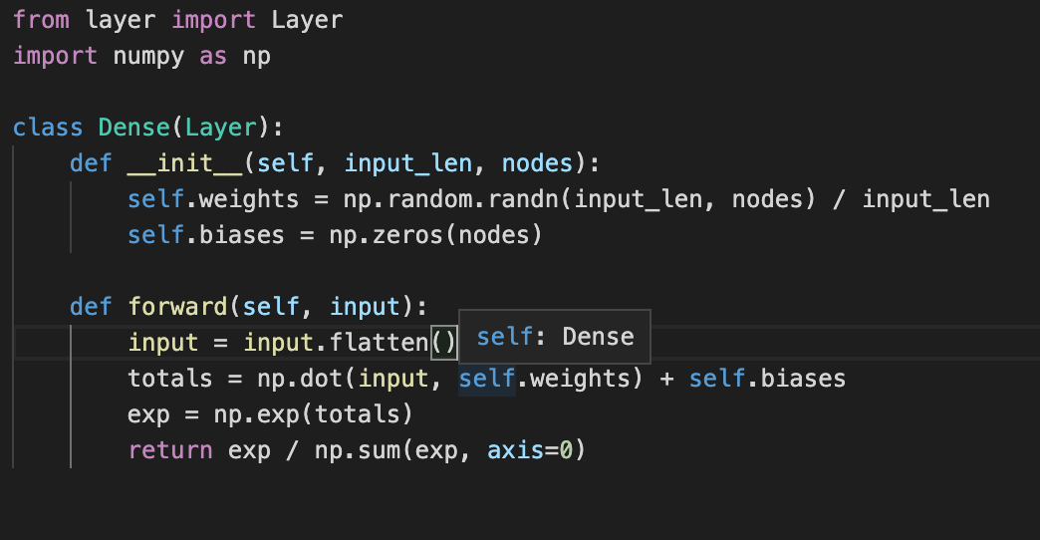

Slide 10
Next week
Implement backpropagation
Benchmark against TensorFlow to confirm functionality
Test using 1D dataset

Slide 11
Josh’s Project Progress
Literature surveys on circuit designs for analog adders and multipliers
Literature surveys on FeFET Neuromorphic implementations
Focusing on CNN Hardware implementations and matrix multiplication
I’m highlighting two papers in particular, but each one contains valuable information

Slide 12
Basic Block Diagram of Matrix Multiplication in CONV Layer
Inputs from SDR
Digital Mixer
DAC
Filter Kernel
Analog Multiplier
Output
to Pooling Layer
ADC
Filter Kernel
Analog Adder
Idea: FeFETS may be used in the Filter Kernel operations as programmable voltage-controlled resistor weights

Slide 13
Performance Metrics

Slide 14
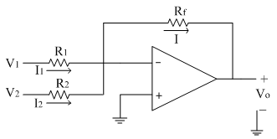
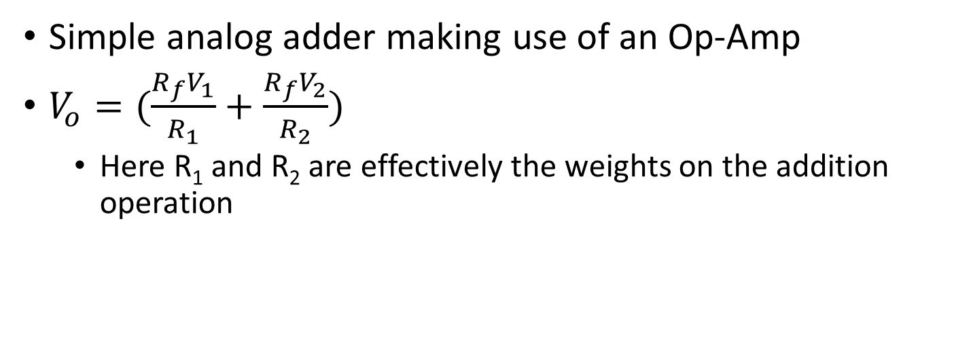
Analog Adder
Simple analog adder making use of an Op-Amp
$V_{o}=(\frac{R_{f}V_{1}}{R_{1}}+\frac{R_{f}V_{2}}{R_{2}})$
Here R₁ and R₂ are effectively the weights on the addition operation

Slide 15
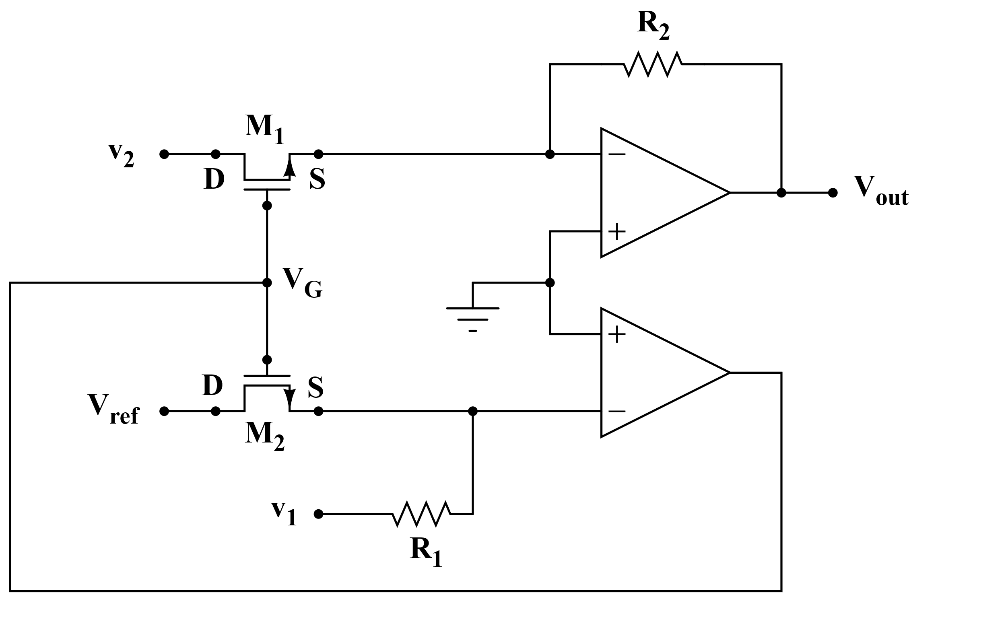
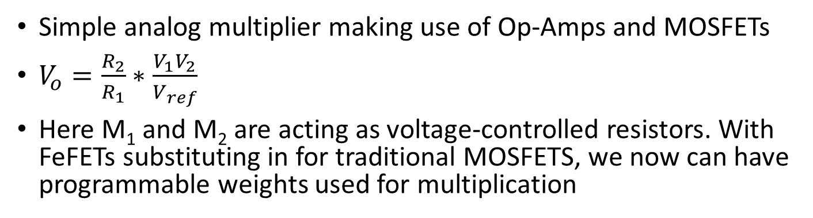
Analog Multiplier
Simple analog multiplier making use of Op-Amps and MOSFETs
$V_{o}=\frac{R_{2}}{R_{1}}∗\frac{V_{1}V_{2}}{V_{ref}}$
Here M₁ and M₂ are acting as voltage-controlled resistors. With FeFETs substituting in for traditional MOSFETS, we now can have programmable weights used for multiplication

Slide 16
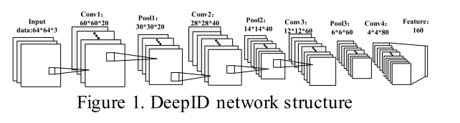
Literature Surveys – [1]
“Hardware Implementation of Convolutional Neural Network for Face Feature Extraction”
Implemented on an FPGA
4 layers of convolution, 3 layers of pooling, and a fully connected final layer
Weights are stored off-chip in DDR3 memory
They propose a reconfigurable kernel matrix multiplication array for different sizes and for multiple channels

Slide 17
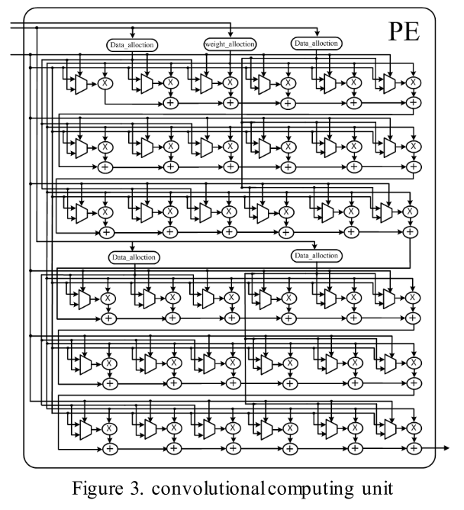
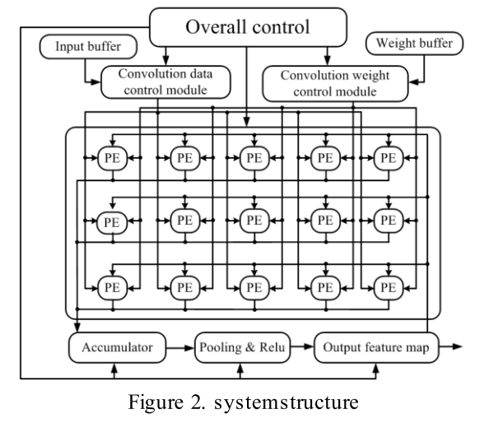
Literature Surveys – [1]
Reconfigurable kernel multiplication unit

Slide 18
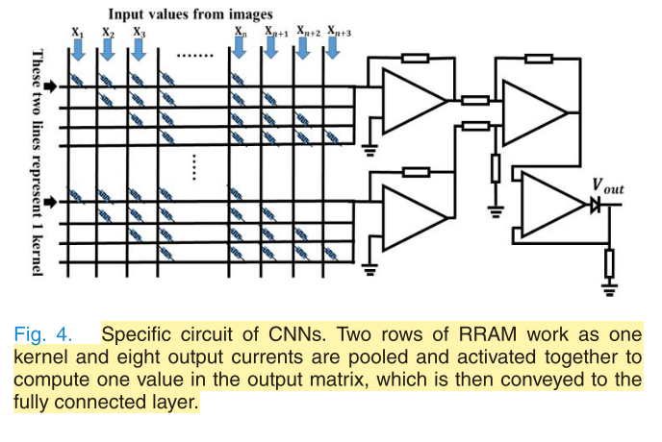
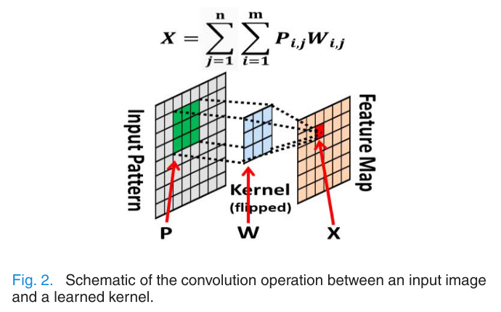
Literature Surveys – [2]
“Convolutional Neural Networks Based on RRAM Devices for Image Recognition and Online Learning Tasks”
Implement an RRAM based CNN
Analyzed impacts of kernel size
Analyzed impact of RRAM states

Slide 19
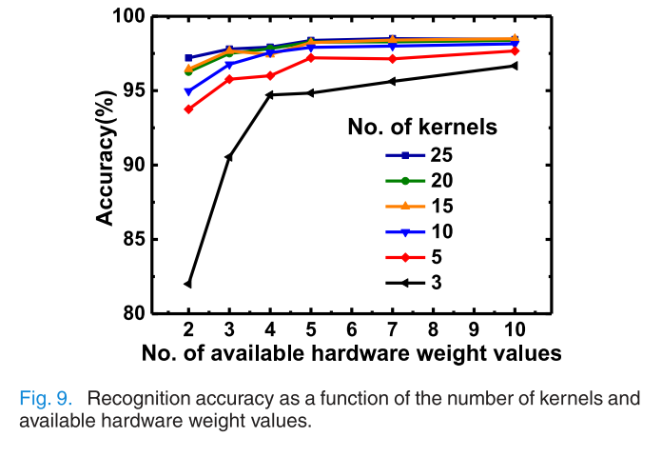
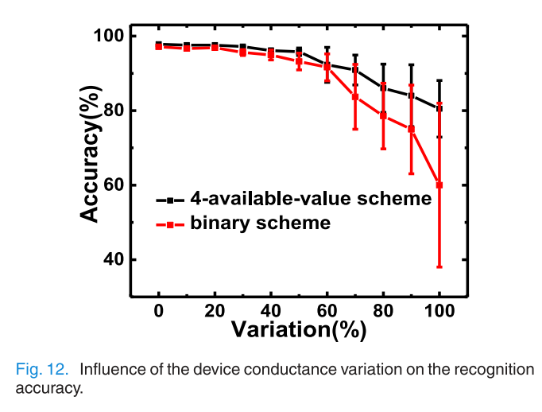
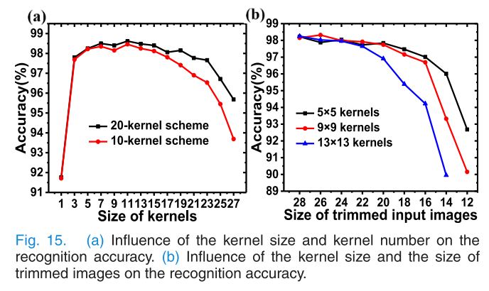
Literature Surveys – [2]
You can compensate for a lack of hardware weight values by increasing the number of kernels for CNN feature extraction
Increasing the size of the kernels has diminishing returns, and even negative impact on accuracy if they get too large
The more states that are available, the more resistant the CNN is to variation

Slide 20
Literature Surveys – References
[1] Ding, R., Tian, X., Bai, G., Su, G. & Wu, X. Hardware implementation of convolutional neural network for face feature extraction. in Proceedings of International Conference on ASIC (IEEE Computer Society, 2019). doi:10.1109/ASICON47005.2019.8983575
[2] Dong, Z. et al. Convolutional Neural Networks Based on RRAM Devices for Image Recognition and Online Learning Tasks. IEEE Transactions on Electron Devices 66, 793–801 (2019).
[3] Soloviev, R., Telpukhov, D., Mkrtchan, I., Kustov, A. & Stempkovskiy, A. Hardware Implementation of Convolutional Neural Networks Based on Residue Number System. in Moscow Workshop on Electronic and Networking Technologies, MWENT 2020 - Proceedings (Institute of Electrical and Electronics Engineers Inc., 2020). doi:10.1109/MWENT47943.2020.9067498
[4] Park, B., Ishiwara, H., Okuyama, M., Sakai, S., Yoon, S. Ferroelectric-Gate Field Effect Transistor Memories Device Physics and Applications. in Topics in Applied Physics 131, (2020).
[5] Valueva, M. V., Nagornov, N. N., Lyakhov, P. A., Valuev, G. V. & Chervyakov, N. I. Application of the residue number system to reduce hardware costs of the convolutional neural network implementation. Mathematics and Computers in Simulation 177, 232–243 (2020).
[6] Chung, J., Choi, W., Park, J. & Ghosh, S. Domain Wall Memory-Based Design of Deep Neural Network Convolutional Layers. IEEE Access 8, 19783–19798 (2020).
[7] Yao, P. et al. Fully hardware-implemented memristor convolutional neural network. Nature 577, 641–646 (2020).
[8] Gong, L., Wang, C., Li, X., Chen, H. & Zhou, X. MALOC: A fully pipelined FPGA accelerator for convolutional neural networks with all layers mapped on chip. IEEE Transactions on Computer-Aided Design of Integrated Circuits and Systems 37, 2601–2612 (2018).
[9] Solovyev, R. A., Stempkovsky, A. L. & Telpukhov, D. V. Study of Fault Tolerance Methods for Hardware Implementations of Convolutional Neural Networks. Optical Memory and Neural Networks (Information Optics) 28, 82–88 (2019).
[10] Hacene, G. B., Gripon, V., Arzel, M., Farrugia, N. & Bengio, Y. Quantized guided pruning for efficient hardware implementations of deep neural networks. in NEWCAS 2020 - 18th IEEE International New Circuits and Systems Conference, Proceedings 206–209 (Institute of Electrical and Electronics Engineers Inc., 2020). doi:10.1109/NEWCAS49341.2020.9159769
[11] Gysel, P. Ristretto: Hardware-Oriented Approximation of Convolutional Neural Networks. (2016).
[12] Chen, W., Wang, Y., Yang, C. & Li, Y. Hardware acceleration implementation of three-dimensional convolutional neural network on vector digital signal processors. in 2020 4th International Conference on Robotics and Automation Sciences, ICRAS 2020 122–129 (Institute of Electrical and Electronics Engineers Inc., 2020). doi:10.1109/ICRAS49812.2020.9135062

Slide 21
Project Deliverables
Matrix Multiplication architecture utilizing FeFETs
Block diagram
Introductory circuit-level SPICE simulations

