Slide 1
FPGA Hardware Acceleration of CNN based SDR Analysis
Corey L. Butts, Joshua Mayersky
buttscl@mail.uc.edu, mayersjd@mail.uc.edu
(330) 883-9679
02/18/2021

Slide 2
CNN Python Implementation
Implemented CNN layers
Conv layer
Pooling Layer
Dense Layer
Implemented forward pass for all layers
Using MNIST at first to benchmark against TensorFlow

Slide 3
Conv Layer
Uses a filter to process each section of the dataset
Multiply each value in the section by the corresponding filter value
Sum all of the products

Slide 4
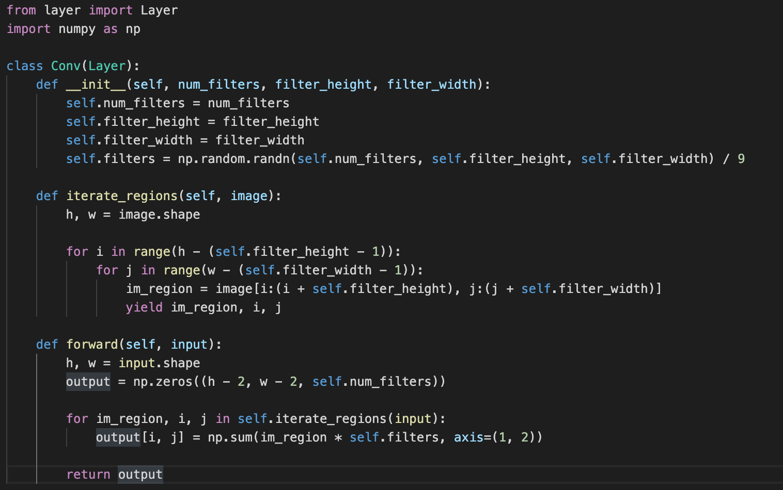

Slide 5
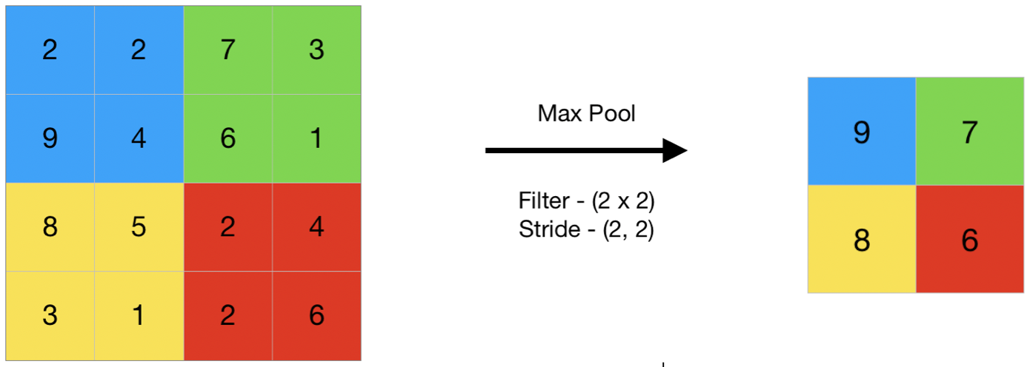
Pooling Layer
Takes either the max or average of each section to reduce data size
Max pooling typically is more effective than average pooling

Slide 6
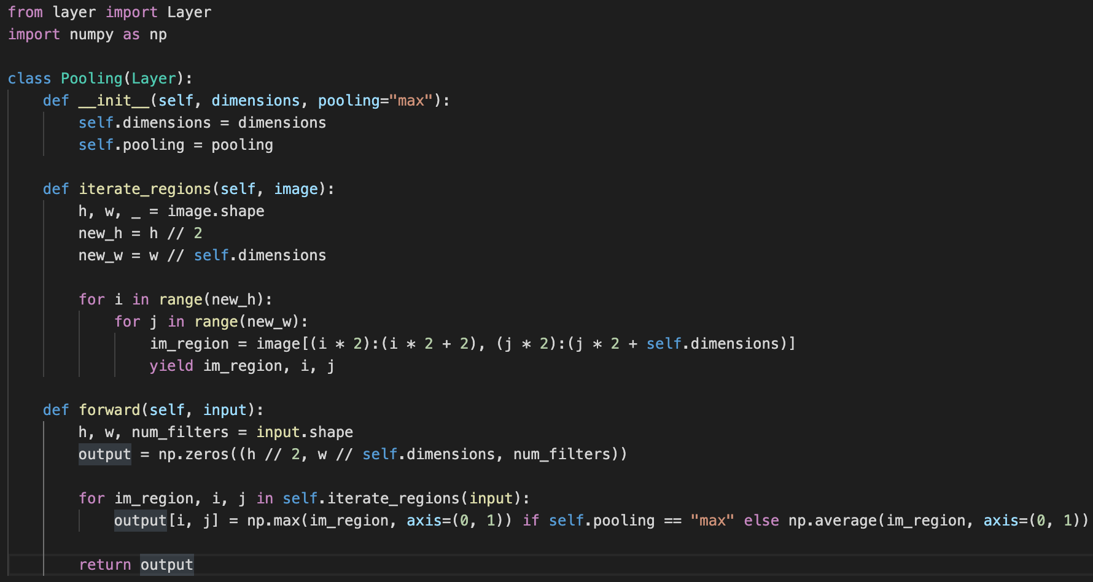

Slide 7
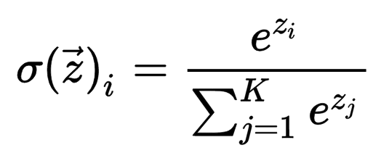
Dense Layer
Multi layer perceptron layer
Activation = softmax

Slide 8
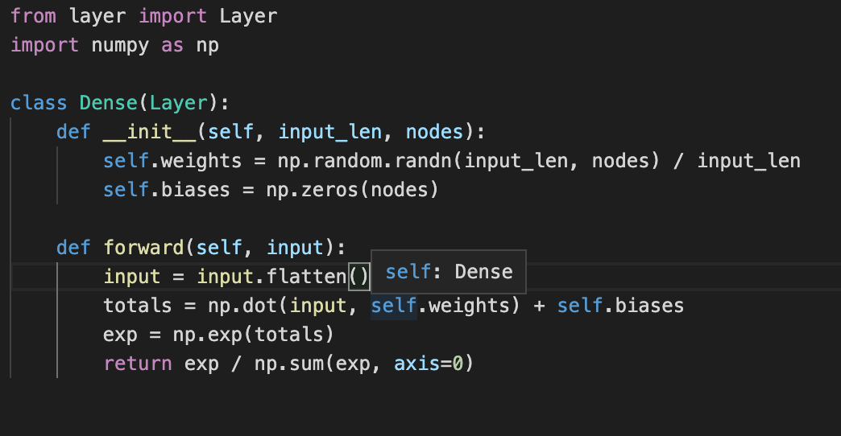

Slide 9
Next week
Implement backpropagation
Benchmark against TensorFlow to confirm functionality
Test using 1D dataset

