Slide 1
Neuromorphic Computing Project Proposal: FPGA Hardware Acceleration of CNN based SDR Analysis
Corey L. Butts, Joshua Mayersky
buttscl@mail.uc.edu, mayersjd@mail.uc.edu
(330) 883-9679
02/01/2021

Slide 2
Application and Motivation
What is our project about?

Slide 3
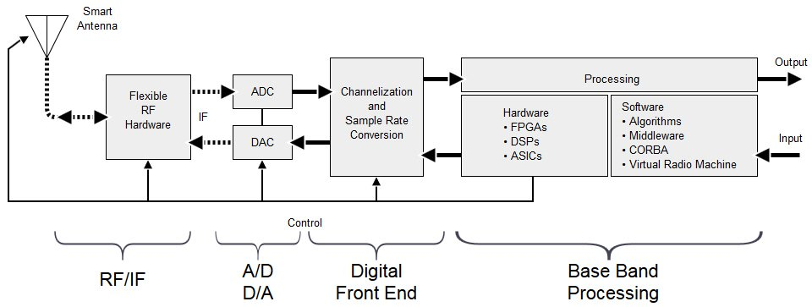
What is Software Defined Radio?
Software Defined Radio (SDR)
Radio systems where components typically implemented in ASIC hardware are implemented in software on SoC/FPGA
It is widely used in military applications and gaining significant interests

Slide 4
RF Front End
Digital Front End
Antenna
Power Amplifier
RFTuner
ADC
Digital Mixer
Lowpass Filter
Signal Processing
Analog
Digital Local Oscillator
Digital
Implemented on FPGA

Slide 5
Antenna
Power Amplifier
RFTuner
ADC
Digital Mixer
Lowpass Filter
Signal Processing
Digital Local Oscillator
Implemented on FPGA

Slide 6
Antenna
Power Amplifier
RFTuner
ADC
Digital Mixer
Lowpass Filter
Signal Processing
Digital Local Oscillator
Trojan
Implemented on FPGA

Slide 7
Potential Issues
Denial of Service (DoS)
Disabling the output of a single component could disable the whole system
Bad in situations where communication is essential (planes, drones etc.)
Information leakage
Encryption circuits can be bypassed leaving data compromised

Slide 8
Antenna
Power Amplifier
RFTuner
ADC
Digital Mixer
Lowpass Filter
Signal Processing
Digital Local Oscillator
Implemented on FPGA

Slide 9
Training
Observer
Neural Network
Antenna
Power Amplifier
RFTuner
ADC
Digital Mixer
Lowpass Filter
Signal Processing
Digital Local Oscillator
Implemented on FPGA

Slide 10
Trained Network
Observer
Neural Network
Error
Antenna
Power Amplifier
RFTuner
ADC
Digital Mixer
Lowpass Filter
Signal Processing
Digital Local Oscillator
Trojan

Slide 11
Observer
Neural Network
Antenna
Power Amplifier
RFTuner
ADC
Digital Mixer
Lowpass Filter
Signal Processing
Digital Local Oscillator
Implemented on FPGA

Slide 12
Antenna
Power Amplifier
RFTuner
ADC
Digital Mixer
Observer
Neural Network
Signal Processing
Digital Local Oscillator
Implemented on FPGA

Slide 13
High Level Idea/Simulation
How will we verify that our model works?

Slide 14
High Level Simulation
Implemented in Python using TensorFlow
Simulate Digital Down Converter (mixer + low pass) portion of SDR circuit
Train network on the low pass filter component

Slide 15
What A DDC Does
ADCs typically sample at a very high frequency
Requires an unnecessarily fast DSP since the data we are concerned about is usually much lower frequency
DDC lowers the frequency the digitized signal
Still preserves the original signal
Reduces DSP speed requirements
Down conversion is used to demodulate AM signals

Slide 16
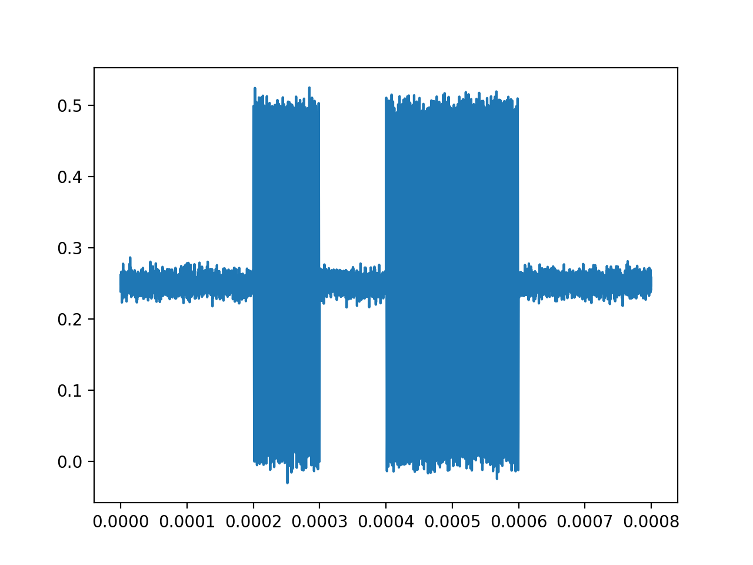
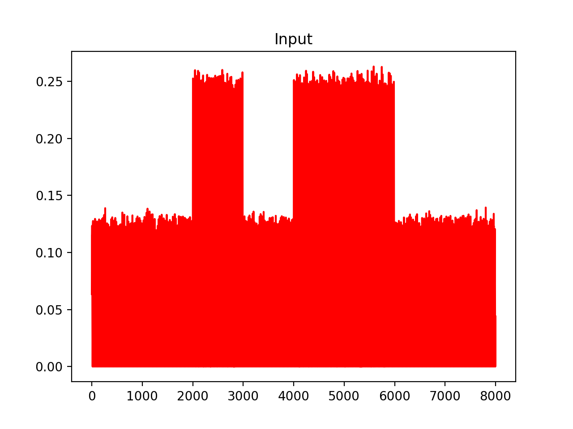
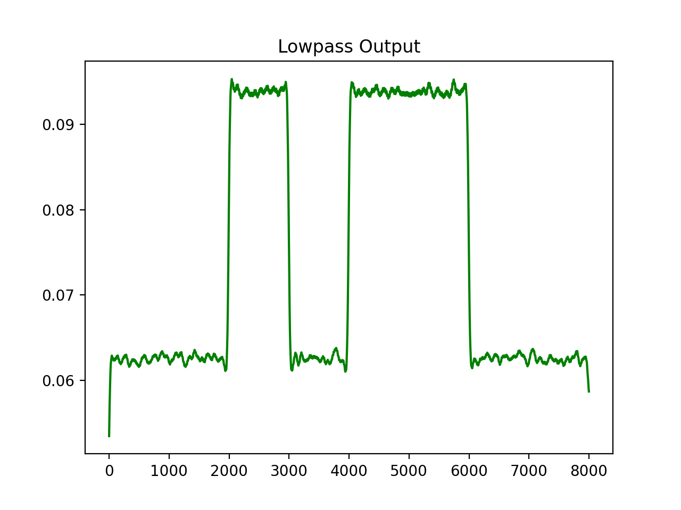
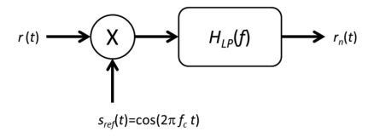
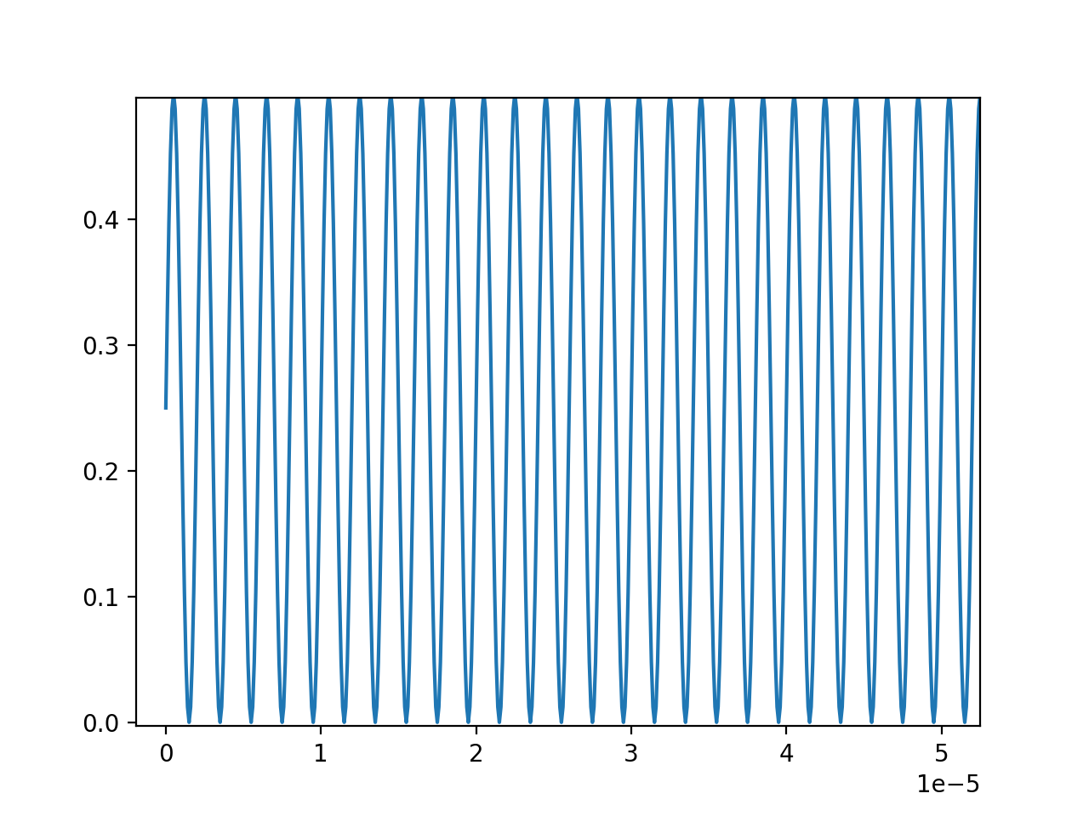
Down Conversion Example Using OOK Data
Mixer
Lowpass Filter

Slide 17
Observer
Neural Network

Slide 18
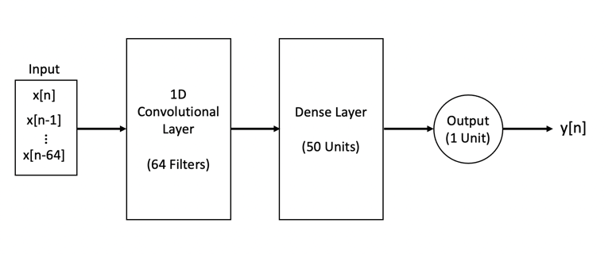
Model Architecture

Slide 19
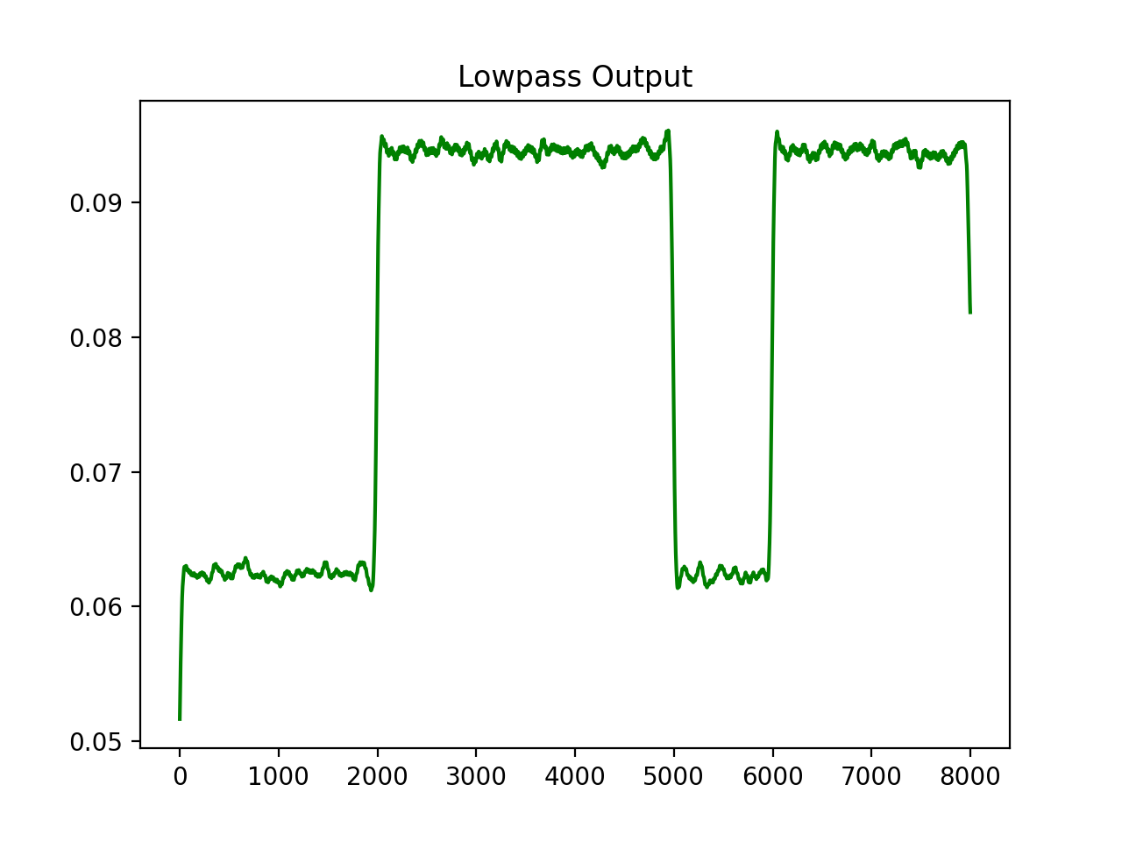
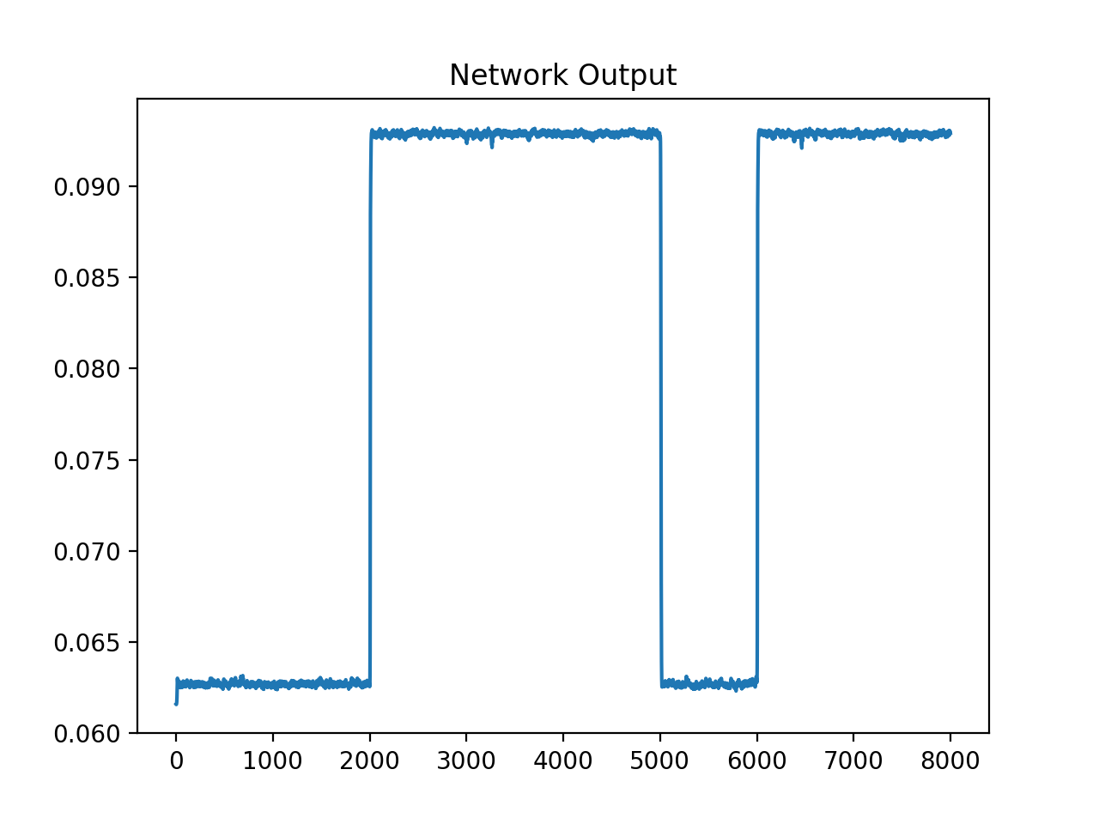
OOK Training Data
BRNN performs very well against this dataset

Slide 20
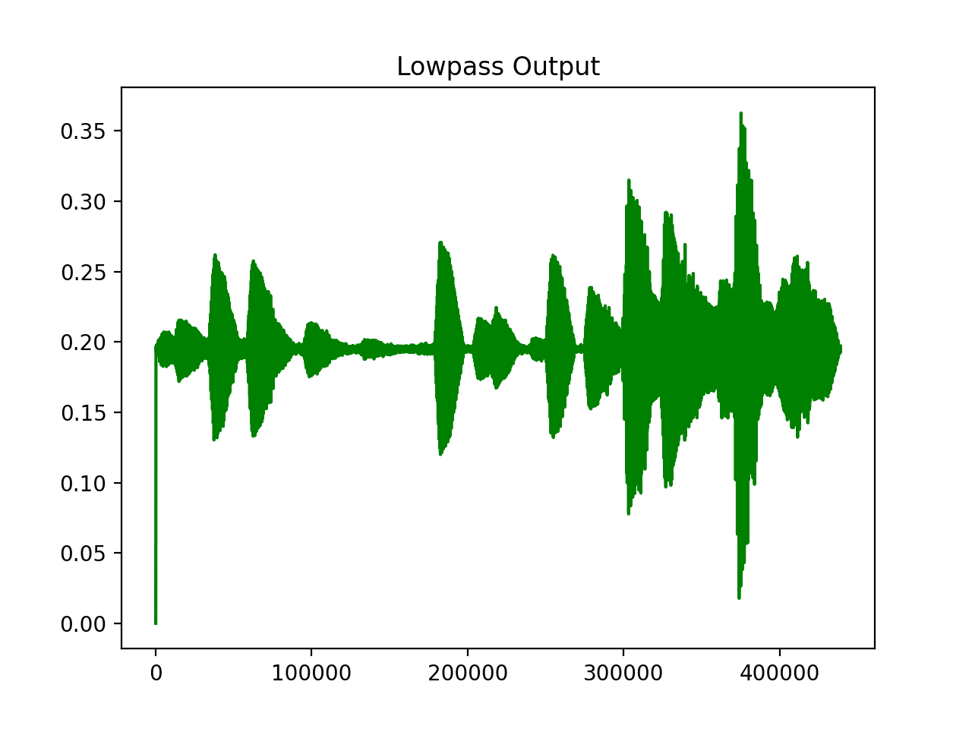
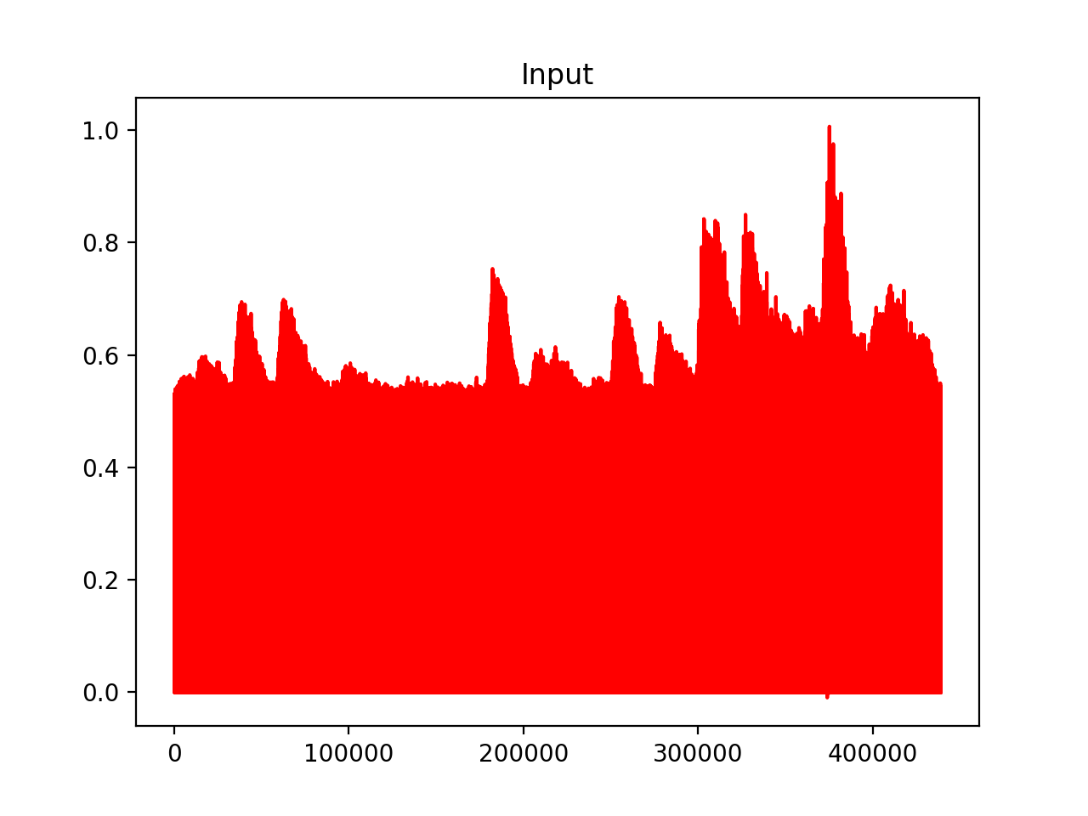
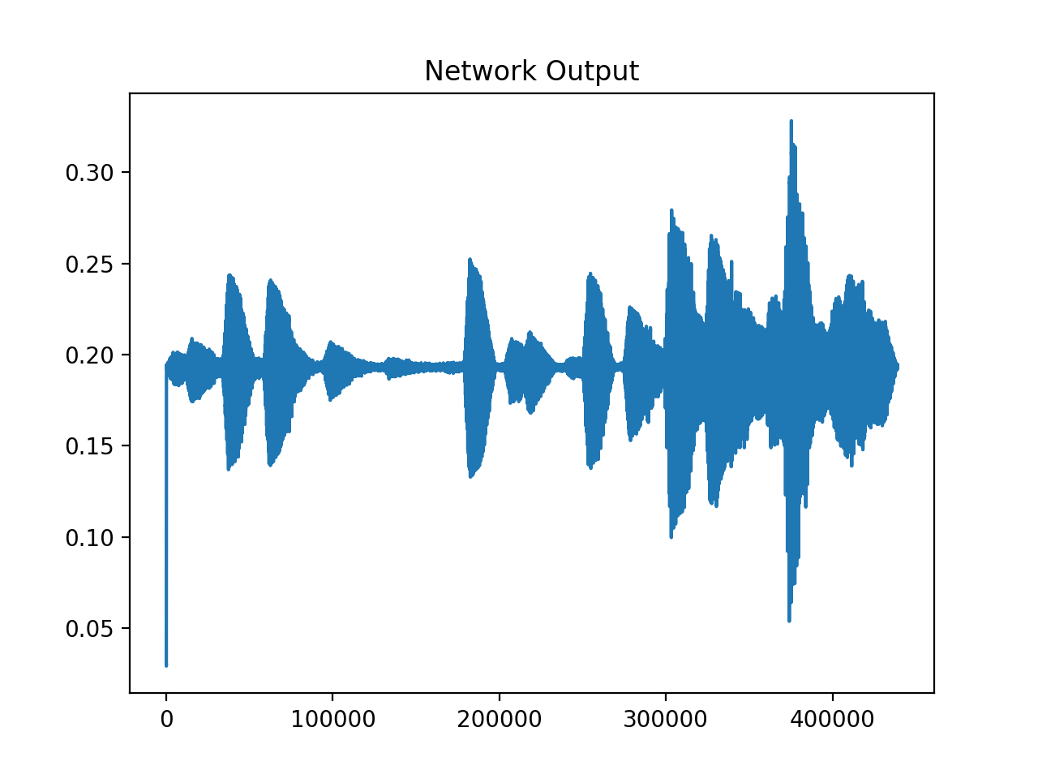
Audio Training Data
Lowpass Input

Slide 21
Neuromorphic Processor Design
How are we going to implement our model?

Slide 22
Approach
A CNN is effectively a regularized version of a multilayer perception (MLP) with each layer performing a distinct function.
Convolutional Layer
Applies filter kernal(s) to detect features
Multiplication and addition of values in the input layer and the filter
These filter values must be learned
Pooling Layer/Down-sampling
Used for dimensionality reduction
Typically, a MAX or AVG of the prior convolutional layer is used
Fully-connected Layer
Same thing as a traditional MLP: summation of weights and an activation function
Weights must be learned
We will be using two different approaches:
FPGA implementation
Custom hardware implementation
We will be providing input signals generated via software

Slide 23
Neuromorphic Processor Design
Input
Feature
Maps
Max Pooling
Kernal
Fully connected Output layer
.
.
.
.
.
.

Slide 24
Neuromorphic Processor Design
HSPICE
Weight update circuitry
Adders
Multipliers
MAX
Python
Synaptic weights
Weights, i.e. Synapses
(RRAM, FeFET, PCM, etc.)
Weight update circuity/
Controller
Kernal
Adders
Multipliers
MAX Function
Max Pooling

Slide 25
Neuromorphic Processor Design
HSPICE
Weight update circuitry
Adders
Multipliers
Python
Synaptic weights
Weights, i.e. Synapses
(RRAM, FeFET, PCM, etc.)
Weight update circuity/
Controller
Fully connected
Output layer
Adders
Multipliers

Slide 26
Performance Characterization
What are the metrics?

Slide 27
Performance Characterization
Area of layout
Power consumption
Speed of operation
Ability to detect anomalous signals
Accuracy
Ability to reconstruct data of components
Error

Slide 28
Project Timeline

Slide 29
Project Deliverables
Python simulations of a pre-trained CNN for SDR analysis
FPGA implementation of CNN
Hspice simulations of hardware acceleration via matrix multiplication in CNN using FeFETs
Final report

