Slide 1
FPGA Hardware Acceleration of CNN based SDR Analysis
Corey L. Butts, Joshua Mayersky
buttscl@mail.uc.edu, mayersjd@mail.uc.edu
(330) 883-9679
04/01/2021

Slide 2
Project Timeline

Slide 3
SDR Implementation Block Diagram
Trained Network
Analog
Observer
Neural Network
Error
Digital
SoC/FPGA
Antenna
Serial
Power Amplifier
RFTuner
ADC
Digital Mixer
Lowpass Filter
Signal Processing
Digital Local Oscillator
FPGA
RF Front End
Digital Front End

Slide 4
Model Architecture
Flatten
CNN Layer
Max Pooling
Dense Layer
(50 Units)
Input
x(t)
Output
(1 Unit)
x(t-1)
y(t)
…
x(t-64)

Slide 5
Model Architecture
Flatten
CNN Layer
Max Pooling
Dense Layer
(50 Units)
Input
x(t)
Output
(1 Unit)
x(t-1)
y(t)
…
x(t-64)

Slide 6
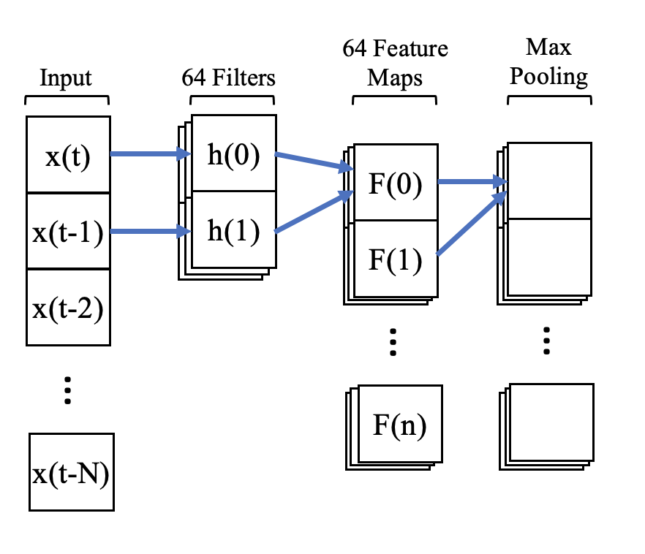
Conv Layer Hardware Implementations
3 Implementations:
MMA (HSpice)
SoC (Jetson Nano)
FPGA (Zynq-7000)
Feed inputs through each implementation and compare throughput
CNN

Slide 7
Implementing Conv Layer
Model was previously simulated in Python
Implementing the conv layer requires the weights of the Python model and the ability to verify output to a given input

Slide 8
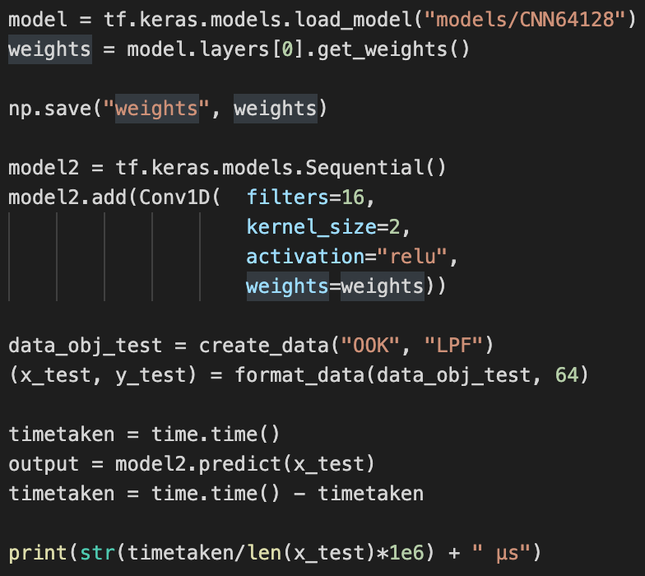
Python Script
Outputs the weights of a given model
Creates a set of input and output data to verify implementations

Slide 9
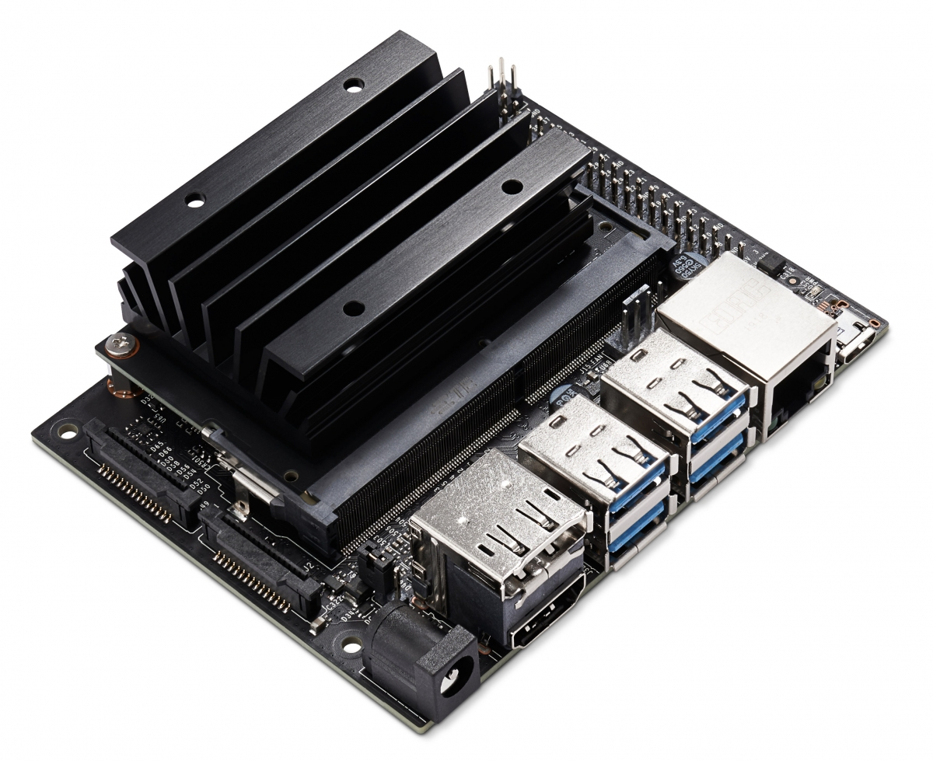
Jetson Nano
Nvidia’s low power ARM computer built specifically for inferencing
Runs on Linux (easy to port TensorFlow model)
Supports PCIe

Slide 10
Implementation Progress
Imported the model using TensorFlow
Generated input data
Tested model functionality (it works!)
Obtained throughput: 816.59 samples/s
Not great compared to MacBook (44903.46 samples/s)
Vanilla TensorFlow is not optimized for Jetson Nano hardware

Slide 11
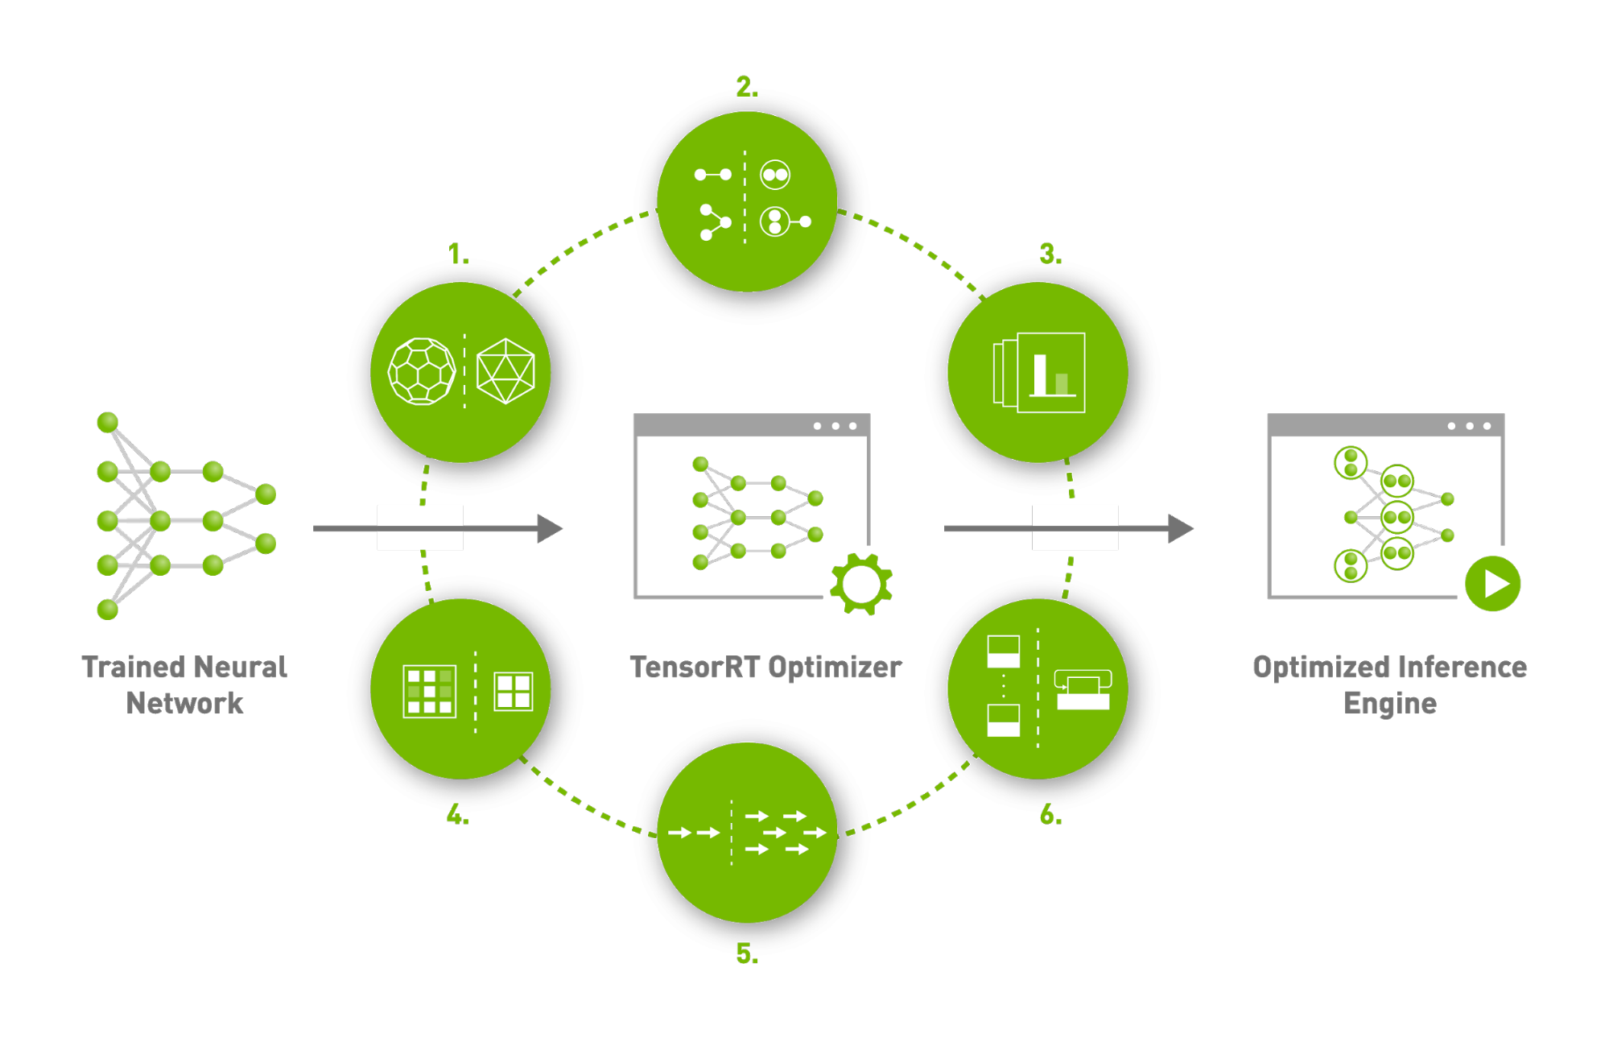
TensorRT
Nvidia’s API for accelerating inferencing models on Jetson Nano
Boasts 6x performance boost
Documentation is not great
Currently working on freezing the model
Requires TF 1.15.3 (<2.3.1)

Slide 12
Future Project Deliverables
Implement TensorRT and see if it improves throughput
Implement model on FPGA

