Slide 1
FPGA Hardware Acceleration of CNN based SDR Analysis
Corey L. Butts, Joshua Mayersky
buttscl@mail.uc.edu, mayersjd@mail.uc.edu
(330) 883-9679
04/15/2021

Slide 2
Project Timeline

Slide 3
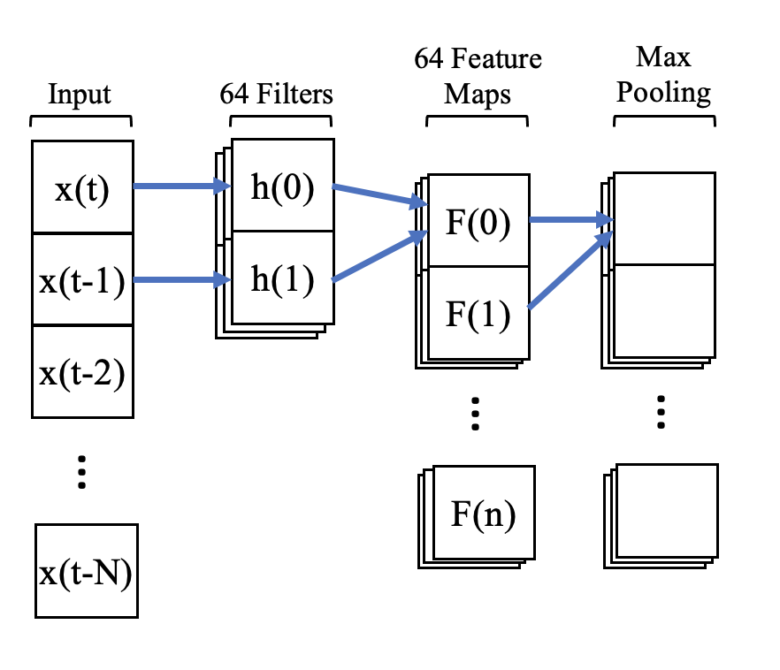

FPGA Conv Layer Acceleration
CNN
Convolution is just a series of multiplications and summations
On traditional processors those operations are performed serially
FPGA can be used to accelerate the execution of math operations
$$F\left(0\right)=x\left(t\right)h\left(0\right)+x\left(t−1\right)h(1)$$

Slide 4
FPGA Implementation
Conv2
16
Input0
16
Input1
32
16
Output
Filter0
16
Filter1
Output = (Input0 * Filter0) + (Input1 * Filter1)

Slide 5
FPGA Implementation
Each conv block implements a hardware circuit used to multiply and add the 4 16-bit numbers
Each number in the feature maps can now be computed in parallel as opposed to serially
Conv2
Conv2
Conv2
Conv2
Output0
Conv2
Conv2
Conv2
Conv2
4 Filters
Output1
…
Conv2
Conv2
Conv2
Conv2
Output31

Slide 6
FPGA Simulation
Started with 8 integer input samples
Model is effective with >= 32 input samples
Uses halfs instead of ints
Input = [0, 1, 2, 3, 4, 5, 6, 7, 8]
Filters: F0 = [1, 1], F1 = [2, 2], F2 = [3, 3], F3 = [4, 4]
Outputs:
O0 = [0*1 + 1*1, 1*1 + 2*1,…, 7*1 + 8*1] = [ 1 , 3 ,…, 15 ]
O1 = [0*2 + 1*2, 1*2 + 2*2,…, 7*2 + 8*2]
O2 = [0*3 + 1*3, 1*3 + 2*3,…, 7*3 + 8*3]
O3 = [0*4 + 1*4, 1*4 + 2*4,…, 7*4 + 8*4]

Slide 7
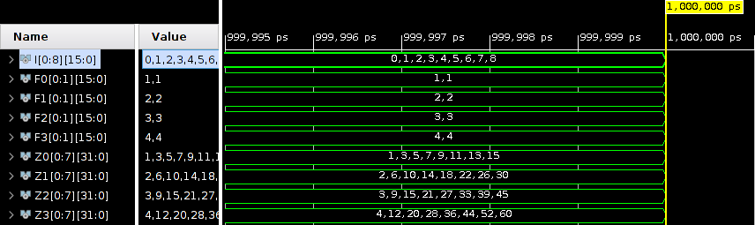
FPGA Simulation Results

Slide 8

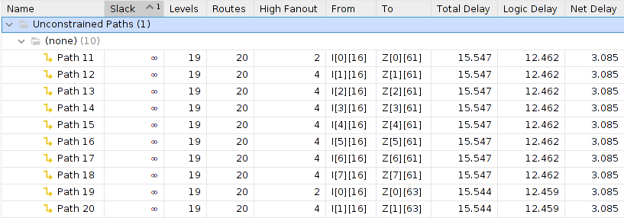
Utilization and Timing

Slide 9
Conclusion
MUCH much faster than Jetson Nano implementation (~15ns << ~23µs)
Comes at the sacrifice of package size
Needs a lot more IO
Higher end FPGAs support much more IO (Virtex-6 goes up to 1200)
Network parameters can be reduced to help shrink size (less filters, smaller input size etc.)

Slide 10
Future Project Deliverables
Scale FPGA implementation to allow for 32 input samples
Develop a python script that can convert the filter and input values to std_logic_vectors for test bench
Benchmark FPGA implementation

