Slide 1
Neuromorphic Computing Midterm Presentation: FPGA Hardware Acceleration of CNN based SDR Analysis
Corey L. Butts, Joshua Mayersky
buttscl@mail.uc.edu, mayersjd@mail.uc.edu
(330) 883-9679
02/18/2021

Slide 2
Project Timeline

Slide 3
Corey’s Project Progress
Python Simulations
Simulated DDC SDR circuit and tested against model
Frequency analysis of models trained on low pass filter
Tested model using different hyper parameters

Slide 4
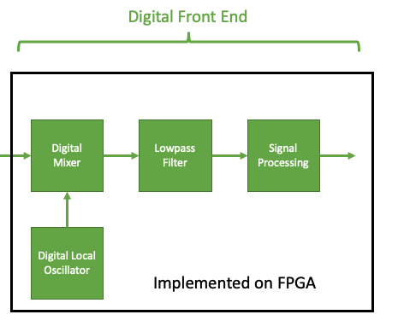
SDR Digital Front End
Digital Down Converter (DDC)

Slide 5
What A DDC Does
ADCs typically sample at a very high frequency
Requires an unnecessarily fast DSP since the data we are concerned about is usually much lower frequency
DDC lowers the frequency the digitized signal
Still preserves the original signal
Reduces DSP speed requirements
Down conversion is used to demodulate AM signals

Slide 6
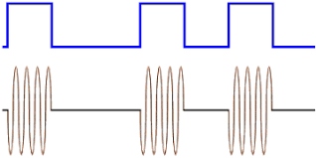
On Off Keying (OOK)
A type of Amplitude Modulation
Presence of the carrier wave denotes a ’1’
Absence of the carrier wave denotes a ‘0’

Slide 7
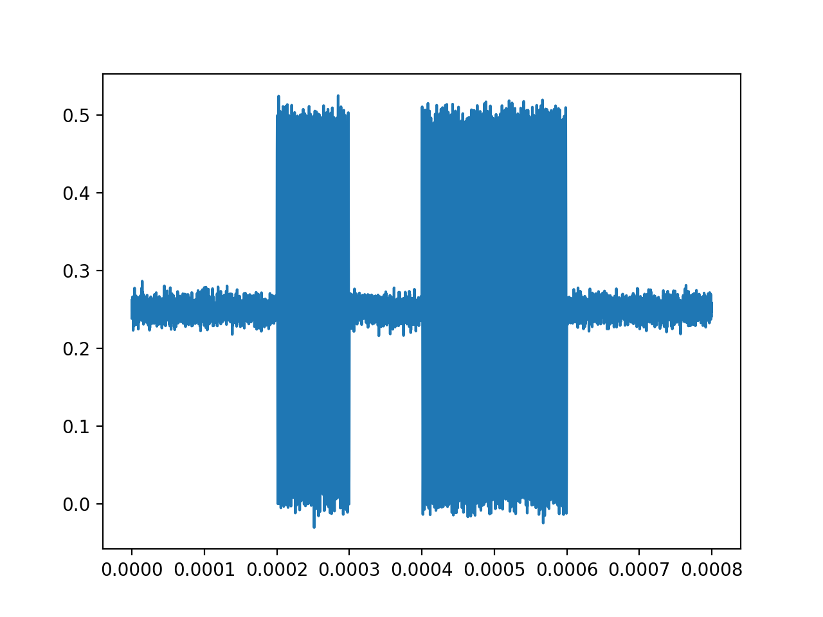
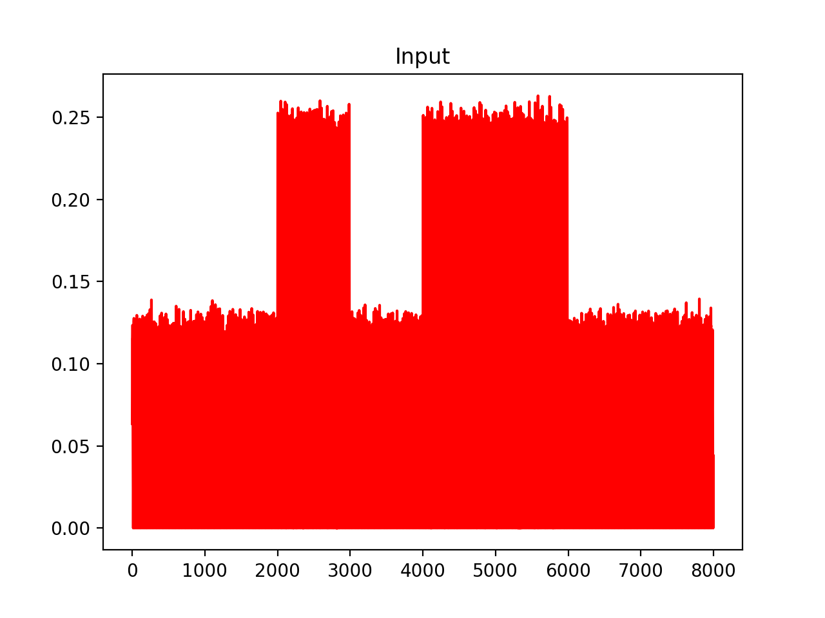
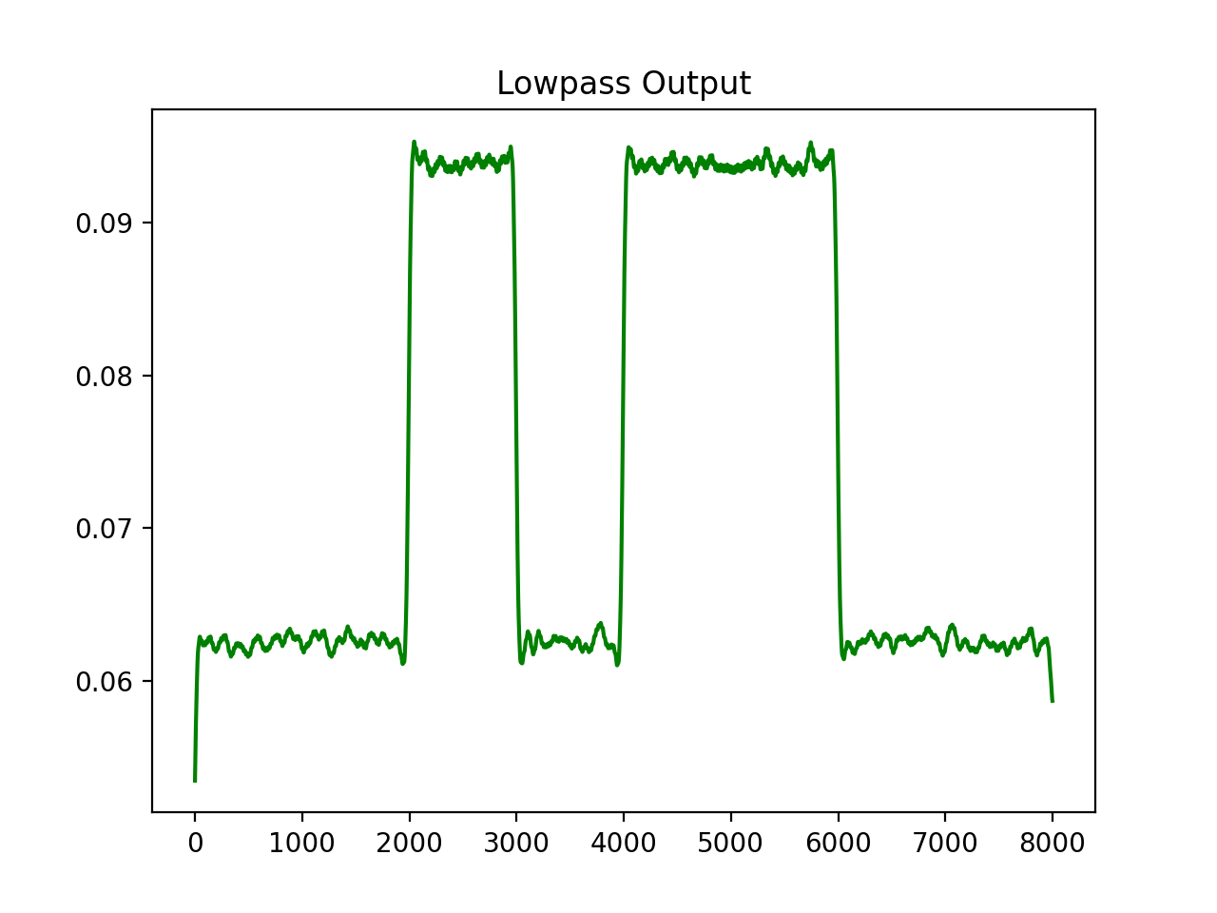
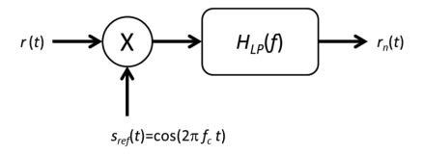
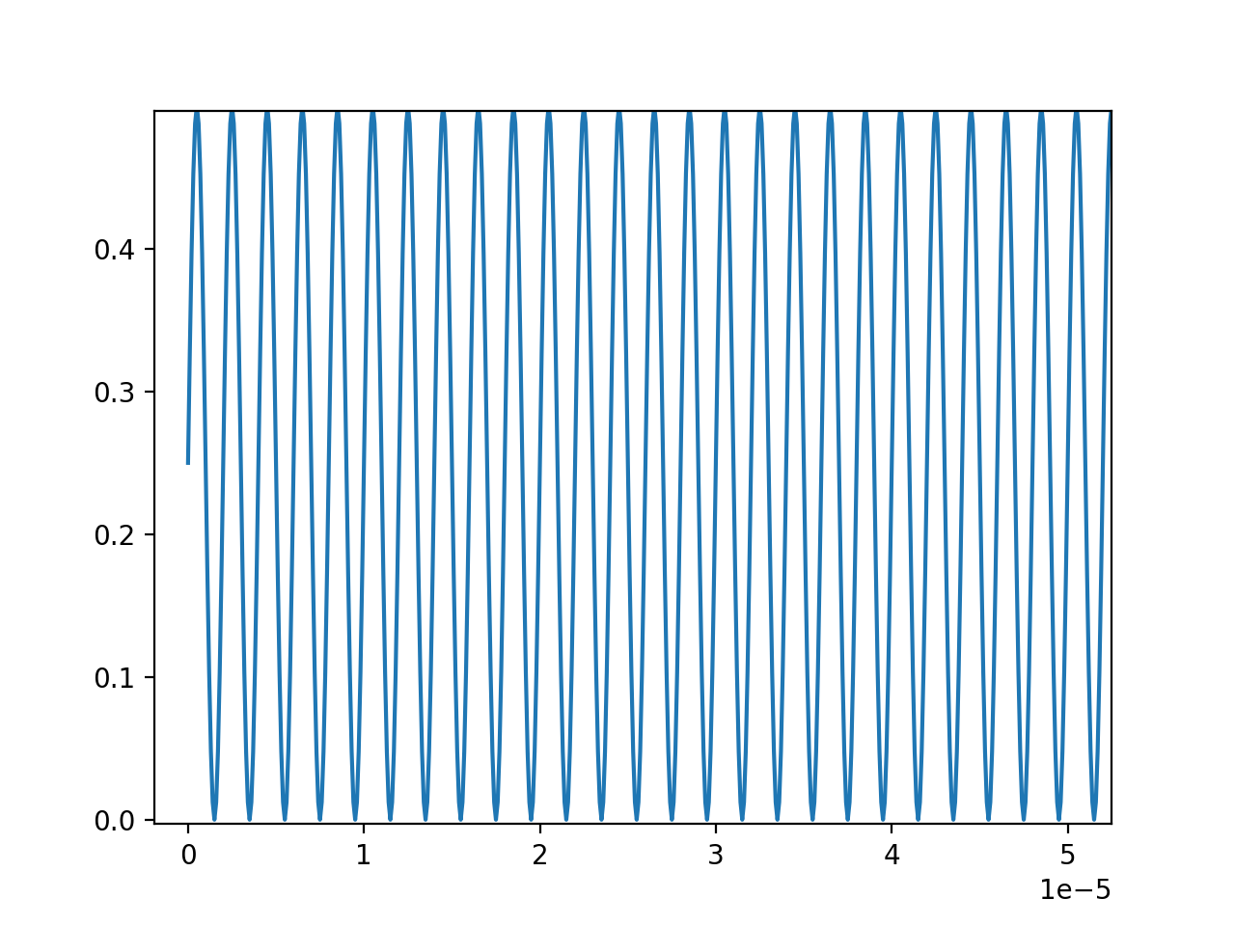
Down Conversion Example Using OOK Data
Mixer
Lowpass Filter

Slide 8
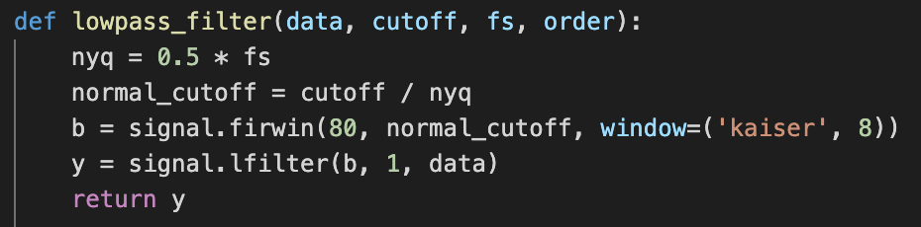
Generating Data
Generate a binary signal modulated using OOK
Carrier frequency = 500kHz
Model a DDC using SciPy (Python)
Mixer multiplies modulated signal with oscillator signal
Low pass FIR filter removes high frequency component

Slide 9
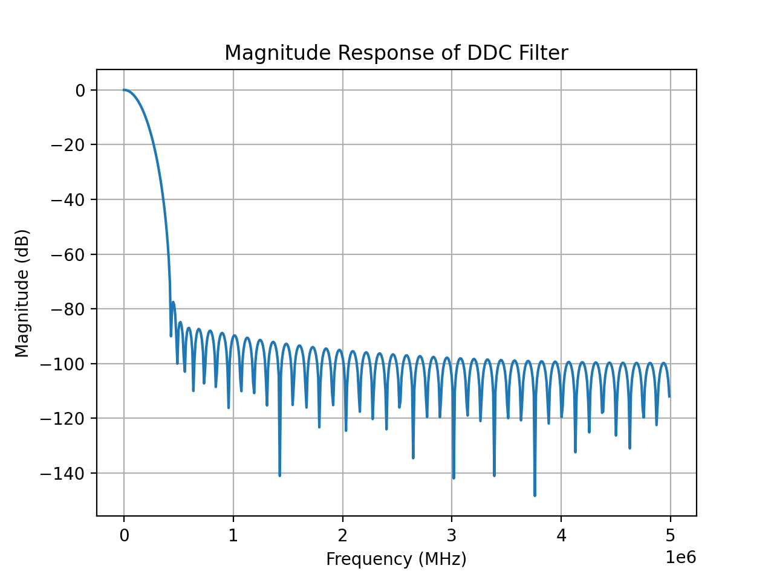
Lowpass FIR Filter
Cutoff
Frequency
(100kHz)
Carrier
Frequency
(500kHz)

Slide 10
Observer
Neural Network

Slide 11
Model Architecture Block Diagram
1-D CNN Layer
(64 Filters)
Max Pooling
(window size = 2)
Dense Layer
(50 Units)
Input
x[n]
Output
(1 Unit)
x[n-1]
Flatten
y[n]
…
x[n-64]

Slide 12
Training Procedure
Generate OOK data
x_train = mixer output
y_train = lowpass output
Train for ~500 epochs with Adadelta optimizer
Finds local minimums fast
Train for ~250 epochs with Adam optimizer (learning rate = 1e-5)
Reduces loss even further without overfitting
Graphical visualization of optimizer performance. Adapted from “LSTM Optimizer Choice?” by Bikal Basnet, 2016, retrieved from https://deepdatascience.wordpress.com/2016/11/18/which-lstm-optimizer-to-use/^{[5]}

Slide 13
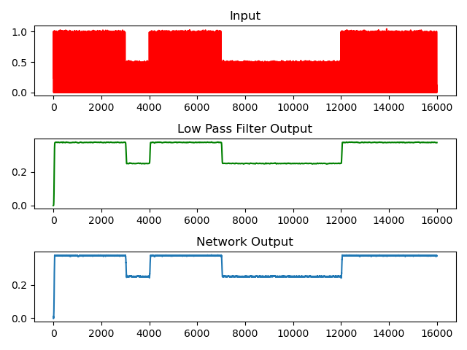
Results OOK Low Pass Filter Data

Slide 14
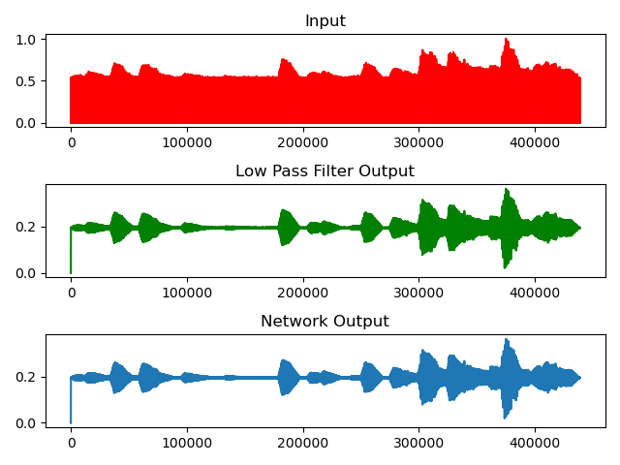
Results Audio Low Pass Filter Data

Slide 15
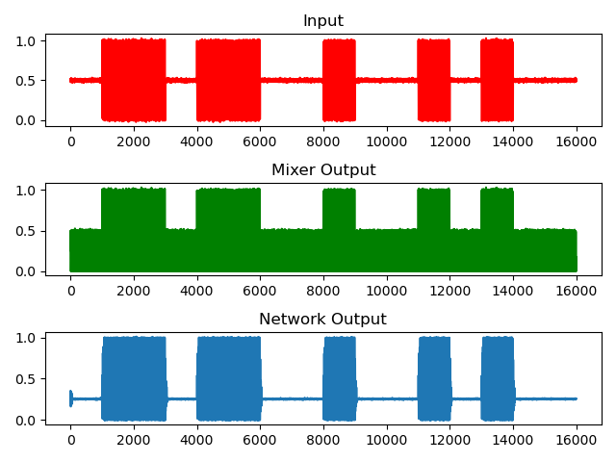
Results OOK Mixer Data

Slide 16
Conclusion
The Model works but its effectiveness is dependent on the dataset
Has difficulty changing a constant signal to a sine wave
Does the model understand the component functionality?

Slide 17
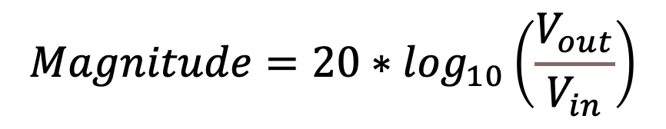
Frequency Response Comparison
Determine how well the CNN models the low pass filter’s functionality
Input a set of sine waves (1kHz – 1MHz) to each model variation
Get the magnitude using the following equation:
$$Magnitude=20∗\log_{10}\left(\frac{V_{out}}{V_{in}}\right)$$

Slide 19
Problems With Current Configuration
64 filters in CNN layer
Weights & biases = 99,493
More filters means more area taken by FeFET circuit
Data type = float (32b)
Input size (bitwise) exponentially increases area taken by FeFET circuit

Slide 20
Float to Half
Half = 16b = float/2
Reducing the data type of the input, weights and biases would significantly reduce the circuit area
Accuracy of the network is not sacrificed

Slide 21
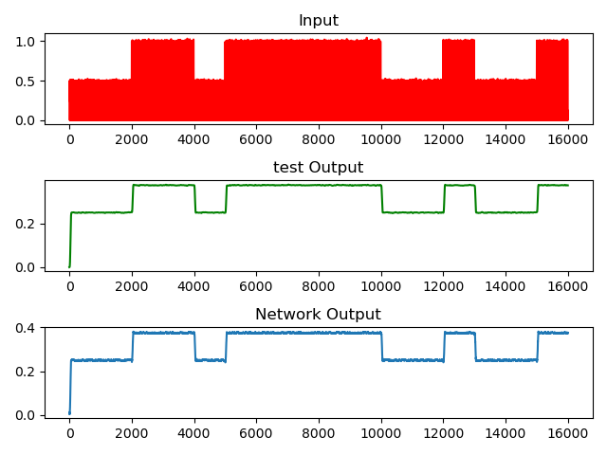
Results: Float to Half

Slide 22
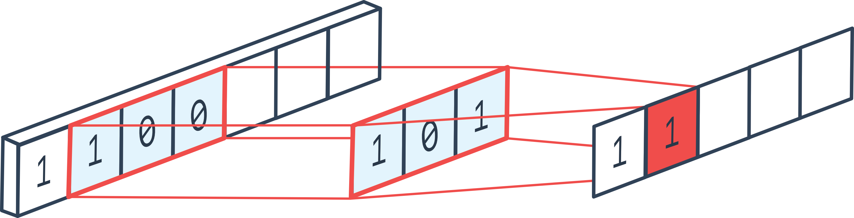
Reducing Filters
Less filters = less operations
More speed (which is great in an SDR application)
Reduces size of matrix multiplication circuit
Using 8 filters → weights & biases = 5,737 << 99,493

Slide 23
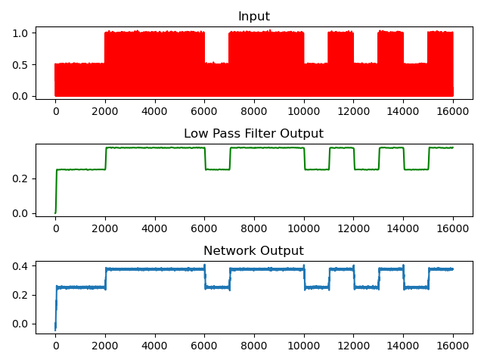
Results: Reducing Filters

Slide 24
Future Deliverables
Implement CNN in:
FPGA
Jetson Nano
Confirm FeFET output accuracy
Benchmark performance of FPGA and Jetson Nano Convolutional layer against FeFET implementation

