Slide 1
Neuromorphic Computing Midterm Presentation: FPGA Hardware Acceleration of CNN based SDR Analysis
Corey L. Butts, Joshua Mayersky
buttscl@mail.uc.edu, mayersjd@mail.uc.edu
(330) 883-9679
(513) 225-7917
04/15/2021

Slide 2
Project Timeline

Slide 3
Josh’s Project Progress
MMA circuit design and HSPICE simulations
Extended weights to full 16-bit length
Architectural level changes and optimizations
Made the crossbar and peripheral circuitry their own subcircuits, to enable simultaneous kernel operation simulations
Trade off is area vs. speed
Began making changes to the controller for the capture and reset signals due to errors introduced by the weight bit extension

Slide 4
Block Diagram of simulated MMA
Encoding inputs as voltage sources
Decoder for word-line loading
Sense amps on bit-lines
Counters (BSC)
Adders to adjust counting value
Multiply by bit-position
Capture values in DFFs
Shift and add DFFs
Final answer in binary
This is where the capture and reset signals are being generated and utilized
Capture values from multiplier
Reset counters for the sense-amplifiers

Slide 5
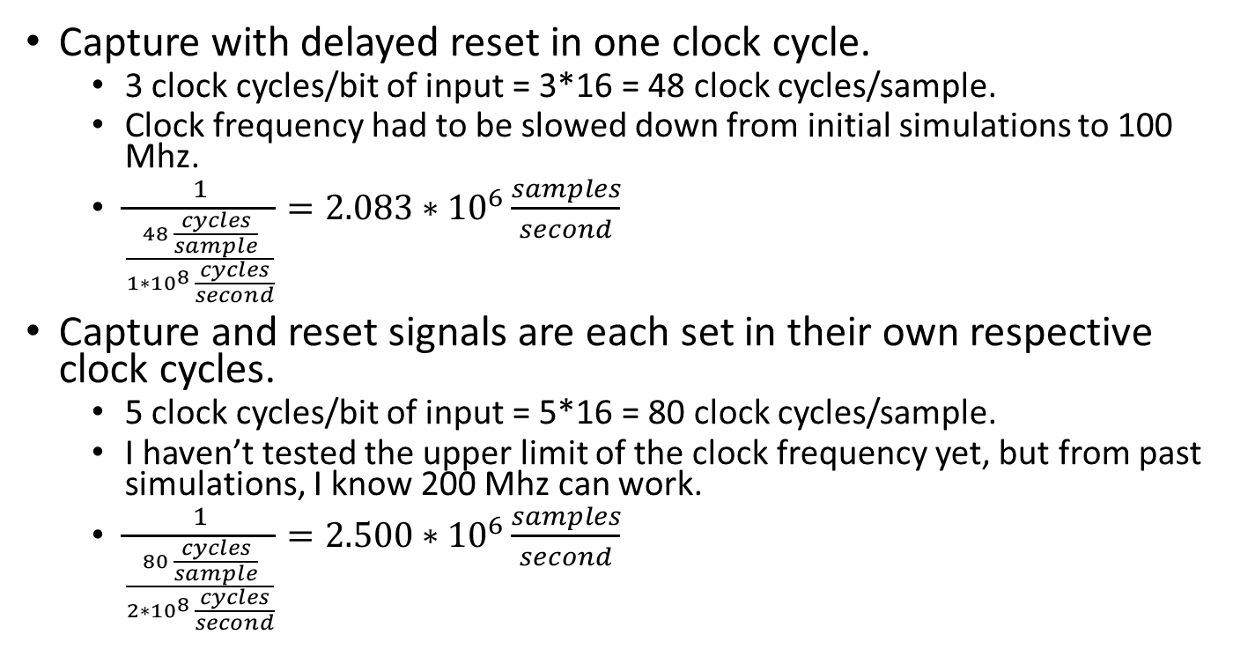
Timing Comparison
Capture with delayed reset in one clock cycle.
3 clock cycles/bit of input = 3*16 = 48 clock cycles/sample.
Clock frequency had to be slowed down from initial simulations to 100 Mhz.
$\frac{1}{\frac{48 \frac{cycles}{sample}}{{1∗10}^{8} \frac{cycles}{second}}}=2.083∗{10}^{6}\frac{samples}{second}$
Capture and reset signals are each set in their own respective clock cycles.
5 clock cycles/bit of input = 5*16 = 80 clock cycles/sample.
I haven’t tested the upper limit of the clock frequency yet, but from past simulations, I know 200 Mhz can work.
$\frac{1}{\frac{80 \frac{cycles}{sample}}{{2∗10}^{8} \frac{cycles}{second}}}=2.500∗{10}^{6}\frac{samples}{second}$

Slide 6
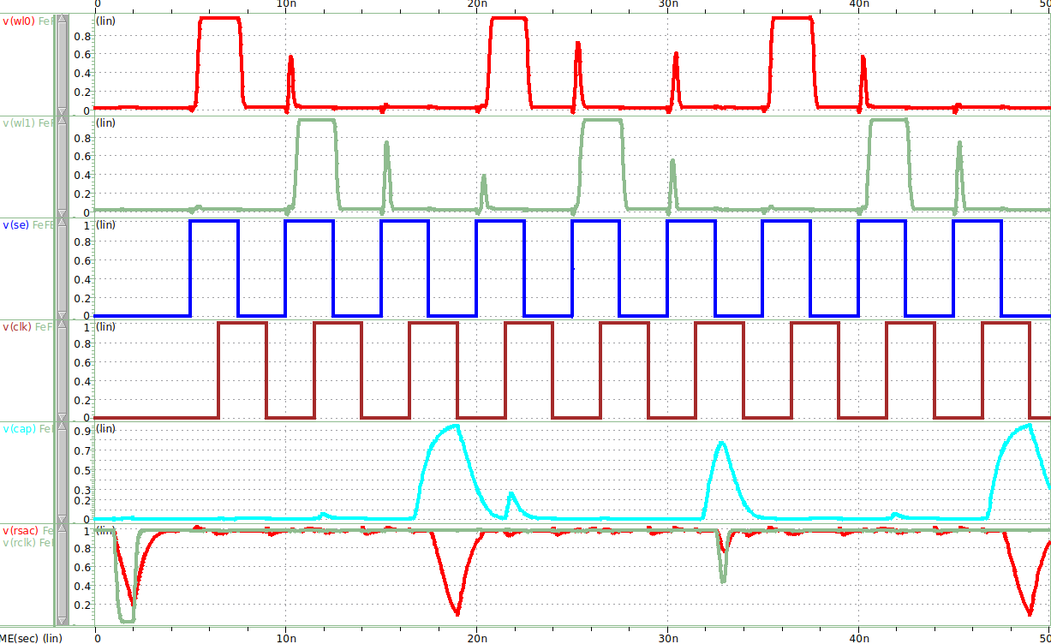
HSPICE Simulation
WL₀
WL₁
SE
CLK
Capture
Reset

Slide 7
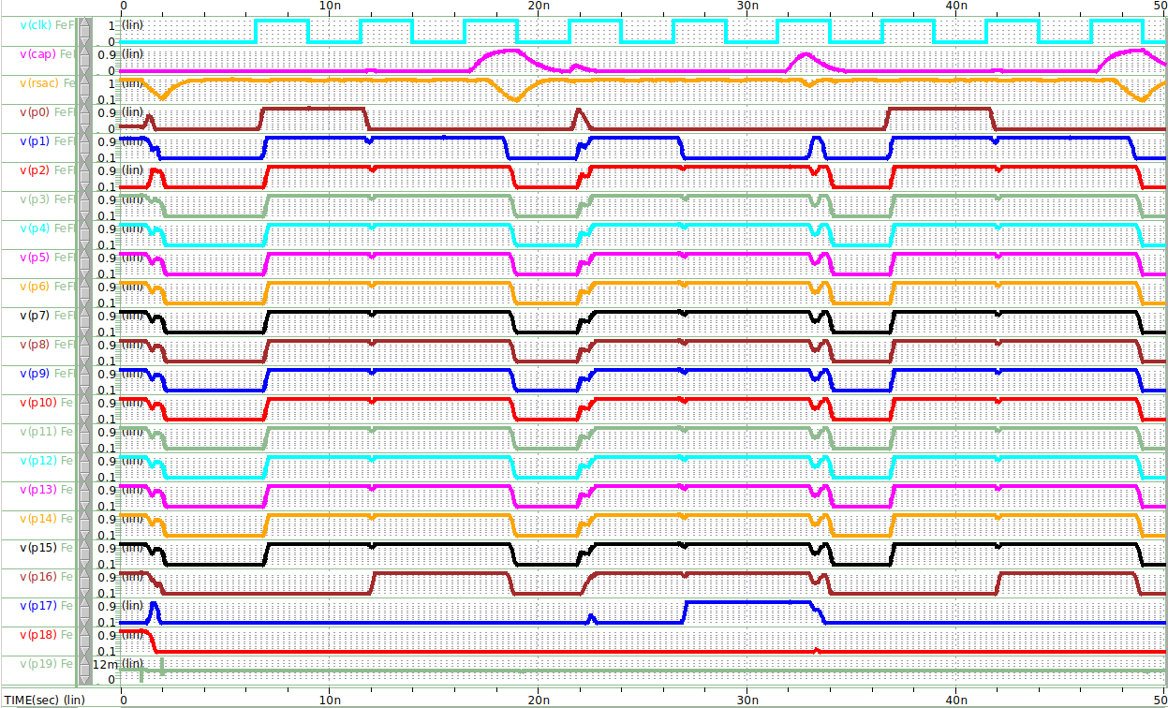
HSPICE Simulation
CLK
Capture
Reset
Multiplier Outputs

Slide 8
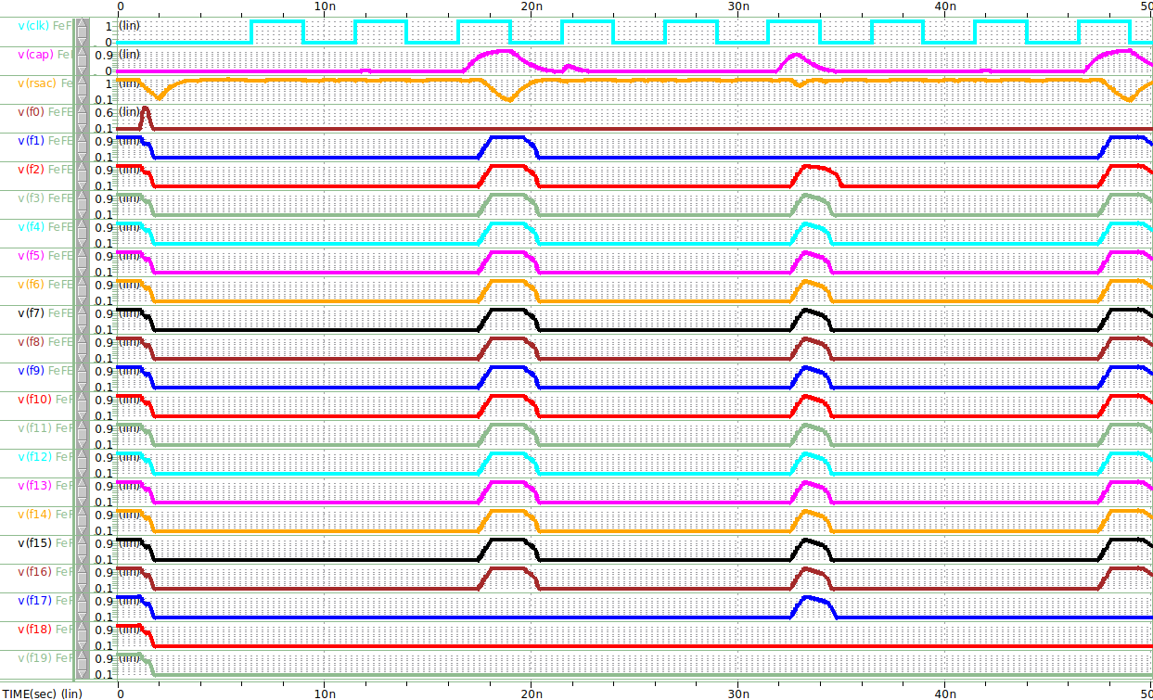
HSPICE Simulation
CLK
Capture
Reset
Final Outputs

Slide 9
Performance Metrics
Problems in area/power consumption calculations
Translation of HSPICE to Verilog/VHDL for Synopses Design Vision/Power Compiler
HSPICE is an analog circuit simulator using transistor level netlists
Verilog/VHDL are purely digital circuit simulators using gate level designs
The standard cell library I have access to does not have variable threshold voltage level transistors available
My design doesn’t use standard cells, as I needed to alter the widths of various transistors in certain gates

Slide 10
Future Project Deliverables
MMA architecture utilizing FeFETs
Finish changing the capture and reset signal controller to individual clock cycles
Drop trained weights into FeFET crossbar
Finalize circuit-level SPICE simulations
Final Report and Presentation
Compare results between FPGA, Jetson Nano, and FeFET MMA implementations

