Slide 1
FPGA Hardware Acceleration of CNN based SDR Analysis
Corey L. Butts, Joshua Mayersky
buttscl@mail.uc.edu, mayersjd@mail.uc.edu
(330) 883-9679
04/15/2021

Slide 2
Project Timeline

Slide 3
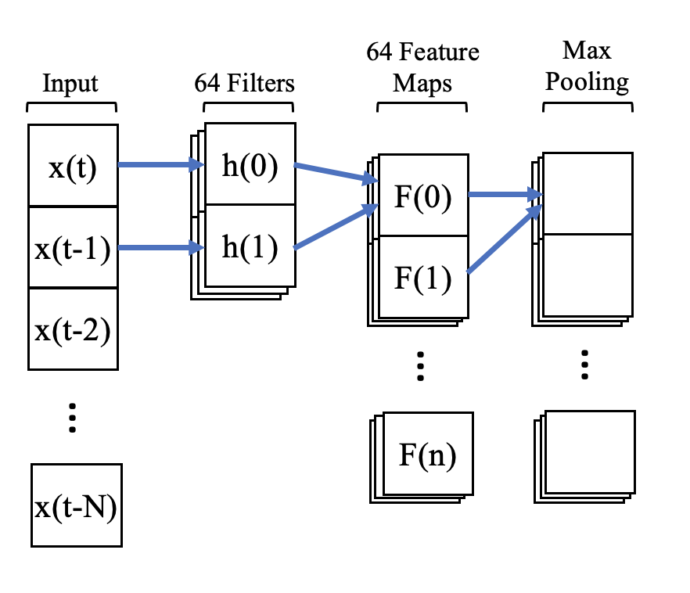

FPGA Conv Layer Acceleration
CNN
Convolution is just a series of multiplications and summations
On traditional processors those operations are performed serially
FPGA can be used to accelerate the execution of math operations
$$F\left(0\right)=x\left(t\right)h\left(0\right)+x\left(t−1\right)h(1)$$

Slide 4
FPGA Implementation
Conv2
16
Input0
16
Input1
32
16
Output
Filter0
16
Filter1
Output = (Input0 * Filter0) + (Input1 * Filter1)

Slide 5
FPGA Implementation
Each conv block implements a hardware circuit used to multiply and add the 4 16-bit numbers
Each number in the feature maps can now be computed in parallel as opposed to serially
Conv2
Conv2
Conv2
Conv2
Output0
Conv2
Conv2
Conv2
Conv2
4 Filters
Output1
…
Conv2
Conv2
Conv2
Conv2
Output31

Slide 6
FPGA Simulation
Started with 8 integer input samples
Model is effective with >= 32 input samples
Uses halfs instead of ints
Input = [0, 1, 2, 3, 4, 5, 6, 7, 8]
Filters: F0 = [1, 1], F1 = [2, 2], F2 = [3, 3], F3 = [4, 4]
Outputs:
O0 = [0*1 + 1*1, 1*1 + 2*1,…, 7*1 + 8*1] = [ 1 , 3 ,…, 15 ]
O1 = [0*2 + 1*2, 1*2 + 2*2,…, 7*2 + 8*2]
O2 = [0*3 + 1*3, 1*3 + 2*3,…, 7*3 + 8*3]
O3 = [0*4 + 1*4, 1*4 + 2*4,…, 7*4 + 8*4]

Slide 7
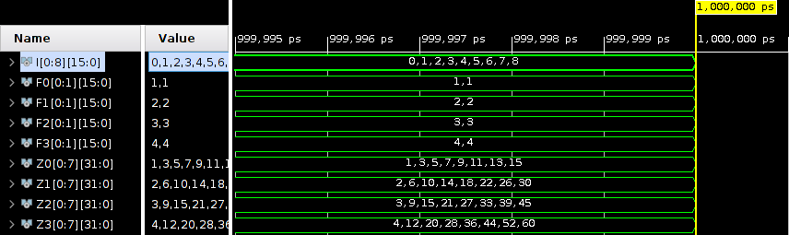
FPGA Simulation Results

Slide 8

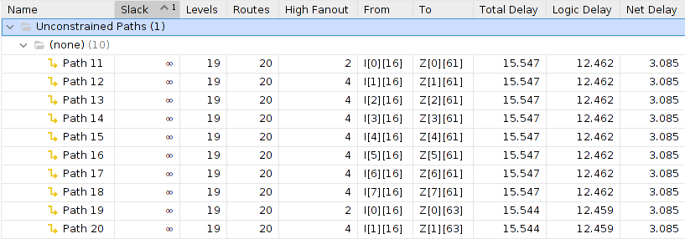
Utilization and Timing

Slide 9
Conclusion
MUCH much faster than Jetson Nano implementation (~15ns << ~23µs)
Comes at the sacrifice of package size
Needs a lot more IO
Higher end FPGAs support much more IO (Virtex-6 goes up to 1200)
Network parameters can be reduced to help shrink size (less filters, smaller input size etc.)

Slide 10
Future Project Deliverables
Scale FPGA implementation to allow for 32 input samples
Develop a python script that can convert the filter and input values to std_logic_vectors for test bench
Benchmark FPGA implementation

Slide 11
Josh’s Project Progress
MMA circuit design and HSPICE simulations
Extended weights to full 16-bit length
Architectural level changes and optimizations
Made the crossbar and peripheral circuitry their own subcircuits, to enable simultaneous kernel operation simulations
Trade off is area vs. speed
Began making changes to the controller for the capture and reset signals due to errors introduced by the weight bit extension

Slide 12
Block Diagram of simulated MMA
Encoding inputs as voltage sources
Decoder for word-line loading
Sense amps on bit-lines
Counters (BSC)
Adders to adjust counting value
Multiply by bit-position
Capture values in DFFs
Shift and add DFFs
Final answer in binary
This is where the capture and reset signals are being generated and utilized
Capture values from multiplier
Reset counters for the sense-amplifiers

Slide 13
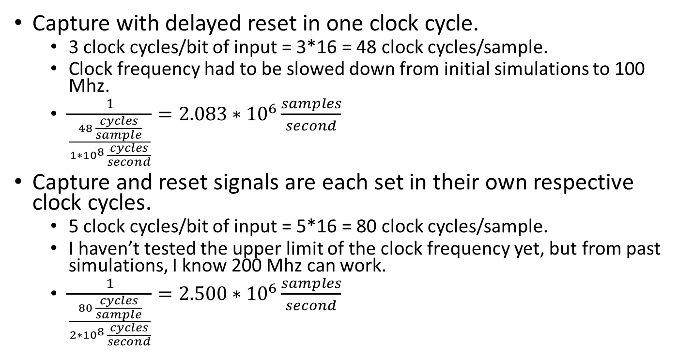
Timing Comparison
Capture with delayed reset in one clock cycle.
3 clock cycles/bit of input = 3*16 = 48 clock cycles/sample.
Clock frequency had to be slowed down from initial simulations to 100 Mhz.
$\frac{1}{\frac{48 \frac{cycles}{sample}}{{1∗10}^{8} \frac{cycles}{second}}}=2.083∗{10}^{6}\frac{samples}{second}$
Capture and reset signals are each set in their own respective clock cycles.
5 clock cycles/bit of input = 5*16 = 80 clock cycles/sample.
I haven’t tested the upper limit of the clock frequency yet, but from past simulations, I know 200 Mhz can work.
$\frac{1}{\frac{80 \frac{cycles}{sample}}{{2∗10}^{8} \frac{cycles}{second}}}=2.500∗{10}^{6}\frac{samples}{second}$

Slide 14
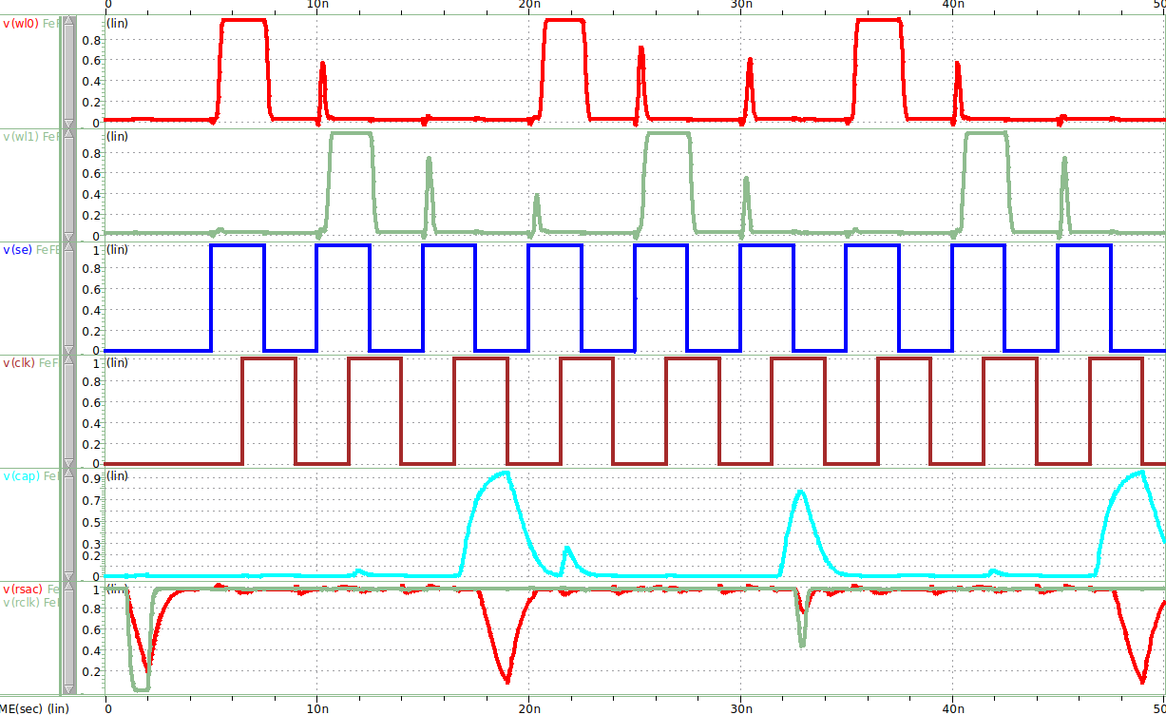
HSPICE Simulation
WL₀
WL₁
SE
CLK
Capture
Reset

Slide 15
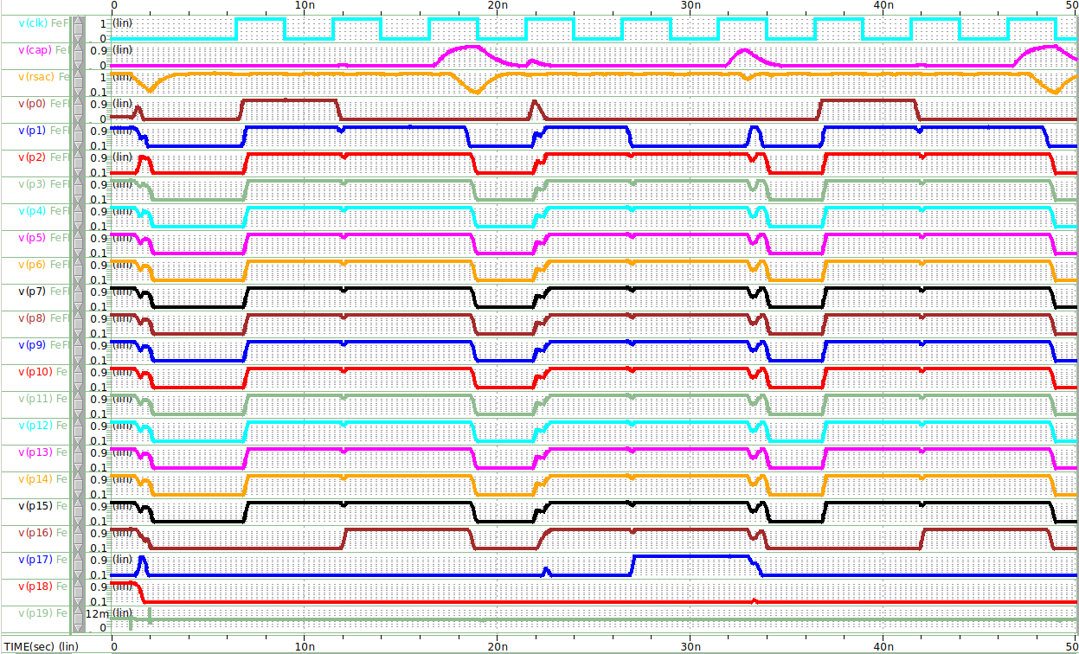
HSPICE Simulation
CLK
Capture
Reset
Multiplier Outputs

Slide 16
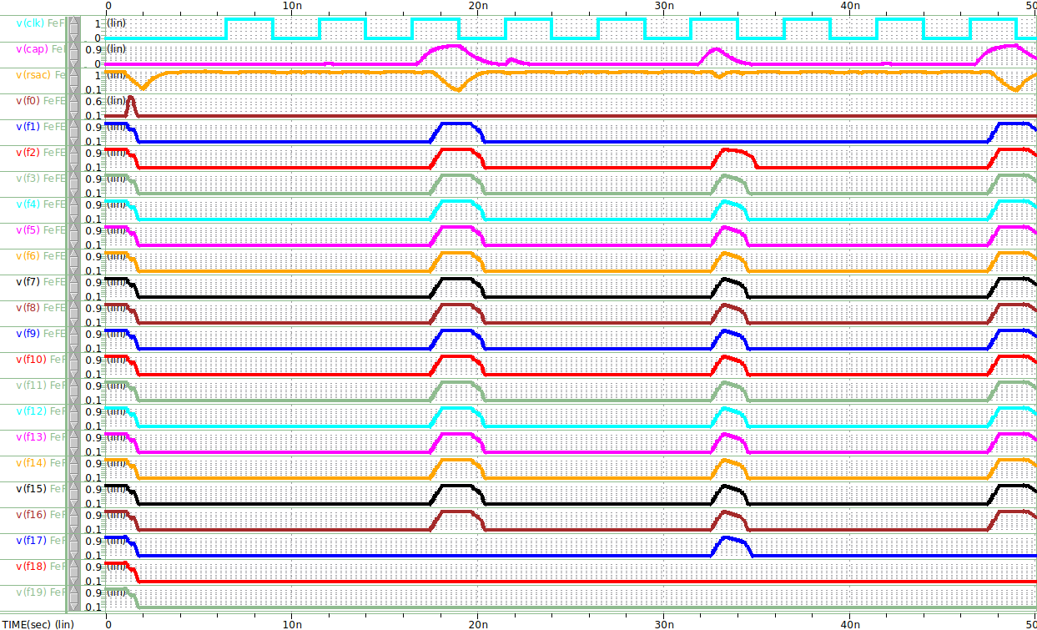
HSPICE Simulation
CLK
Capture
Reset
Final Outputs

Slide 17
Performance Metrics
Problems in area/power consumption calculations
Translation of HSPICE to Verilog/VHDL for Synopses Design Vision/Power Compiler
HSPICE is an analog circuit simulator using transistor level netlists
Verilog/VHDL are purely digital circuit simulators using gate level designs
The standard cell library I have access to does not have variable threshold voltage level transistors available
My design doesn’t use standard cells, as I needed to alter the widths of various transistors in certain gates

Slide 18
Future Project Deliverables
MMA architecture utilizing FeFETs
Finish changing the capture and reset signal controller to individual clock cycles
Drop trained weights into FeFET crossbar
Finalize circuit-level SPICE simulations
Final Report and Presentation
Compare results between FPGA, Jetson Nano, and FeFET MMA implementations

