Slide 1
Neuromorphic Computing Midterm Presentation: FPGA Hardware Acceleration of CNN based SDR Analysis
Corey L. Butts, Joshua Mayersky
buttscl@mail.uc.edu, mayersjd@mail.uc.edu
(330) 883-9679
(513) 225-7917
04/01/2021

Slide 2
Project Timeline

Slide 3
Josh’s Project Progress
MMA circuit design
Fully implemented 2bitx3bit multiplication.
Decoding circuitry for word-line loading
Sense-amplifiers and counters at the end of the bit lines
Adders, multipliers, decoders, flip-flops to perform the necessary arithmetic to get the final answer
MMA circuit HSPICE simulations

Slide 4
Block Diagram of simulated MMA
Encoding inputs as voltage sources
Decoder for word-line loading
Sense amps on bit-lines
Counters (BSC)
Adders to adjust counting value
Multiply by bit-position
Capture values in DFFs
Shift and add DFFs
Final answer in binary

Slide 5
Josh’s Project Progress
Input encoding
Each bit of input is a separate voltage source
I would like to change this to be parallelly loaded into registers
Word line decoding
Word lines are loaded based on a clock-cycle counter (BRC) and after the sense-amps have been pre-charged
Sense-amps
No changes here since last update
BSC for sense-amp
A binary synchronous counter has been added to the output of the sense-amps in order to keep track of the AND operations
Adding to adjust counting value
I need to shift the MSBs of each counter output to the next counter and add them together
Multiplication of count value by the appropriate bit-place
This is done by using the clock counting and a decoder
The multiplied values are captured in flip-flops, then shifted and added together

Slide 6
Circuit Simulation
 | clk: 3-4 | clk: 1-2
a₁ | 1 | 1
a₂ | 1 | 1
BL₂
BL₁
BL₀
 | a₁ | b₁ | a₂ | b₂
Decimal | 3 | 7 | 3 | 7
Binary | 11 | 111 | 11 | 111
WL₀
1
b₁₂
1
b₁₁
1
b₁₀
(3*7)+(3*7) = 42
WL₁
1
b₂₁
1
b₂₁
1
b₂₀
SA₂
SA₁
SA₀
clk1 | 1 | 1 | 1
clk2 | 10 | 10 | 10
clk3 | 1 | 1 | 1
clk4 | 10 | 10 | 10

Slide 7
Circuit Simulation
clk1 | 1 | 1 | 1
clk2 | 10 | 10 | 10
clk3 | 1 | 1 | 1
clk4 | 10 | 10 | 10
10 10 10
1
+10
11
1
+10
11
clk: 1-2 | 1 | 1 | 1 | 0 | = 14*2⁰
clk: 3-4 | 1 | 1 | 1 | 0 | = 14*2¹
(14*2⁰)+(14*2¹) = 42
11 1 0

Slide 8
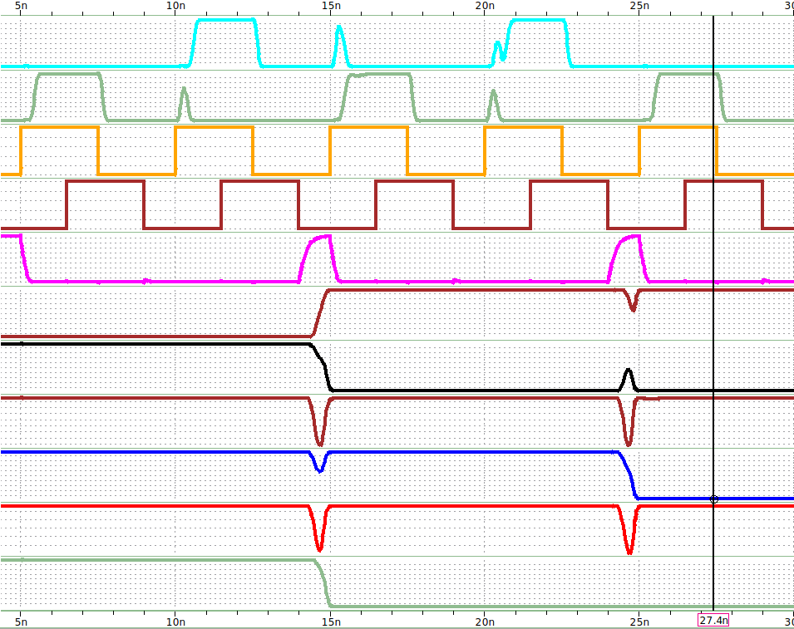
Circuit Simulation
WL₁
WL₀
SE
CLK
CAP
F₅
 | a₁ | b₁ | a₂ | b₂
Decimal | 3 | 7 | 3 | 7
Binary | 11 | 111 | 11 | 111
F₄
F₃
F₂
F₁
F₀
 | clk: 3-4 | clk: 1-2
a₁ | 1 | 1
a₂ | 1 | 1
BL₂
BL₁
BL₀
clk₁
clk₂
clk₃
clk₄
WL₀
1
b₁₂
1
b₁₁
1
b₁₀
clk | F₅ | F₄ | F₃ | F₂ | F₁ | F₀
1 | 0 | 1 | 1 | 1 | 1 | 1
2 | 0 | 1 | 1 | 1 | 1 | 1
3 | 1 | 0 | 1 | 1 | 1 | 0
4 | 1 | 0 | 1 | 1 | 1 | 0
5 | 1 | 0 | 1 | 0 | 1 | 0
WL₁
1
b₂₁
1
b₂₁
1
b₂₀
SA₂
SA₁
SA₀

Slide 9
Performance Metrics

Slide 10
Future Project Deliverables
MMA architecture utilizing FeFETs
Extend weights to full 16 bit width (Bit/Source lines), and full 96 weights (Word line)
Drop trained weights into FeFET crossbar
Mapping of the input values to vectors for MMA
Load in inputs into registers then utilize existing one-hot vector decoder to load each value on the word-lines
Finalize circuit-level SPICE simulations
Interface with python simulations

Slide 11
References
[1] Ding, R., Tian, X., Bai, G., Su, G. & Wu, X. Hardware implementation of convolutional neural network for face feature extraction. in Proceedings of International Conference on ASIC (IEEE Computer Society, 2019). doi:10.1109/ASICON47005.2019.8983575
[2] Dong, Z. et al. Convolutional Neural Networks Based on RRAM Devices for Image Recognition and Online Learning Tasks. IEEE Transactions on Electron Devices 66, 793–801 (2019).
[3] Soloviev, R., Telpukhov, D., Mkrtchan, I., Kustov, A. & Stempkovskiy, A. Hardware Implementation of Convolutional Neural Networks Based on Residue Number System. in Moscow Workshop on Electronic and Networking Technologies, MWENT 2020 - Proceedings (Institute of Electrical and Electronics Engineers Inc., 2020). doi:10.1109/MWENT47943.2020.9067498
[4] Park, B., Ishiwara, H., Okuyama, M., Sakai, S., Yoon, S. Ferroelectric-Gate Field Effect Transistor Memories Device Physics and Applications. in Topics in Applied Physics 131, (2020).
[5] Valueva, M. V., Nagornov, N. N., Lyakhov, P. A., Valuev, G. V. & Chervyakov, N. I. Application of the residue number system to reduce hardware costs of the convolutional neural network implementation. Mathematics and Computers in Simulation 177, 232–243 (2020).
[6] Chung, J., Choi, W., Park, J. & Ghosh, S. Domain Wall Memory-Based Design of Deep Neural Network Convolutional Layers. IEEE Access 8, 19783–19798 (2020).
[7] Yao, P. et al. Fully hardware-implemented memristor convolutional neural network. Nature 577, 641–646 (2020).
[8] Gong, L., Wang, C., Li, X., Chen, H. & Zhou, X. MALOC: A fully pipelined FPGA accelerator for convolutional neural networks with all layers mapped on chip. IEEE Transactions on Computer-Aided Design of Integrated Circuits and Systems 37, 2601–2612 (2018).
[9] Solovyev, R. A., Stempkovsky, A. L. & Telpukhov, D. V. Study of Fault Tolerance Methods for Hardware Implementations of Convolutional Neural Networks. Optical Memory and Neural Networks (Information Optics) 28, 82–88 (2019).
[10] Hacene, G. B., Gripon, V., Arzel, M., Farrugia, N. & Bengio, Y. Quantized guided pruning for efficient hardware implementations of deep neural networks. in NEWCAS 2020 - 18th IEEE International New Circuits and Systems Conference, Proceedings 206–209 (Institute of Electrical and Electronics Engineers Inc., 2020). doi:10.1109/NEWCAS49341.2020.9159769
[11] Gysel, P. Ristretto: Hardware-Oriented Approximation of Convolutional Neural Networks. (2016).
[12] Chen, W., Wang, Y., Yang, C. & Li, Y. Hardware acceleration implementation of three-dimensional convolutional neural network on vector digital signal processors. in 2020 4th International Conference on Robotics and Automation Sciences, ICRAS 2020 122–129 (Institute of Electrical and Electronics Engineers Inc., 2020). doi:10.1109/ICRAS49812.2020.9135062
[13] Long, Y., Na, T., Rastogi, P., Rao, K., Khan, A., Yalamanchili, S., Mukhopadhyay, S. A ferroelectric FET based power-efficient architecture for data-intensive computing. IEEE/ACM International Conference on Computer-Aided Design, Digest of Technical Papers, ICCAD, (2018). doi:10.1145/3240765.3240770
[14] Long, Y., Kim, D., Lee, E., Saha, P., Mudassar, Burhan A., She, X., Khan, A., Mukhopadhyay, S. A Ferroelectric FET-Based Processing-in-Memory Architecture for DNN Acceleration. IEEE Journal on Exploratory Solid-State Computational Devices and Circuits, 5, 2, 113-122 (2019). doi: 10.1109/JXCDC.2019.2923745
[15] Long, Y., Lee, E., Kim, D., Mukhopadhyay, S. Flex-PIM: A Ferroelectric FET based Vector Matrix Multiplication Engine with Dynamical Bitwidth and Floating Point Precision. Proceedings of the International Joint Conference on Neural Networks (2020). doi: 10.1109/IJCNN48605.2020.9206672.
[16] Shalini, Kumar, A., Design Of High Speed And Low Power Sense Amplifier for SRAM Applications. International Journal of Scientific & Engineering Research. 4, 7, 402-406 (2013).
[17] Okobiah, O., Mohanty, S.P., Kougianos, E., Poolakkaparambil, M. Towards Robust Nano-CMOS Sense Amplifier Design: A Dual-Threshold versus Dual-Oxide Perspective in ACM Great Lakes Symposium on VLSI, GLSVLSI, Proceedings 145-150 (2011).

