Slide 1
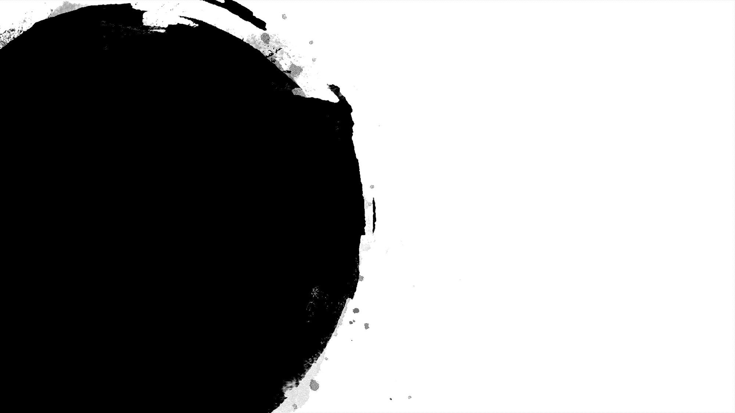

Merchant Category Recommendation
Group 10
Qi Su
Chuchu Jin
Runlai Yang
Help understand customer loyalty

Slide 2
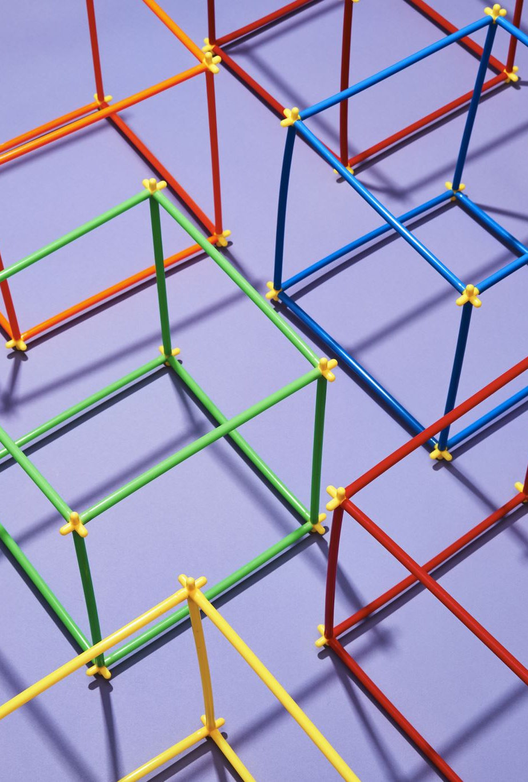
Catalog
Background
Data processing
Methods
Results
Evaluation and Improvement
Reference

Slide 3

Background
This topic is adopted from Kaggle Competition, the original goal of the topic is to help understand the customer loyalty from the credit card information and recommend personalized promotions.
Elo has built machine learning models to understand the general aspects and preferences on analysis of all customers, but so far these features are not specified for an individual. In order to help provide the personalized promotions for customers, our goal is to come up with a model that analyzes the individual loyalty to merchants as references to the personalization.

Slide 4
Data introduction
The new_merchant_transactions.csv file mainly contains information about each customer's card transaction, such as card_id, merchant_id, category_# and purchase_date.
The merchants.csv file mainly contains merchant_id, category_#, avg_purchases, and active_month, etc.
The train.csv file contains first month active purchases, including card_id, feature_# , and target.
The test.csv file is also the first month active purchases, including card_id, feature_#, and then we should give a target for the result.

Slide 5
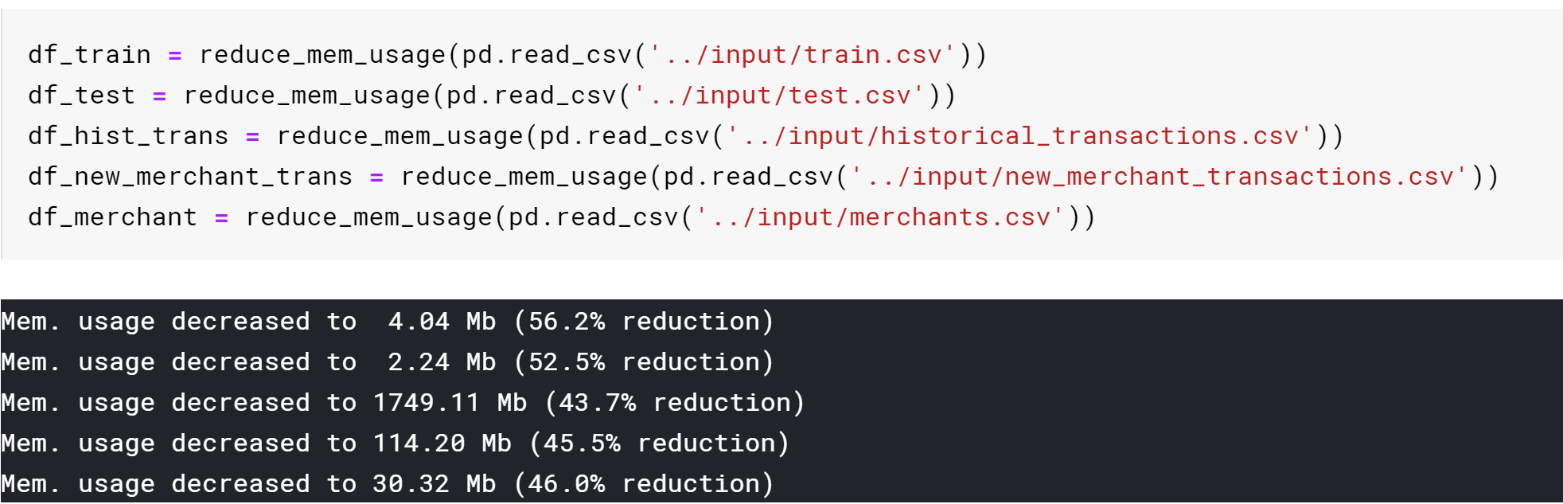
Data preprocessing
1. Reduce memory usage
Notes:
Due to extreme large scale of raw data, we use minimal data type to store the data, which could keep the most information of the original data.

Slide 6
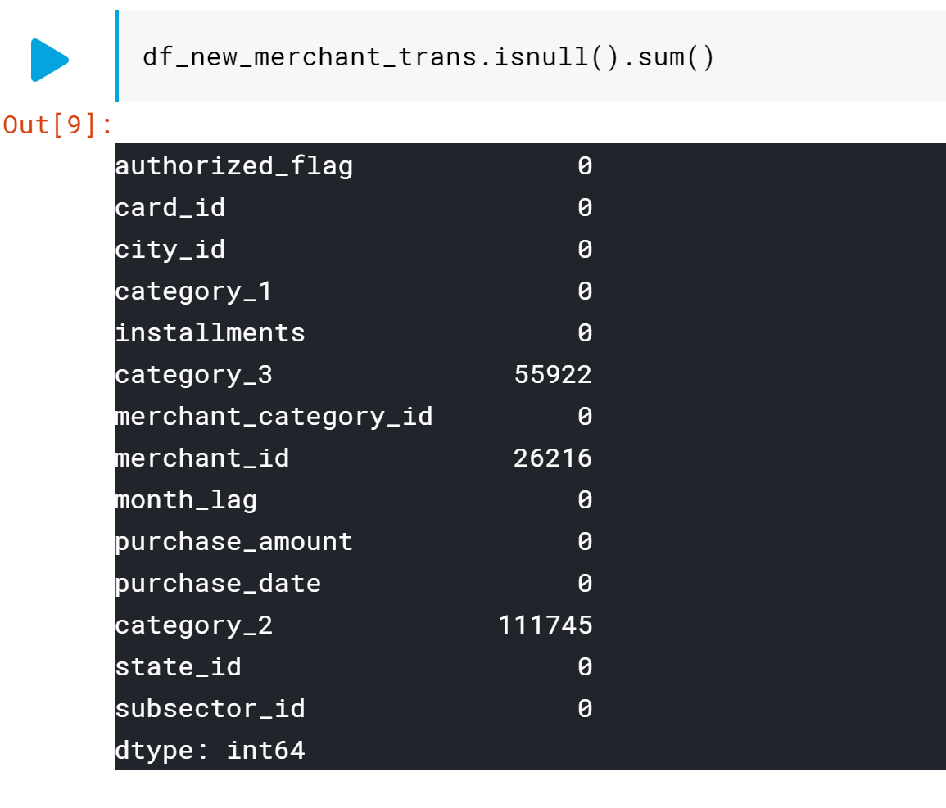
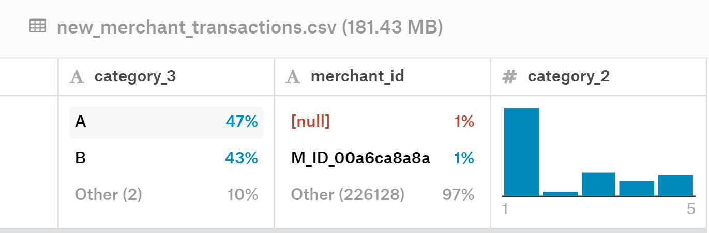
Data preprocessing
2. Handle 0 or empty data
Due to large amount of NULL values, we filled them with most frequently occurring values.

Slide 7
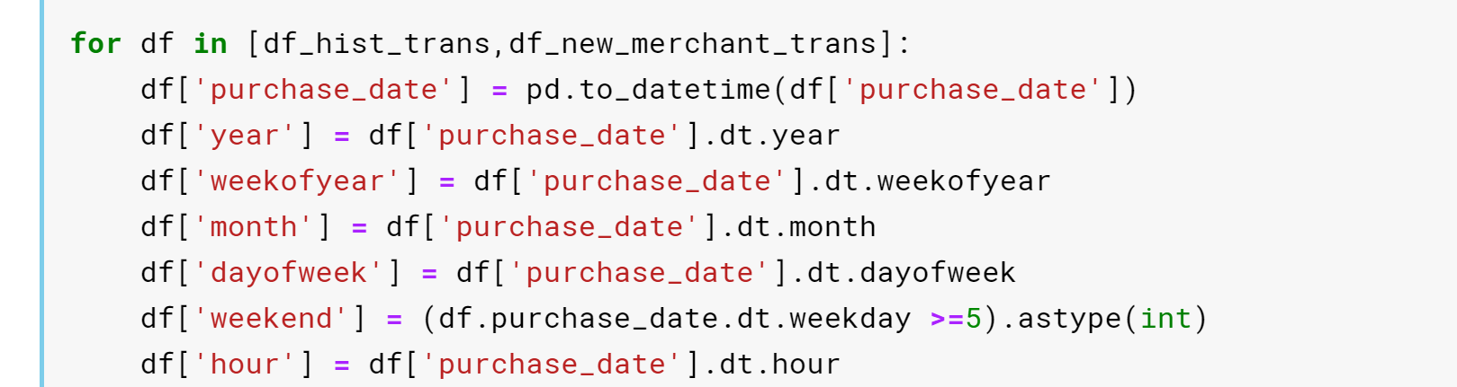
Data preprocessing
3. Processing date data
The pure date data is meaningless, so we have to split the date to different parts, such as which year it is, which week in a year, which day in a week, whether it is a weekend, etc.

Slide 8
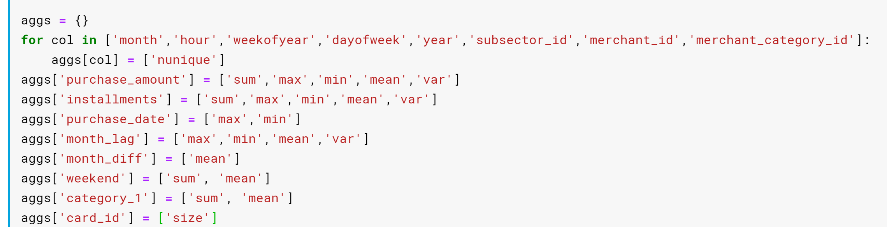
Data preprocessing
4. Extend features
Because we have many different tables, we need to "join" the tables together based on the associated fields.
Also, we calculate min, max, mean, variance of the numerical data to extend them.

Slide 9
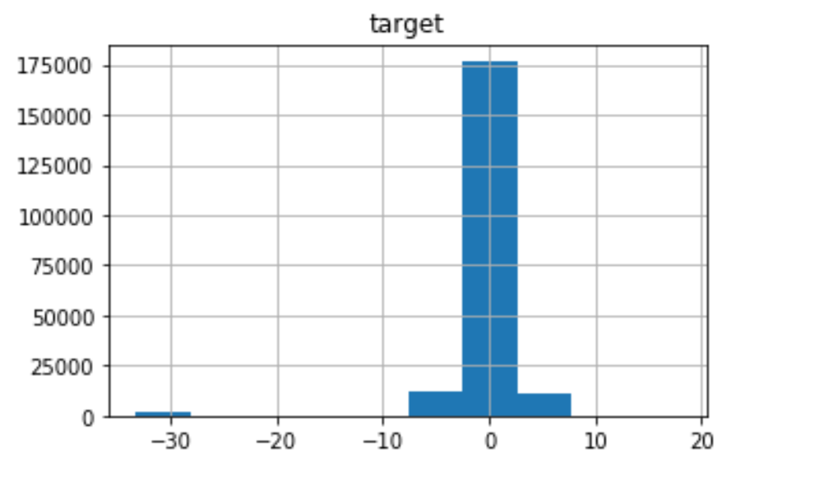
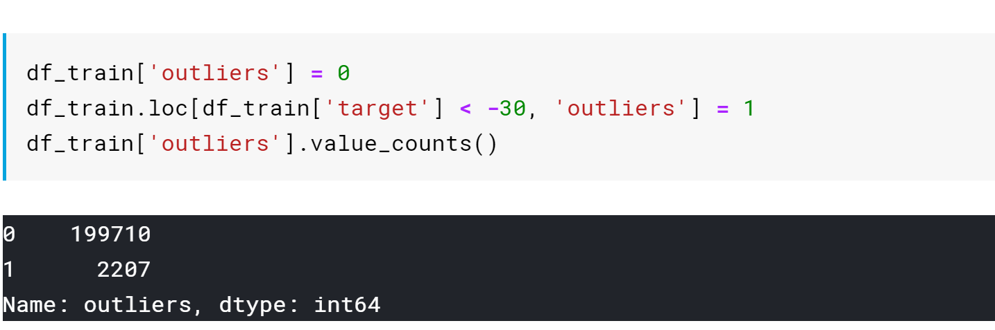
Data preprocessing
5. Outliers
About 1% of the data are outliers, which is already a large part of the data. We cannot give up directly, so we must find a way to deal with it.
Notes:
outlier 2207, standard data 199710, about 1% outlier. We cannot omit the outliers, because they take up relatively large amount that can’t be ignored.

Slide 10
Method
1. Bagging
Based on the concept of bagging and random return sampling, a random attribute selection is introduced, and a part of features is randomly selected each time. Thus further enhance the diversity of weak learners.
Some advantages of bagging:
Parallel, no dependencies between classifiers
Multiple sampling to train multiple models
Reduce variance after fusion
Notes:
This sequential learning technique sounds a bit like Gradient Descent, except that instead of tweaking a single predictor’s parameter to minimise the cost function, AdaBoost adds predictors to the ensemble gradually making it better. The great disadvantage of this algorithm is that the model cannot be parallelized since each predictor can only be trained after the previous one has been trained and evaluated. Adaboost
Bagging
Based on the principle of bagging and random return sampling, a random attribute selection is introduced, and a part of features is randomly selected each time. Based on this, the optimal attributes are divided to further enhance the diversity of weak learners.Some advantages of bagging:Parallel, no dependencies between classifiers Multiple sampling to train multiple models Reduce variance after fusion

Slide 11
Boosting: Adaboost and Gradient Boost
Adaboost:
Alters the distribution of the training dataset to increase weights on sample observations that are difficult to classify.
The final prediction is based on a majority vote of the weak learner's predictions weighted by their individual accuracy.
Gradient Boost:
The approach trains learners based upon minimizing the loss function of a strong learner (i.e., training on the residuals of the strong model) as an alternative means to focus on training upon misclassified observations.
The contribution of each weak learner to the final prediction is based on a gradient optimization process to minimize the overall error of the strong learner.
Notes:
Boosting comes from the idea that a weak learner (i.e., models) can be enhanced by learning based on the errors by other weak learners. Grouping these weak learners together results in a strong learner.
The two main boosting algorithms are Adaptive Boosting and Gradient Boosting. XGBoost, LightGBM and CatBoost are basically different implementations of Gradient Boosting.
Why choose gradient boosting instead of adaboost: Adaboost is sensitive to distribution of the datasets, the outliers may have huge impact on the performance of the models, so we choose to use gradient boosting algorithm in order to reduce the impact.

Slide 12
Gradient Boost
Gradient boosting re-defines boosting as a numerical optimization problem where the objective is to minimize the loss function of the model by adding weak learners using a gradient-descent like procedure.
Gradient boosting does not modify the sample distribution as weak learners train on the remaining residual errors of a strong learner (i.e, pseudo-residuals).
By training on the residuals of the model, this is an alternative means to give more importance to misclassified observations
Notes:
Intuitively, gradient boosting is a stage-wise additive model that generates learners during the learning process (i.e., trees are added one at a time, and existing trees in the model are not changed). It builds a first learner to predict the observations in the training dataset, and then it calculates the loss (i.e., the value between the first learner's outcomes and the actual values). It will build a second learner that is fitted/trained on the residual error produced by the first learner to predict the loss after the first step and continue to do so until it reaches a threshold (i.e., residuals are zero). By training the second learner on the gradient of the error with respect to the loss predictions of the first learner, the second learner is being trained to correct the mistakes of the first model. This is the core of gradient boosting, and allows many simple learners to compensate for each other’s weaknesses to better fit the data.
The contribution of the weak learner to the ensemble is based on a gradient descent optimization process. The calculated contribution of each tree is based on minimizing the overall error of the strong learner.

Slide 13
Method
2. Lightgbm
Light GBM is a fast, distributed, high-performance gradient boosting framework based on decision tree algorithm, used for ranking, classification and many other machine learning tasks.
Faster training speed and higher efficiency.
Lower memory usage.
Better accuracy.
Support of parallel and GPU learning.
Capable of handling large-scale data.
Notes:
LightGBM is a popular framework used in kaggle, it takes less time to run when on large datasets.
The parameter is chosen by grid search.
Boosting-Dart: Dropouts meet Multiple Additive Regression Trees

Slide 14
Method
3. Handle outliers
We use three models to process outlier. The first model is trained by all the data, the second one is trained without all the outliers, and the third model is to determine whether the data is an outlier or not. Thus, we can decide which model to use depending on the third model.

Slide 15
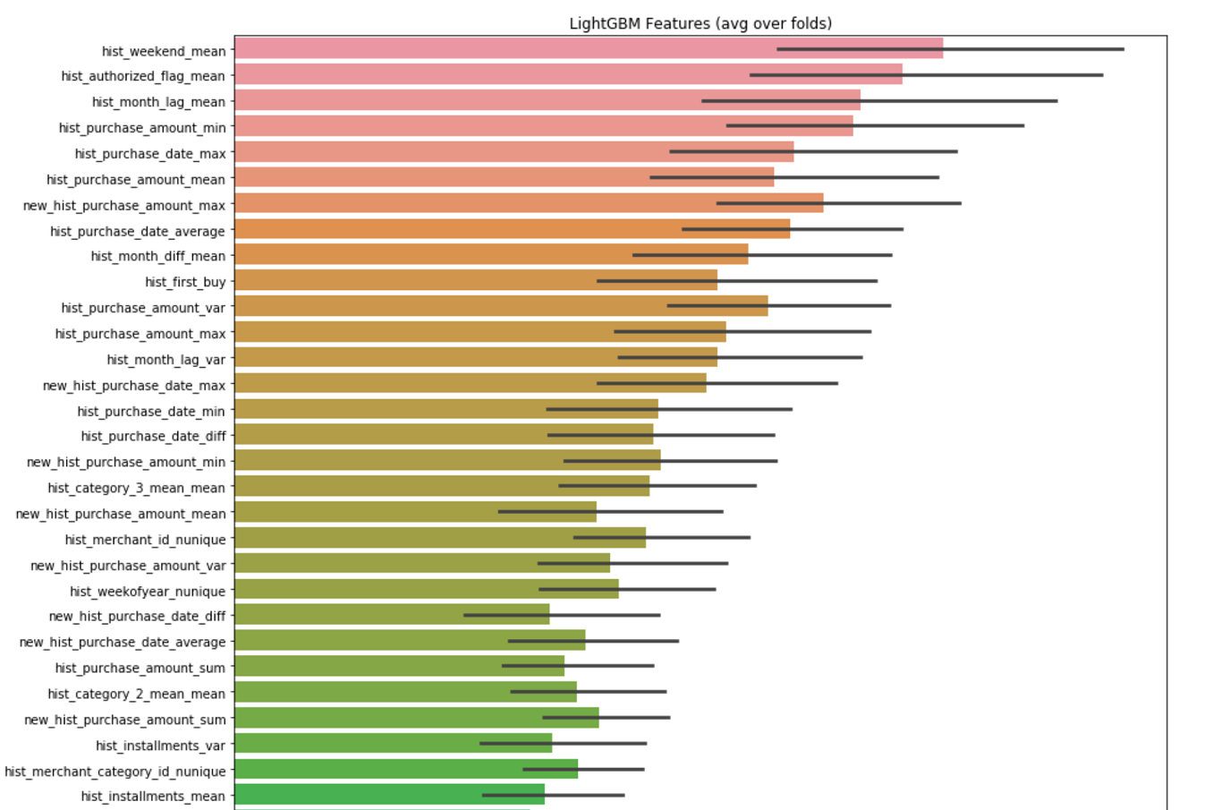
LightGBM features importances after training

Slide 16
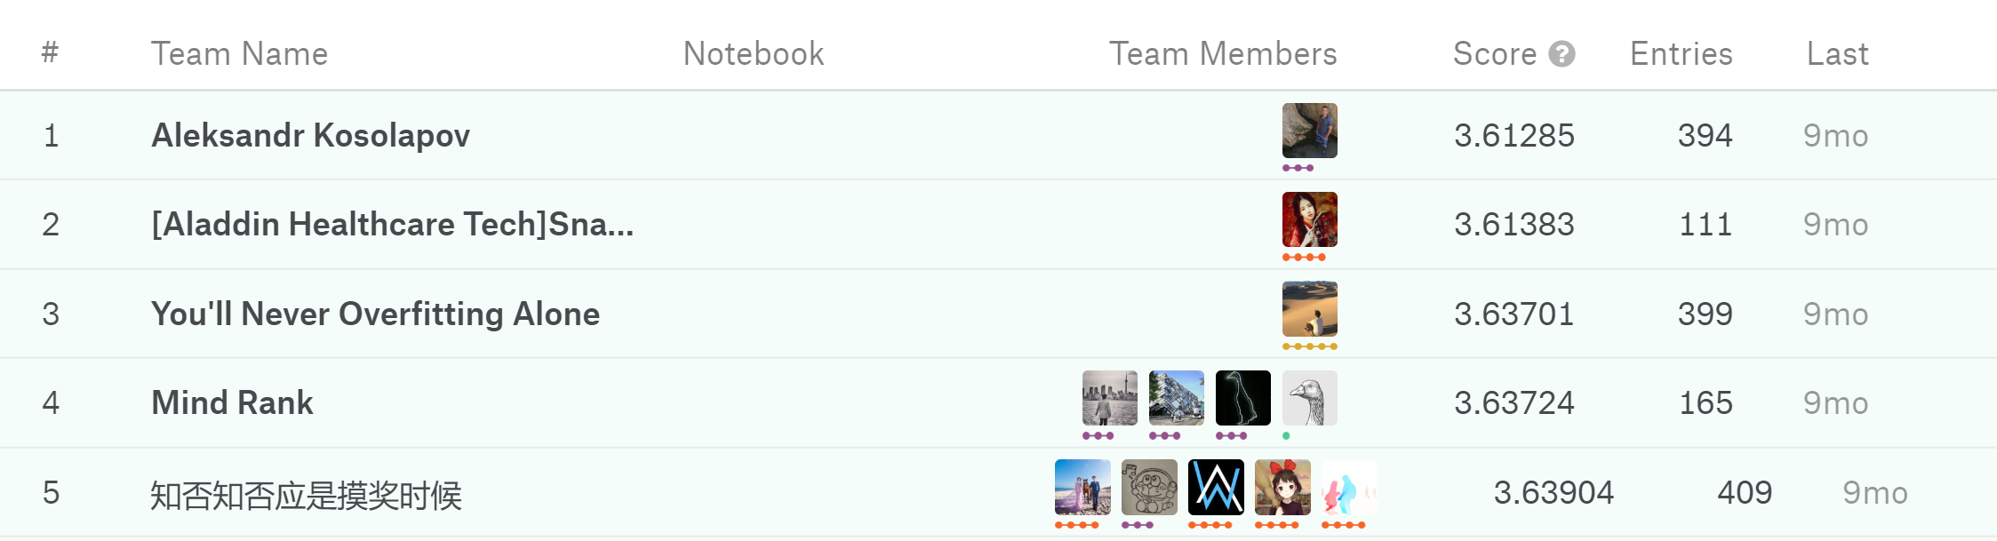
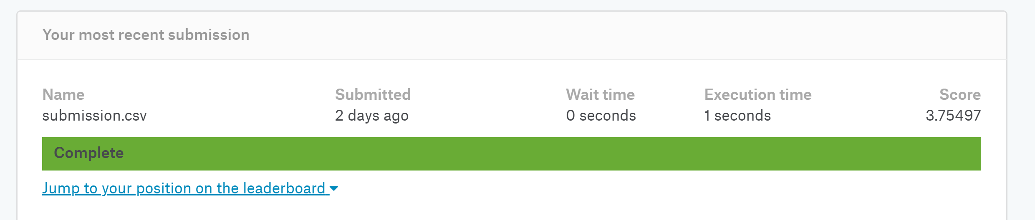
Results
RMES score
Notes:
Due to the limitation of machine performance, we did not get good results. Using rmes only got a score of 3.75, while the first place on kaggle got a score of about 3.61.

Slide 17
Evaluation and Improvement
In real world problem, the data set is very large. In order to get better results, we need to expand more features. Due to machine performance limitations, we did not get very good results.
Consider special holidays because they have a great impact on consumption.
For the choice of hyperparameter, we may choose a better hyperparameter if we have more time and a higher computation performance machine.
Try stacking method to see if we can obtain a better result.

Slide 18
Reference
LighGBM official documentation https://lightgbm.readthedocs.io/en/latest/
DART: Dropouts meet Multiple Additive Regression Trees by K. V. Rashmi, Ran Gilad-Bachrach (7 May 2015)
https://arxiv.org/abs/1505.01866
Adaptive Boosting vs Gradient Boosting
https://randlow.github.io/posts/machine-learning/boosting-explain/

