Slide 1
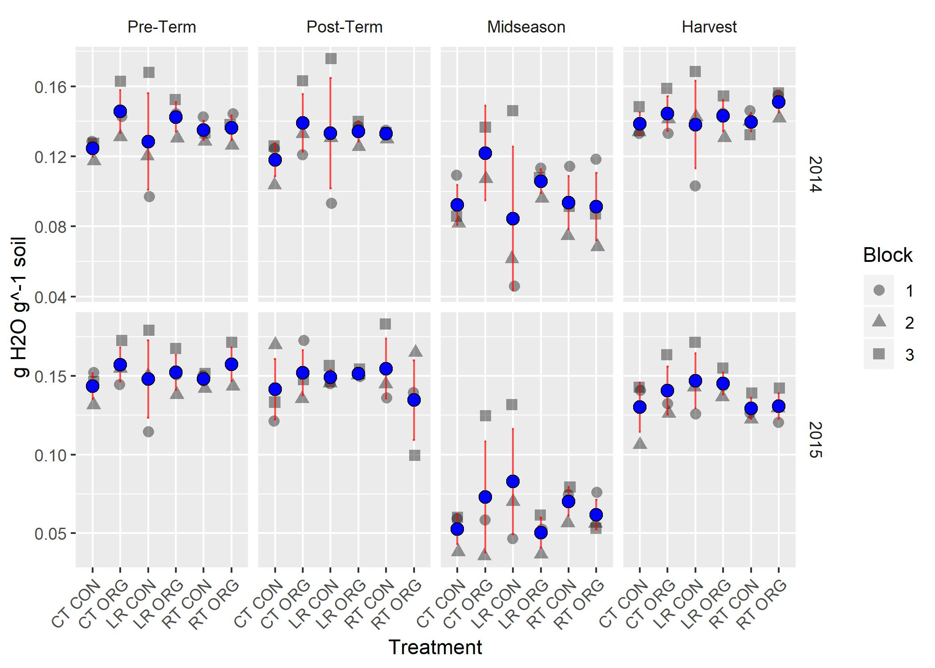
Term | NumDF | DenDF
Treatment(T) | 5 | 125
Sampling(S) | 3 | 125 | ***
Year(Y) | 1 | 125
T x S | 15 | 113
T x Y | 5 | 123
S x Y | 3 | 125 | ***
T x S x Y | 10 | 69
A A B A
A AB C B
Individual sampling points within a given year sharing red letters are not significantly different.
Notes:
#samp:year #p=2.18E-08 *** maineff_for_trt_w_sampbyyear #

Slide 2
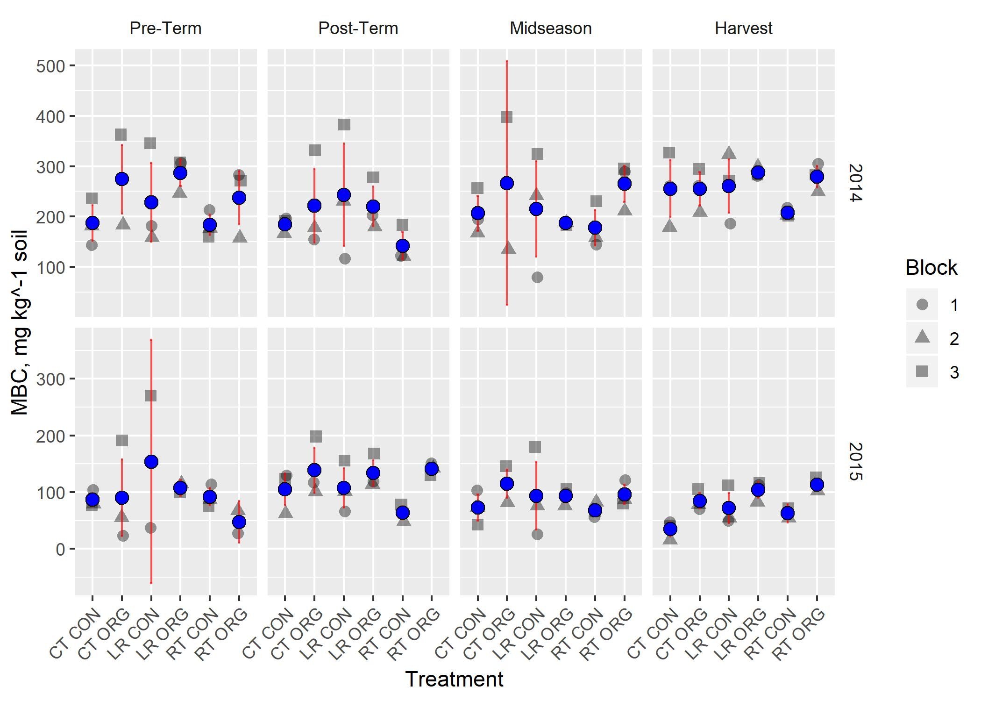
Term | NumDF | DenDF
Treatment(T) | 5 | 125 | ***
Sampling(S) | 3 | 125
Year(Y) | 1 | 125 | ***
T x S | 15 | 113
T x Y | 5 | 123
S x Y | 3 | 125 | **
T x S x Y | 10 | 69
A
AB B B A
B
B A AB B
Individual sampling points within a given year sharing red letters are not significantly different.
Years are significantly different (blue letters)
Notes:
#samp:year #p=0.001470972 ** maineff_for_trt_w_sampbyyear

Slide 3
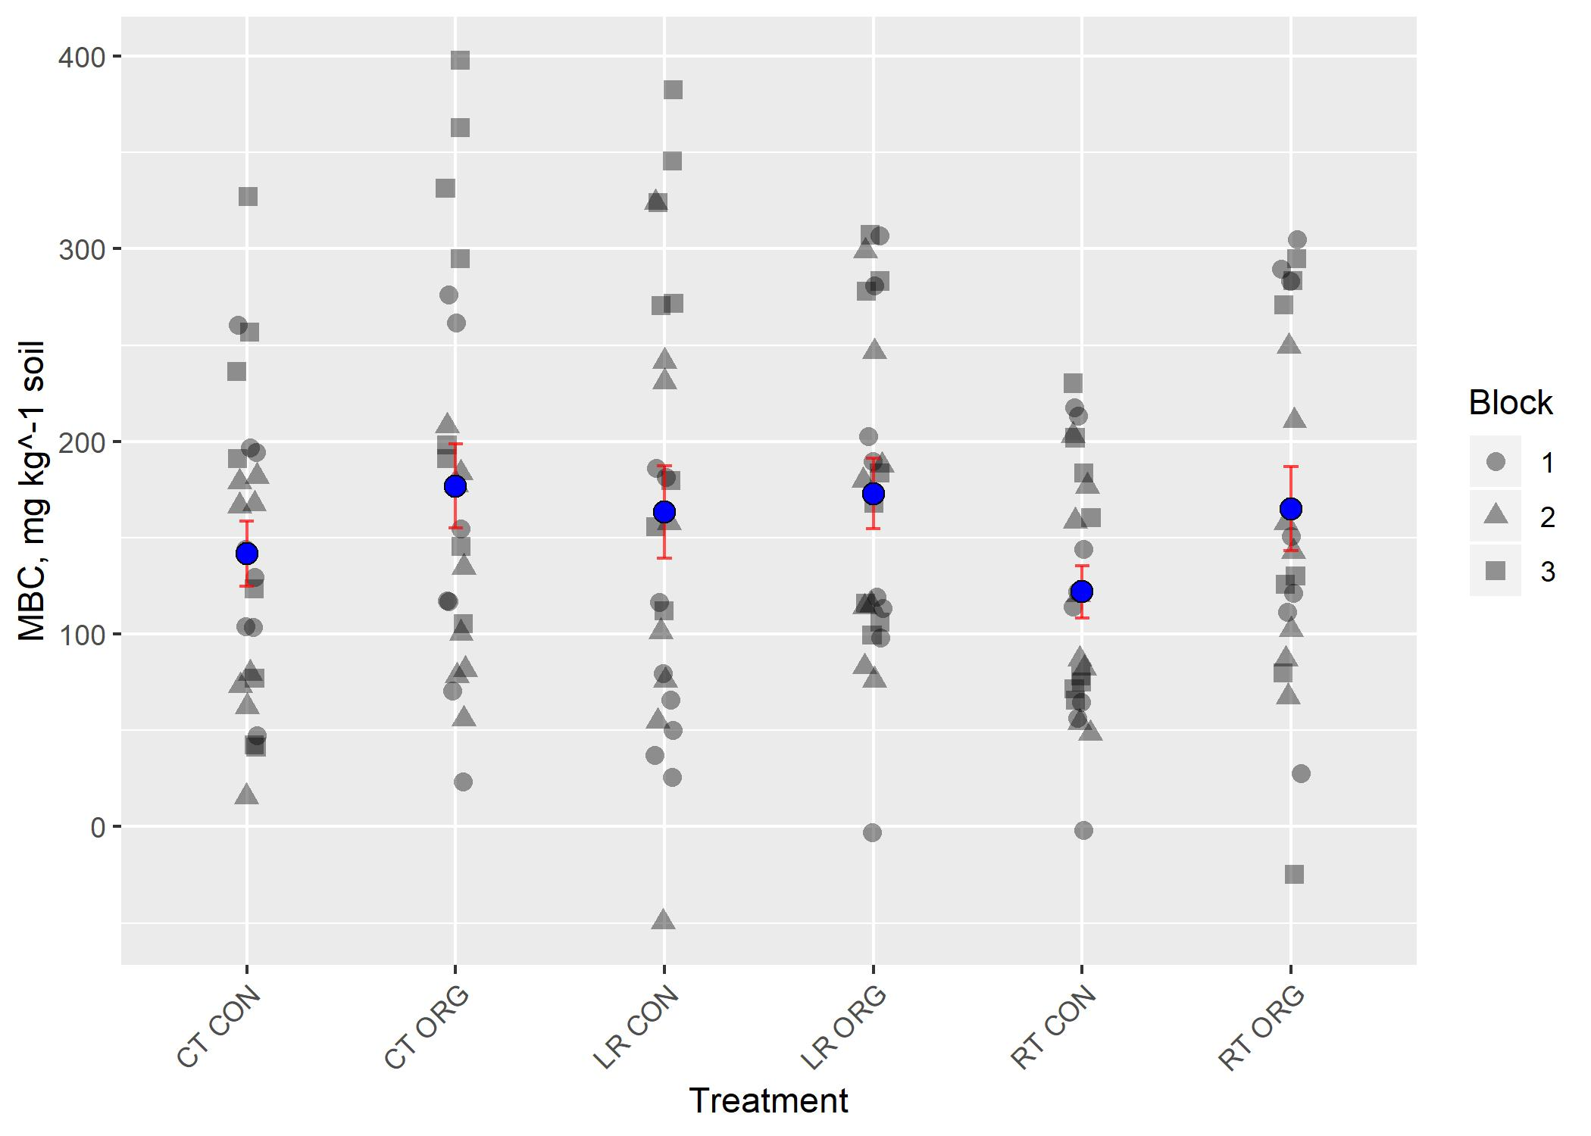
BC A AB A C A
Treatments not sharing black letters are significantly different (no interactions with treatment).
Notes:
trt #p=0.000680198 *** maineff_for_trt_w_sampbyyear

Slide 4
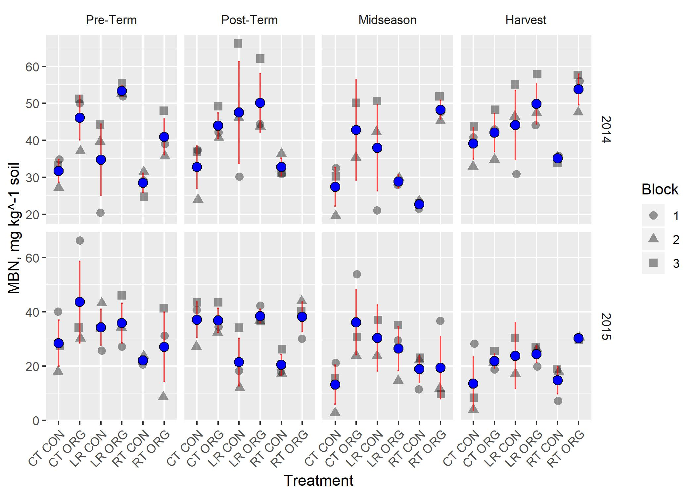
Term | NumDF | DenDF
Treatment(T) | 5 | 122 | ***
Sampling(S) | 3 | 122 | **
Year(Y) | 1 | 122 | ***
T x S | 15 | 110
T x Y | 5 | 120
S x Y | 3 | 122 | **
T x S x Y | 10 | 66
A
AB A B A
B
A A B B
Individual sampling points within a given year sharing red letters are not significantly different.
Years are significantly different (blue letters)

Slide 5
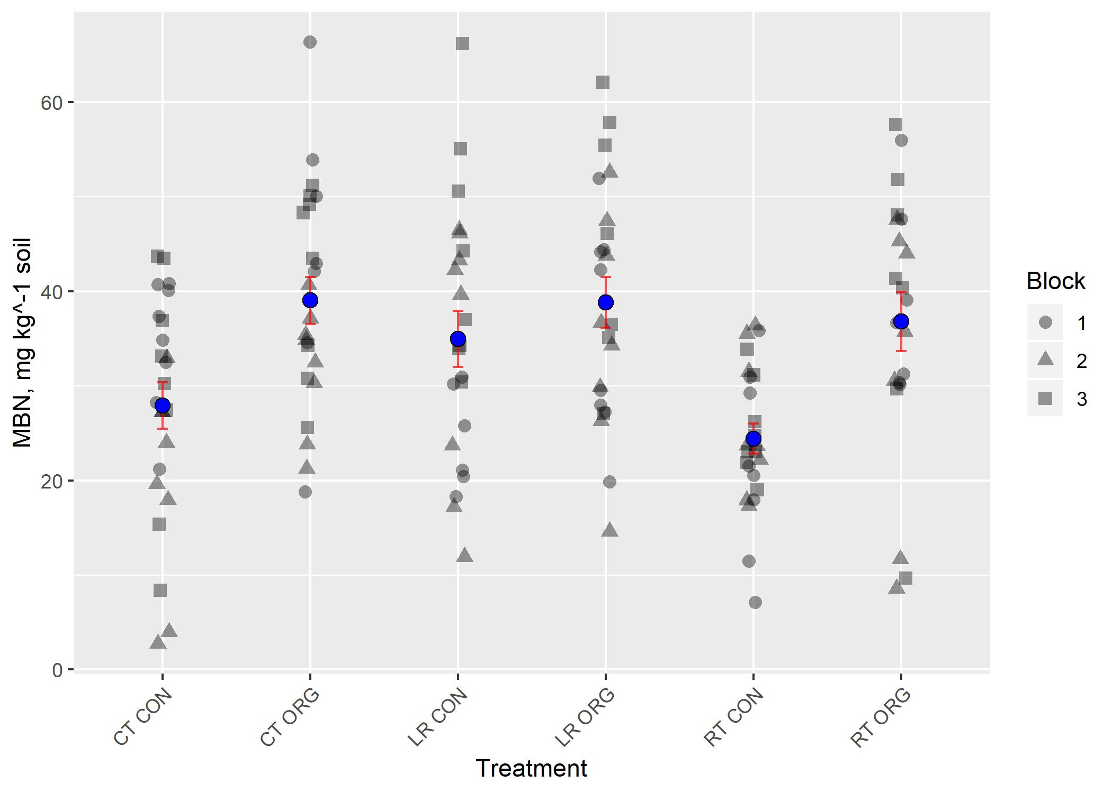
B A A A B A

Slide 6
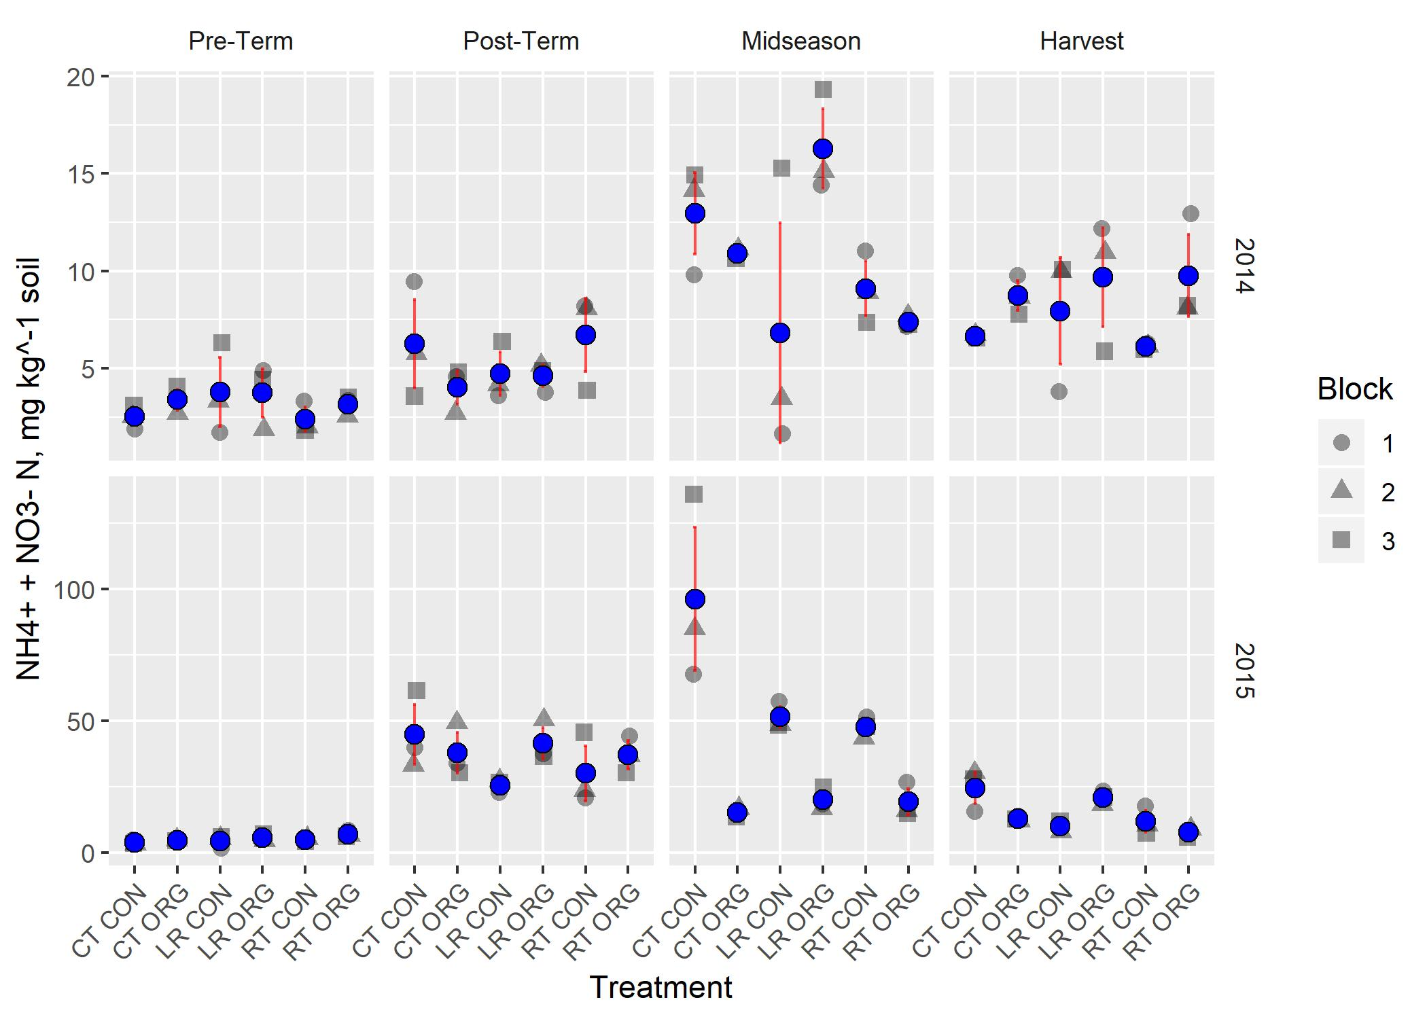
Term | NumDF | DenDF
Treatment(T) | 5 | 127 | **
Sampling(S) | 3 | 127 | ***
Year(Y) | 1 | 127 | ***
T x S | 15 | 115 | **
T x Y | 5 | 125 | *
S x Y | 3 | 127 | ***
T x S x Y | 10 | 69 | ***
B
A AB C A BC AB A C B C B C A BC AB BC BC C
C A A B
A
Individual treatments within a given year * sampling sharing black letters are not significantly different.
Individual sampling points within a given year sharing red letters are not significantly different.
Years are significantly different (blue letters)

Slide 7
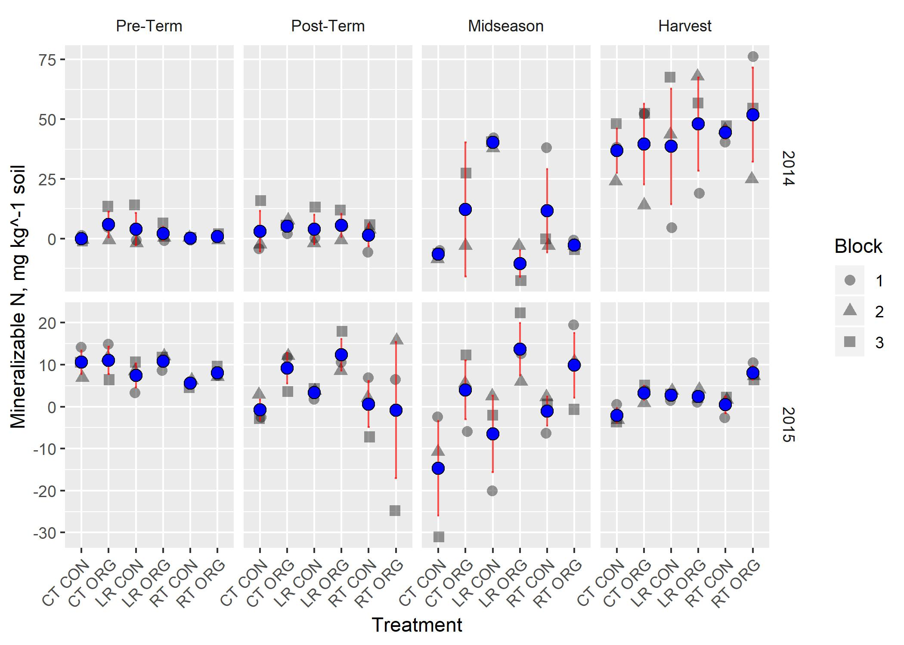
CD BC A D B BCD
Term | NumDF | DenDF
Treatment(T) | 5 | 127
Sampling(S) | 3 | 127 | ***
Year(Y) | 1 | 127 | ***
T x S | 15 | 115
T x Y | 5 | 125
S x Y | 3 | 127 | ***
T x S x Y | 10 | 69 | *
B B B A
C BC AB A ABC AB
A AB AB B
Individual treatments within a given year * sampling sharing black letters are not significantly different.
Individual sampling points within a given year sharing red letters are not significantly different.

Slide 8
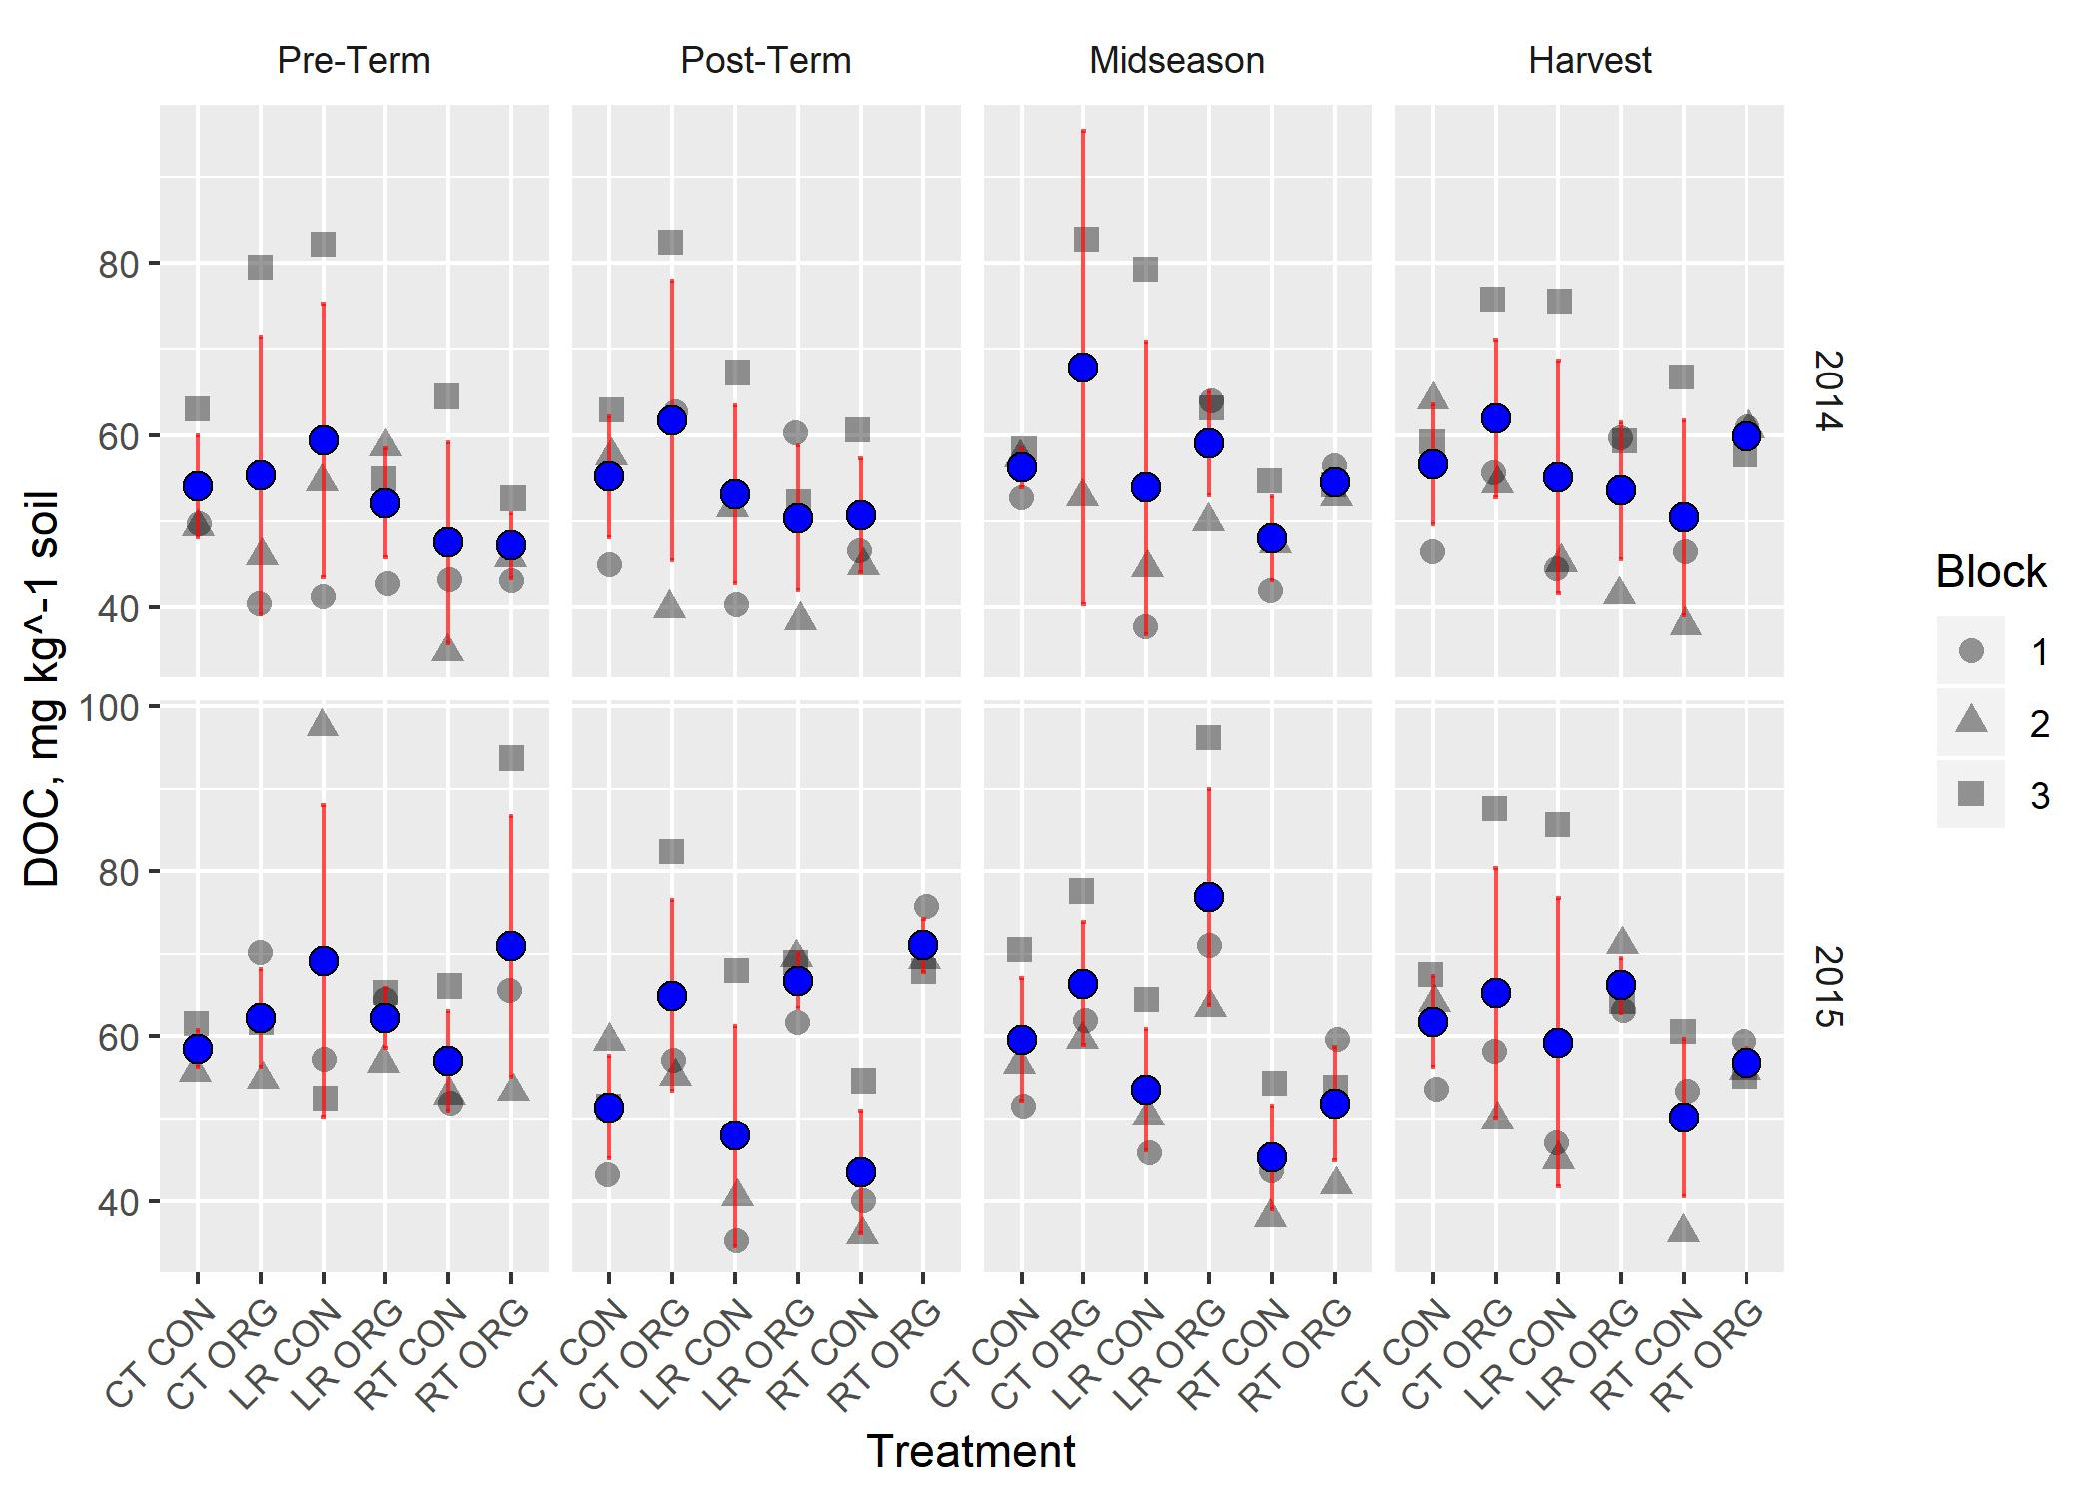
Term | NumDF | DenDF
Treatment(T) | 5 | 125 | ***
Sampling(S) | 3 | 125
Year(Y) | 1 | 125 | **
T x S | 15 | 113
T x Y | 5 | 123
S x Y | 3 | 125
T x S x Y | 10 | 69
B
A
Years are significantly different (blue letters)

Slide 9
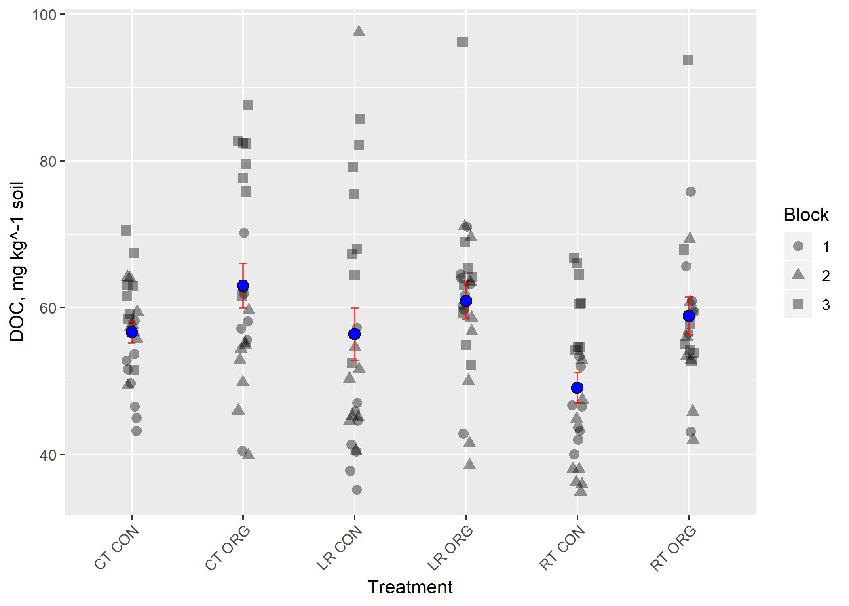
B A B AB C AB
Treatments not sharing black letters are significantly different (no interactions with treatment).
Notes:
C:/Users/seanb/Documents/words/My Career/NCSU/Studies/LabileC/Presentable/MBC Plots/2020Redo_soil_extrns/mbcn_mgkg_trt_main_effect_only.jpeg

Slide 10
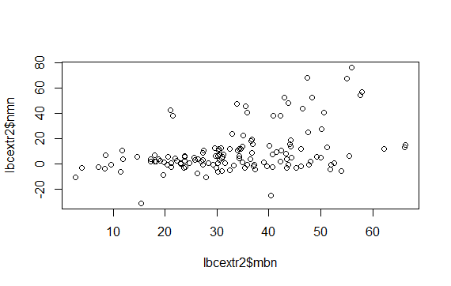
MBN is positively correlated with net mineralizable N
NMN = -9.12 + 0.56*MBN
Analysis of Variance Table
Response: lbcextr2$nmn
Df Sum Sq Mean Sq F value Pr(>F)
lbcextr2$mbn 1 7302 7302.1 28.087 4.602e-07 ***
Residuals 135 35097 260.0
---
Signif. codes: 0 ‘***’ 0.001 ‘**’ 0.01 ‘*’ 0.05 ‘.’ 0.1 ‘ ’ 1

