Slide 1

Implement your own shell MIET SHELL which performs the same function like other shells.
Submitted By:
Astha Sharma (2021a1r121)
Mayida(2021a1r129)
Rishita Sharma (2021a1r130)
Suhani Koul(2021a1r138)
Submitted To:
Ms. Pragti Jamwal
Assistant Professor
DEPARTMENT OF COMPUTER SCIENCE AND ENGINEERING
MIET(Autonomous), JAMMU

Slide 2
Introduction
This report has described the successful design and implementation of our own “miet” shell.This shell program is written in C language.It performs the same functions as other shell programs like Ksh,bash.
Shell Programs: A shell program is an application that allows interacting with the computer. In a shell the user can run programs and also redirect the input to come from a file and output to come from a file. Shells also provide programming constructions such as if, for, while, functions, variables etc. Additionally, shell programs offer features such as line editing, history, file completion, wildcards, environment variable expansion, and programing constructions
In addition to command line shells, there are also Graphical Shells such as the Windows Desktop, MacOS Finder, or Linux Gnome and KDE that simplify the use of computers for most of the users. However, these graphical shells are not a substitute for command line shells for power users who want to execute complex sequences of commands repeatedly or with parameters not available in the friendly, but limited graphical dialogs and controls.

Slide 3
Problem Statement
Implement your own shell “miet_shell” which performs the same function as the other shell programs like Ksh, bash.
Objective:
The objective of this project is to gain experience with some advanced programming techniques like process creation and control, file descriptors, signals and possibly pipes. To do this, you will be writing your own command shell - much like csh, bsh or the DOS command shell.

Slide 4
What is Shell?
A shell is special user program which provide an interface to user to use operating system services. Shell accept human readable commands from user and convert them into something which kernel can understand. It is a command language interpreter that execute commands read from input devices such as keyboards or from files. The shell gets started when the user logs in or start the terminal.

Slide 5
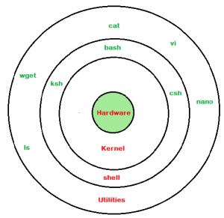

Slide 6
Types of shells:
Shell is broadly classified into two categories –
Command Line Shell
Graphical shell
1.Command Line Shell
Shell can be accessed by user using a command line interface. A special program called Terminal in linux/macOS or Command Prompt in Windows OS is provided to type in the human readable commands such as “cat”, “ls” etc. and then it is being execute. The result is then displayed on the terminal to the user. A terminal in Ubuntu 16.4 system looks like this –

Slide 7
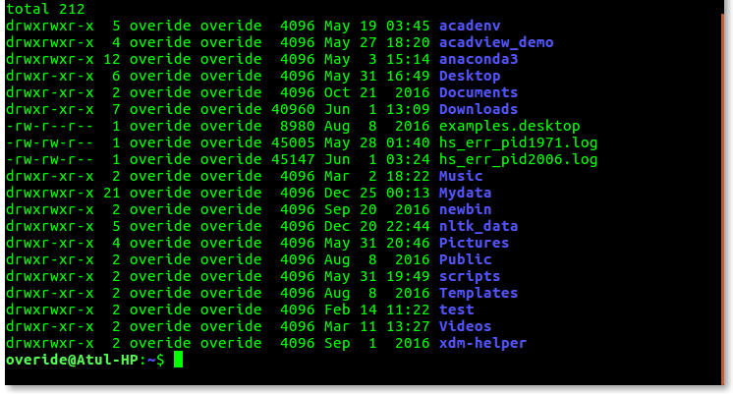
A terminal in Ubuntu 16.4 system looks like this –
In above screenshot “ls” command with “-l” option is executed.
It will list all the files in current working directory in long listing format.

Slide 8
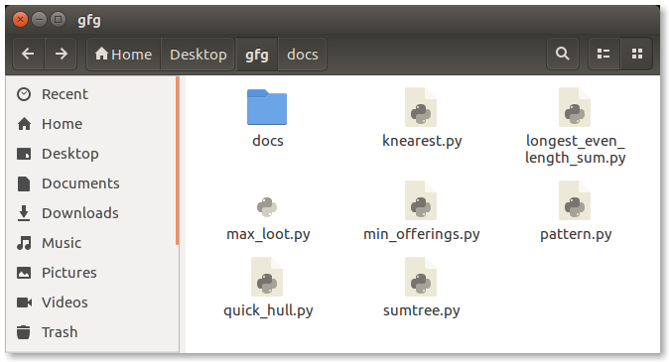
2. Graphical Shells
Graphical shells provide means for manipulating programs based on graphical user interface (GUI), by allowing for operations such as opening, closing, moving and resizing windows, as well as switching focus between windows. Window OS or Ubuntu OS can be considered as good example which provide GUI to user for interacting with program. User do not need to type in command for every actions.A typical GUI in Ubuntu system –

Slide 9
Types of Graphical Shells:
There are several shells are available for Linux systems like –
BASH (Bourne Again SHell) – It is most widely used shell in Linux systems. It is used as default login shell in Linux systems and in macOS. It can also be installed on Windows OS.
CSH (C SHell) – The C shell’s syntax and usage are very similar to the C programming language.
KSH (Korn SHell) – The Korn Shell also was the base for the POSIX Shell standard specifications etc.
Each shell does the same job but understand different commands and provide different built in functions.

Slide 10
Shell Scripting
A shell script is a list of commands in a computer program that is run by the Unix shell which is a command line interpreter. A shell script usually has comments that describe the steps. The different operations performed by shell scripts are program execution, file manipulation and text printing. A wrapper is also a kind of shell script that creates the program environment, runs the program etc.
A shell script have syntax just like any other programming language. If you have any prior experience with any programming language like Python, C/C++ etc. it would be very easy to get started with it.
A shell script comprises following elements –
Shell Keywords – if, else, break etc.
Shell commands – cd, ls, echo, pwd, touch etc.
Functions
Control flow – if..then..else, case and shell loops etc.

Slide 11
Why do we need shell scripts?
There are many reasons to write shell scripts:
To avoid repetitive work and automation
System admins use shell scripting for routine backups
System monitoring
Adding new functionality to the shell etc.

Slide 12
Advantages of shell scripts
The command and syntax are exactly the same as those directly entered in command line, so programmer do not need to switch to entirely different syntax
Writing shell scripts are much quicker
Quick start
Interactive debugging etc.

Slide 13
Disadvantages of shell scripts
Prone to costly errors, a single mistake can change the command which might be harmful
Slow execution speed
Design flaws within the language syntax or implementation
Not well suited for large and complex task
Provide minimal data structure unlike other scripting languages. etc

Slide 14
Basic lifetime of a shell
Let’s look at a shell from the top down. A shell does three main things in its lifetime.
Initialize: In this step, a typical shell would read and execute its configuration files. These change aspects of the shell’s behaviour.
Interpret: Next, the shell reads commands from stdin(which could be interactive, or a file) and executes them.
Terminate: After its commands are executed, the shell executes any shutdown commands, frees up any memory, and terminates.

Slide 15
THANK YOU!

