Slide 1
Title Text

Slide 3



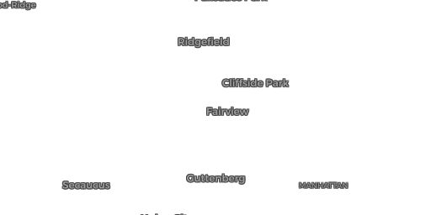
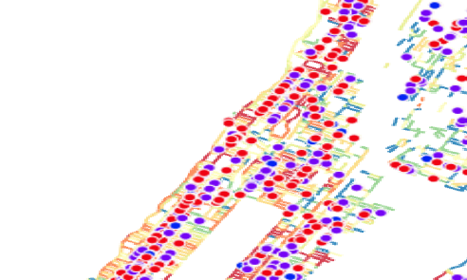

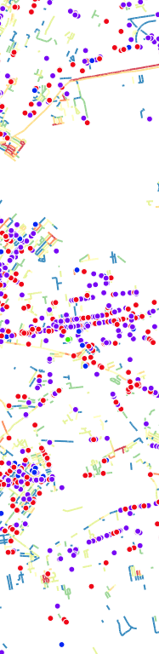


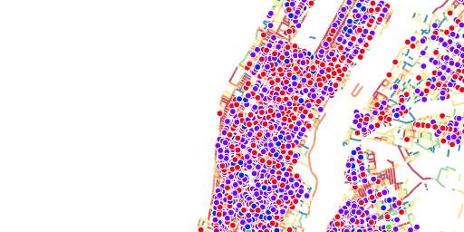
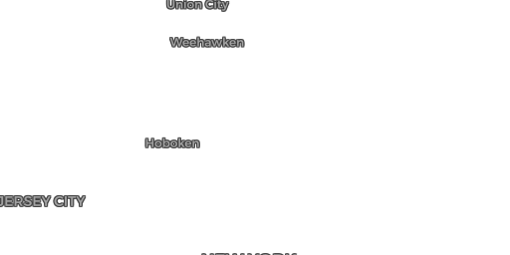

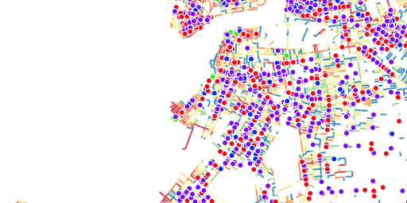







Film Permits and Open …
Open Restaurants 090720
BOTH SIDEWALK ROADWAY OPENSTREETS OTHERS
Film Permit Streets
# OF HOURS 1
8.9k
92.2 AVG
Title Text
© © OpenStreetMap contributors, © CARTO
Map by dcptransportation
  

Slide 4
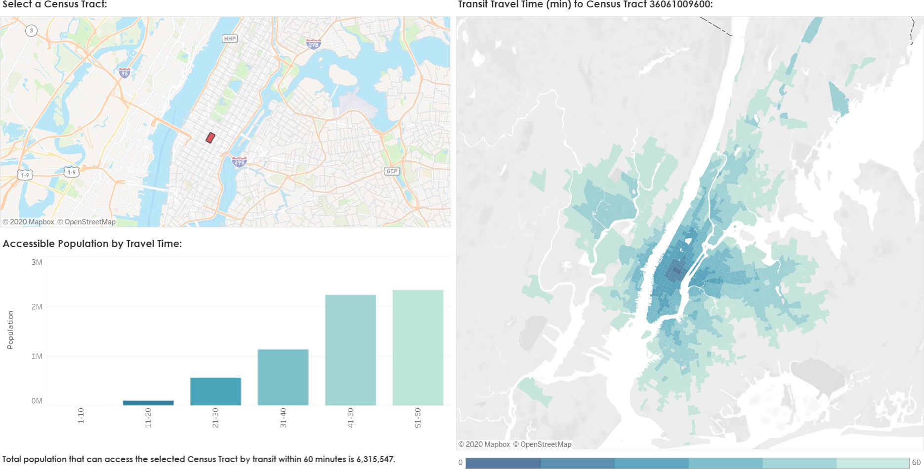
Text

Slide 5

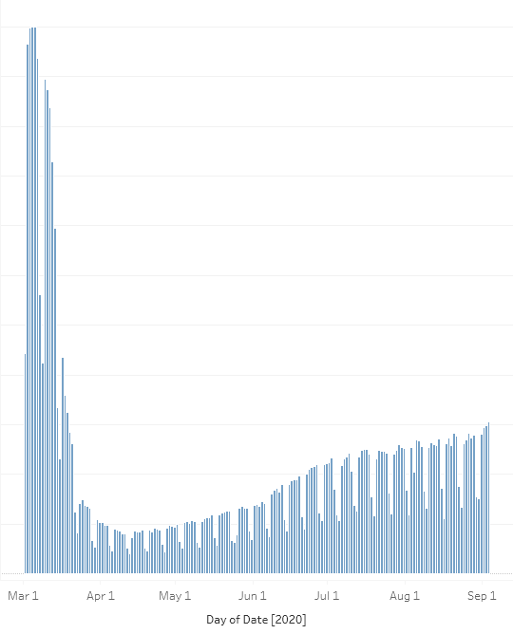
Sheet 1

Slide 6

TEST
% Change From 2019 0
5M
Total Estimated Ridership
4M
−0.2
3M
−0.4
2M
−0.6
1M
−0.8
0
8/30/2020
8/23/2020
8/16/2020
8/9/2020
8/2/2020
7/26/2020
7/19/2020
7/12/2020
7/5/2020
6/28/2020
6/21/2020
6/14/2020
6/7/2020
5/31/2020
5/24/2020
5/17/2020
5/10/2020
5/3/2020
4/26/2020
4/19/2020
4/12/2020
4/5/2020
3/29/2020
3/22/2020
3/15/2020
3/8/2020
3/1/2020
Date

Slide 7
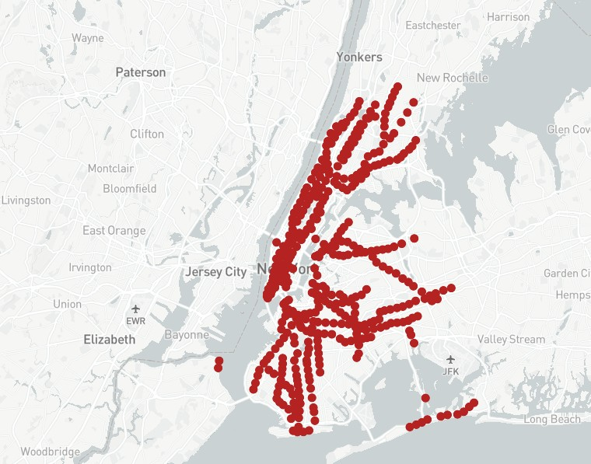

© Mapbox © OpenStreetMap Improve this map

Slide 8
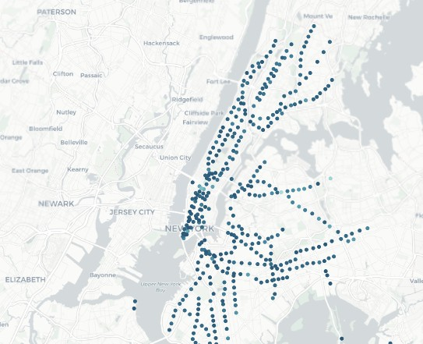

LatestEntries
5000
4000
3000
2000
1000
0

