Slide 1
COVID19 Impacts on Transportation
Produced by the NYC Department of City Planning’s Transportation Division
August 11, 2020

Slide 2
Introduction
The NYC Department of City Planning's Transportation Division is compiling data to help understand the effects of COVID19 on the transportation network. This is our twentieth weekly report.
This will likely be our final weekly report before Labor Day. We’ll continue to watch travel behavior closely and will resume our reporting existing conditions in September, on a weekly or less frequent basis.
This week’s report includes the following information:
Executive Summary
Citywide Trends
MTA: Subway and Bus
MTA: Metro North Railroad, Long Island Rail Road, Access-A-Ride
Ferry
Traffic
Citi Bike
Cell Phone-based Mobility
Timeline
This report may serve to help in pandemic response and longer-term recovery. We are eager for feedback in how to make this more useful. Feel free to reach out to Laura Smith (lsmith@planning.nyc.gov) with questions or comments.

Slide 3
MTA Bus System-wide Ridership Changes
Weekday bus ridership was down 1 percent during the week of August 3 from the previous week, while weekend ridership up 2 percent.
Weekday bus ridership is now at nearly half of pre-pandemic levels.
*From the MTA: Current bus ridership figures are estimated from models that use MetroCard and OMNY swipes and taps and Automatic Passenger Counter data that is available on a portion of our bus fleet. These figures are indicative of ridership but not a precise count. Figures from recent days may be revised as reconciliation processes are carried out. Data sources: MTA (https://new.mta.info/coronavirus/ridership)

Slide 4
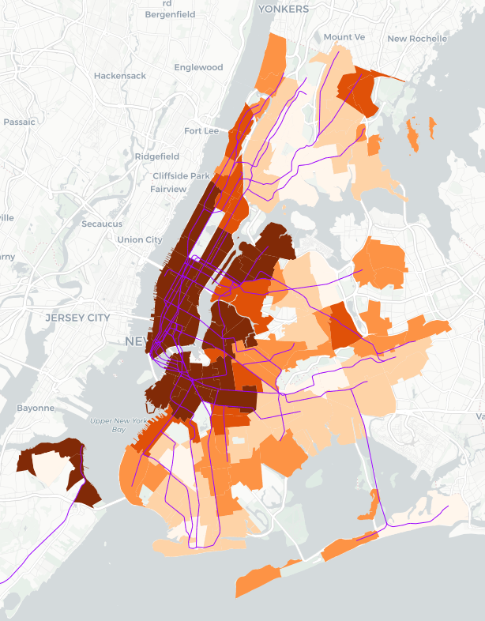
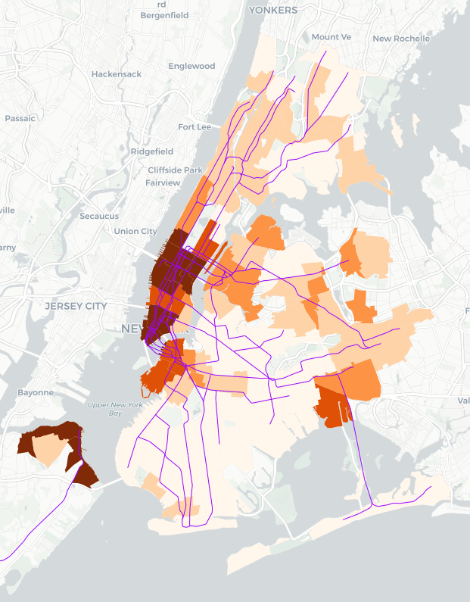
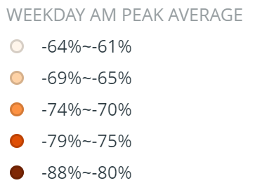
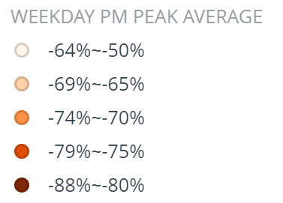
Weekday AM and PM Peak Turnstile Data – Comparisons with July 2019
The maps on the right illustrate changes in AM and PM peak ridership by neighborhood during the week of August 3 compared to the same week in 2019.
AM peak ridership remains more than 80% down in the much of Manhattan and in western Brooklyn and Queens over the same period in 2019.
PM peak ridership – an indicator of where people are commuting home from – is more than 80 percent down in the Manhattan CBD, and more than 70 percent down in the city’s other business districts, including the greater downtown Brooklyn area, Long Island City, Flushing, and Jamaica.
8/3,8/5,8/6/2020 vs 8/5,8/7,8/8/2019 Percent Change
8/3,8/5,8/6/2020 vs 8/5,8/7,8/8/2019 Percent Change
Data sources: MTA Turnstile data (http://web.mta.info/developers/turnstile.html)
Notes:
YM 8/10

