Slide 1

DMS Requirements
Version 0.1

Slide 2
SBS and DMS
Project management will be done in SBS
Front end MS Access, Backend Oracle SQL Server
Define the Trigger for DMS to start with the documentation
Documentation is divided into several areas of the project
The documentation starts with the work pack triggered by SBS
A workflow between SBS and DMS for all phases of the project should be defined
A bidirectional interface between both application have to be implemented
DMS is responsible of managing all kinds of documentation
Web application (Front end Web Browser, Backend ( Webserver, Django (web development platform based on python and connected with the SQL server MySQL on the test cloud server)
MySQL is used temporarily
Oracle has to be updated from V12.3 to V19 to use these web development platform
Update planned on the beginning of next year
RACI Matrix Permission ( admin, superuser, user, third party)
Versioning
Check in/Check out
Read metainformation
Check Geo tagging and resolution of images

Slide 3
Dokumentation area
Documentation is devided into several areas
Akquise
Baufreigabe
BTB
EP_AP_TDL
NOSS
PO_WE_BELEGE
PRECHECK
SYSTEMTECHNIK
WORKPACK
With green marked: Start of the DMS development.
Start and End Trigger point are defined: SBS EINGANGÜBERPRÜFUNG: ACCEPTED, internal Status values: P44E_PLAN and PP44E_IST
For all these areas trigger points have to be defined. Normally internal status values could be used for this purpose
Start
End
Reject
Approved
Quality Check necessary
EP and AP
Revision for each cycle in the TDL (Team Durchlauf)
Starting with Revision: AA, AB, AC, ….
Internal status values should be also versioned?

Slide 4
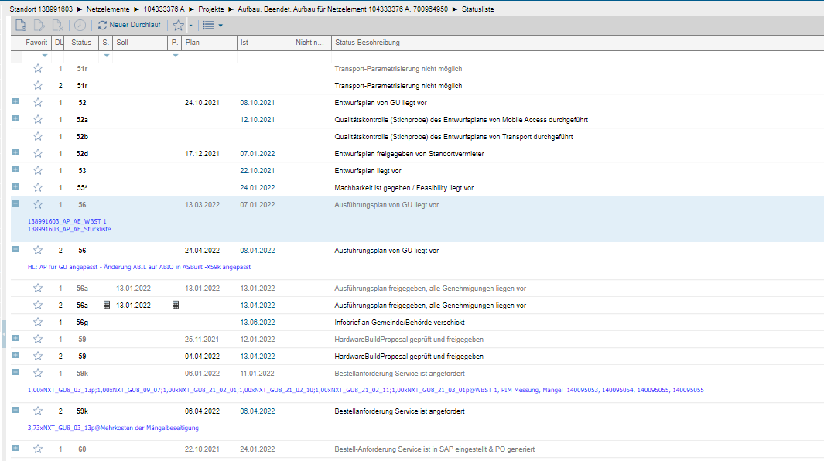
Documentation area TEF uses cyclic status values

Slide 5
SBS and DMS: Start with the work pack (WP)
The documentation starts with the work pack
SBS triggers DMS to start
Trigger point could be the Acceptance of the Project (Eingangsüberprüfung)
After the work pack documentation is finished, DMS informs SBS
All required documents from our supplier have been uploaded by Team assistance (TA):
Set status values PP44e_PLAN
These are original documents from the supplier and should be not changed
All the documents has been checked by our PP team (Site manager, Radio planner and Transport planner)
If necessary some documents has to be added
Set status values P44e_IST: Documents ready to deliver to the third party PP GU ( Planungs Phase General Unternehmen)
PP Manager decides which PP GU should be taken. The PP GU and the trigger point is set in SBS
Now the PP GU will be informed and is allowed to view all “WP” documents in DMS
The PP GU will see only the allowed folders/documents defined by the RACI matrix

Slide 6
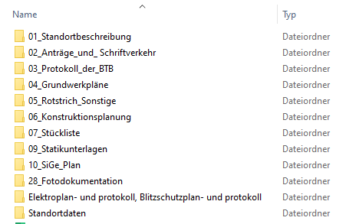
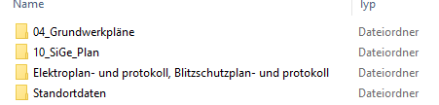
DMS Work pack folder structure
Work pack is divided into 2 types
Default (3MS)
Light
ROOT \ STO\MASTER_PROJEKT\WORK_PACK
RACI should be defined for each sub folder

Slide 7
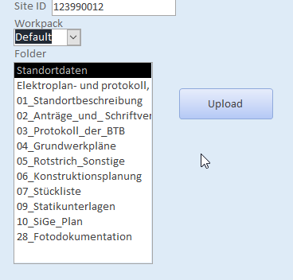
SBS - DMS: Upload all “WP” documents
SBS
DMS
WP Trigger
Open web browser
WP Trigger:
Transfer all necessary data to DMS
SITE_ID
Project_ID
Personal data
Trigger points
…
Create WP folder structure
Update Database
After the update procedure the documents can be uploaded via the web browser into our DMS
The team assistence will be informed and starts to collect all „WP“ documents from our customer like TEF, ATC, .. and upload the documents into our DMS:
Select Folder
Upload all Documents from the local folder into DMS

Slide 8
SBS - DMS: Upload all “WP” documents
Filter after new site
Upload all files from local folder possible
Select all files of the current local folder
Possible to overwrite (message box pops up with a warning, check in / check out)
For images check if geo tagging data are available.
Save Meta Data in the DMS Database
For images save geo coordinates: longitude, latitude and resolution

Slide 9
DMS: View all “WP” documents
The documents can be viewed dependent on the permission
Admin, Super User, User, Third party
Permissions are defined in the RACI matrix
Download of the files is possible

Slide 10
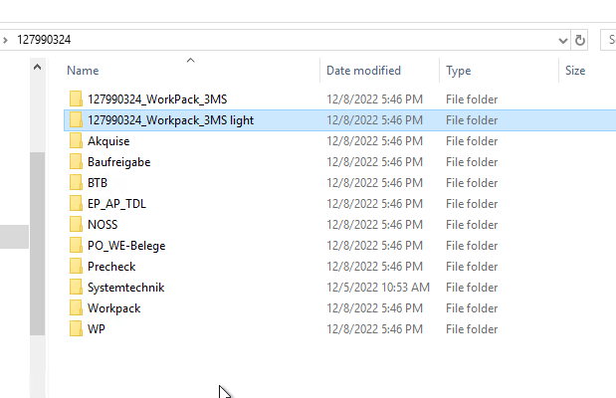
Work pack Actual Problems
STO contains several work packs folder
Which work pack is the actual one?
Versioning should be possible on folder as well as on file level
Use cases should be defined
Check in / Check out concept
The structure of the folder should be extended like
{root}\{STO}\{MASTER_PROJEKT}\workpack
127990324_WorkPack_3MS and 127990324_Workpack_3MS light belongs different project
Which work pack should be seen by the PP GU
Authorization of the folder (release management)

Slide 11
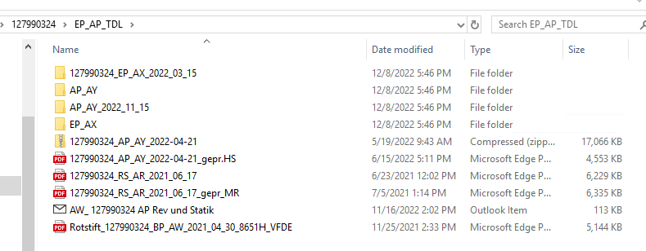
Work pack Actual Problems: EP_AP_TDL Folder
Which EP, AP is the actual one?
How to avoid this confusion?
How is the workflow between NRS and Third party

Slide 12
General Workflow draft
SBS
DMS
BROWSER
New Site(Master_Projekt): „ACCEPTED“
Start WEB „WP Doku“ Upload
SET PP44e_Plan
WP Doku Upload completed
Start to Check WP Doku
Check WP Doku: add missing Doku if needed
SET PP44e_IST
WP Doku Check completed
PP Manager assigned PP_GU and relase WP (trigger?)
PP_GU check WP Doku and starts with BTB preparation
SET X48_IST
Sent BTB protocol including images
PP Manager inform PP_GU to start with EP (trigger?)
Sent EP (technical drawing)

Slide 13
Further requirements (tbd)
Save somehow the version of Planungshandbuch which is base for EP and AP
Search Site ID for different customers
Choose different templates depending on customer
Requirements regarding transport and DWDM documentation is missing

Slide 14

Thank you

