Slide 1
Text Editor and Syntax Highlighter

Slide 2
Project Objective
The primary objective of this project is to develop a text editor that supports syntax highlighting for different programming languages. This feature is essential for developers as it enhances code readability and helps in identifying syntax errors quickly. The project aims to provide a user-friendly interface with various functionalities such as file operations, text editing, formatting options, and keyword highlighting.

Slide 3
Methodology
The project was divided into several parts, with each team member responsible for specific components:
Fayzul Hoque Mayin : Responsible for the graphical user interface (GUI) design and implementation.
Md Anmol Tanim Bhuiyan: Handled file operations and keyword highlighting. Implemented the edit and format menus, as well as the keyword highlighting functionality.

Slide 4
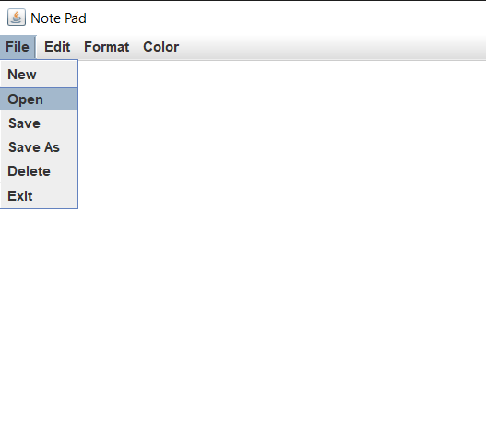
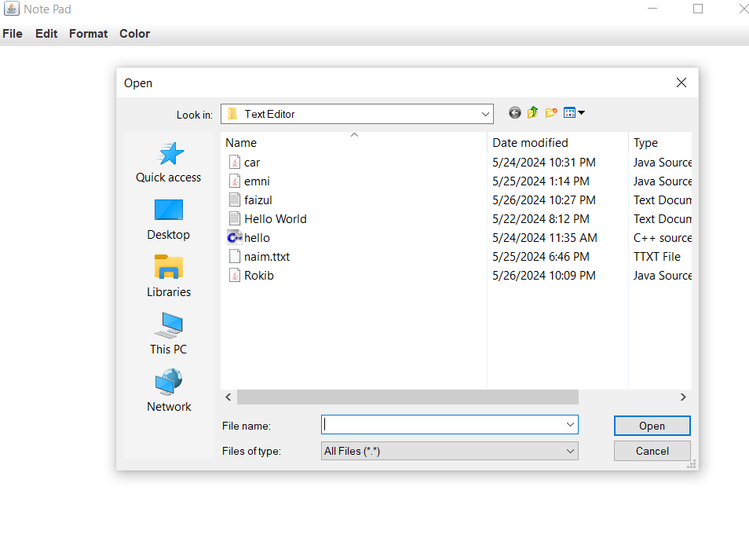
Fayzul Hoque Mayin: GUI.java
Key Points and Features
1. GUI Design: Fayzul designed the graphical user interface using Java Swing components. The main components include a `JFrame` for the window, a `JTextArea` for text input, and a `JScrollPane` for scroll functionality.
2. Menu Bar: The GUI includes a menu bar with four menus: File, Edit, Format, and Color. Each menu contains various menu items for different functionalities.
3. Action Listeners: Action listeners are implemented to handle user interactions with the menu items.
4. Undo and Redo: An `UndoManager` is used to manage undo and redo operations.

Slide 5
Key Features and How They Work
1. Window Creation: The `create_window` method initializes the main window of the text editor with a specified size and title.
2. Text Area: The `create_text_area` method sets up the text area where users can input and edit text. It also adds an undoable edit listener to manage undo and redo operations.
3. Menu Bar: The `create_menu_bar` method creates the menu bar and adds menus and menu items to it. Each menu item is associated with an action command and an action listener.
4. Action Handling: The `actionPerformed` method handles user interactions with the menu items. It calls the appropriate methods from the `Function_File`, `Format_Menu`, and `Edit_Menu` classes based on the action command.

Slide 6
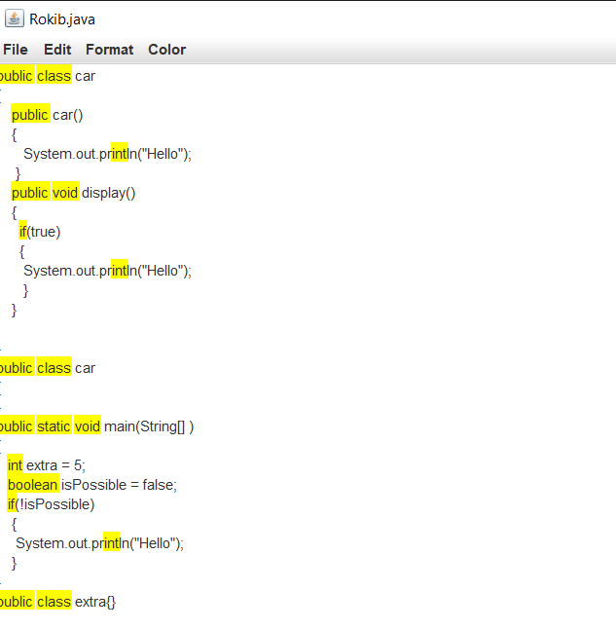
MD ANMOL TANIM BHUIYAN: Function_File.java
Key Points and Features
1. File Operations: Tanim implemented methods for creating new files, opening existing files, saving files, and deleting files.
2. Keyword Highlighting: The `KeywordHighlighter` class is used to highlight specific keywords in the text area.
3. File Dialogs: File dialogs are used to prompt the user for file selection during open and save operations.
4. Error Handling: The code includes error handling to manage exceptions that may occur during file operations.

Slide 7
Key Features and How They Work
New File: The `new_file` method clears the text area and resets the window title, file name, and file address.
2. Open File: The `open_file` method uses a file dialog to prompt the user for a file to open. It reads the file content and displays it in the text area. If the file is a Java file, it enables keyword highlighting.Here we use fileReader and bufferReader method to complete our task.
3. Save As File: The `save_as_file` method uses a file dialog to prompt the user for a file name and location to save the current content. It writes the content to the specified file and enables keyword highlighting if the file is a Java file. we use fileWriter class to write the file.
4. Save File: The `save_file` method saves the current content to the existing file. If no file is open, it calls the `save_as_file` method.Here we use fileWriter class to write the file.
5. Delete File: The `delete_file` method deletes the current file after confirming with the user. It then clears the text area and resets the file name and address.We use Files.deleteIfExists(filePath) method to delete the file permanently.
6. checkJavaFile: Here we Pass a String Typed file Name to check whether is it java file or not.

Slide 8
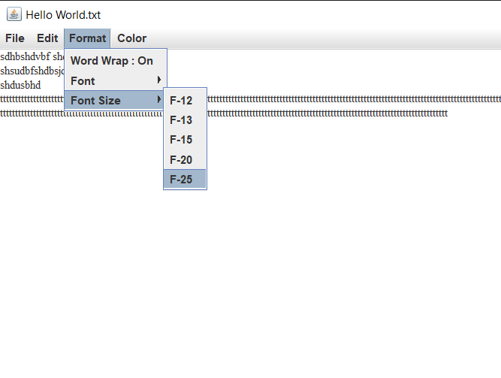
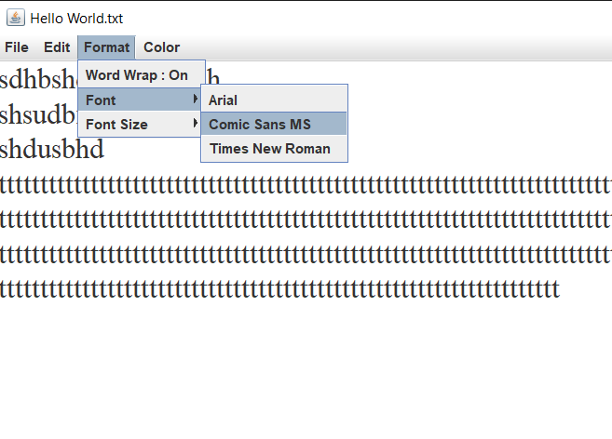
MD ANMOL TANIM BHUIYAN: Edit_Menu.java, Format_Menu.java, KeywordHighlighter.java
Key Points and Features
1. Edit Menu: Tanim implemented the edit menu with undo and redo functionalities.
2. Format Menu: The format menu includes options for word wrap, font selection, and font size adjustment.
3. Keyword Highlighter: The `KeywordHighlighter` class highlights specific keywords in the text area.

Slide 9
How it Works:
The Edit_Menu class implements the edit menu with options for undo and redo.
The Format_Menu class implements the format menu with options for font style and size.
The Keyword Highlighter class highlights specific keywords in the text area.The highlightKeywords() method highlights the keywords in the text area

Slide 10
Recommendations
For future improvements, the project could consider:
Expanding Language Support: Adding support for more programming languages, such as Python or C++.
Enhancing User Interface: Improving the user interface to make it more intuitive and user-friendly.
Increasing Performance: Optimizing the project's performance to handle larger files and more complex code.

