Slide 1

Seasonal Agriculture Performance Analysis
Krish
Rajkiya Engineering College, Banda
AICTE STU ID : STU6888a7b39f8c21753786291

Slide 2

PROBLEM STATEMENT
Agricultural activities are influenced by seasonal variations in environmental conditions, farming practices, resource availability and market conditions. As a result, agricultural performance may differ from one season to another. However, raw agricultural data does not clearly explain how agricultural performance changes across seasons or what patterns can be observed in different seasonal conditions. The problem is to analyze the given agricultural dataset and investigate seasonal differences in agricultural performance by identifying meaningful patterns, trends, relationships and variations within the available data.

Slide 3
Project Description
This project analyzes a 4,000-farm dataset spanning three Indian agricultural seasons (Kharif, Rabi, Zaid) across 8 states, 8 crops and 4 irrigation methods, to explain how and why agricultural performance changes across seasons.
After verifying the dataset's internal numeric identities and recovering or imputing a small number of missing values (under 1.2% of any column), the analysis combines descriptive statistics, non-parametric hypothesis testing (Kruskal-Wallis, Levene's test, effect sizes), two-way ANOVA variance decomposition, and correlation analysis in Python to determine which seasonal differences are statistically real, how large they are relative to crop and regional effects, and what that implies for seasonal agricultural planning.

Slide 4

WHO ARE THE END USERS?
Farmers and farmer cooperatives -- seasonal crop and resource-planning decisions
Agricultural credit providers and crop insurers -- season-specific risk underwriting
State agriculture department officials and extension officers -- targeted seasonal advisories
Agri-input and irrigation equipment companies -- timing outreach to the seasons with the clearest efficiency gap
Agricultural researchers and students -- a reusable template for season-effect analysis

Slide 5

Technology Used
Python 3 -- pandas & NumPy for data cleaning and analysis
SciPy (Kruskal-Wallis, Levene's test, Pearson/Spearman correlation) & statsmodels (two-way ANOVA)
Matplotlib & Seaborn for statistical visualization
Jupyter Notebook for reproducible, documented analysis
python-pptx for automated report/presentation generation

Slide 6
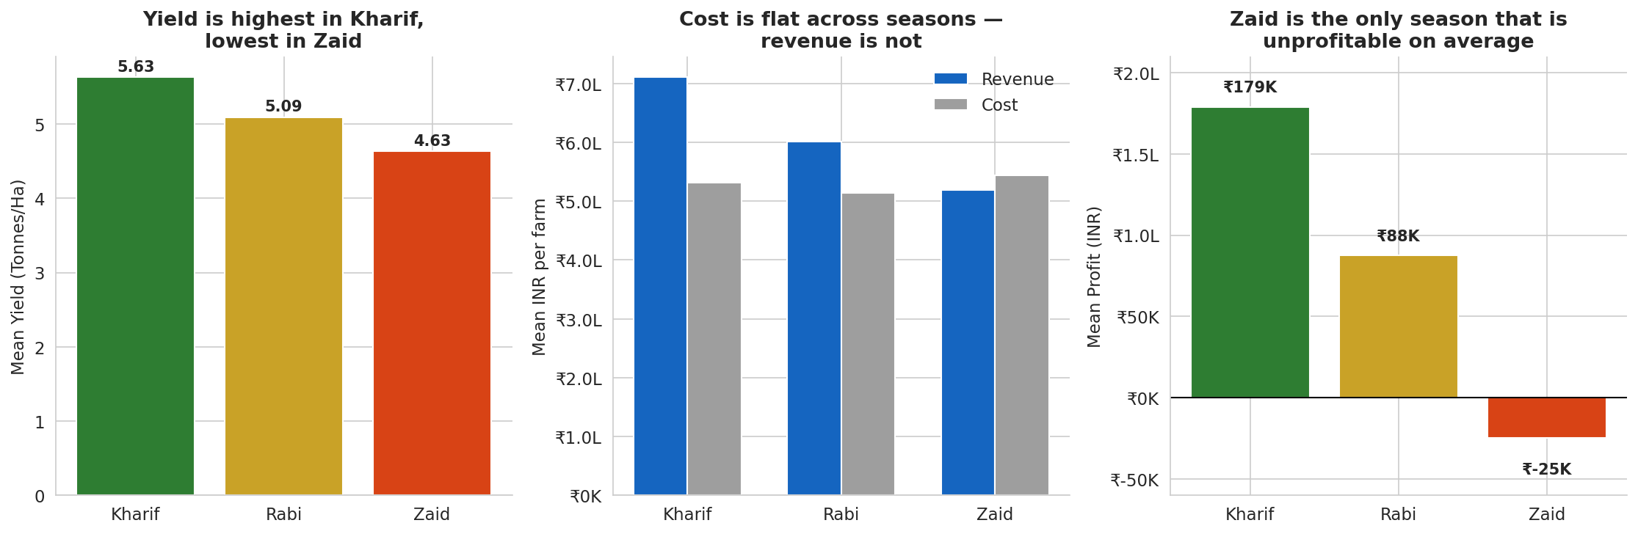
RESULTS
Kharif is unambiguously the strongest season -- mean profit falls from +Rs.1.79L (Kharif) to +Rs.0.88L (Rabi) to -Rs.0.25L (Zaid), a statistically significant gradient (Kruskal-Wallis p<0.001) driven by revenue, not cost.

Slide 7
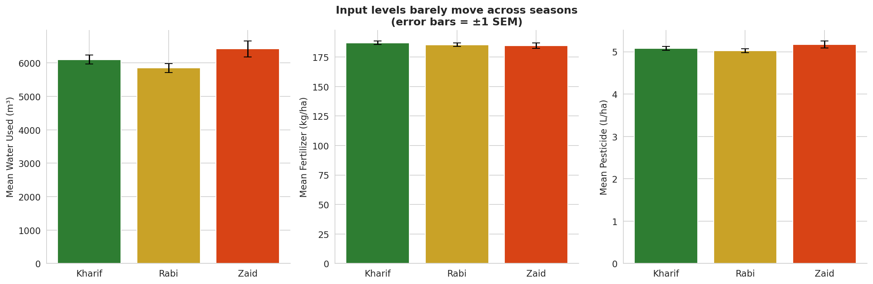
RESULTS
Chemical input intensity barely differs by season (fertilizer, nitrogen, pesticide all p>0.3) -- farmers are not spending differently by season, they are earning differently.

Slide 8
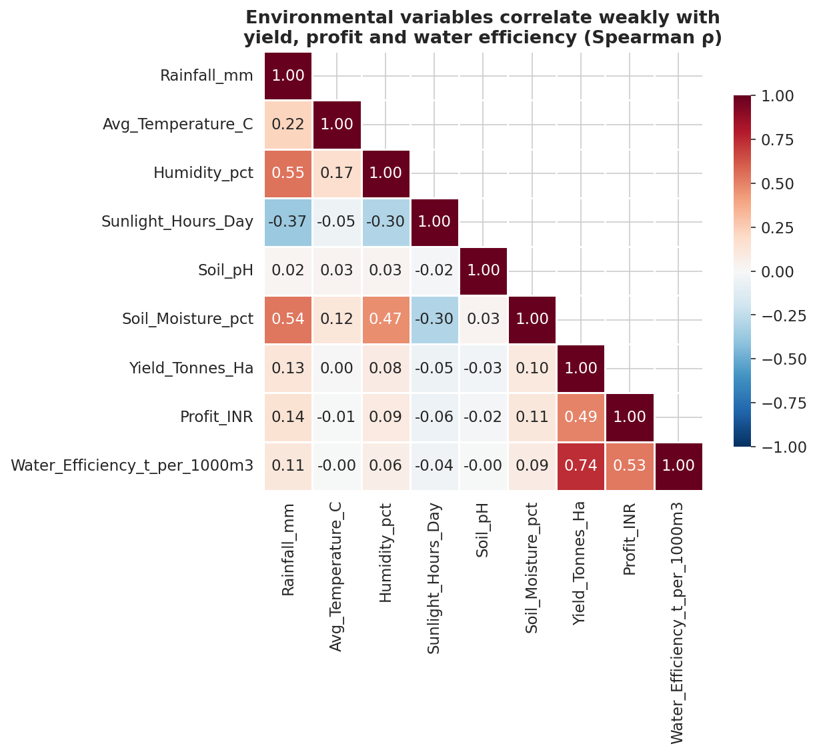
RESULTS
Environmental variables correlate only weakly with yield and profit at the individual-farm level (all pooled |r| <= 0.14).
- Rainfall is the strongest single correlate (r=0.14 with profit, 0.13 with yield) -- still weak
- Yield and Water Efficiency correlate strongly (r=0.74) by construction
- Temperature and soil pH show ~0 relationship with either outcome

Slide 9
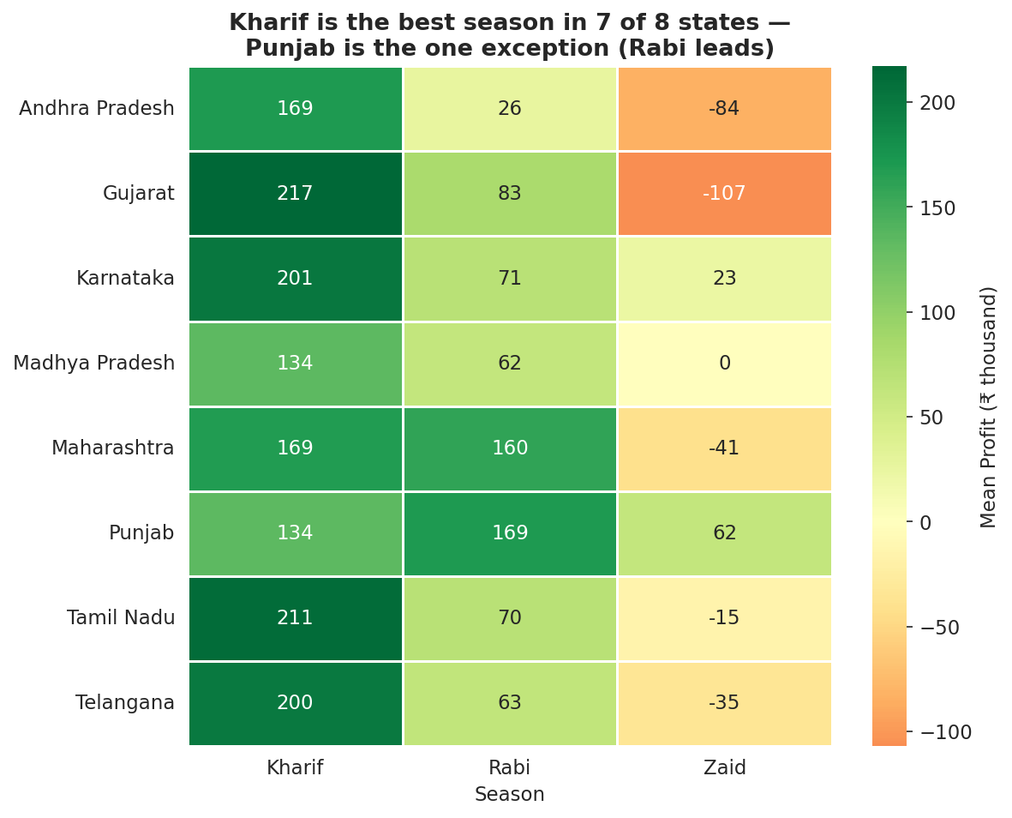
RESULTS
The Kharif > Rabi > Zaid profitability ranking holds by median profit in all 8 states.
- Season x State interaction is not significant (p=0.26)
- Punjab's mean-profit exception is outlier-driven -- its median still favors Kharif
- Seasonal guidance can be issued nationally, not state-by-state

Slide 10
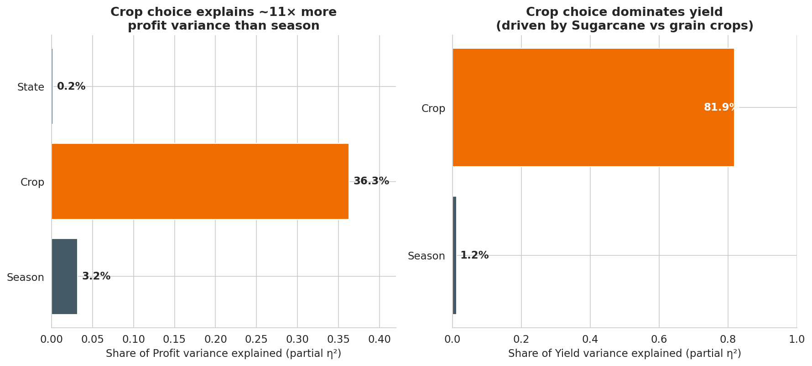
RESULTS
Crop choice -- not season -- is the dominant driver of outcomes: it explains 36.3% of profit variance and 81.9% of yield variance, versus just 3.2% and 1.2% for season.

Slide 11
Future scope
- Treat Zaid as a distinct higher-risk season in credit/insurance design -- it has the highest loss rate of any season (64.5% of farms unprofitable).
- Target water-use-efficiency programs (drip/sprinkler, irrigation scheduling) at Zaid first -- it combines the highest water use with the lowest water efficiency.
- Lead extension advice with crop economics: crop choice explains far more outcome variance than season (81.9% vs 1.2% of yield variance).
- Protect, don't discourage, Kharif planting -- its disease/pest risk is the highest of any season, yet it remains the most profitable.
- Extend to multi-year panel data and a predictive model to test how much season adds once crop and region are already known.

Slide 12
GitHub Link
https://github.com/maykrishhoon/Seasonal-Agriculture-Performance-Analysis.git

Slide 13
VOIS Course completion certificate -
Course name- Data Visualization

Slide 14
Thank you
.
.

