Slide 1
Predicting DNA binding of new DNA-binding proteins Project in Deep Learning in Computational Biology

Slide 2
Outline
Some biological background again…
2. The project

Slide 3
1. Background
Slides with Ron Shamir and Chaim Linhart, Computational Genomics TAU

Slide 4
Gene: from DNA to protein
DNA
Pre-mRNA
Mature mRNA
protein
transcription
splicing
translation

Slide 5
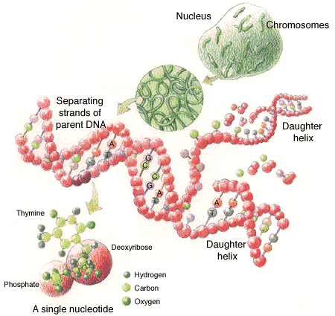
DNA
DNA: a “string” over the alphabet of 4 bases (nucleotides): { A, C, G, T }
Resides in chromosomes
Complementary strands: A-T ; C-G
Forward/sense strand: AACTTGCG
Reverse-complement/anti-sense strand: TTGAACGC
Directional: from 5’ to 3’:
(upstream) AACTTGCGATACTCCTA (downstream)
5’ end
3’ end

Slide 6
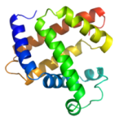
Gene structure (eukaryotes)
Promoter
DNA
Coding strand
Transcription start site (TSS)
Transcription (RNA polymerase)
Pre-mRNA
Exon
Intron
Exon
Splicing (spliceosome)
5’ UTR
3’ UTR
Mature mRNA
Start codon
Stop codon
Coding region
Translation (ribosome)
Protein

Slide 7
Regulation of Expression
Each cell contains an identical copy of the whole genome - but utilizes only a subset of the genes to perform diverse, unique tasks
Most genes are highly regulated –
their expression is limited to specific tissues, developmental stages, physiological condition
Main regulatory mechanisms:
transcriptional regulation
post-transcriptional regulation

Slide 8
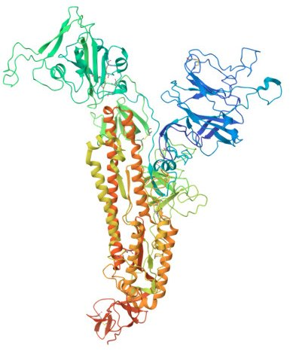


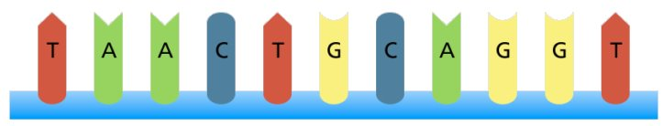
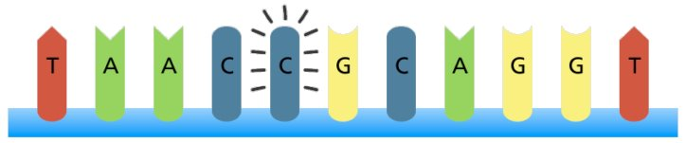
Transcriptional regulation
DNA-binding proteins (DBPs) are primary regulators of gene expression.​
DBPs recognize specific DNA binding sites.

Slide 9
Protein DNA-binding

Slide 10
DBP BS motif models - strings
Consensus (“degenerate”) string:
A C
ACT
C G
T
gene 1
AACTGT
gene 2
CACTGT
gene 3
CACTCT
gene 4
CACTGT
gene 5
gene 6
gene 7
gene 8
AACTGT
gene 9
gene 10
How can we use NN for these models?

Slide 11
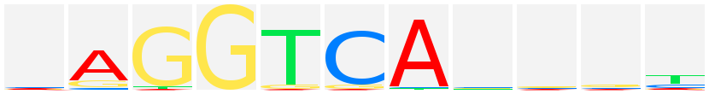
DBP BS models - PWM
Position weight matrix (PWM): each position has weights for the 4 possible letters (A, C, G, T)
For example:
Logo format:
6 | 5 | 4 | 3 | 2 | 1
0 | 0.2 | 0.7 | 0 | 0.8 | 0.1 | A
0.6 | 0.4 | 0.1 | 0.5 | 0.1 | 0 | C
0.1 | 0.4 | 0.1 | 0.5 | 0 | 0 | G
0.3 | 0 | 0.1 | 0 | 0.1 | 0.9 | T
How can we use NN for this model?

Slide 12
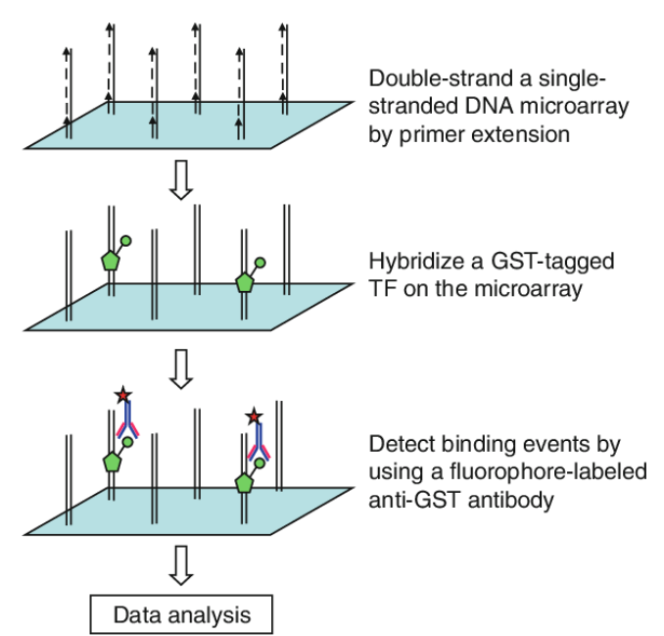
PBM Berger, M. F. et al. (2006)
Generate an DNA pool covering all possible 10-mers, each at least 1 time.
11
Notes:
14

Slide 13
PBM- implementation
36nt variable region
A sequence library covering of all 8-mers, each at least 32 times
41,728 probes
Notes:
16

Slide 14
The computational challenge
Input:
Amino-acid sequences of new proteins (1 sequence file)
a list of DNA sequences (1 sequence file)
Goal: Predict DNA binding intensity for each DNA sequence
Intuition: learning a binding model based on a protein’s amino acid sequence

Slide 15
The project

Slide 16
General goals
Research
- Learn about known solutions
- Trial and error with training data
Develop software from A-Z:
Design of deep neural networks
Implementation
Execution & analysis of test data
A taste of bioinformatics
Have fun
Get credit…

Slide 17
The computational task
Given a set of PBM data of different DBPs
Learn a model that for a given DBP can score PBM probes
Main challenges:
Prediction performance
Prediction runtime

Slide 18
PBP Input
1 amino-acid sequence file
<sequence>\n
MSSKIFVGGNNVYIGYDNQKALGLILRRFETRKGFGFVTFDDQSRGKLIPYEVVGEVVKLGYRDQRG

Slide 19
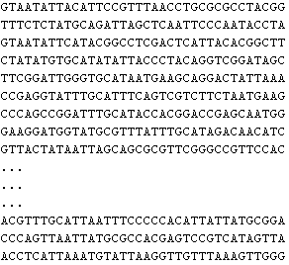
PBM Input
A file with ~41K lines, each containing an DNA sequence of length 36.
<sequence>\n
The input sequence file is sorted lexicographically
The output is a file with a binding intensity for input sequence (in the same order)

Slide 20
Ttrain Test Split
Train:
400 proteins. (training_DBPs.txt)
30,000 DNA probes. ( training_seqs.txt)
Binding intensities. (training_data.zip)
Test:
64 proteins. (test_DBPs.txt)
11,728 DNA probes (test_seqs.txt)
11728

Slide 21
The goal
For each protein in the test set, the model predicts the binding intensity score for every DNA probe sequence in the test set.
For this list we can compare to real values by Pearson correlation: cov(x,y)/(std(x)*std(y))

Slide 22
Solution example
Train a model that receives a pair
(amino acid DBP sequence, DNA probe sequence)
And outputs a binding intensity
Protein representation can be using protein LLMs
DNA representation by one-hot

Slide 23
Baseline Model (For Performance Comparison)
To evaluate your model, we provide a baseline results file (baseline_results.txt).
How the baseline was built:
Training data was split into:
First 380 proteins
First 27,000 DNA sequences
The remaining protein–DNA pairs from the training set were used for evaluation.

Slide 24
Baseline Model
Baseline Prediction Method
For each test protein–DNA pair:
Protein matching:
Find the most similar protein in the training set
Similarity is computed using sequence alignment
DNA matching:
Find the most similar DNA sequence in the training set
Similarity is computed using 3-mer count similarity
Prediction:
The binding score for the test pair is taken from the most similar training pair
Evaluation Metric
The results in baseline_results.txt are Pearson correlation scores
A score is computed for each protein separately

Slide 25
Submission
Electronic design document
Electronic code submission
64 binding intensities files, e.g. DBP1.txt
Executable / script for running time test

Slide 26
Design document
3-5 pages (pdf), Hebrew/English
Briefly describe main goal, input and output of program
Describe neural net architecture, algorithms, and scores

Slide 27
References
Rapid and systematic analysis of the RNA recognition specificities of RNA-binding proteins
Ray et al. Nature Biotechnology, 2009
ProbeRating: a recommender system to infer binding profiles for nucleic acid-binding proteins
Yang et al. Bioinformatics, 2020

