Slide 1
Lab Meeting
11 September 2017

Slide 2
Python Libraries
NumPy
Pandas
Scikit-learn

Slide 3
Machine Learning

Slide 4
Feedforward Networks

Slide 5
Deep Learning

Slide 6
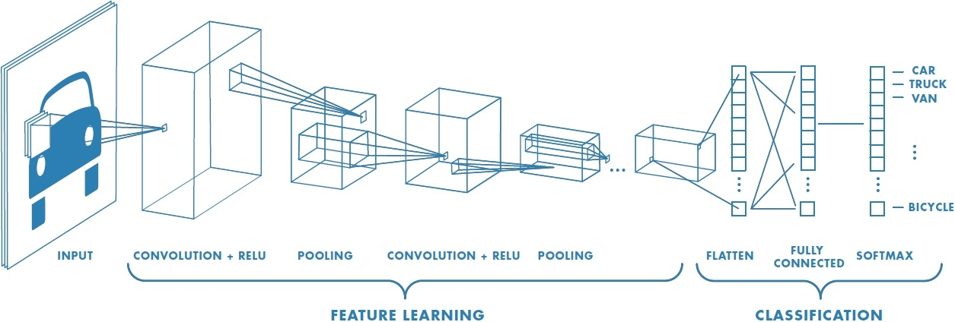
Convolutional Neural Network

Slide 7
Recurrent Networks & LSTM

