Slide 1
Fit.ly Tech Customer Churn Analysis
Understanding churn drivers and opportunities to improve customer retention

Slide 2
Business Problem & Goal
Business Problem
Customer churn has been increasing
Customer retention is becoming more important
The cost of acquiring new customers is rising
Analysis Focus
Subscription plan
Customer engagement
Customer support experience

Slide 3
Data & Approach
Approach
Validate and clean data
↓
Aggregate support and activity data by customer
↓
Combine datasets
↓
Compare churned vs. active customers
↓
Identify potential churn drivers
Data Sources
Account information
Customer support
User activity

Slide 4
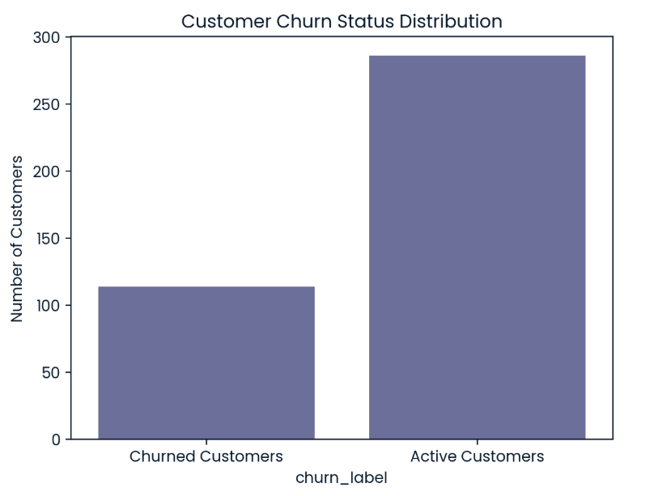
Current Churn Situation
Current Customer Churn Rate 28.5%
Active Customers: 71.5%
Churned Customers: 28.5%

Slide 5
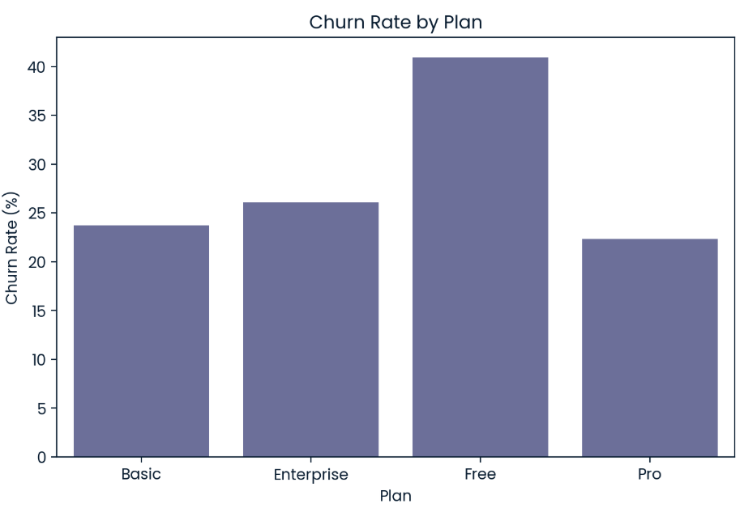
Churn Differs by Plan
Plan | Churn Rate
Enterprise | 26.09%
Free | 40.95%
Basic | 23.73%
Pro | 22.35%

Slide 6
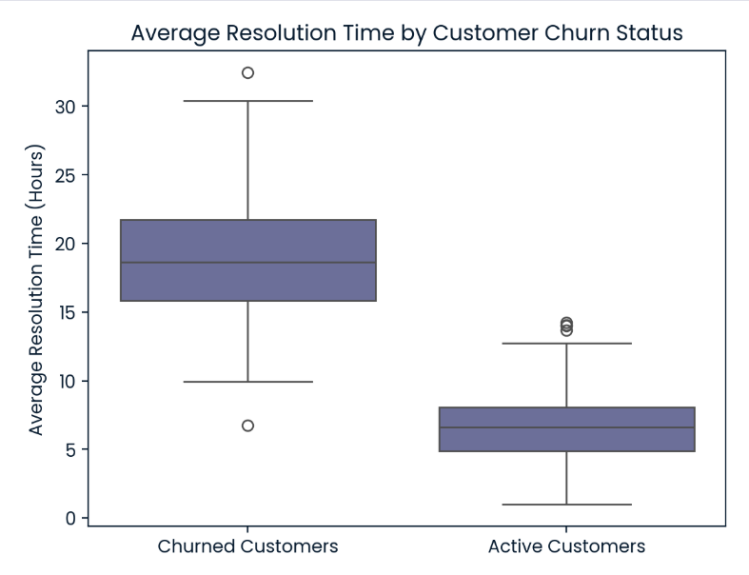
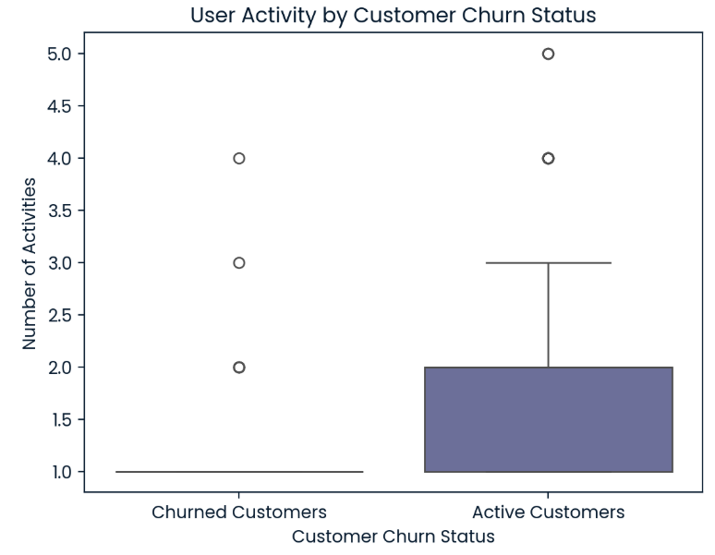
Support Experience & Engagement
Support Resolution Time
Active: 6.66 hours
Churned: 18.69 hours
User Engagement
Active: 1.88 activities
Churned: 1.32 activities

Slide 7
KPI
Primary KPI
Overall Customer Churn Rate
Current baseline: 28.5%
Goal: Reduce over time
Supporting Metrics
Churn rate by plan
Customer engagement
Average support resolution time

Slide 8
Recommendations
1. Improve Support Resolution
Prioritise tickets from at-risk customers.
Set faster response and resolution targets.
Review long-running tickets regularly.
2. Improve Free-Plan Retention
Free-plan users have the highest churn rate at 40.95%.
Find out why Free users leave.
Test targeted offers or upgrade messages.
3. Re-engage Low-Activity Customers
Churned customers had lower activity than active customers.
Identify customers with declining activity.
Send personalised workout recommendations.
Use reminders to bring customers back.

Slide 9
Conclusion
Key Message
Fit.ly Tech should focus on reducing churn by improving support experience, strengthening Free-plan retention, and identifying low-engagement customers early.
Success Metric
Reduce Overall Customer Churn Rate from the current 28.5% baseline.

